Slide 1
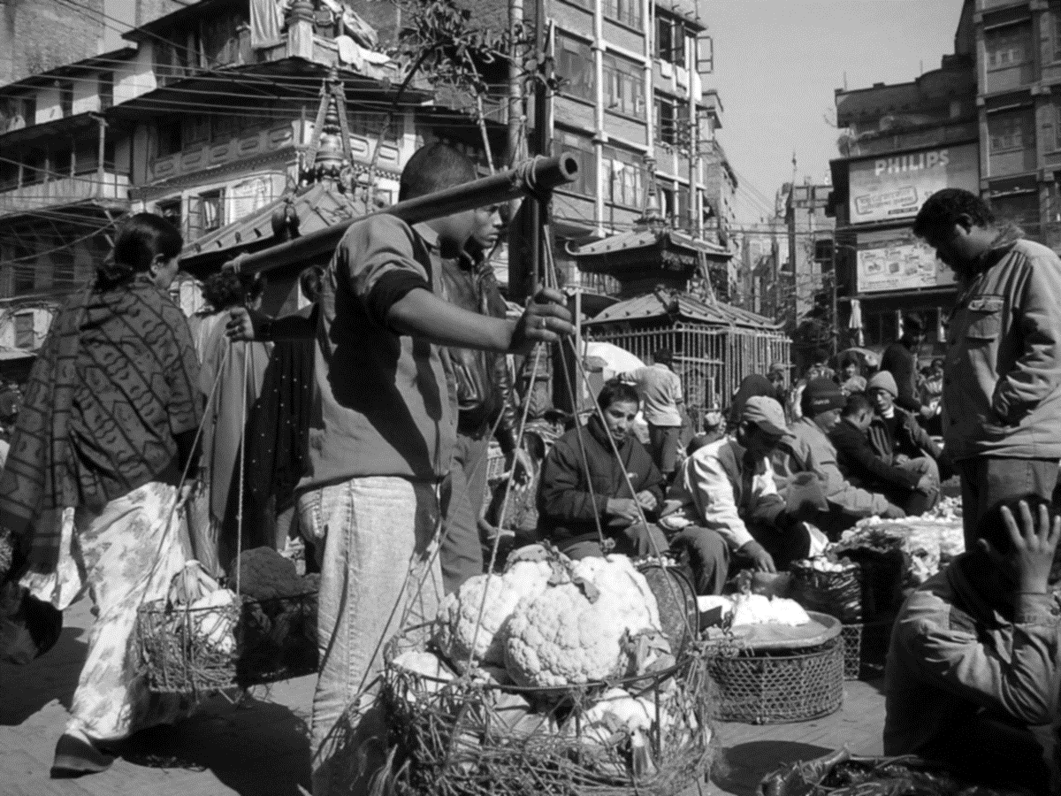


Cash back

Slide 2
Vision
To help small businesses to get wider market and buyers can buy product safely

Slide 3
Business Components
Logistics
(10%)
Marketing
(10%)
R&D
(7%)
Human Resources
(20%)
Finance
(25%)
Delivery
(5%)
Operation
(10%)
Sales
(3%)
Product
(10%)

Slide 4
Business Components
Handles employee recruitment, outsourcing, company culture, etc.
Logistics
(10%)
Marketing
(10%)
R&D
(7%)
Human Resources
(20%)
Finance
(25%)
Delivery
(5%)
Operation
(10%)
Sales
(3%)
Product
(10%)

Slide 5
Business Components
Goods delivery to customer, internal logistic, etc.
Logistics
(10%)
Marketing
(10%)
R&D
(7%)
Human Resources
(20%)
Finance
(25%)
Delivery
(5%)
Operation
(10%)
Sales
(3%)
Product
(10%)

Slide 6
Business Components
Logistics
(10%)
Marketing
(10%)
R&D
(7%)
Human Resources
(20%)
Finance
(25%)
Delivery
(5%)
Operation
(10%)
Sales
(3%)
Product
(10%)
Supporting tools, IT helpdesk,

Slide 7
Business Components
Customer engagement
Logistics
(10%)
Marketing
(10%)
R&D
(7%)
Human Resources
(20%)
Finance
(25%)
Delivery
(5%)
Operation
(10%)
Sales
(3%)
Product
(10%)

Slide 8
Business Components
Company branding
Logistics
(10%)
Marketing
(10%)
R&D
(7%)
Human Resources
(20%)
Finance
(25%)
Delivery
(5%)
Operation
(10%)
Sales
(3%)
Product
(10%)

Slide 9
Business Components
Logistics
(10%)
Marketing
(10%)
R&D
(7%)
Human Resources
(20%)
Finance
(25%)
Delivery
(5%)
Operation
(10%)
Sales
(3%)
Product
(10%)
In charge of sales, sales strategy

Slide 10
Business Components
Research new technology, customer behavior, etc.
Logistics
(10%)
Marketing
(10%)
R&D
(7%)
Human Resources
(20%)
Finance
(25%)
Delivery
(5%)
Operation
(10%)
Sales
(3%)
Product
(10%)

Slide 11
Business Components
Logistics
(10%)
Marketing
(10%)
R&D
(7%)
Human Resources
(20%)
Finance
(25%)
Delivery
(5%)
Operation
(10%)
Sales
(3%)
Product
(10%)
Segmenting our customer, dynamic product eligibility, voucher, etc.

Slide 12
Business Components
Logistics
(10%)
Marketing
(10%)
R&D
(7%)
Human Resources
(20%)
Finance
(25%)
Delivery
(5%)
Operation
(10%)
Sales
(3%)
Product
(10%)
Funding, accounting, etc.

Slide 13
How cash back works?
Cash back
Transaction
Voucher
Voucher
Voucher
Voucher

Slide 14
Identifying the problem
Cashback Fraud
Fraud customer
Unverified customer
Fraud merchant
Unverified merchant
Miss target of the promotion

Slide 15
Why Cash back?
Cash back has been used as our method to engage new customer or low performance customer. Even though this method has been budgeted by our Finance team, we found out that some of the voucher is being miss-used by some of fraudster that leads to miss target engagement.
This will hurt our funds for promotion and also credibility by regulators.

Slide 16
Solution
New team consisted of combination of business components, The components are:
R&D: This component is the core of the solution, by doing some research, we’re going to separate our customers based on their risk group and voucher benefits is different for each group.
Product: this function that going to execute of R&D founding and implement voucher distribution strategy based on their risk group, and also create a new rule where the voucher only for certified merchant only.

Slide 17
Conclusion
Re-targeting voucher/promotion eligibility based on user group.

