Slide 1
Home Credit Default Risk Machine Learning CS 6140 Instructor: Dr. Bagherjeiran
Seyedeh Negin Mortazavi
Graduate Student
Northeastern University

Slide 2

Introduction and Project Goal
Notes:
Many people struggle to get loans due to insufficient or non-existent credit histories. And, unfortunately, this population is often taken advantage of by untrustworthy lenders.
Home Credit strives to broaden financial inclusion for the unbanked population by providing a positive and safe borrowing experience. In order to make sure this underserved population has a positive loan experience, Home Credit makes use of a variety of alternative data--including telco and transactional information--to predict their clients' repayment abilities.
Our main goal in this project is to predict whether the user has high credit risk or low credit risk. Target variable in this project is the prediction value of the user for specific given sk_id_curr. It is binary classification, whether the user is positive or negative in the credit risk predication.
While Home Credit is currently using various statistical and machine learning methods to make these predictions, they're challenging Kagglers to help them unlock the full potential of their data. Doing so will ensure that clients capable of repayment are not rejected and that loans are given with a principal, maturity, and repayment calendar that will empower their clients to be successful [1].

Slide 3
Related Work
Neural networks for credit risk evaluation: Investigation of different neural models and learning schemes [1]
Credit Risk Evaluation with Least Square Support Vector Machine[2]
Decision diagrams in machine learning: an empirical study on real-life credit-risk data [3]
Machine Learning: The High Interest Credit Card of Technical Debt[4]
Credit Risk Assessment Using Statistical and Machine Learning: Basic Methodology and Risk Modeling Applications [5]

Slide 4
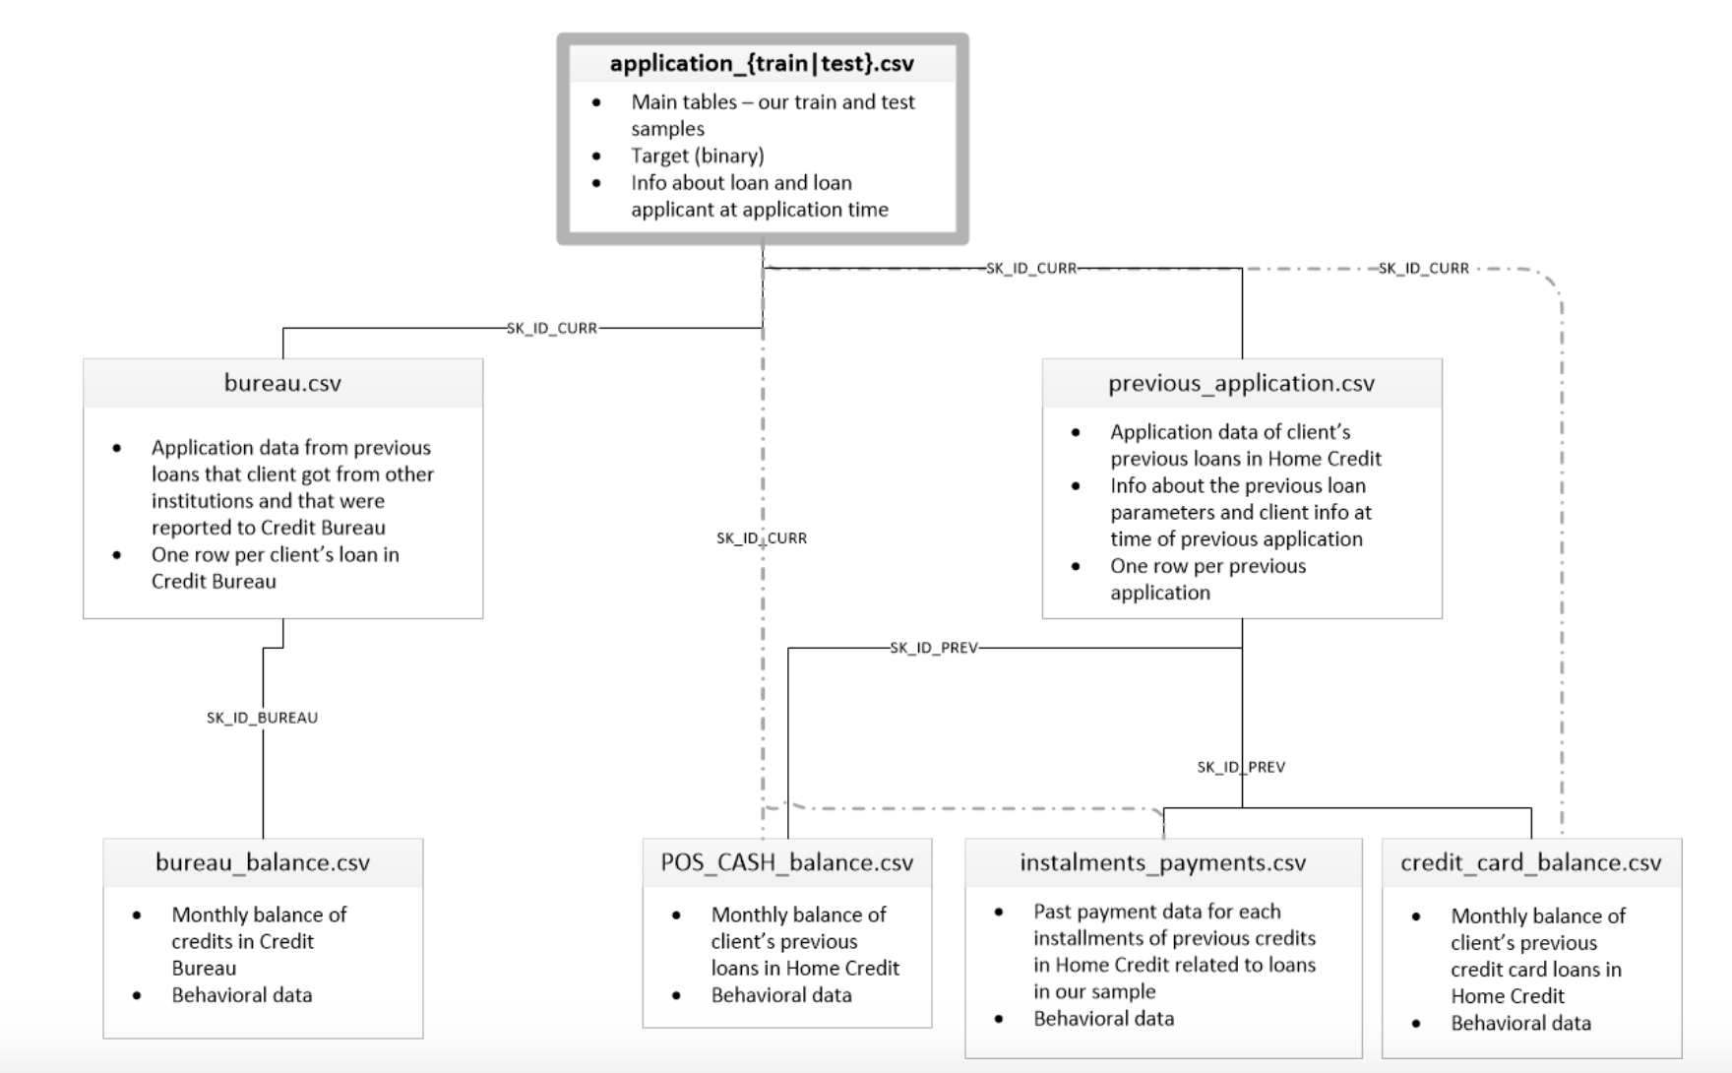
Data Format

Slide 5
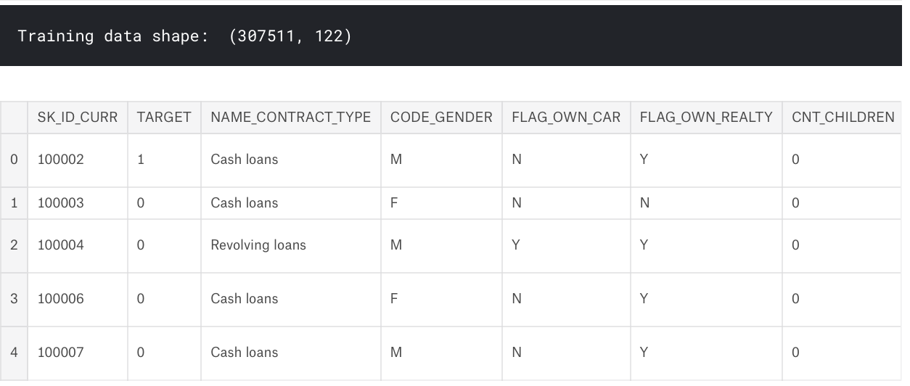
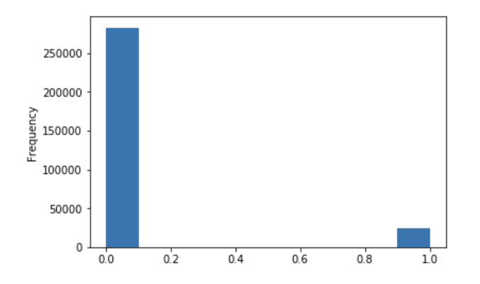
Features in main table
0: loans that were repaid on time
1: loans that were not repaid

Slide 6
Data Analysis
Information Gain Criteria:
OWN_CAR_AGE, EXT_SOURCE_1, EXT_SOURCE_2, APARTMENTS_AVG, BASEMENTAREA_AVG, YEARS_BEGINEXPLUATATION_AVG, YEARS_BUILD_AVG, COMMONAREA_AVG, ELEVATORS_AVG, ENTRANCES_AVG
Applying Normalization
Missing Values
Further Feature Engineering:
Data transformation
Better analysis of missing value
Using information from all tables instead of just using Application train test table

Slide 7
Proposed Methods
Decision Tree
Linear Regression
Logistic Regression
Neural Networks
Notes:
https://machinelearning-blog.com/2018/04/23/logistic-regression-101/

Slide 8
Proposed Method
Logistic Regression
discrete binary outcome between 0 and 1
very efficient
does not require too many computational resources
highly interpretable
it doesn’t require input features to be scaled
it’s easy to regularize

Slide 9
Proposed Method
do feature engineering and extract features
normalize features
initialize weight and learning rate
apply L2 regularization
calculate gradient and update weights
use stochastic gradient descent to evaluate the weights.
evaluating prediction based on AUC

Slide 10
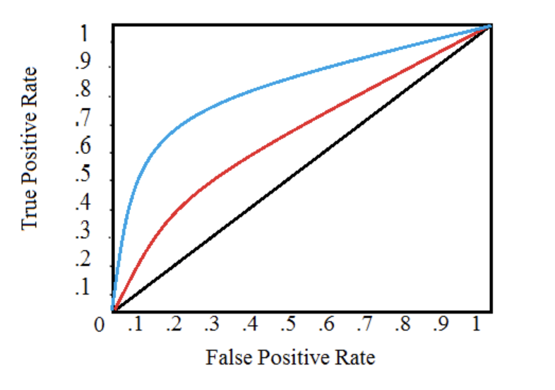
AUC criteria
The Area Under the Curve (AUC) explains itself by its name! It is simply the area under the ROC curve. (This is the integral of the curve.) This metric is between 0 and 1 with a better model scoring higher. A model that simply guesses at random will have ROC AUC of 0.5.
Notes:
https://www.kaggle.com/willkoehrsen/start-here-a-gentle-introduction

Slide 11
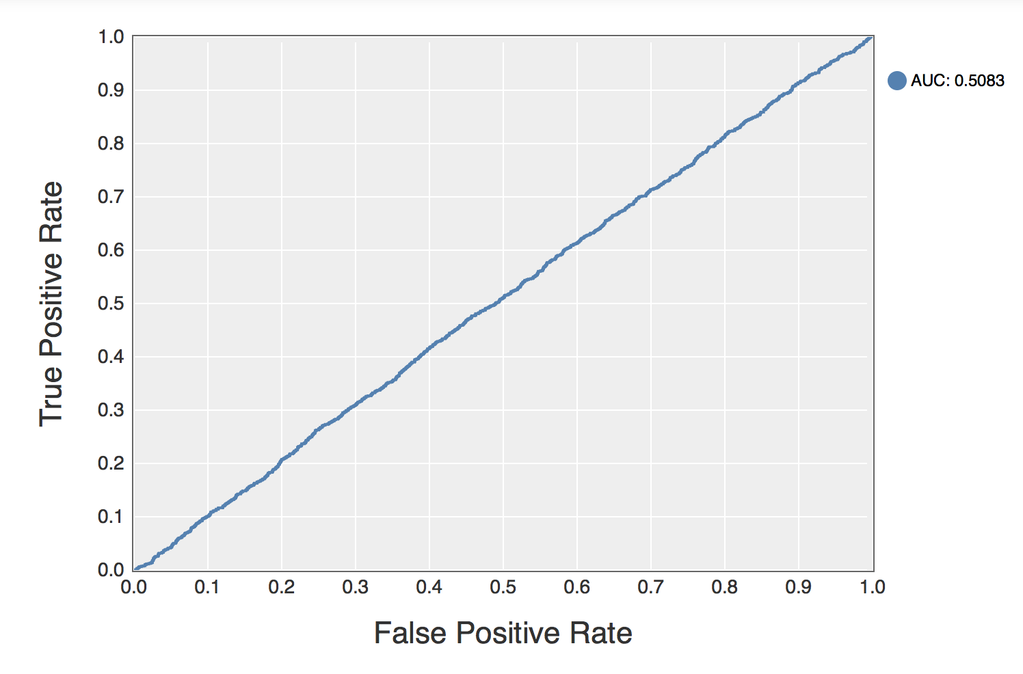
Results
Random Classifier

Slide 12
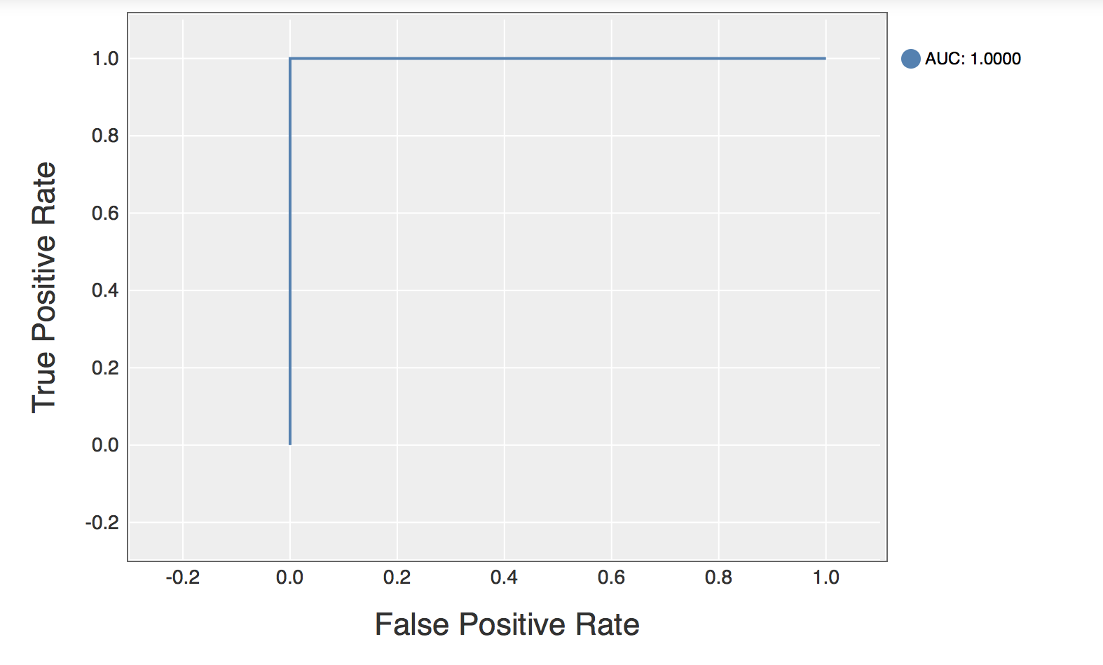
Results
Perfect Classifier

Slide 13
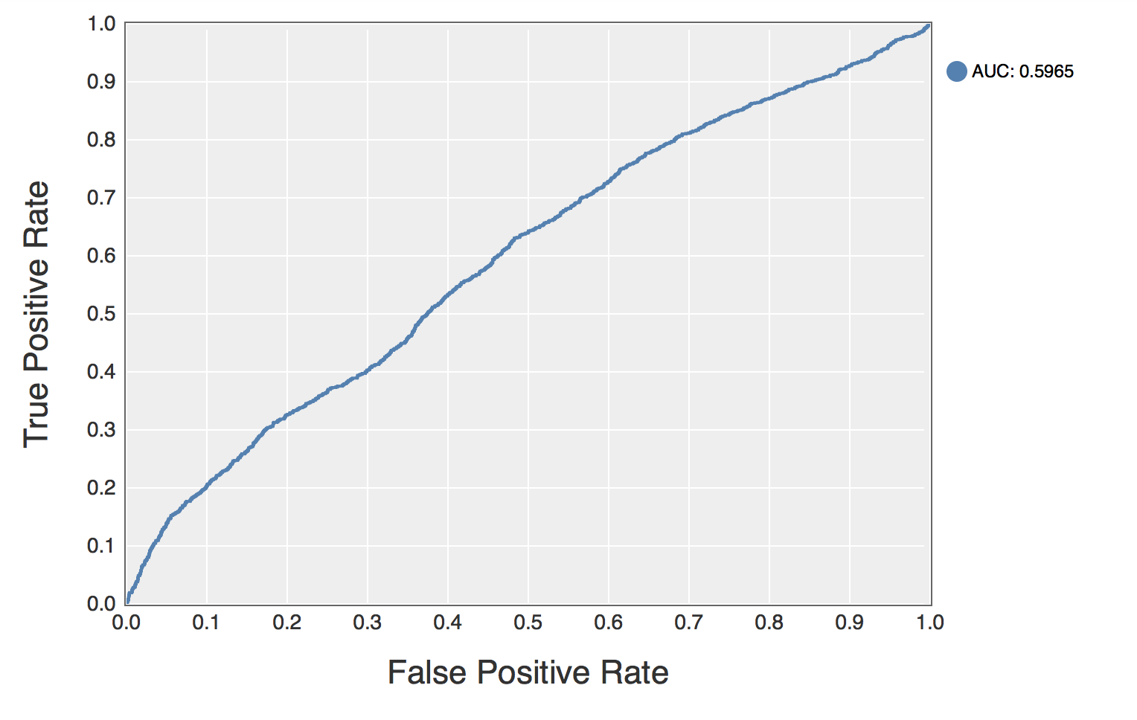
Result
Implement a classifier that achieves an auc, in range a∈(0.5,0.6).
Without using any normalization

Slide 14
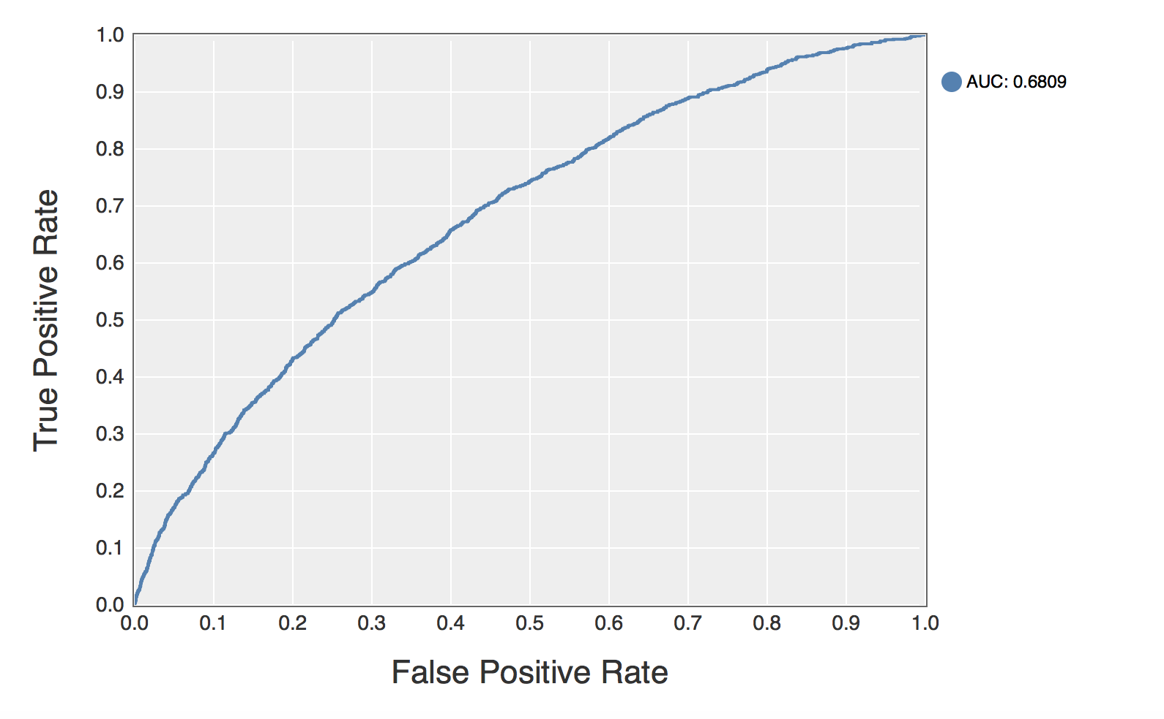
Result
Implement a classifier that achieves an auc, in range a in (0.6, 0.7)
Used zdatabase (applied normalization on dataset)

Slide 15
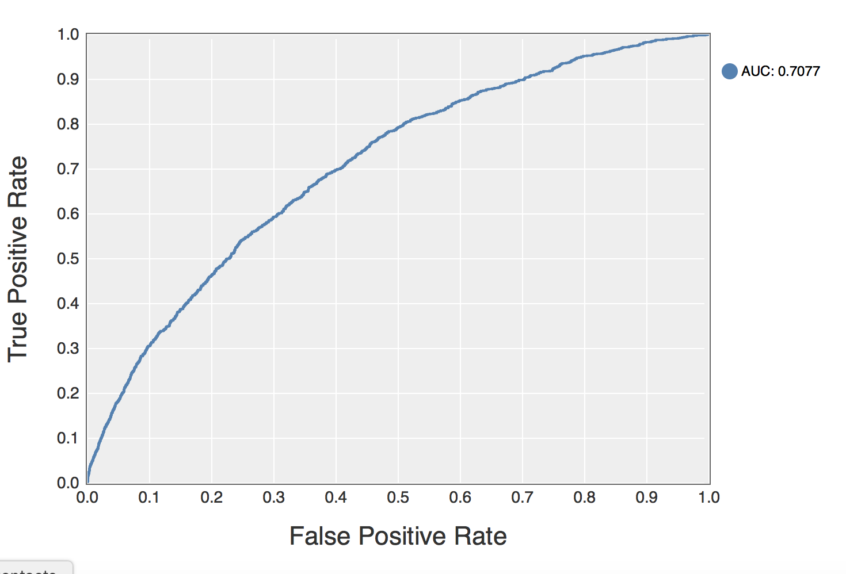
Result
Implement a classifier that achieves an auc, in range a > 0.7.
Used zdatabase (applied normalization on dataset)

Slide 16
References
Neural networks for credit risk evaluation: Investigation of different neural models and learning schemes, Khashman, Adnan, Expert Systems with Applications, 2010, Volume 37, Number 9, Pages 6233—6239
Credit risk evaluation with least square support vector machine, Lai, Kin Keung and Yu, Lean and Zhou, Ligang and Wang, Shouyang, 2006, Pages 490--495
Decision diagrams in machine learning: an empirical study on real-life credit-risk data (article), Mues, Christophe and Baesens, Bart and Files, Craig M and Vanthienen, Jan, Expert Systems with Applications, 2004, Volume 27, Number 2, Pages 257--264
Machine learning: The high interest credit card of technical debt, Sculley, D and Holt, Gary and Golovin, Daniel and Davydov, Eugene and Phillips, Todd and Ebner, Dietmar and Chaudhary, Vinay and Young, Michael, 2014
Credit risk assessment using statistical and machine learning: basic methodology and risk modeling applications, Galindo, Jorge and Tamayo, Pablo, Computational Economics, 2000, Volume 15, Number 1-2, Pages 107--143

