Slide 1
College Marketplace App
A platform for students and sellers within a college to buy and sell products efficiently. Key Features:
Seller Portal: Store registration, product management, order History.
Student Portal: Product browsing, cart & checkout, order History,

Slide 2
Tech Stack
Frontend: React + Material UI
Backend: Express.js + MongoDB
Database: MongoDB
APIs: RESTful APIs for authentication, product management
Implementation Approach
Database Design (MongoDB collections for users, products, orders)
Backend (Express.js with REST APIs for user authentication, orders, and products)
Frontend (React with Material UI for UI components)

Slide 3
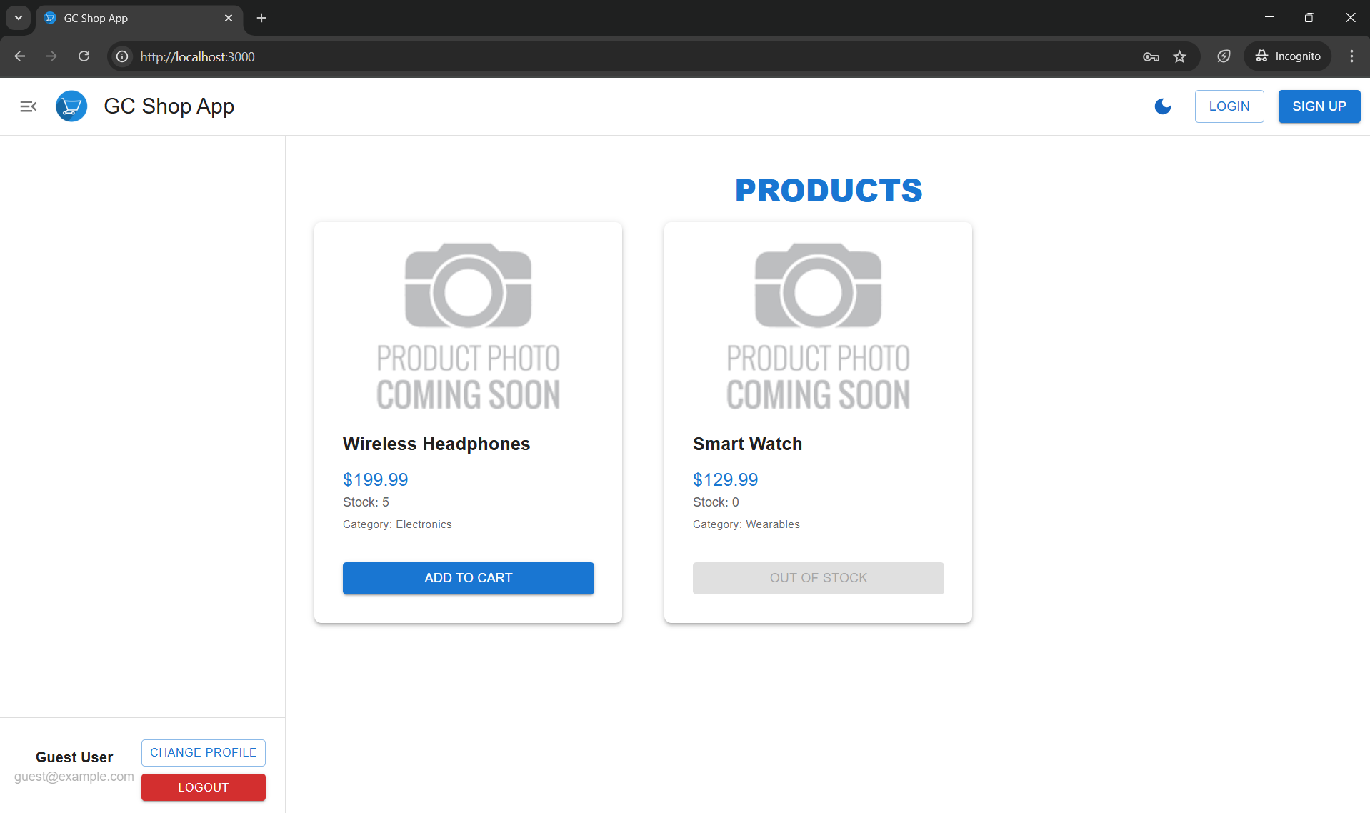

Slide 4
