Slide 1
WaveCon Telecom analysis presentation.
Presented by:
Sumesh S Dhotre

Slide 2

Introduction
Wavecon Telecom.
In the competitive world of telecommunications. Wavecon telecom had long been a prominent players. With the imminent launch of 5G technology, the company was eager to understand the impact on their plans and revenue. Determined to uncover insights that would guide their strategies, wavecon embarked on an intensive analysis.

Slide 3
Data Summary (Year – 2022)
Before 5G
Jan
Feb
Mar
Apr
May - 5G implemented
Jun
July
Aug
Sep
After 5G

Slide 4
Important KPI’s
Revenue
Active Users
ARPU
(Average Revenue Per User)
Unsubscribed Users

Slide 5
01.
What is the impact of the 5G launch on our revenue?

Slide 6

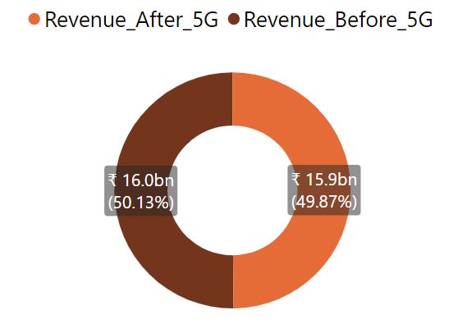
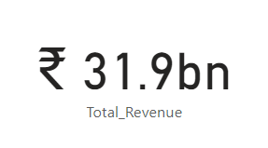
01.What is the impact of the 5G launch on our revenue?
Split Revenue by “Before 5G” & “After 5G”
Total Revenue
The Revenue has decline by 0.5% post 5G launch

Slide 7
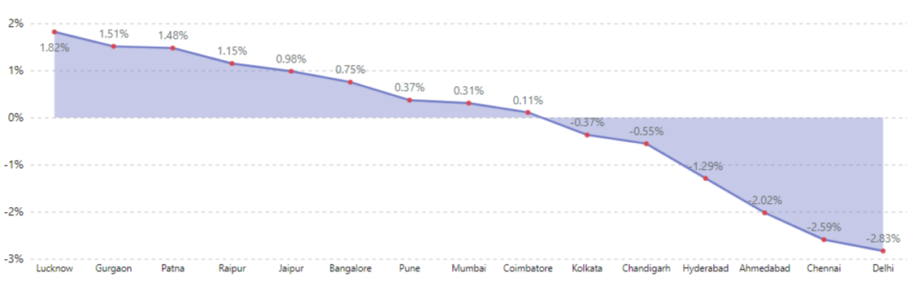


01.What is the impact of the 5G launch on our revenue?
Split Revenue by Cities
Kolkata, Chandigarh, Hyderabad, Ahmedabad, Chennai and Delhi cities revenue has been declined after the 5G launch.
There is a modest growth after the 5G launch in cities like Lucknow, Gurgaon, Patna, Raipur, Jaipur, Bangalore, Pune and Mumbai

Slide 8
02.
Which KPI is Underperforming after the 5G launch?

Slide 9

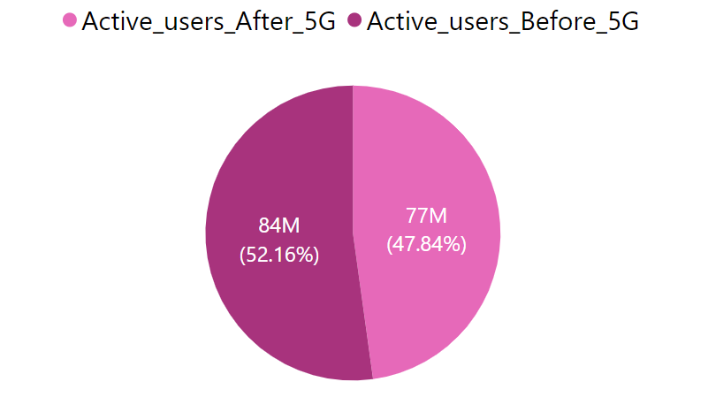

02.Which KPI is underperforming after the 5G launch?
Total Active Users: 161.7M
There are two KPI’s which have underperformed post 5G launch:
Total Active Users
Total Unsubscribed Users
There is a drop of around 8.3% in the Active Users after the 5G Launch compared to the number of users before 5G

Slide 10
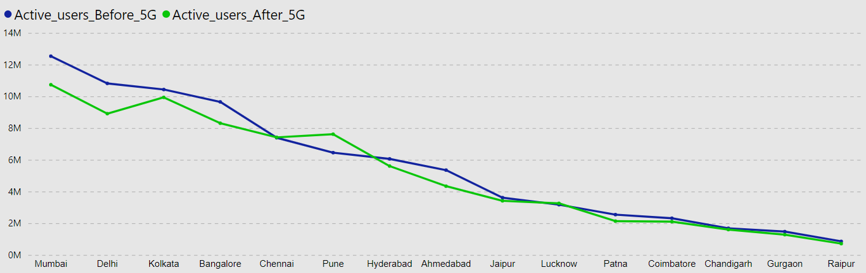
According to this chart, Pune is the only city that has experienced an increased in active users of 17% growth. while Chennai and Chandigarh remains unchanged after the 5G launch. Whereas Mumbai and Delhi witnessed a decrease of 14.4% and 17.5% in active users after the 5G launch. Therefore, we need to investigate in this cities to find the reason behind the decline in active users.

Slide 11
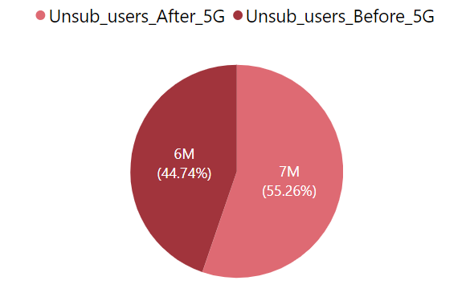
02.Which KPI is underperforming after the 5G launch?
Total Unsubscribed Users: 12.6M
There are two KPI’s which have underperformed post 5G launch:
Total Active Users
Total Unsubscribed Users
Unsubscribed Users have increased with the change% of around 23.50% after the 5G launch

Slide 12
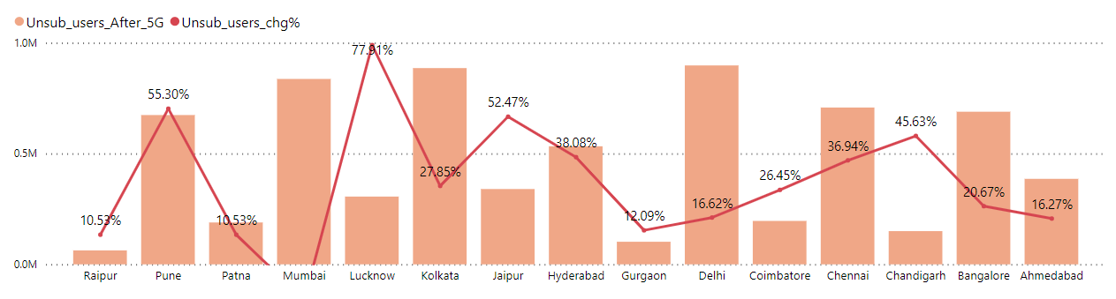
The chart above illustrates the percentage change in unsubscribed users after the implementation of 5G, cities like Lucknow, Pune and Jaipur have experienced an increase in unsubscribed users with the percentage of 77.91%, 55.30% and 52.47% respectively

Slide 13
03.
After the 5G launch, which plans are performing well in terms of revenue? Which plans are not performing well?

Slide 14
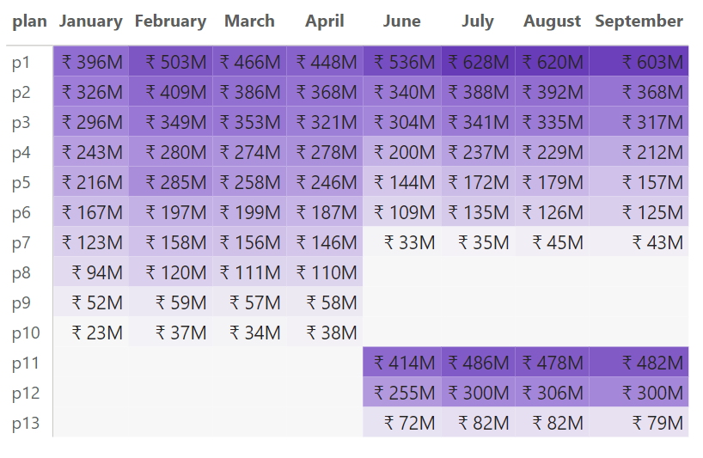
03.After the 5G launch, which plans are performing well and which are not in terms of revenue?
By looking at matrix table we can say that the plans P1, P2, P3 and P11 stand out as the most successful 5G plans, whereas the plans P7 and P13 are not performing well respectively

Slide 15
04.
Is there any plan affected largely by the 5G launch? Should we continue or discontinue that plan?

Slide 16

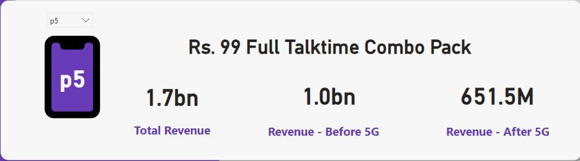
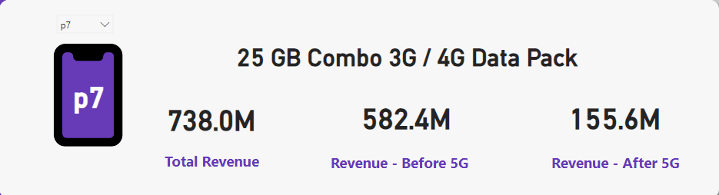
04. Is there any plan affected largely by the 5G launch? Should we continue or discontinue that plan?
The above data indicates that the revenue for plan 5 experienced a decrease of approximately 35% post 5G launch.
The above data indicates that the revenue for plan 7 experienced a decrease of approximately 70% post 5G launch.
There is a drastic change in the plan 5 in terms of revenue in cities like Bangalore, Delhi, Chennai & Kolkata with change% of -43.36%, -40.88%, -32.34% & -42.97% respectively.
Across multiple cities, plan 7 has experienced a significant decline in revenue after the 5G launch, impacting overall revenue of those cities.

Slide 17

Thank you!

