Slide 1
Selbst-organisierende, adaptive Systeme Übung 2 - Aufgabe 1
Gruppe 13
Andreas Knote
Birgit Kühbacher
Christopher Stifter

Slide 2
Aufgabenstellung
Veranschaulichen Sie sich das Verhalten von chaotischen Systemen am Beispiel des logistischen Modells bzw. der logistischen Abbildung. […]
Vervollständigen Sie dazu das User-Interface [mit Slidern für y0 und R]
Platzieren Sie Monitore [für y-current und y-new]
Vervollständigen Sie den Code […]
Testen Sie Ihre Implementierung mit verschiedenen Parametern von R. Können Sie Bifurkationen beobachten? […]

Slide 3
Netlogo Code

Slide 4
Initialization
;; the initialization makes sure y-current and y-new are
;; set to y(0) and y(1), respectively
;; PRE: none
;; POST: y-current equals y(0); y-new equals y(1)
to initialize
set y-current y0
set y-new logisticMap R y-current
end

Slide 5
Transform Function
;; The transformation function performs exactly
;; one step in the logistic map
;; PRE: y-current equals y(t); y-new equals y(t+1)
;; POST: y-current equals y(t+1); y-new equals y(t+2)
to transformFunc
set y-current y-new
set y-new logisticMap R y-current
end

Slide 6
Logistic Map Function
;; PRE R_ in [0, 4.0), y in [0, 1]
;; POST Result of logistic map
to-report logisticMap [R_ y]
report R_ * y * (1 - y)
end

Slide 7
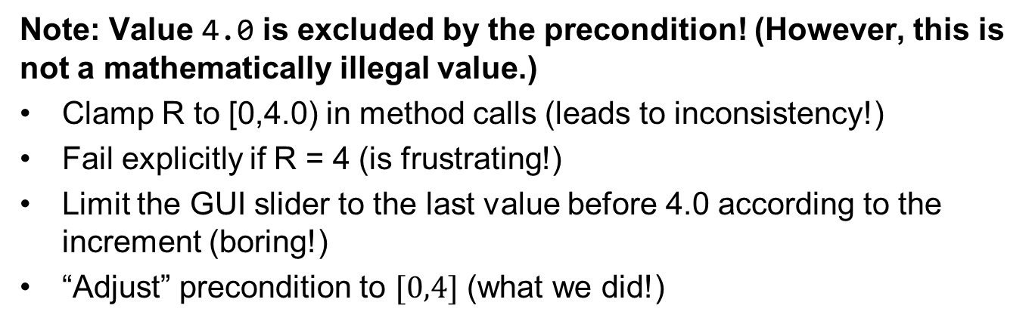
Logistic Map Function
;; PRE R_ in [0, 4.0), y in [0, 1]
;; POST Result of logistic map
to-report logisticMap [R_ y]
report R_ * y * (1 - y)
end
Note: Value 4.0 is excluded by the precondition! (However, this is not a mathematically illegal value.)
Clamp R to [0,4.0) in method calls (leads to inconsistency!)
Fail explicitly if R = 4 (is frustrating!)
Limit the GUI slider to the last value before 4.0 according to the increment (boring!)
“Adjust” precondition to $[0,4]$ (what we did!)

Slide 8
Demonstration

Slide 9
Behavior of Logistic Map for Different Values of R

Slide 10
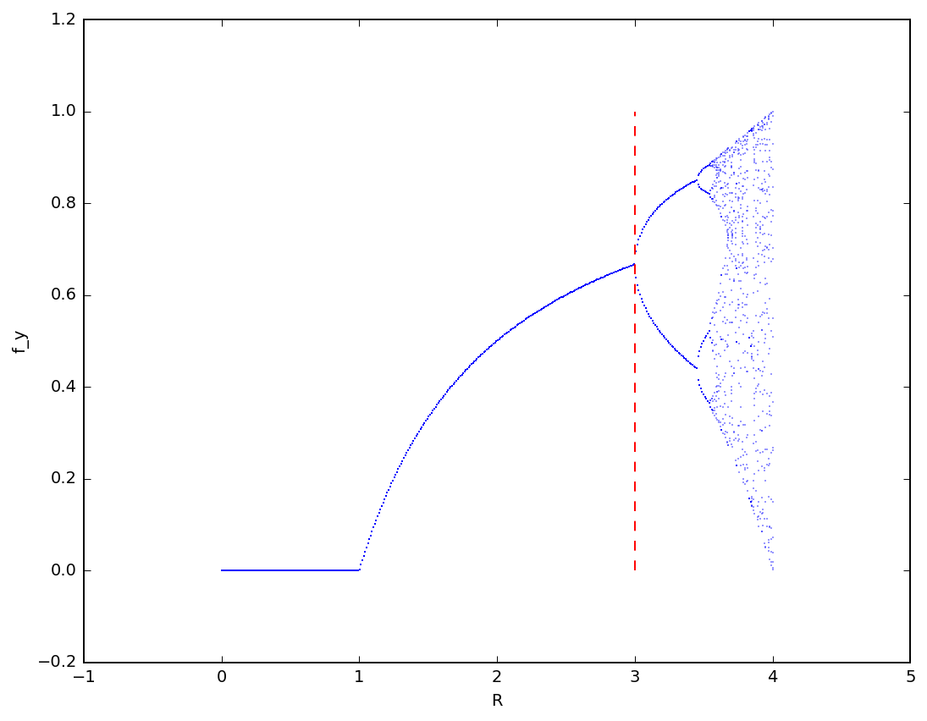

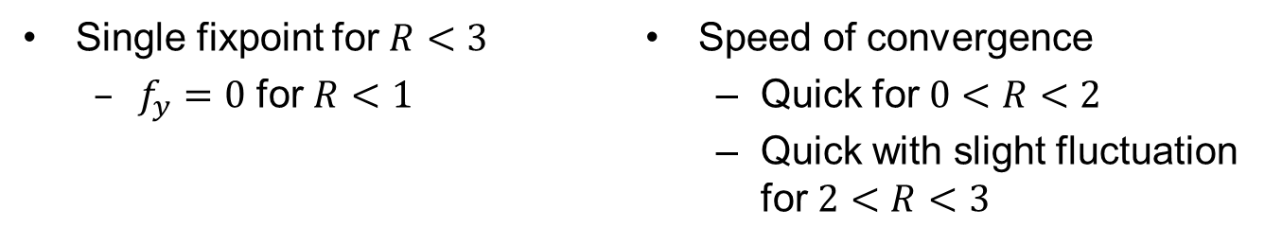
Behavior for Different Values of $R$
Single fixpoint for $R<3$
$f_{y}=0$ for $R<1$
Speed of convergence
Quick for $0<R<2$
Quick with slight fluctuation for $2<R<3$

Slide 11
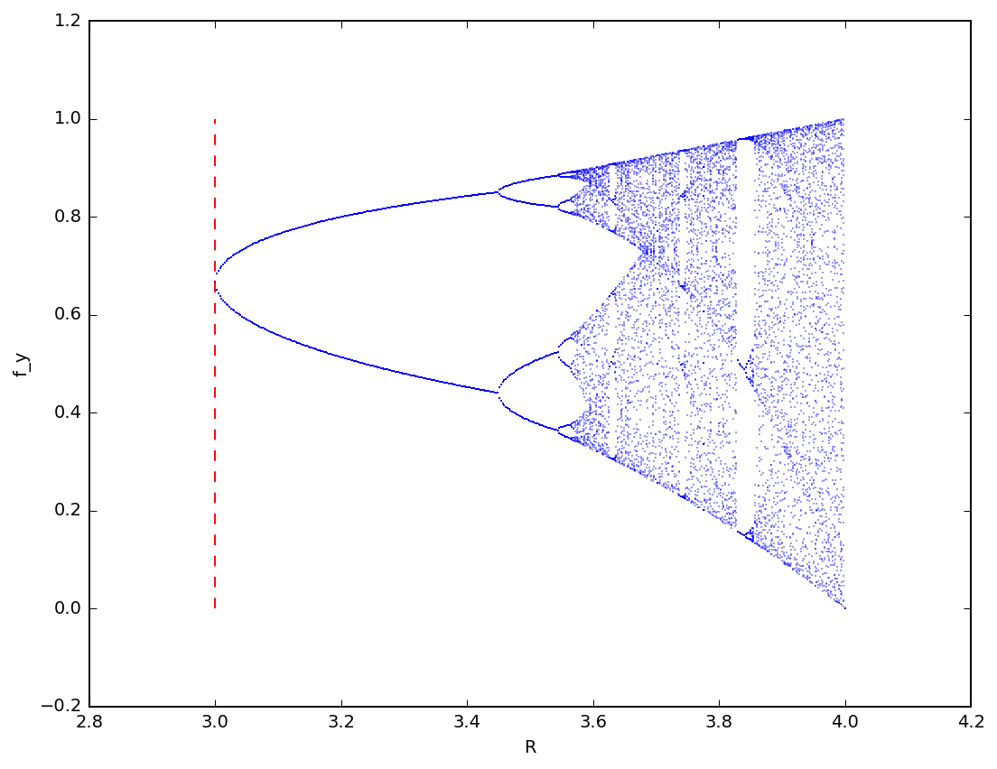


Behavior for Different Values of $R$ $$3<R<4$$
For $R=3$, $y$ converges „dramatically slow”
Bifurcation Appears for $R > 3$

Slide 12
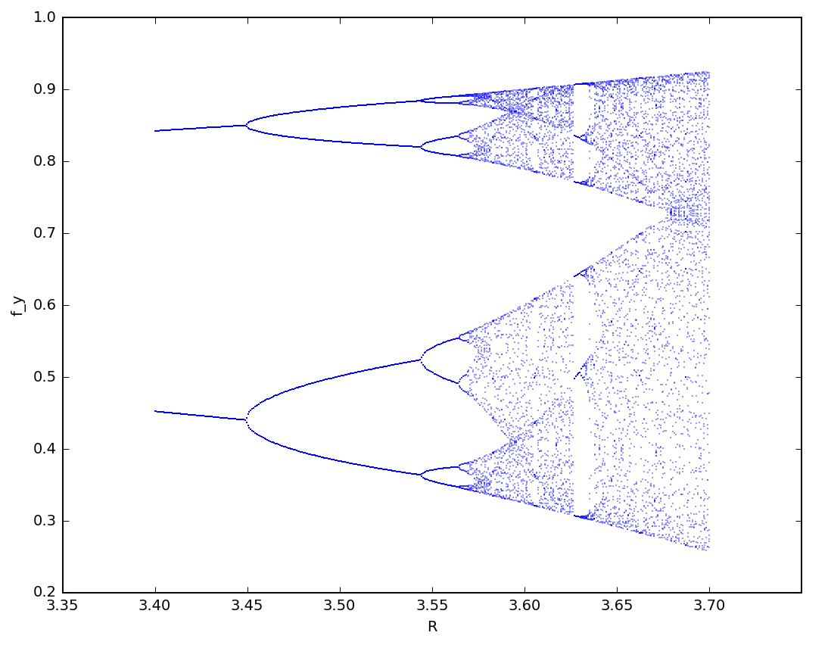

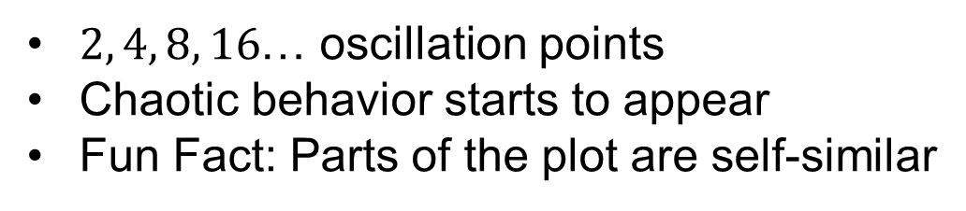
Behavior for Different Values of $R$ $$3.4<R<3.7$$
$2, 4, 8, 16$… oscillation points
Chaotic behavior starts to appear
Fun Fact: Parts of the plot are self-similar

Slide 13
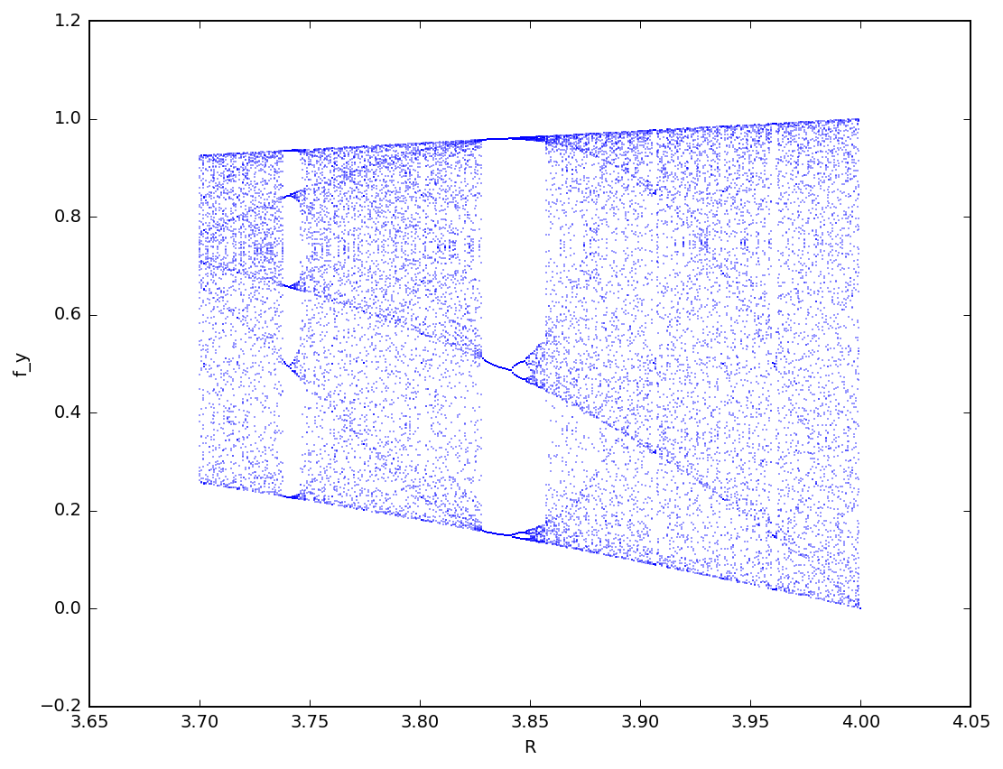

Behavior for Different Values of $R$ $$3.7<R<4$$
Certain „Islands of Stability“

Slide 14


Behavior for Different Values of $R$ $$R>4$$
For $R>4$, $y$ will exceed $[0,1]$ quickly (no plotting possible)

