Slide 1

TRAINEE ID-1282731
TRAINEE NAME-A.S.M ABDULLAH
PROJECT- JOB PORTAL MANGEMENT SYSTEM

Slide 2
JOB PORTAL MANGEMENT SYSTEM

Slide 3

JOBSHUB-
DATABASE SCHEMA

Slide 4
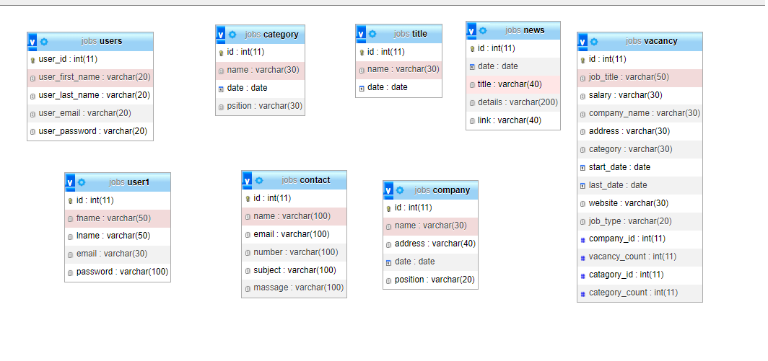

Slide 5
JOBS HUB
FRONTEND

Slide 7
FRONTEND FEATURES-
HOME
ABOUT
JOBS
COMPANY
JOBS NEWS
CONTACT US
SIGN IN
SIGN UP
LOGOUT

Slide 8
JOBS HUB
BACK END

Slide 9
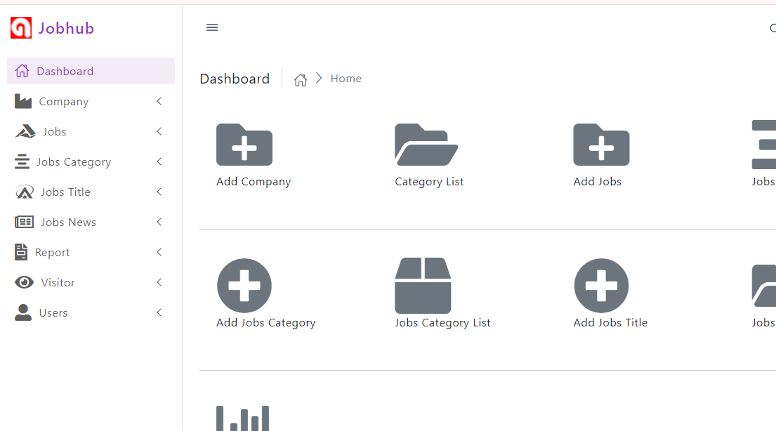

Slide 10
JOBHUB MANAGEMENT SYSTEM
COMPANY MANAGE
JOB VACENCY MANAGE
JOB CATAGORY MANAGE
JOB TITLE MANAGE
REPORT OF VACENCY UNDER COMPANY SYSTEM
JOB NEWS MANAGE
FRONTED CONTACT MANAGE
FRONTED SIGNUP MANAGE
ADMIN USER MANAGE

Slide 11
BACKEND –
ADMIN LOGIN

Slide 12
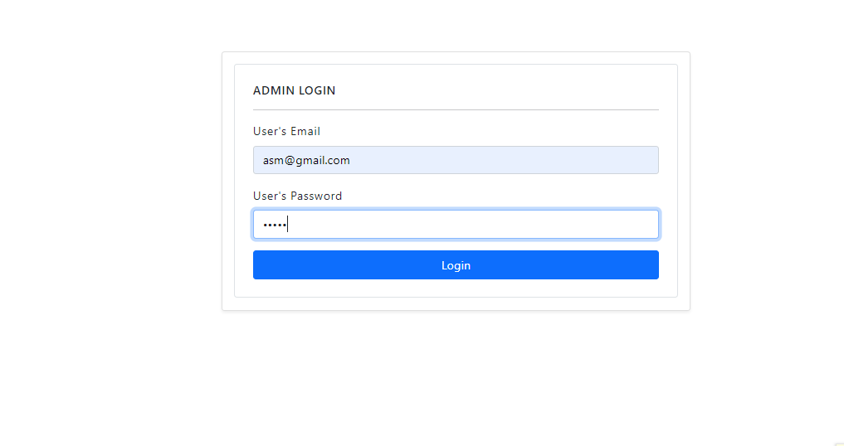

Slide 13
WELCOME TO
JOBHUB

