Slide 1
SOFACE: Exercise 7
Concurrency

Slide 2
Active Learning
Todays lesson focuses on concept!
Google Docs:
  https://docs.google.com/document/d/1YdKcoDiT8-bGga6o0c3GMhGOXmX3R2oB4V6LxeQNX_4/edit?usp=sharing

Slide 3
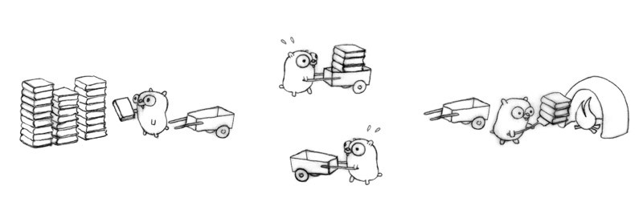
1. Goal of Concurrency
Questions to discuss (5 minutes)
  What could be some of the benefits of using concurrency?
  What are some of the drawbacks of using concurrency?

Slide 4
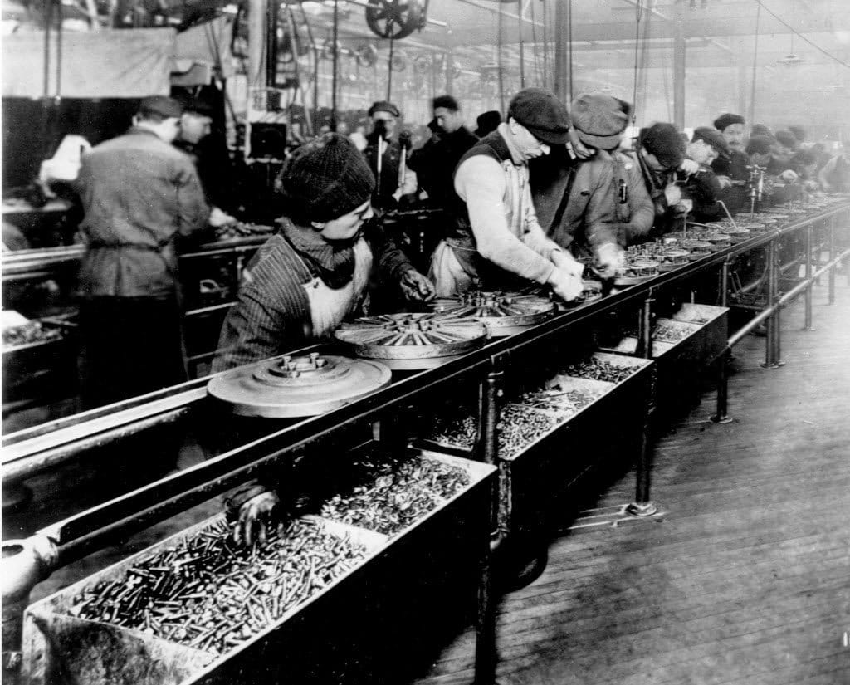
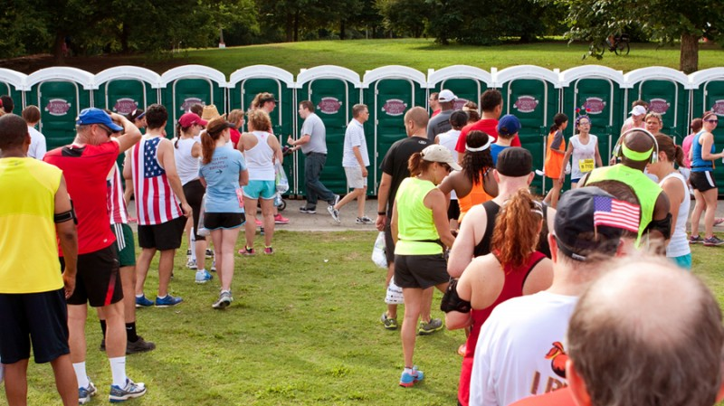

2. Real-Life Concurrency
Concurrency is everywhere!
  People are threads
  The thing they share is the shared resource
In pairs discuss (10 min):
  For each picture What is the thread and the resource
  Find a picture that exemplifies an interesting case of concurrency
      Paste into board
      Identify the thread and resource

Slide 5
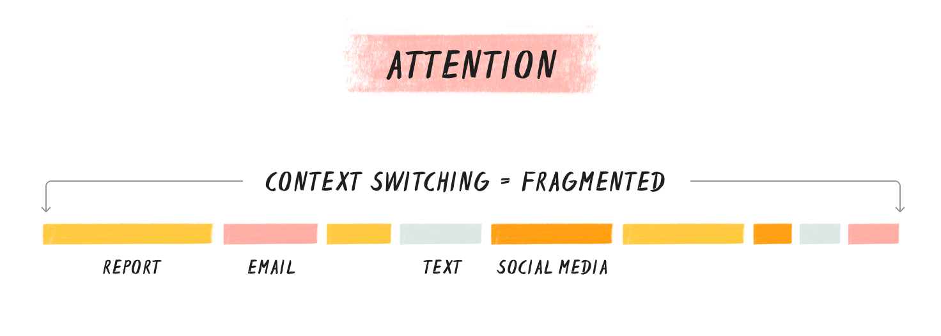
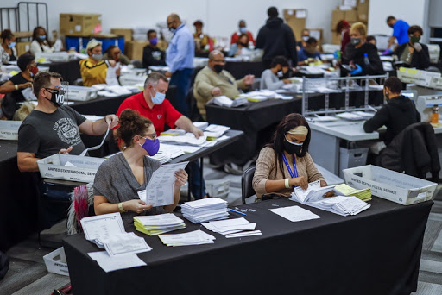
3. Issues of concurrency?
Too many threads sharing the same resource
  Resource is you, many threads of procrastination
In pairs discuss (10 min):
  Comparing the 2 pictures, which one is most efficient and why?
  Could you make the first example more efficient? If so describe this

