Slide 1
Road Ready Aotearoa
SE701 Group 2
Week 10 - Design & User Research

Slide 2
Today’s Agenda
01
Updates from Week 9
What has Changed based on last week’s feedback
05
Prototype & Wireframes
Mission Map V.C - interaction & learning goals
02
User Persona
Sarath & Sofia - who are we designing for
06
Educational Theory
Linking theory to design decisions
03
Real User Feedback
Interview finding from two participants
07
Next Steps
Plan before Week 11
04
Improved Persona
How personas evolved after testing

Slide 3
Updates from Week 9
🎯 Narrowed Target Users
Originally 3 target groups (Beginners, Students, Newcomers) → Focused exclusively on Newcomers to New Zealand.
💡 Rationale for the Change
Newcomers face the most distinct and urgent challenges — unfamiliar signs, give-way rules, and driving culture — making them the highest-impact audience.
🔄 Impact on Product Direction
Features, language, and content will now be tailored specifically for international drivers adapting to NZ road rules, simplifying our design scope.

Slide 4
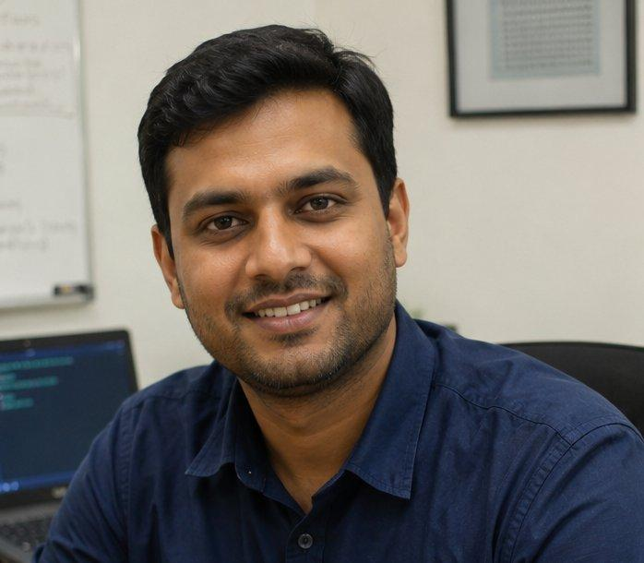
User Persona
Demographic info
Goals
30 years old
Quickly understand NZ-specific road rules
Software Tester
Drive confidently to and from work
Open Work Visa
Avoid fines or mistakes during his visa period
Auckland
Personalities
Pain points
Methodical and detail-oriented
India drives on the left, but NZ roundabout give-way rules differ significantly
Comfortable with technology
Unsure which rules carry over from home and which are unique to NZ
Generated by AI model
Prefers to learn by doing
Sarath
No time for formal lessons due to work schedule
Cautious in unfamiliar situations
"How do I handle these roundabouts? Everyone just goes without stopping!"
Devices
Official NZTA resources feel dense and hard to navigate quickly
Mobile (Android)
Laptop

Slide 5

User Persona
SF
Demographic info
Goals
26 years old
Safely rent a car and explore NZ on road trips
Graphic Designer
Build confidence driving on the left side
Working Holiday Visa
Understand NZ road signs and speed limits quickly
Wellington
Personalities
Pain points
Adventurous but safety-conscious
US drives on the right — switching sides feels unnatural and stressful
Visual learner — prefers diagrams over text
Struggles to find quick, visual summaries of NZ rules in one place
Generated by AI model
Easily overwhelmed by large amounts of written rules
Sofia
No local friends or family to guide her through differences
Motivated by real-world application
"Everything feels reversed — I keep drifting to the right side of the road."
Devices
Worried about making an illegal move and affecting her visa
Mobile (iPhone)
Tablet

Slide 6
Real User Feedback
Interview findings from two participants — School Run · Aotearoa, Version C: Mission Map
Sarath · 30 · India · Open Work Visa
SF
Sofia · 26 · USA · Working Holiday Visa
Driven in NZ: Yes — on foreign licence
Driven in NZ: Not yet
"Official resources read like textbooks. This gave me a risk-free environment to practice the logic of the road."
"Everything is reversed here. This game let my brain practice looking at lanes from the left side before renting a car."
✓
Roundabouts confirmed as #1 fear — validated persona
✓
Left-side driving muscle memory addressed through gameplay
✓
School zone + T-intersection rules clicked through gameplay
✓
Would use BEFORE arriving in NZ — travel anxiety use case
✓
Would use in first week — before getting behind the wheel
✓
Validated: visual learner, overwhelmed by text-heavy resources
⚠
HUD density overwhelming for detail-oriented users initially
⚠
Keyboard-only controls are a barrier — uses phone/tablet only
＋
Requested: multi-lane roundabout mission module
＋
Requested: mobile/touch support + 'Switch Sides' visual guide
Ratings (1=Strongly Disagree → 5=Strongly Agree)
Ratings (1=Strongly Disagree → 5=Strongly Agree)
Easy to play:
4/5
Easy to play:
3/5
NZ rules clear:
5/5
NZ rules clear:
5/5
HUD helpful:
4/5
HUD helpful:
3/5
Would use again:
5/5
Would use again:
5/5
Learned something:
5/5
Learned something:
5/5
Common gap: Roundabout module missing · Mobile/touch support needed · Both users rated NZ rules clarity 5/5 and would use again

Slide 7
Improved Personas
How our personas evolved after real user testing
Before Testing
After Testing (Updated)
SARATH 🇮🇳
Main pain point:
Roundabouts as primary fear
Roundabouts confirmed ✓ — plus T-intersection give-way also a significant gap
Device preference:
Laptop as primary device
Laptop confirmed ✓ — HUD needs a simplified onboarding mode for first-time users
Learning style:
Prefers to learn by doing
Strongly confirmed ✓ — interactive practice beats reading rules by a wide margin
When he'd use it:
Assumed: before/after arriving
Specific: during first week in Auckland, before first solo drive
💡 Design implication (Sarath): Add a dedicated roundabout mission module. Offer a simplified HUD mode for new users.
SOFIA 🇺🇸
Primary fear:
Driving on wrong side — general anxiety
Confirmed — specifically muscle memory kicking in during sudden panic situations
Device access:
Mobile/tablet user (assumed barrier)
Keyboard-only game confirmed as a critical barrier — mobile support now a must-have
When she'd use it:
First week in NZ
Before arriving — while still in the US planning road trips (earlier than assumed)
Content need:
Visual summaries of NZ rules
Confirmed ✓ — plus wants a 'Switch Sides' guide for mirrors and blind spots
💡 Design implication (Sofia): Add mobile/touch controls. Build a 'Switch Sides' onboarding guide. Make the tool available pre-arrival.
Green highlight = assumption updated by real user feedback · SE701 Group 2 · Learning Road Safety in NZ

Slide 8
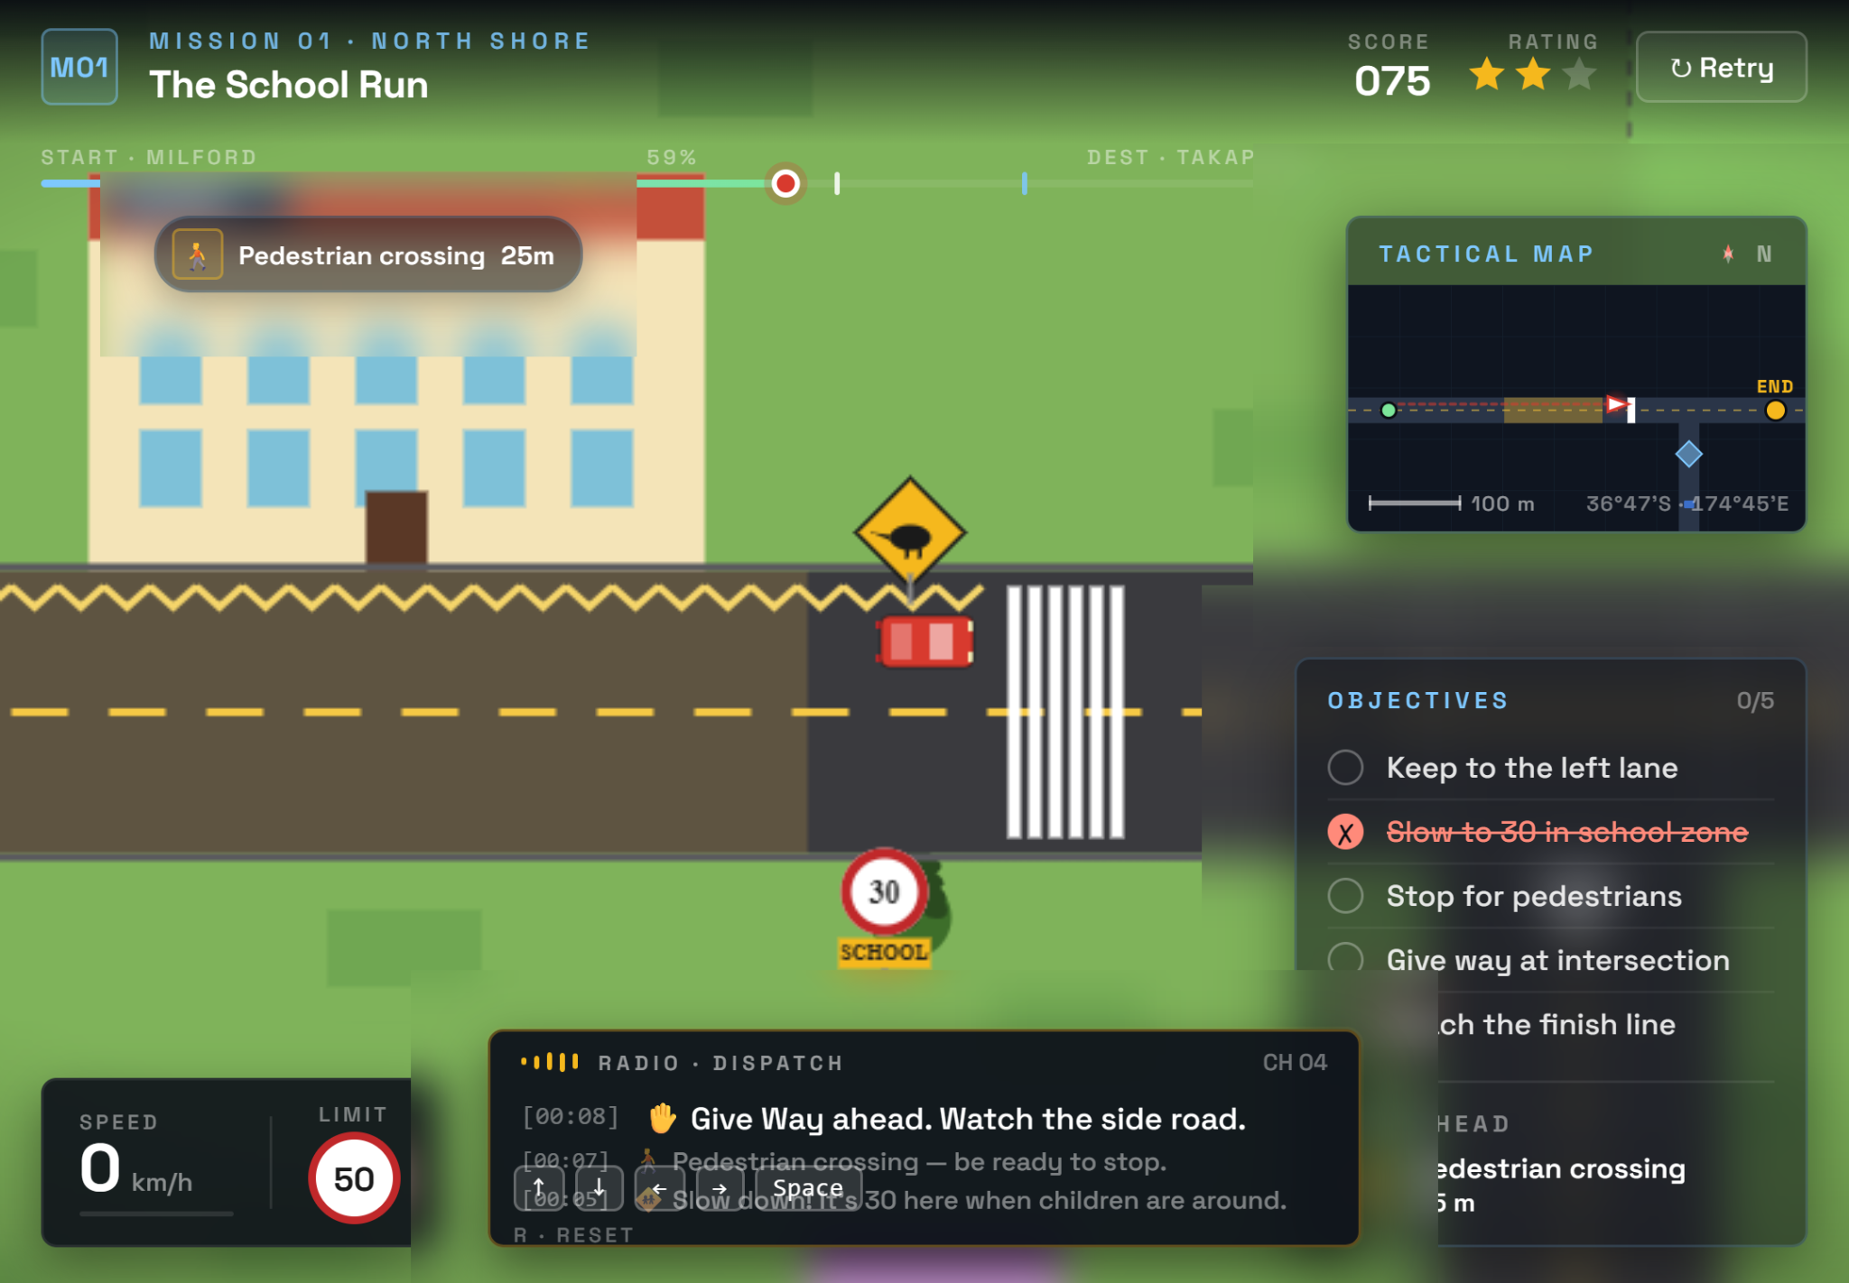
Wireframes & Prototype
🗺️
Mission Map HUD
Minimap, Hazards, Objective Tracker
🎯
Mission Scenarios
Multiple driving contexts across different locations
🧭
Guidance
Visual and audio cues
📈
Progressive Difficulty
Missions scale from basic to complex multi-hazard
♿
Accessibility
>16pt text, Keyboard Controls and Audio

Slide 9
Linking Educational Theory to Design
Experientialism
Game provides concrete experience -> Reflective Observation via mission replay -> active experimentation in safe simulated environments.
Design: Mission Map loop mirrors Kolb's cycle; hazard pings trigger mid-drive reflection without breaking immersion.
Cognitivism
HUD simplification reduces extraneous load so working memory can focus on road rules, not interface clutter.
Design: Decluttered HUD (Week 9 update); large 16pt+ fonts; grouped indicators.
Constructivism
Scaffolded scenario exploration lets learners integrate new NZ rules with prior overseas driving knowledge, building generalisable understanding.
Design: Missions set in recognisable NZ environments; reflection prompts after key decisions.
Behaviourism
Repeated practice and immediate corrective feedback reinforce correct road behaviours — score penalties, hazard pings, and mission retries build reflexive responses.
Design: Feedback after every decision; points/progress tied to safe choices, not just completion.

Slide 10
Next Steps - Before Week 11
More Modules
Addition of different road rule applications - Roundabouts, merge and multi-lanes
Progressive Difficulty
Introduce difficulty scaling so missions increase in complexity
Guidance Expansion
Add visual guide covering mirrors, blind spots and/or lane awareness
Additional Mission Scenarios
Expand beyond current missions - more locations and rule types
User testing
Test with more newcomers

Slide 11
Road Ready Aotearoa
Questions & Discussion

