Slide 1






Learning
Road Safety
in New Zealand
Team 2
Bharat, Alvin, Huijing, Jamuna, Kurt, Yutao

Slide 2


PROJECT OVERVIEW
Learning Road Safety in New Zealand
A lightweight road safety mini-game
Player controls a car and reaches the destination
Road signs and simple situations appear during gameplay
Learning through practice and feedback

Slide 3
PROJECT PURPOSE
WHY THIS GAME?
Newcomers may already know how to drive
NZ road culture may still feel unfamiliar
Formal resources can be text-heavy
A mini-game makes learning more engaging
It is a lightweight introduction, not training

Slide 4






Who We are Designing For
We started with three
Beginner learners
OUR FOCUS
Newcomers to New Zealand
Unfamiliar signs & road markings
Students
Different give-way & roundabout
logic
A new driving culture and keeping
left
Newcomers to NZ

Slide 5



The gap and our opportunity
What exists
Drive
the official NZ Road Code site
DrivingTests.co.nz
practice quizzes & mock theory tests
Good coverage of the rules but built around reading & multiple choice.

Slide 6

The gap and our opportunity
The gap
They test if you can recall a rule not whether you can apply it the moment a roundabout or school zone appears.
Key drawback : Reading + re-quizzing
gets repetitive

Slide 7

The gap and our opportunity
Our opportunity
Turn the road code into playablescenarios
Signs, speed limits & give-way as short missions
Make the safe choice in context, not on paper
Instant feedback, points & progress, practice you'll repeat

Slide 8

User Persona:Sarath
Demographic Info:
30 years old
Software tester
Open work visa
Auckland
Personality:
Methodical and detail-oriented
Comfortable with technology
Prefers to learn by doing
Cautious in unfamiliar situations
Devices:
Mobile (Android) • Laptop
Goals:
Quickly understand NZ-specific road rules
Drive confidently to and from work
Avoid fines or mistakes during visa period
Pain Points:
NZ roundabout give-way rules differ from India
Unsure which rules carry over from home
No time for formal lessons (busy work schedule)
Official NZTA resources feel dense and complex

Slide 9

User Persona:Sofia
Demographic Info:
26 years old
Graphic Designer
Working Holiday Visa
Wellington
Personality:
Adventurous but safety-conscious
Visual learner - prefers diagrams over text
Easily overwhelmed by written rules
Motivated by real-world application
Devices:
Mobile (iPhone) •Tablet
Goals:
Safely rent a car and explore NZ on road trips
Build confidence driving on the left side
Understand NZ road signs and speed limits quickly
Pain Points:
US drives on the right — switching sides is stressful
Can't find quick visual summaries of NZrules
No local friends or family to guide her
Worried about making an illegal move on her visa

Slide 10

Real User Feedback
Interview findings
Sarath • 30 • India • Open Work Visa Driven in NZ: Yes — on foreign licence
"Official resources read like textbooks. This gave me a risk-free environment to practice the logic of the road."
KEY FINDINGS
Roundabouts confirmed as #1 fear - validated persona
School zone + T-intersection rules clicked through gameplay
Would use in first week - before getting behind the wheel
HUD density overwhelming for detail-oriented users initially
Requested: multi-lane roundabout mission module
Sofia· 26 ·USA · Working Holiday Visa
Driven in NZ: Not yet
"Everything is reversed here. This game let my brain practice looking at lanes from the left side before renting a car."
KEY FINDINGS
Left-side driving muscle memory addressed through gameplay
Would use BEFORE arriving in NZ — travel anxiety use case
Validated: visual learner, overwhelmed by text-heavy resources
Keyboard-only controls are a barrier — uses phone/tablet only
Requested: mobile/touch support + 'Switch Sides' visual guide

Slide 11
Improved Personas
How our personas evolved after real user testing
SARATH 🇮🇳 | SARATH 🇮🇳
Before Testing | After Testing
Pain Point - Roundabouts as primary fear | Confirmed ✓ — T-intersection give-way also significant
Device - Laptop as primary device | Confirmed ✓ — HUD needs simplified onboarding mode
Learning Style - Prefers to learn by doing | Strongly confirmed ✓ — interactive beats reading rules
When to use - Assumed: before/after arriving | Specific: first week in Auckland, before first solo drive
SOFIA 🇺🇸 | SOFIA 🇺🇸
Before Testing | After Testing
Primary Fear - Driving on wrong side — general anxiety | Specifically muscle memory in sudden panic situations
Device - Mobile/tablet user | Keyboard-only confirmed critical barrier — mobile now must-have
Content Need - Visual summaries of NZ rules | Confirmed ✓ — plus 'Switch Sides' guide for mirrors/blind spots
When to use - First week in NZ | Before arriving — planning road trips earlier than assumed

Slide 12
DESIGN & PROTOTYPE
Road safety mini-game
Simple scenarios
Instant feedback
Score/progress system
Prototype comes from Claude

Slide 13
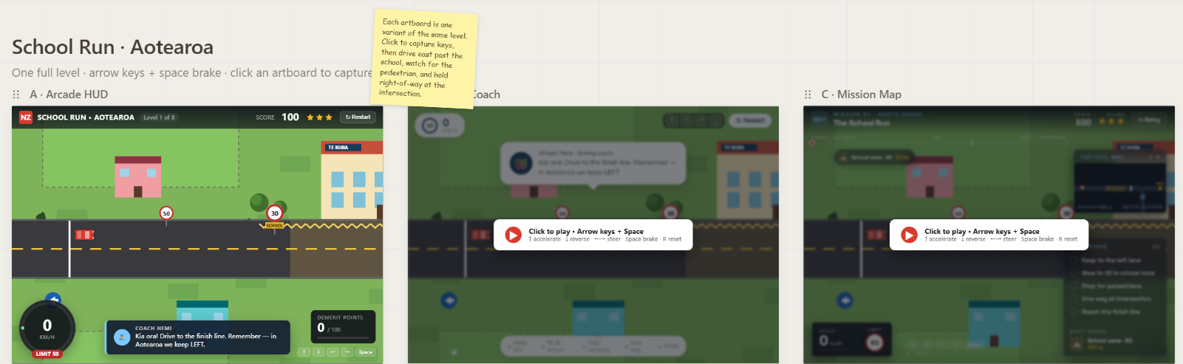
PROTOTYPE

Slide 14
EDUCATIONAL THEORIES USED
THEORY FRAMEWORK
Behaviourism: feedback, rewards, penalties, game-base design
Constructivism: learners build rule understanding
Experientialism: learning through driving practice
Cognitivism: clear cues reduce mental load

Slide 15
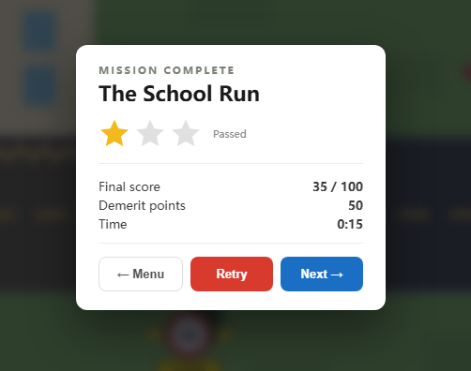
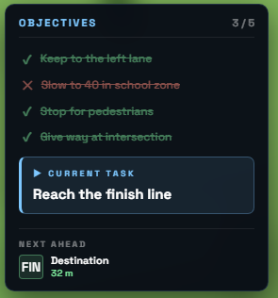
Game-based learning (Behaviourism)
Objectives + Real‑Time Feedback
Clear objectives define correct behaviours
→ Reinforces safe driving habits through operant conditioning.
→ Helps learners internalise NZ road rules through repeated, reinforced practice.

Slide 16
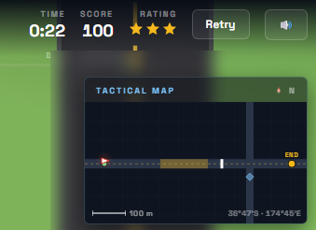
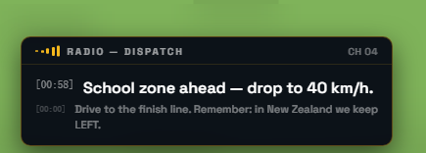
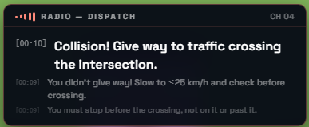
Kolb's Experiential Learning Cycle (Experientialism)
Concrete experience: driving
Reflective observation: feedback
Abstract conceptualisation: rules inferred
Active experimentation: retrying levels
→ Enables “learning by doing,” which is essential for procedural skills like driving.
→ Helps learners transfer knowledge to real-world driving situations.

Slide 17
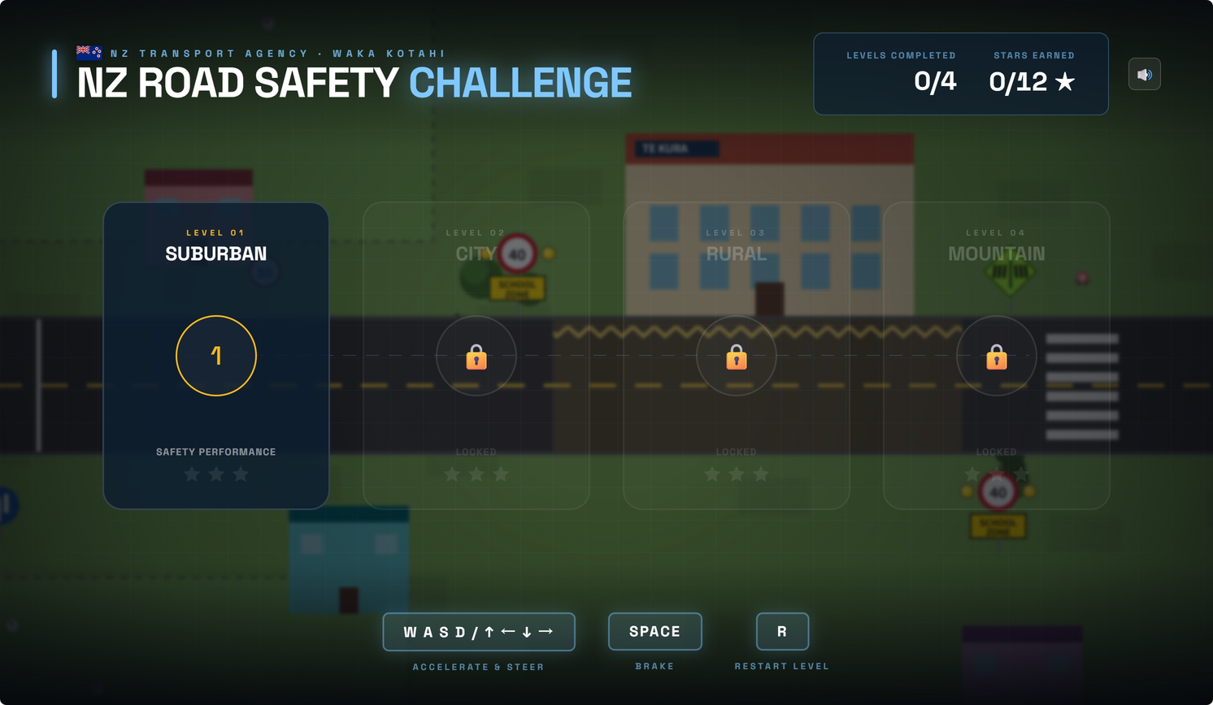

Cognitive load (Cognitivism)
Reduces cognitive load
Chunking via Levels
Levels introduce rules gradually
HUD simplification
Supports mental model formation
→ Reduces working memory load.
→ Helps learners focus on one concept at a time.

Slide 18
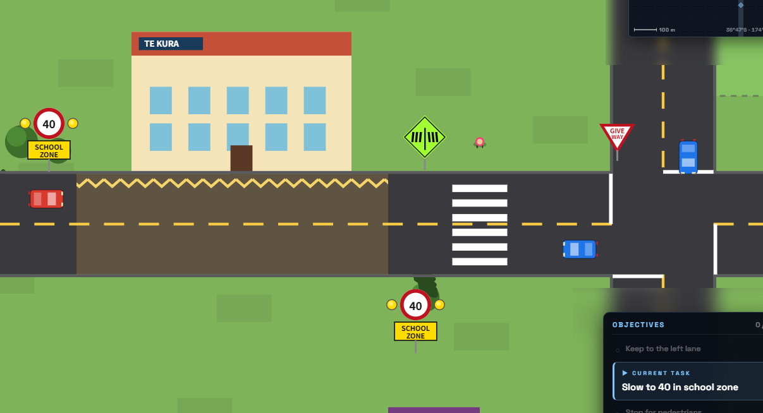
Scaffolding (Constructivism)
Learners integrate prior driving experience
Levels progress from simple to complex
Each level introduces only a small number of new rules.
→ Helps learners operate within their Zone of Proximal Development (ZPD).
→ Enables step‑by‑step mastery of NZ road rules.

Slide 19
SUMMARY
Theory
Game Feature
Learning Outcome
Behaviourism
Score, stars, demerit points
Develop Safe driving Habit
Cognitivism
HUD, radio dispact, levels
Apply NZ rules w/o overload
Constructivism
Scenario-Based
Recognize Hazards
Experientialism
Drive, reflect, retry
See, understand and retry

Slide 20
LEARNING OUTCOMES
WHAT LEARNERS PRACTISE
Learners can identify and apply NZ road rules
Learners can recognise hazards in varied environments
Learners develop safe driving habits through repeated practice
Learners transfer knowledge across contexts (city → rural → mountain)

Slide 21

AI USAGE DECISION
Not Used
Rule feedback is deterministic
More predictable for learners
Easier to test and validate
Potential risks of using AI
Hallucinations may mislead learners
Incorrect rule explanations
Inconsistent feedback

Slide 22

LimiTATIONS
Limited user testing sample size
Simplified driving physics and collision model
Limited driving road length and scenario diversity
Mobile design and controls not fully optimized
Limited accessibility support
Notes:
1.
Current evaluation involved only a small number of learners, which may not represent diverse driving backgrounds.
2.
Vehicle dynamics and collision responses are simplified to meet time and performance constraints.
3.
The current prototype includes mainly straight roads with minimal turning or curved segments, reducing realism and variety.
4.
Touch‑based steering and UI layout are less responsive and less precise compared to desktop controls.
5.
The current version lacks features such as adjustable text size, high‑contrast mode, alternative input methods, and audio guidance.

Slide 23
FUTURE PLANS
Expand user testing with a more diverse learner group
Enhance driving physics and collision realism
Extend road network and scenario diversity
Improve mobile UI and control responsiveness
Add comprehensive accessibility features
Notes:
1.
To validate learning effectiveness across different driving backgrounds and cultural contexts.
2.
Introduce more accurate vehicle dynamics, braking behavior, and collision responses to improve authenticity.
3.
Add curved roads, intersections, roundabouts, and more complex real‑world driving situations.
4.
Refine touch‑based steering, optimize layout spacing, and enhance overall mobile usability.
5.
Introduce adjustable text size, high‑contrast mode, audio guidance, and alternative input methods.

Slide 24
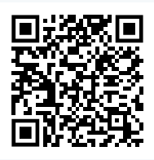
Scan to play
Thank you
Q & A
Team 2
https://softeng701-2026.github.io/group2-nz-road-safety-game/

