Slide 1






Learning road safety in New Zealand
Presented by
GROUP 2
Huijing ＆ Bharat

Slide 2
1.Topic and Scope
1.Topic:
Learning Road Safety in New Zealand through an Interactive Game
2.Scope:
A educational game for learning basic NZ road-safety rules.
Focusing on:
road signs
give-way rules
speed limits
safe choices in simple traffic scenarios
3.Out of scope:
Real driving simulation, advanced driving skills, full licence test training.

Slide 3

2.Target Users
1.Beginner Road Safety Learners
People who are new to NZ road rules and need simple guidance.
2.Young Learners / Students
Users who may find traditional road-code reading boring or difficult to remember.
3.Newcomers to New Zealand
People unfamiliar with local signs, give-way rules, and driving expectations.

Slide 4
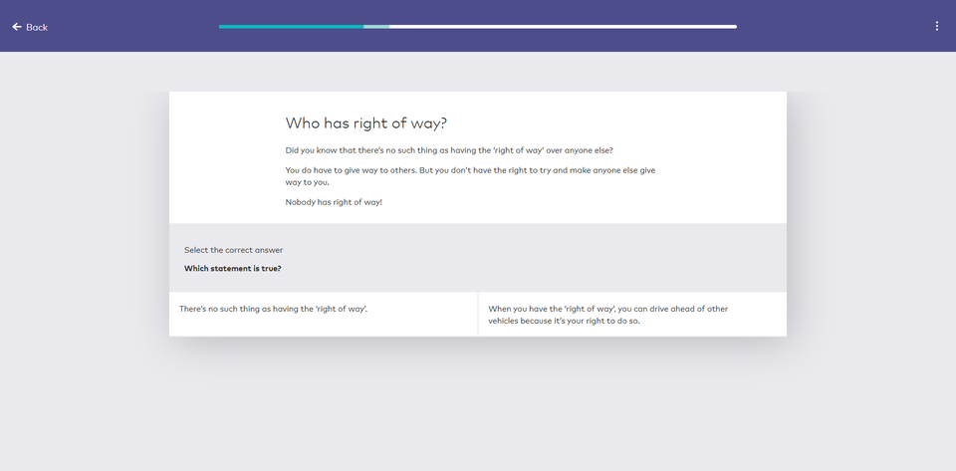

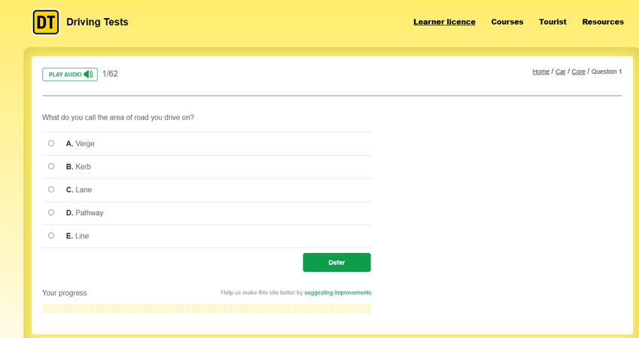
3.Research Gap / Opportunities
1. Existing Tools
Drive Road Code
DrivingTests.co.nz

Slide 5

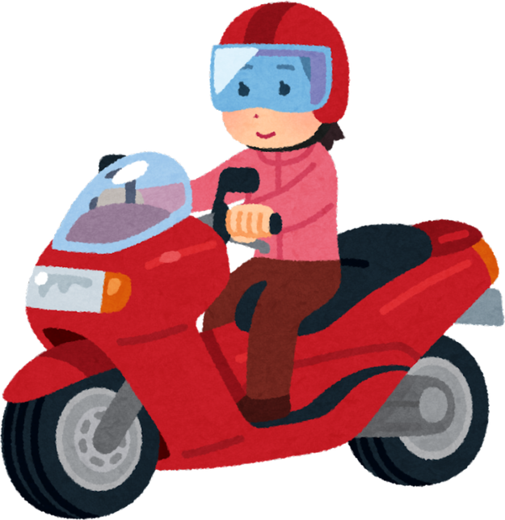
2. Gap from Existing Tools
• Many tools focus on reading, quizzes, and mock tests
• Learners may know rules, but struggle to apply them in scenarios
• Practice may not feel engaging enough for repeated learning.
3. Findings
• Behaviourism: feedback + repetition
• Cognitivism: small chunks
• Constructivism: prior experience
• Experientialism: scenarios
• AI: personalised feedback, accuracy concerns
4. Our Opportunity
• Turn road-code learning into playable challenges
• Design short levels for signs, speed limits, and give-way rules
• Let players make safe choices in road scenarios
• Give instant feedback, points, and progress rewards

Slide 6

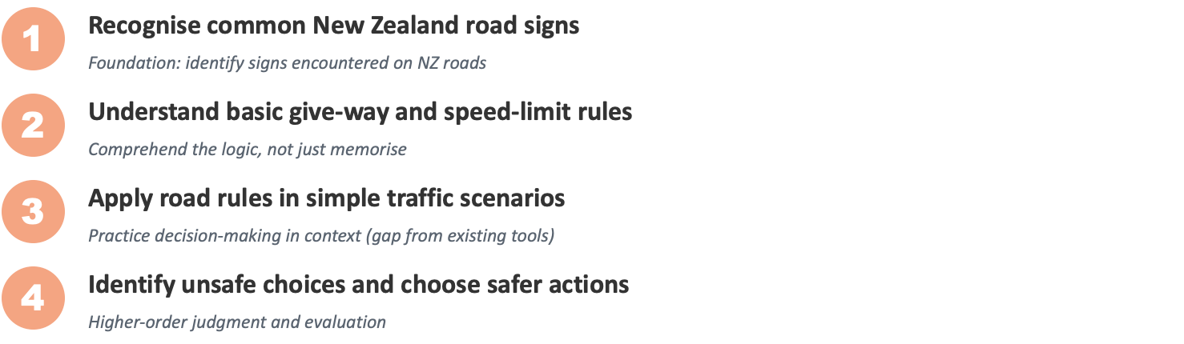

4.Learning Outcomes
By the end of the game,learners should be able to:

Slide 7

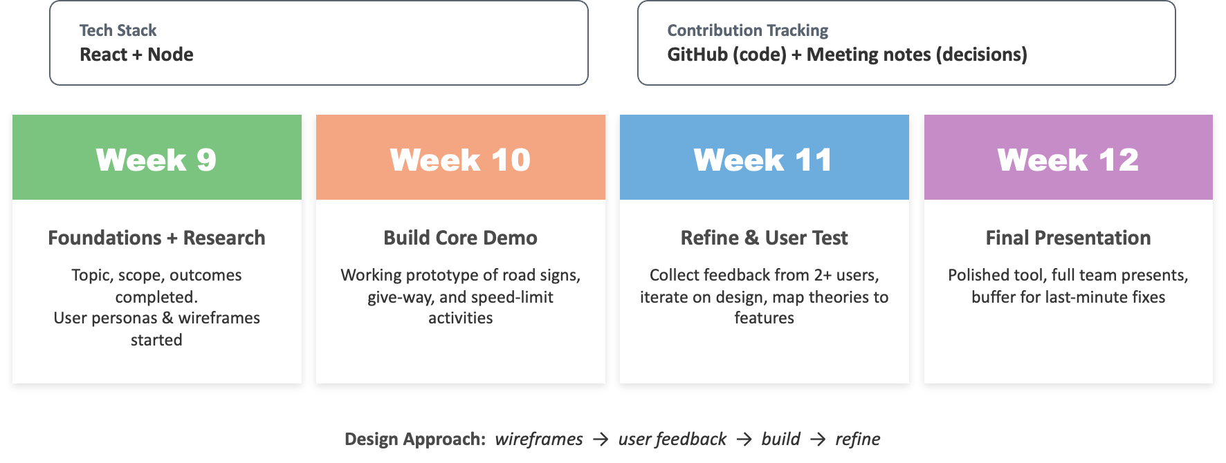
5.PROJECT PLAN

Slide 8

THANK YOU

