Slide 1
welcome

Slide 2

A
Project on
“ONLINE BUS TRACKING SYSTEM USING GPS”
submitted by
ADNAN SHEIKH ROLL NO- 74
SOHAM JAGTAP ROLL NO- 70
ADITYA MARNE ROLL NO- 72
VIVEK POTDAR ROLL NO- 73
VIPUL KATALE ROLL NO- 56 Under the Guidance of
Prof. SANKET PAWAR
BHARATI VIDYAPEETH’S
COLLEGE OF ENGINEERING LAVALE, PUNE PIN-412115
SAVITRIBAI PHULE PUNE UNIVERSITY
YEAR 2021-22

Slide 3
#Grievance Redressal system for institute

Slide 4
#Introduction
Overview of Project
Objectives of Project
Project Features

Slide 5
#Need of Proposed System
Study of Existing System
Proposed System

Slide 6
#Functionality of Proposed System
scope
Power
S
p
Purpose
Functions
p
f

Slide 7
#Requirements Analysis
HARDWARE REQUIREMENTS
Processor
Speed
Ram
Hard Disk Capacity
Network
Anti Virus
SOFTWARE REQUIREMENTS
Operating System
Front End
Programming Language
Database
IDE
.

Slide 8

#REQUIREMENT SPECIFICATION
Economical Feasibility
Technical Feasibility
Operational Feasibility
Legal feasibility
Schedule feasibility

Slide 9
#Tools and technology used
HTML
CSS
JS
Python
Firebase

Slide 10
#Pros and Cons

Slide 11

#Future Enhancements

Slide 12
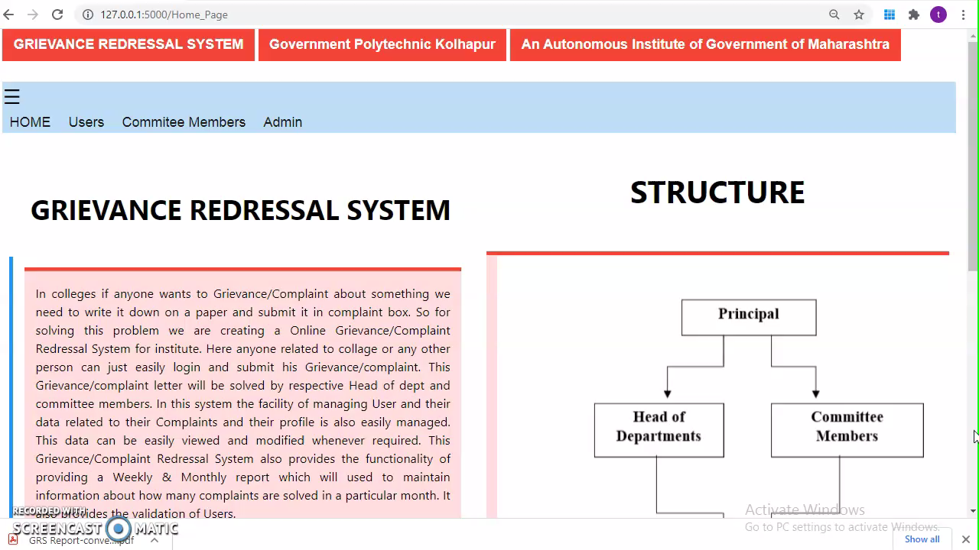
#Implementation

Slide 13
thanks!
#trident tridentgpkp@gmail.com
Any questions?

