Slide 1
Sports Team Entry Management System
By :
Soham R. Kharge
Umesh R. Sable

Slide 2
INDEX
ACKNOWLEDGEMENT
PROJECT OVERVIEW
TECHNOLOGIES USED
PROJECT STRUCTURE
CONSOLE APPLICATION
GUI APPLICATION
DATABASE DESIGN
SQL COMMEND
GUI SNAPSHOTS

Slide 3
Acknowledgement
Gratitude to Kajal Moghe Mam for project guidance.

Slide 4
Project Overview
Java application for managing sports team members.
Console and GUI-based interface using Java Swing.
MySQL used for backend data management.

Slide 5
Technologies Used
Java (JDK 21)
MySQL Database
JDBC (MySQL Connector/J 9.3.0)
Java Swing GUI Framework
IntelliJ IDEA IDE

Slide 6
Project Structure
SportsTeamManager.java – Console application logic.
SportsTeamGUI.java – GUI for team management.
Main.java – Entry point.
.xml and .iml files for IntelliJ setup and configuration.

Slide 7
Console Application Features
Add/View/Update/Delete team members.
MySQL database interaction via JDBC.
Player data stored in 'team_members' table.

Slide 8
GUI Application Features
Team Member Tab: Manage player info.
Panel Member Tab: Select and manage team panels.
Player Info Lookup: View player's selection status.
Error handling using JOptionPane dialogs.

Slide 9
Database Design
MySQL database 'sportsdb'.
Tables: 'team_members', 'panel_selection'.
JDBC connection: root/pass123 (default).

Slide 10
Sample SQL Commands
CREATE TABLE team_members (...)
CREATE TABLE panel_selection (...)
Ensure MySQL server and tables are set up before running.

Slide 11
Setup & Execution
Ensure MySQL database 'sportsdb' is available.
Run SportsTeamGUI.java for GUI interface.
Use mysql-connector-j-9.3.0.jar in classpath.

Slide 12
Future Enhancements
Input validation for form fields.
Better error messages and handling.
Add user login and role-based access.
Search, filter, and sort player data.
Package project as executable JAR.

Slide 13
GUI Snapshots
Input form for new player entry.
Panel selection and view.
Player data update interface.
Final team view in JTable.

Slide 14
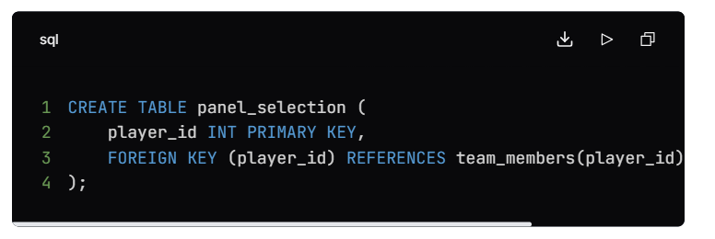
Snapshot

Slide 15
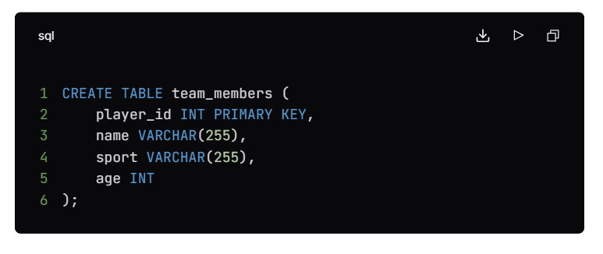
Snapshot

Slide 16
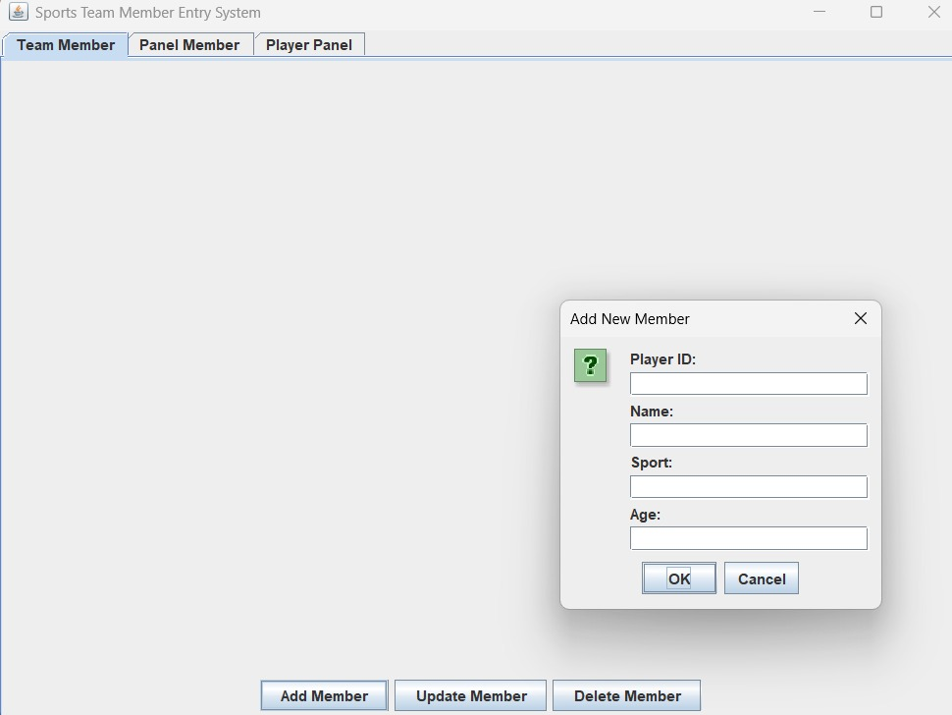
Snapshot

Slide 17
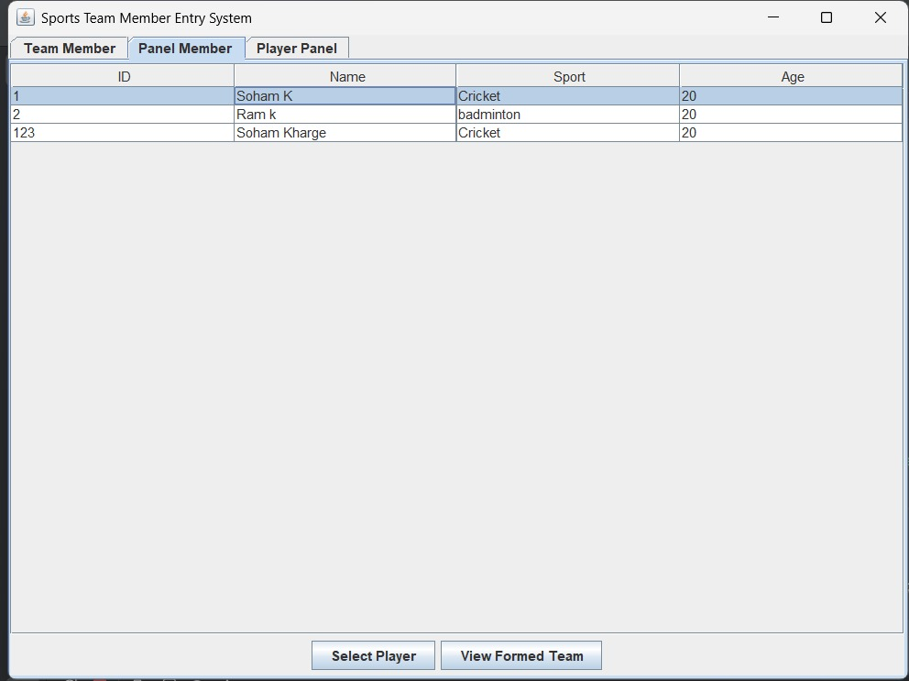
Snapshot

Slide 18
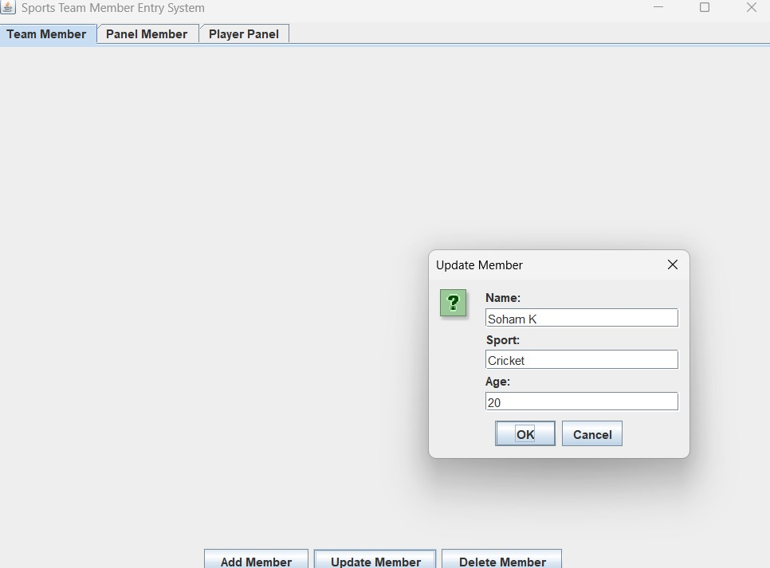
Snapshot

Slide 19
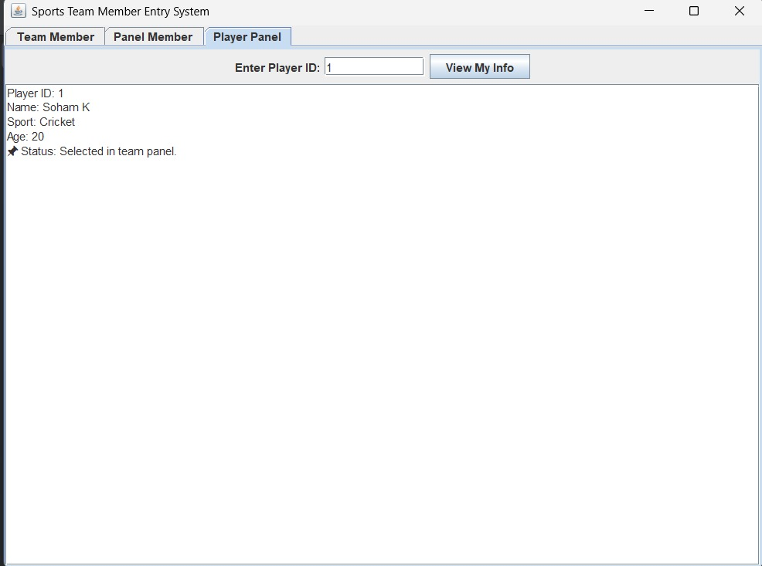
Snapshot

