Slide 1
Project name : Smart NUB Campus Presentation topic : Project overview
Project members:
1. Md. Sojib (1343)
2. Zeanur Rahaman Zeon (1652)
3. Md. Kamal Hossain (1353)

Slide 2
Introduction of the Project
NUB students were losing time and resources to scattered WhatsApp groups, broken Drive links, and disconnected chat apps — tools never designed for how students actually collaborate. Smart NUB Campus brings resource sharing, AI-powered study help, and student discussions into one verified platform, so finding notes or a study partner takes seconds, not days.

Slide 3
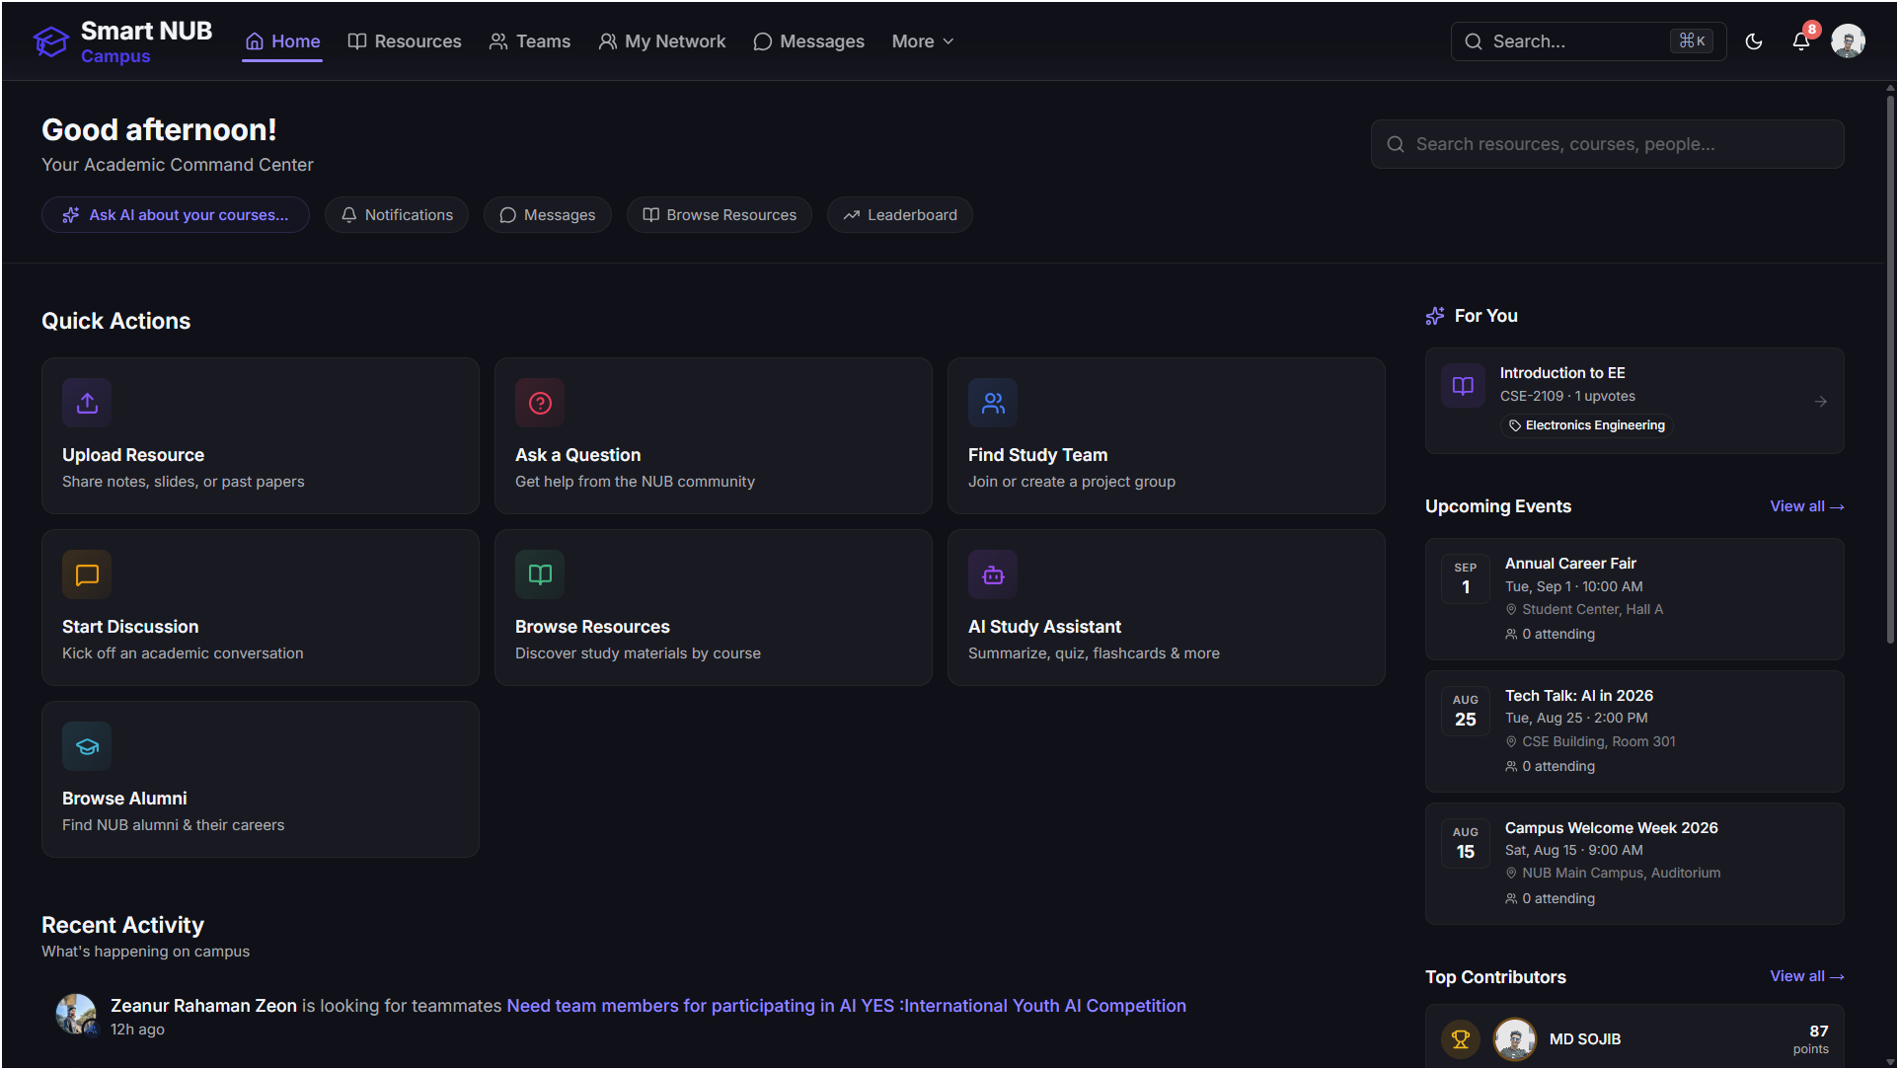
Home Page : A personalized "Academic Command Center" where students land after login — quick access to upload resources, ask questions, find study teams, and use the AI assistant, plus a live feed of campus events, top contributors, and recommended resources for their department.

Slide 4
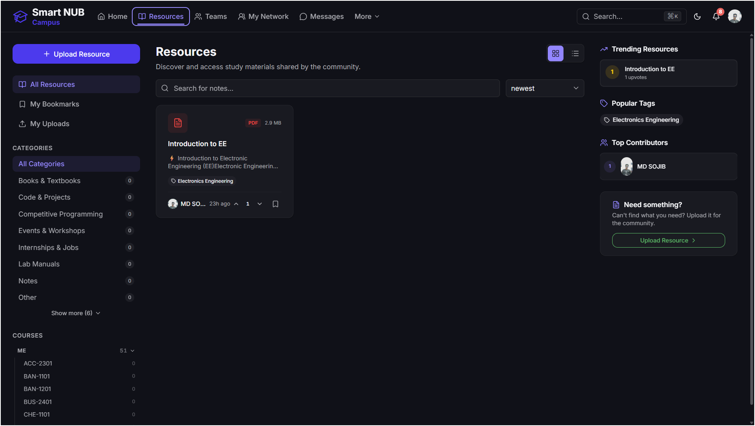
Resources Page : A central library of study materials — notes, books, past papers, and more — organized by category and course, with search, upvotes, and trending picks so students can quickly find or share what they need.

Slide 5
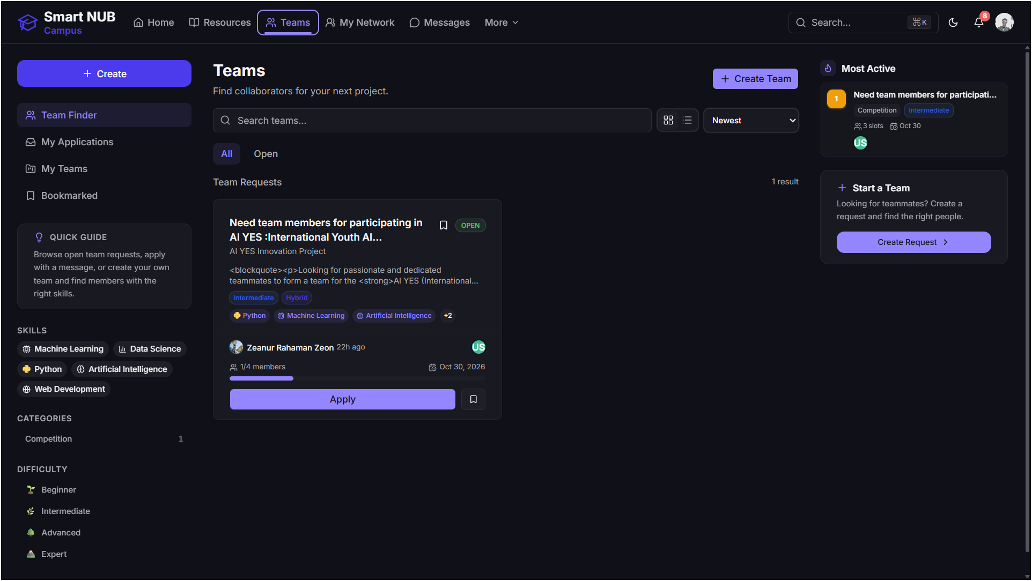
Team page : A space for students to find or start project teams — browse open requests by skill, difficulty, and category, then apply directly or post your own request to build the right team.

Slide 6
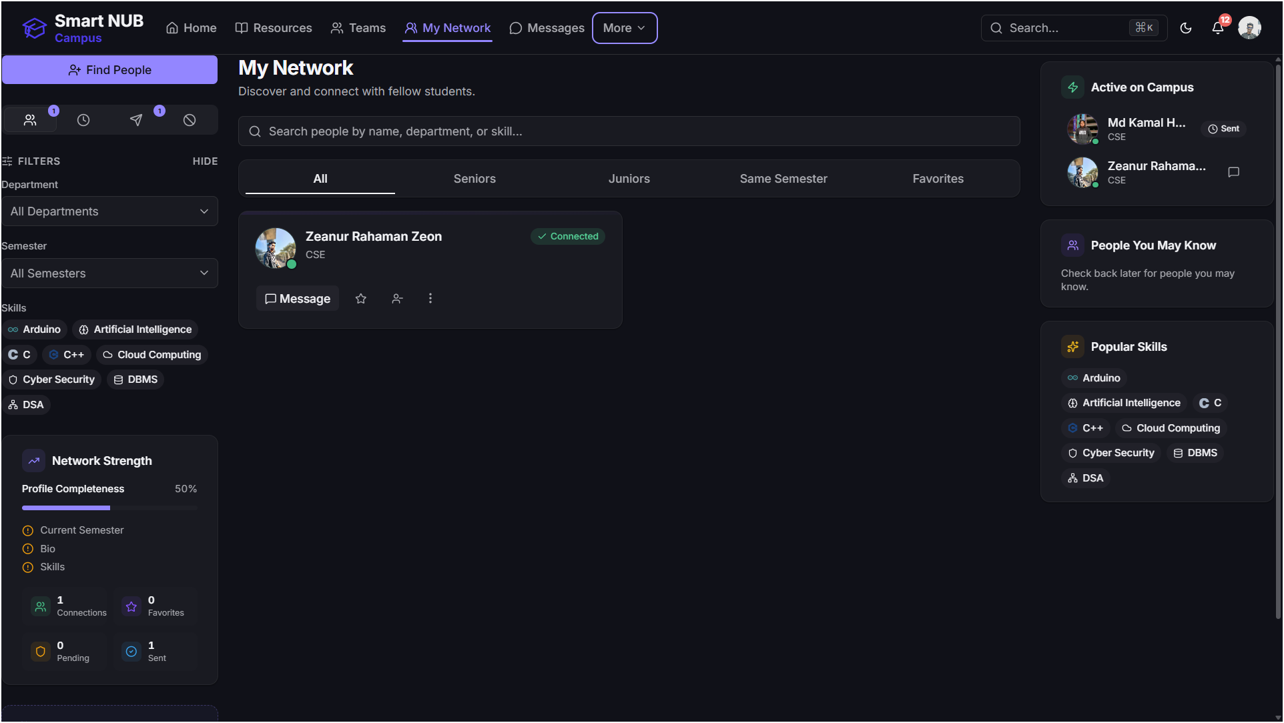
My Network Page : Where students discover and connect with peers — filter by department, semester, and skills to find the right classmates, track connection requests, and see who's active on campus.

Slide 7
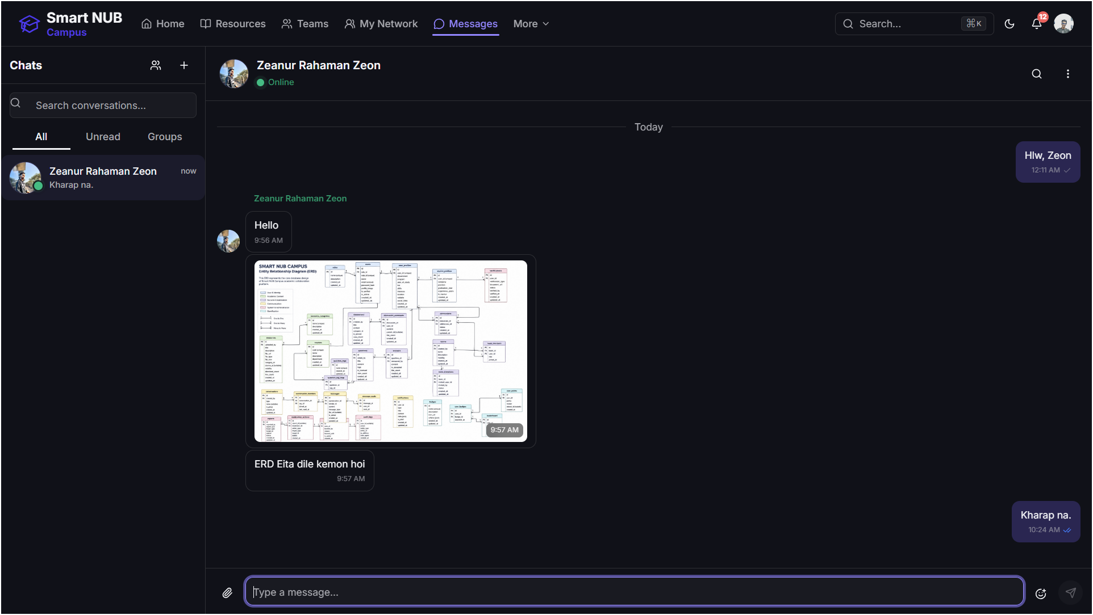
Messages Page : A built-in real-time chat where students message classmates and teammates directly — supporting one-on-one and group conversations, all in one place instead of scattered across outside apps.

Slide 8
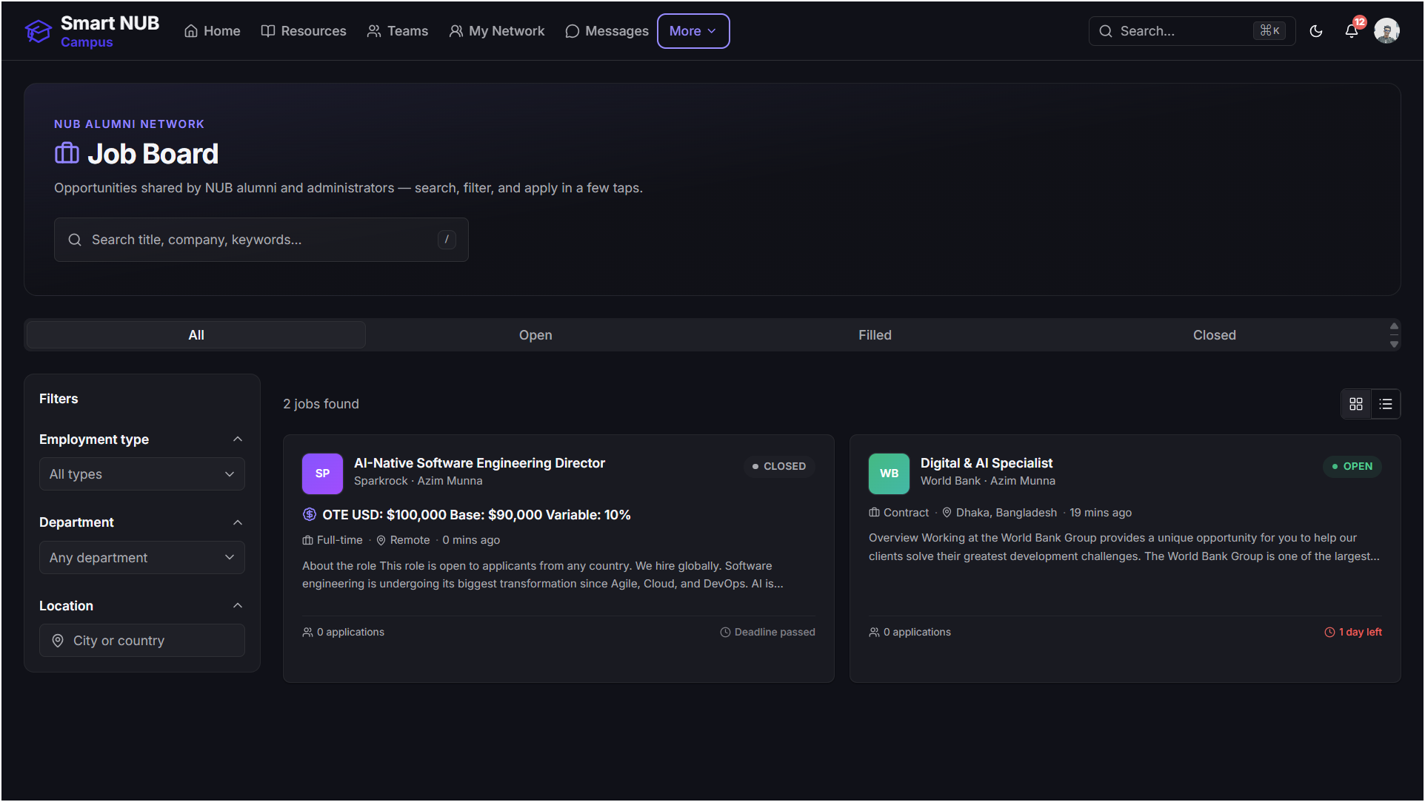
Job Board Page : A dedicated space where NUB alumni and admins post job and internship opportunities — students can search and filter by type, department, and location to find the right career openings.

Slide 9
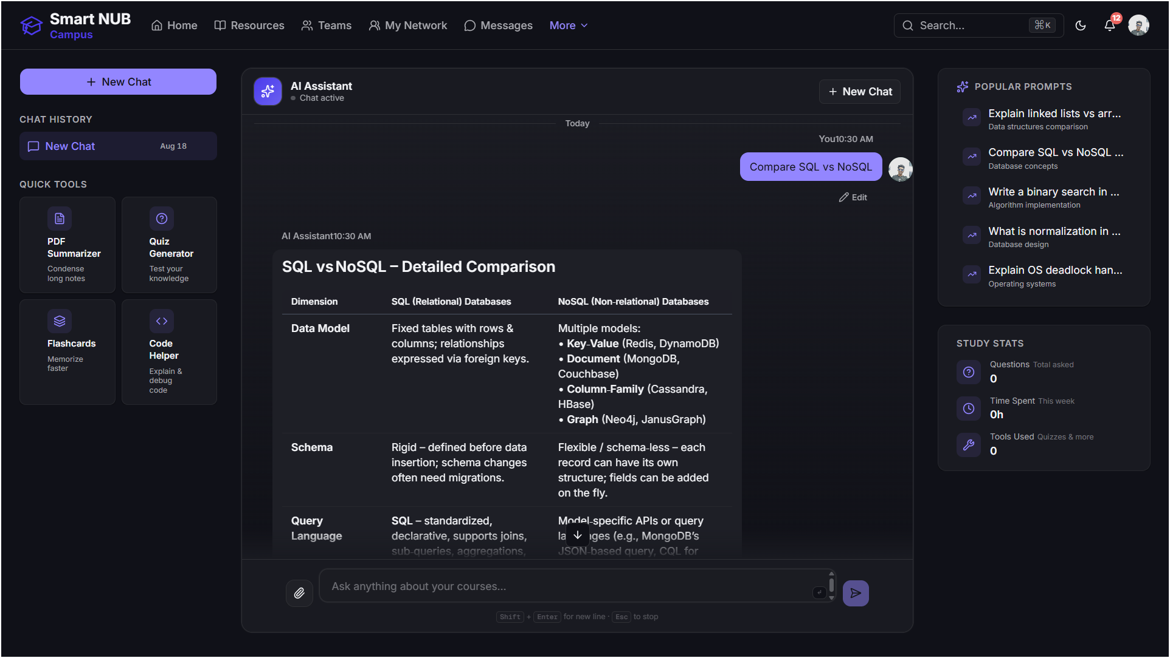
AI Assistant Page: A 24/7 study companion that explains concepts, summarizes notes, generates quizzes and flashcards, and helps debug code — with quick tools and popular prompts to get started instantly.

Slide 10
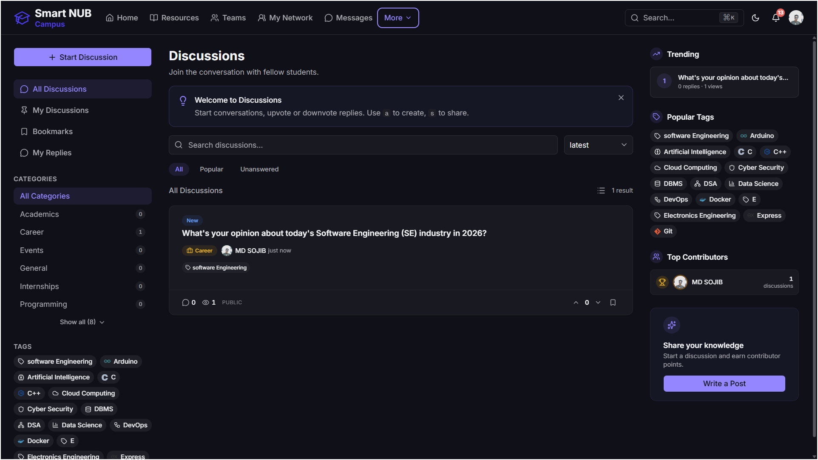
Discussions Page : An open Q&A space where students start conversations, ask academic or career questions, and get answers from peers — organized by category and tags, with contributor points to encourage sharing.

Slide 11
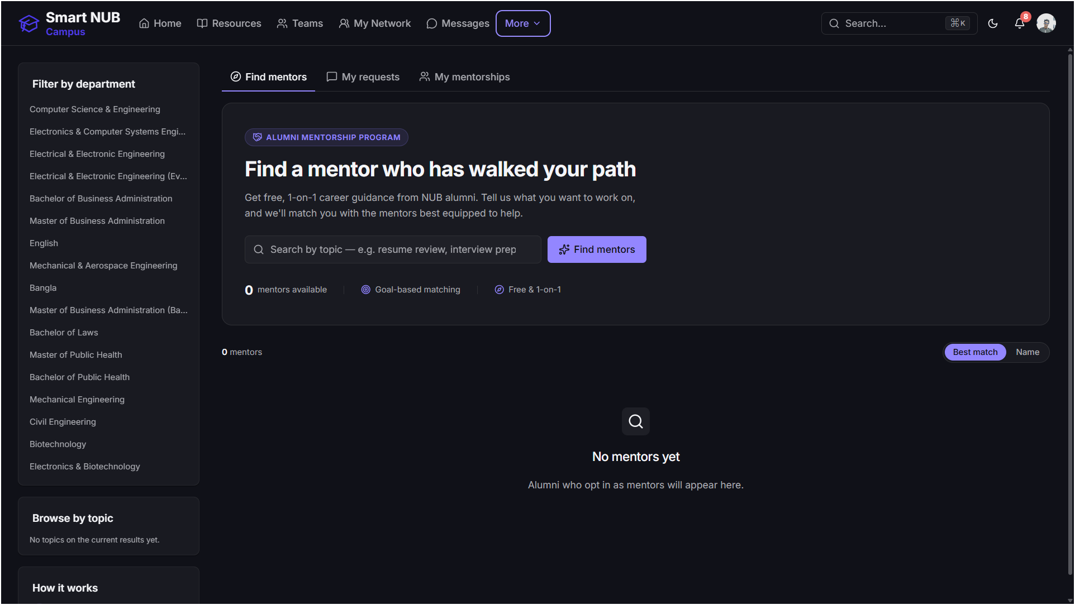
Mentorships Page : Connects students with NUB alumni for free, 1-on-1 career guidance — goal-based matching by topic and department, so students get advice from people who've walked the same path.

Slide 12
Thank You

