Slide 1




University of Milano – Bicocca
Department of Informatics Systems and Communication
Laboratory of Software Testing and Analysis
19th International Symposium On Software Reliability Engineering
Seattle/Redmond
Automated Identification of Failure Causes in System Logs
Leonardo Mariani and Fabrizio Pastore
www.lta.disco.unimib.it

Slide 2
Log File Analysis
Many software systems continuously store runtime data in log files
  application servers (JBoss, Tomcat), desktop applications (Eclipse), OSs…
In case of failures, logs are the main source of information to identify causes and locations of problems
Manual analysis is difficult and time-consuming:
  log files grow fast
    200.000 “page requests”/minute logged on eBay servers [Chen04]
  logged events are sometime hard to interpret
… unsetting current xid XidImpl[FormatId=257, GlobalId=null:1199/57, BranchQual=null:1199/1, localId=0:57…

Slide 3
Tool-Supported Log File Analysis
Compare logs with formal specifications of the expected behavior to identify illegal event sequences [Andrews00]
  extremely effective, but
  formal specifications are expensive to be generated and seldom available
Detect failures by comparing logs with specs of known problems
  limited to known problems
  depend on the log format
Use models inferred at testing time to identify failure causes
  several (almost) completely automated solutions: supervised learning [Chen04], clustering [Stearley04], sequences matching [Forrest98]
  limitations:
[LogSurfer08]
  event attributes are not considered,
  identify anomalous sequences of limited length and complexity
  strong dependency on the format of the logs

Slide 4
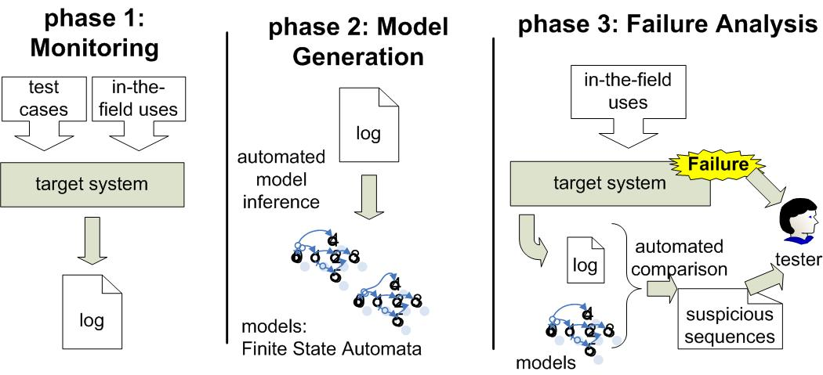
Automated Log File Analysis
overcomes many limitations of existing solutions:
  completely automated
  analyzes unknown file formats
handles concrete values and captures data flow information
Multi model approach to analyze same problems at different levels of granularity

Slide 5
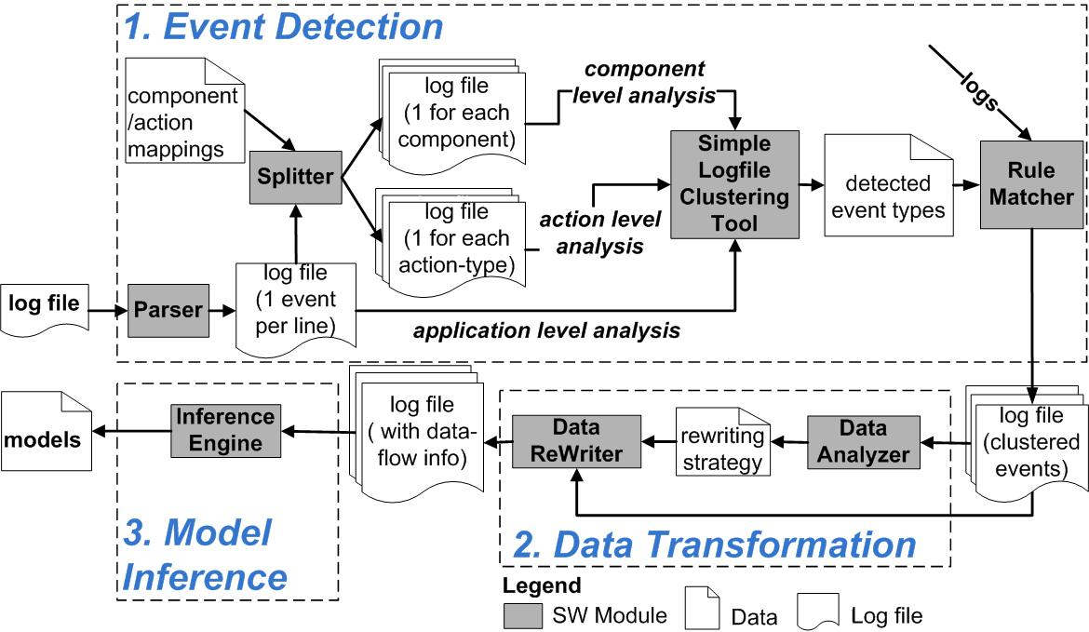
Phase 2: Model Generation

Slide 6
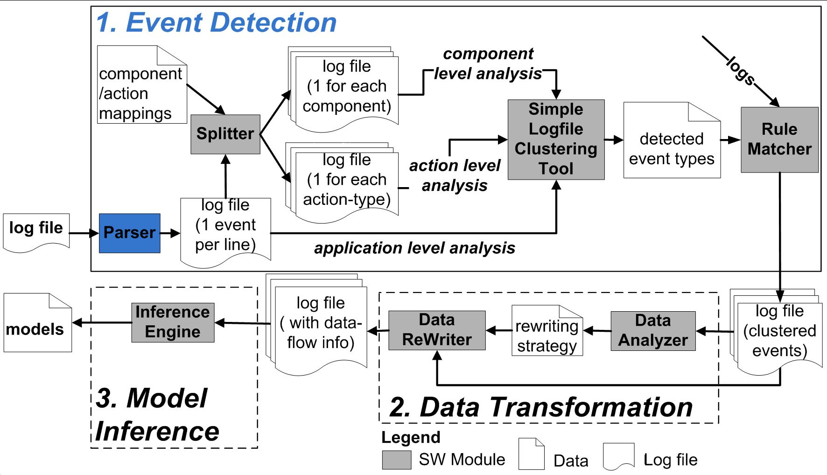
Parsing

Slide 7
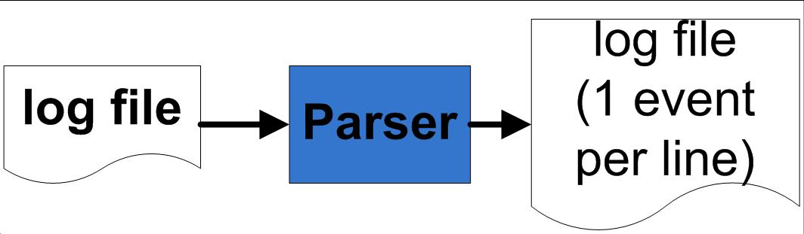
Parsing
Apr 23, 2008 11:49:50 PM org.apache.catalina.core.ContainerBase addChildInternal
FINE: Add child StandardHost[localhost] StandardEngine[Catalina]
Apr 23, 2008 11:49:50 PM org.apache.catalina.core.AprLifecycleListener initializeAPR
FINE: The Apache Tomcat Native library which allows optimal performance in production environments was not found on the java.library.path: /opt/jdk1.6.0_04/jre/lib/i386/server:/opt/jdk1.6.0_04/jre/lib/i386:/opt/jdk1.6.0_04/jre
java.lang.reflect.InvocationTargetException
at sun.reflect.NativeMethodAccessorImpl.invoke0(Native Method)‏
at sun.reflect.NativeMethodAccessorImpl.invoke(NativeMethodAccessorImpl.java:39)‏
at sun.reflect.DelegatingMethodAccessorImpl.invoke(DelegatingMethodAccessorImpl.java:25)‏
Apr 23, 2008 11:49:50 PM org.apache.catalina.core.ContainerBase addChildInternal FINE: Add child Standard...
Apr 23, 2008 11:49:50 PM org.apache.catalina.core.AprLifecycleListener initializeAPR FINE: The Apache….

Slide 8
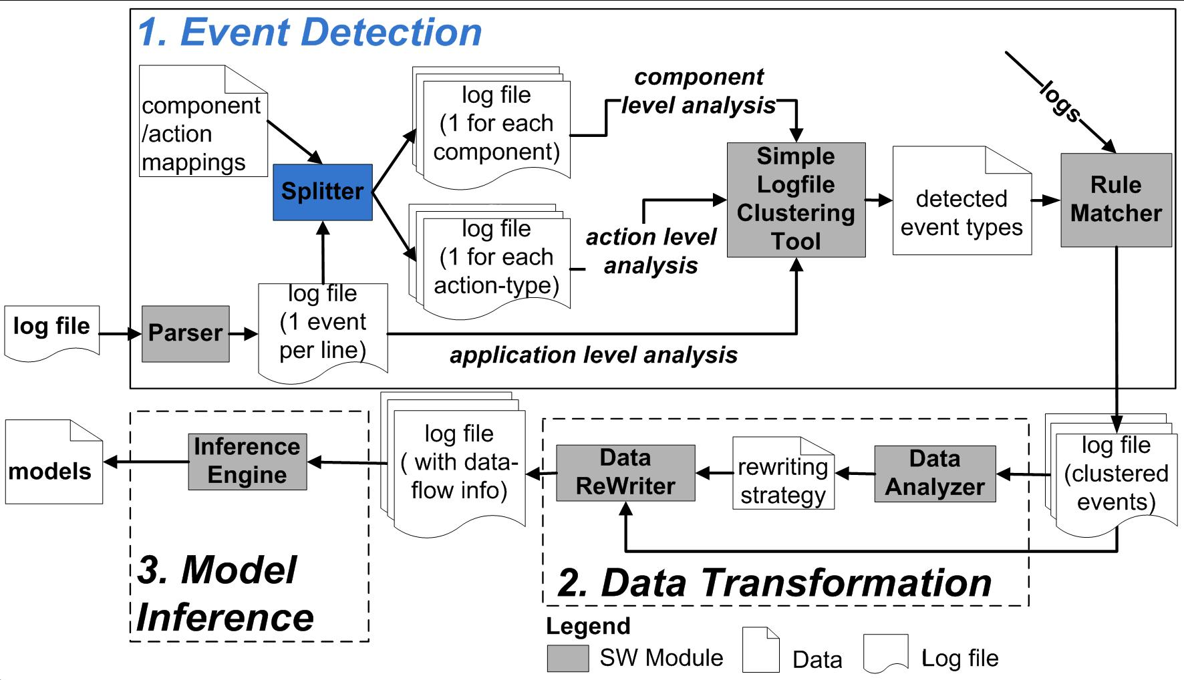
Splitting

Slide 9
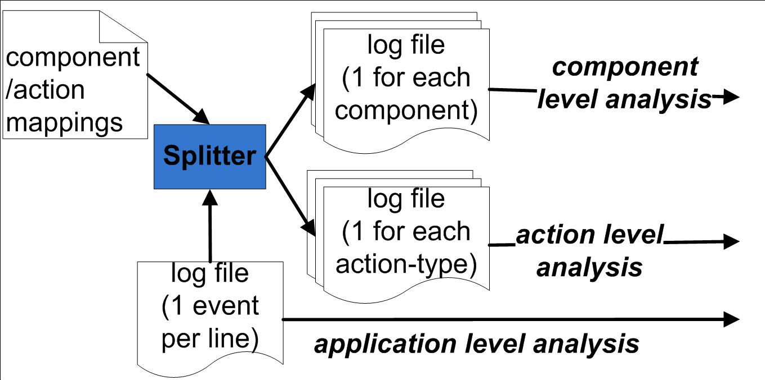
Splitting

Slide 10
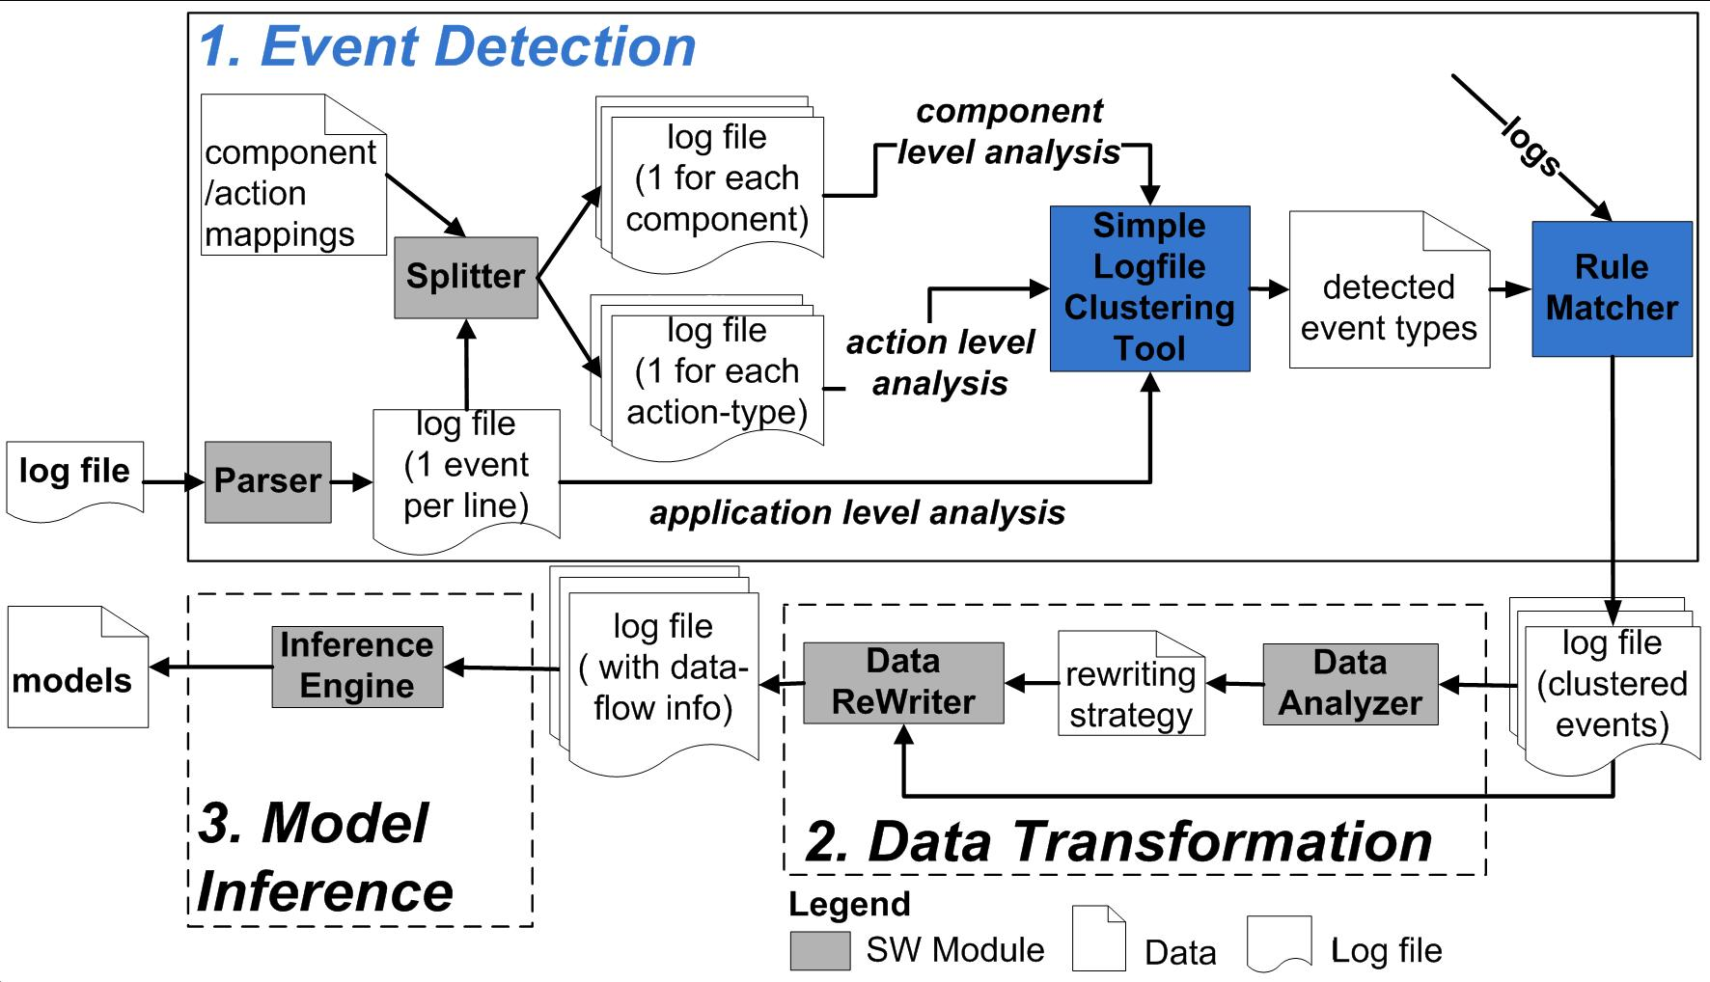
Event Name Detection

Slide 11
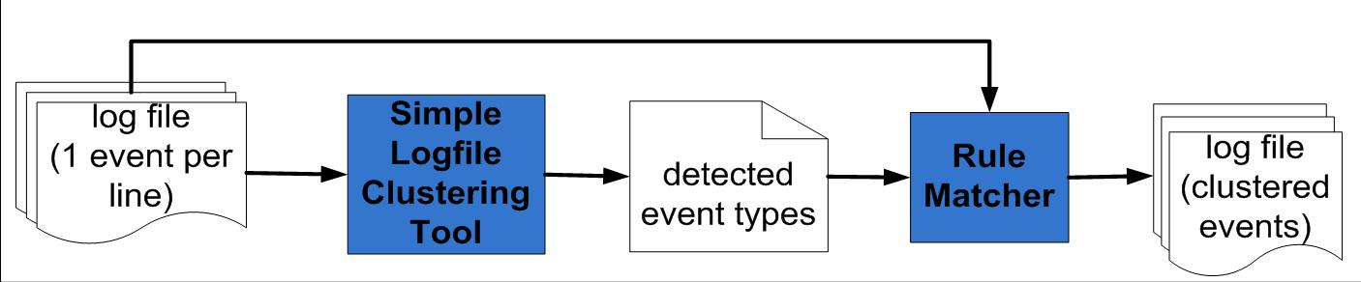
Event Name Detection
received page request from 10.0.1.3
login request for fabrizio (10.0.1.3)
user fabrizio logged in, IP 10.0.1.3
received page request from 10.0.1.5
login request for leonardo (10.0.1.5)
user leonardo logged in, IP 10.0.1.5

Slide 12
Event Name Detection
received page request from 10.0.1.3
login request for fabrizio (10.0.1.3)
user fabrizio logged in, IP 10.0.1.3
received page request from 10.0.1.5
login request for leonardo (10.0.1.5)
user leonardo logged in, IP 10.0.1.5
Simple Logfile Clustering Tool (SLCT) [Vaarandi03]
  Identifies frequent patterns (event structures)
  Generates corresponding regular expressions
  We rewrite the file according to the identified expressions (details in the paper)

Slide 13
Event Name Detection
received page request from 10.0.1.3
login request for fabrizio (10.0.1.3)
user fabrizio logged in, IP 10.0.1.3
received page request from 10.0.1.5
login request for leonardo (10.0.1.5)
user leonardo logged in, IP 10.0.1.5
received page request from 10.0.1.3
login request for fabrizio (10.0.1.3)
user fabrizio logged in, IP 10.0.1.3
received page request from 10.0.1.5
login request for leonardo (10.0.1.5)
user leonardo logged in, IP 10.0.1.5
Simple Logfile Clustering Tool (SLCT) [Vaarandi03]
  Identifies frequent patterns (event structures)
  Generates corresponding regular expressions
  We rewrite the file according to the identified expressions (details in the paper)

Slide 14
Event Name Detection
received page request from 10.0.1.3
login request for fabrizio (10.0.1.3)
user fabrizio logged in, IP 10.0.1.3
received page request from 10.0.1.5
login request for leonardo (10.0.1.5)
user leonardo logged in, IP 10.0.1.5
received page request from 10.0.1.3
login request for fabrizio (10.0.1.3)
user fabrizio logged in, IP 10.0.1.3
received page request from 10.0.1.5
login request for leonardo (10.0.1.5)
user leonardo logged in, IP 10.0.1.5
Simple Logfile Clustering Tool (SLCT) [Vaarandi03]
  Identifies frequent patterns (event structures)
  Generates corresponding regular expressions
  We rewrite the file according to the identified expressions (details in the paper)
received page request from *
login request for * (*)
user * logged in, IP *

Slide 15
Event Name Detection
received page request from 10.0.1.3
login request for fabrizio (10.0.1.3)
user fabrizio logged in, IP 10.0.1.3
received page request from 10.0.1.5
login request for leonardo (10.0.1.5)
user leonardo logged in, IP 10.0.1.5
Expr1,10.0.1.3
Expr2,fabrizio,10.0.1.3
Expr3,fabrizio,10.0.1.3
Expr1,10.0.1.5
Expr2,leonardo,10.0.1.5
Expr2,leonardo,10.0.1.5
Simple Logfile Clustering Tool (SLCT) [Vaarandi03]
  Identifies frequent patterns (event structures)
  Generates corresponding regular expressions
  We rewrite the file according to the identified expressions (details in the paper)
received page request from *
login request for * (*)
user * logged in, IP *

Slide 16
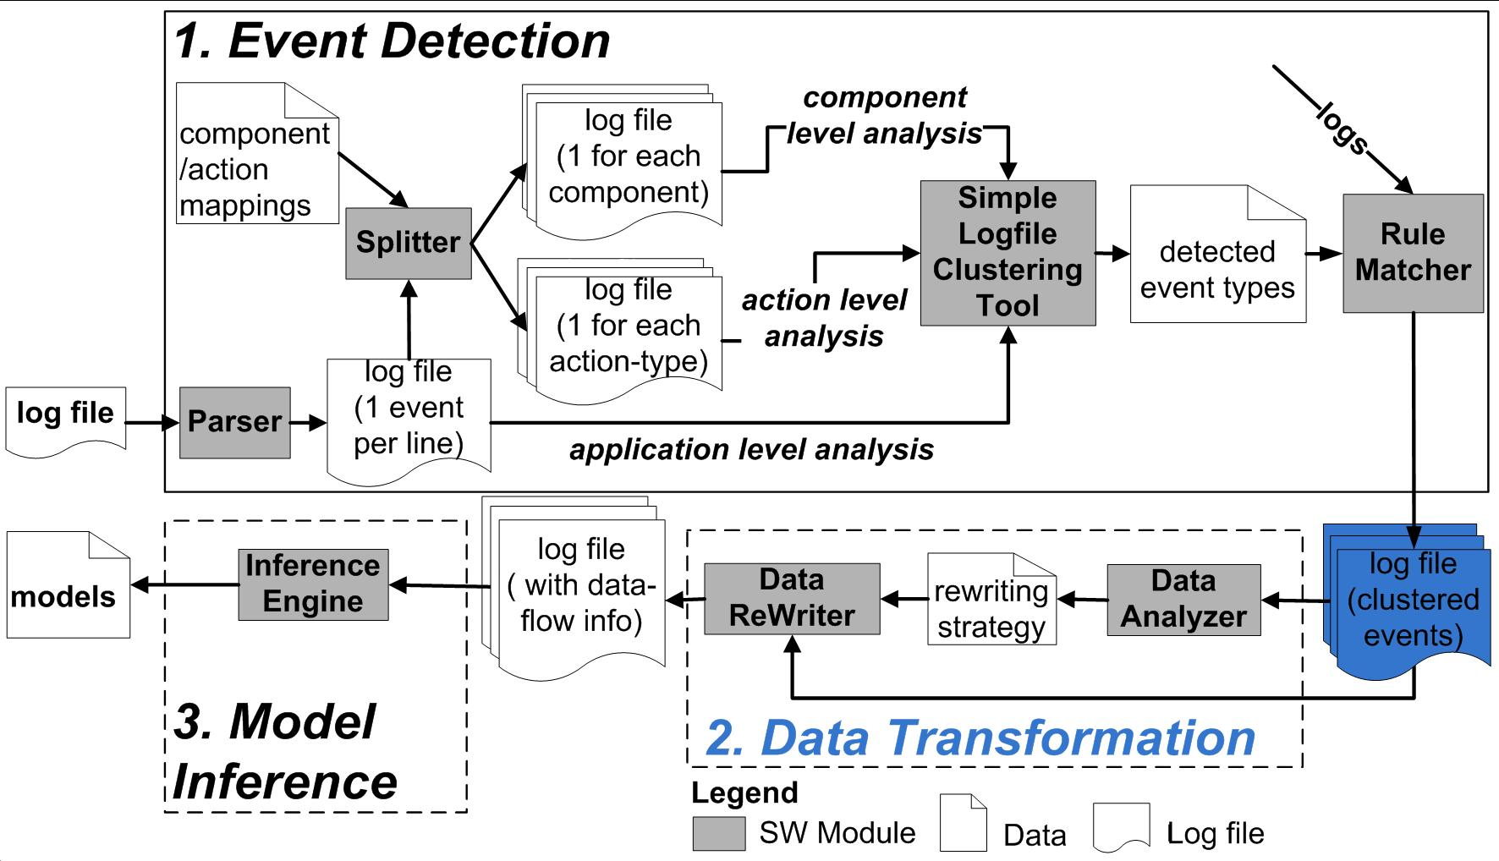
Data Rewriting

Slide 17
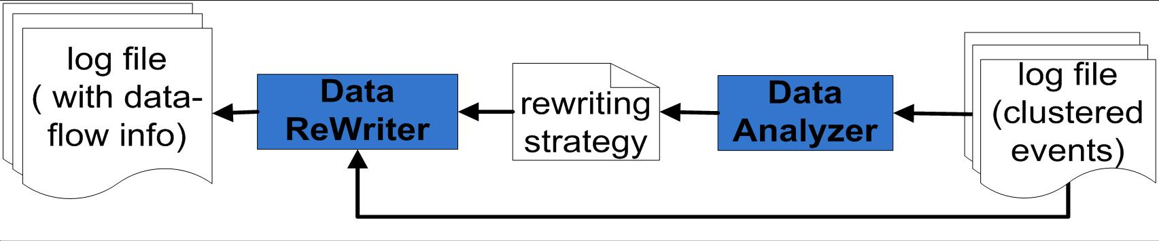
Data Rewriting

Slide 18
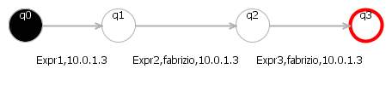
Data Rewriting
Expr1,10.0.1.3
Expr2,fabrizio,10.0.1.3
Expr3,fabrizio,10.0.1.3
Expr1,10.0.1.9
Expr2,mike,10.0.1.9
Expr3,mike,10.0.1.9
Inference
Comparison
Not matching
Legend:
Expr1=received page request from *
Expr2=login request for * (*)
Expr3=user * logged in, IP *
Three rewriting strategies:
  Global Ordering
  Relative to Initialization
  Relative to access
We automatically identify the strategy to apply. See the paper for details.

Slide 19
Rewriting Example
Expr1,10.0.1.3
Expr2,fabrizio,10.0.1.3
Expr3,fabrizio,10.0.1.3
Expr1,10.0.1.5
Expr2,leonardo,10.0.1.5
Expr3,leonardo,10.0.1.5
Expr1,0
Expr2,0,0
Expr3,0,0
Expr1,1
Expr2,1,1
Expr3,1,1
IP
Legend:
Expr1=page request from *
Expr2=login request * (*)
Expr3=user * logged in, *
User
Groups of semantically related values are rewritten individually
  e.g., rewriting strategies are individually applied to user names and ip addresses,

Slide 20
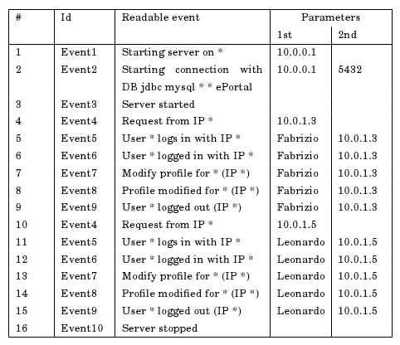
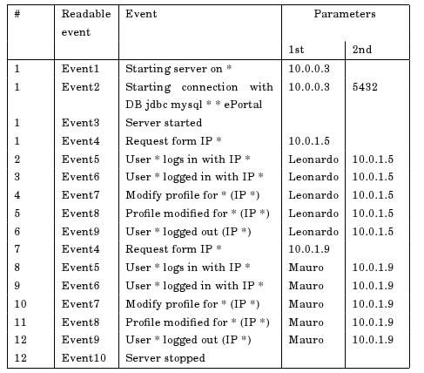
Global Ordering
Global Ordering replaces consistently concrete values with:
  Numbers respecting the order of appearance
User
Global Ordering replaces concrete values with:
  Numbers that respect the order of appearance

Slide 21
Global Ordering
Global Ordering replaces consistently concrete values with:
  Numbers respecting the order of appearance
User

Slide 22
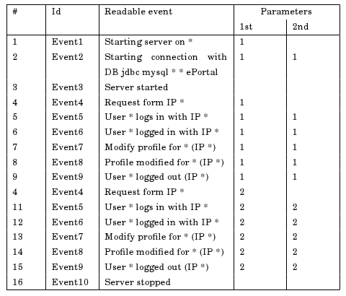
Global Ordering
Global Ordering replaces consistently concrete values with:
  Numbers respecting the order of appearance
User

Slide 23
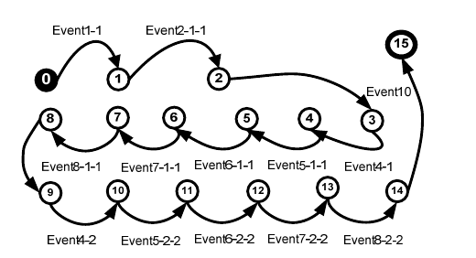
Global Ordering
Replaced values are then used to infer a model

Slide 24
Relative to Instantiation
Global Ordering does not capture patterns of values generation/usage
  Events 3-9 and 10-15 shows a repeated behavior
User

Slide 25
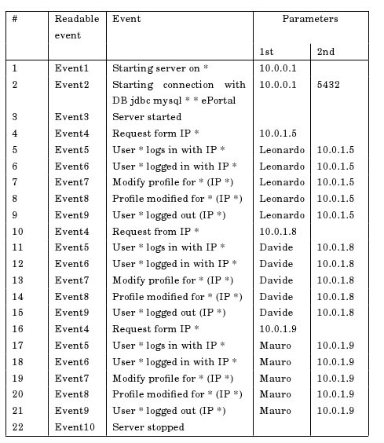
Relative to Instantiation
With Global Ordering sequences of arbitrary length cannot be matched
User
3
3
3
3
3
3
3
3
3
3
3

Slide 26
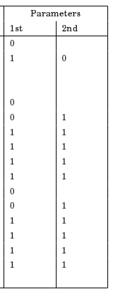
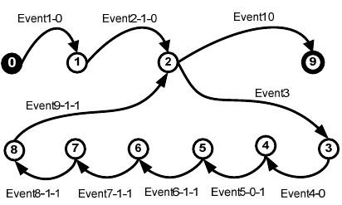
Relative to Instantiation
Relative to Instantiation replaces concrete values with
  0 if the value was never observed before
  N, if observed, where N=# introduced values after 1st occurrence + 1
User

Slide 27
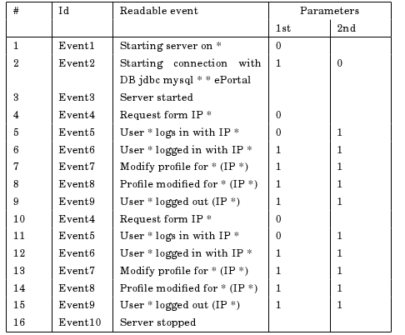
Relative to Instantiation
Inferred model captures the loop

Slide 28
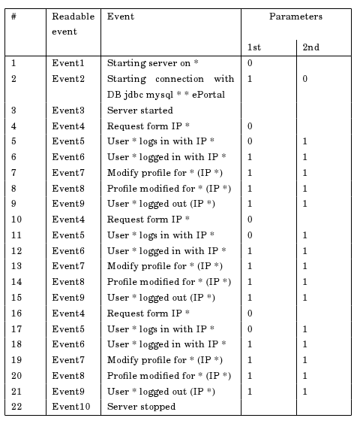
Relative to Instantiation
Sequences of arbitrary length can be matched

Slide 29
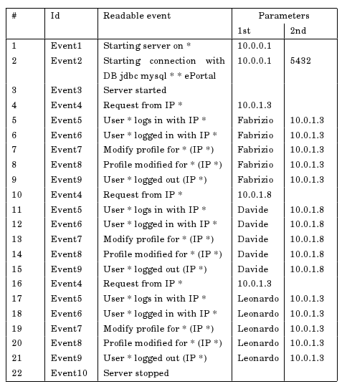
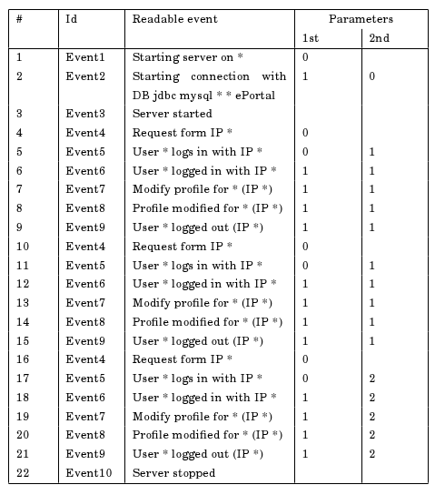
Relative to Instantiation
Relative to Instantiation does not capture patterns of reuse

Slide 30
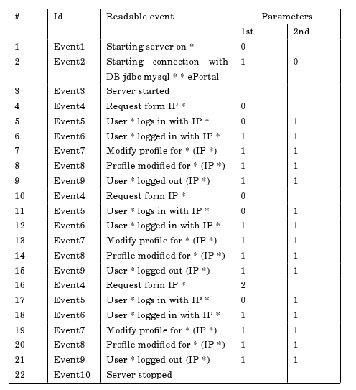
Relative to Access
Relative to access replaces concrete values with:
  0, if the value occurred for the first time (definition)
  N, if N events observed after the previous occurrence of the same value (use)

Slide 31
Relative to Access
Expr1,10.0.1.3
Expr2,fabrizio,10.0.1.3
Expr3,fabrizio,10.0.1.3
Expr1,10.0.1.5
Expr2,leonardo,10.0.1.5
Expr3,leonardo,10.0.1.5
Expr1,0
Expr2,0,1
Expr3,1,1
Expr1,0
Expr2,0,1
Expr3,1,1
IP
Legend:
Expr1=page request from *
Expr2=login request * (*)
Expr3=user * logged in, *
User
Relative to access replaces concrete values with:
  0, if the value occurred for the first time (definition)
  N, if N events observed after the previous occurrence of the same value (use)
Groups of semantically related values are rewritten individually
  e.g., rewriting strategies are individually applied to user names and ip addresses,

Slide 32
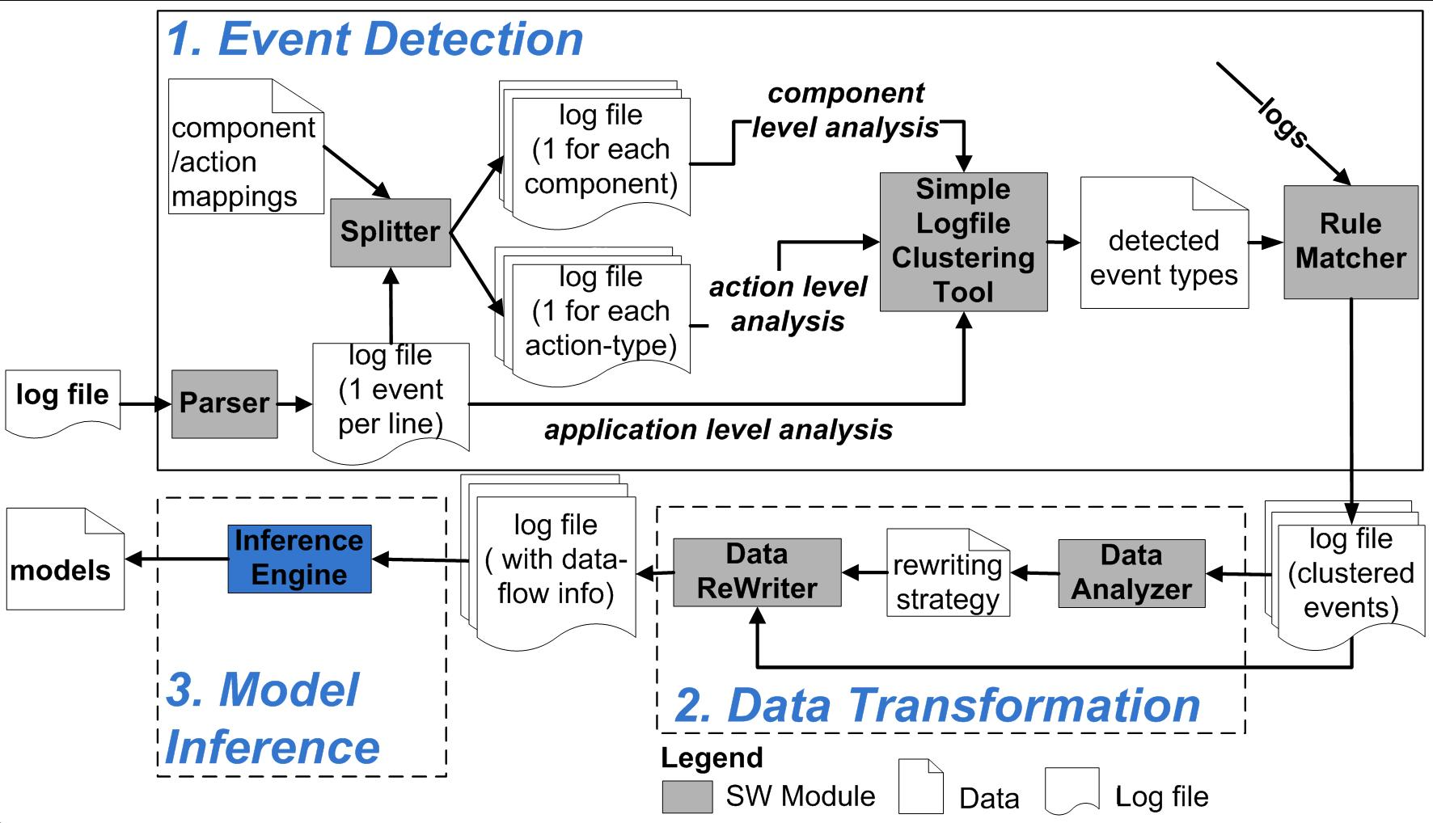
Model Inference

Slide 33
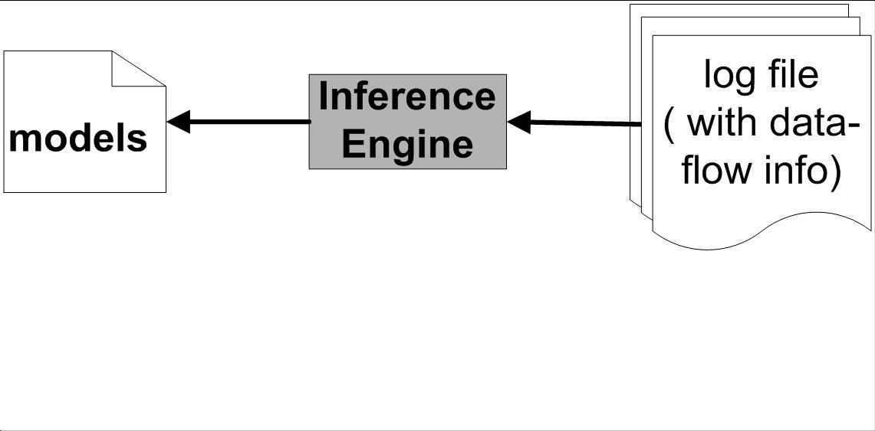
Model Inference

Slide 34
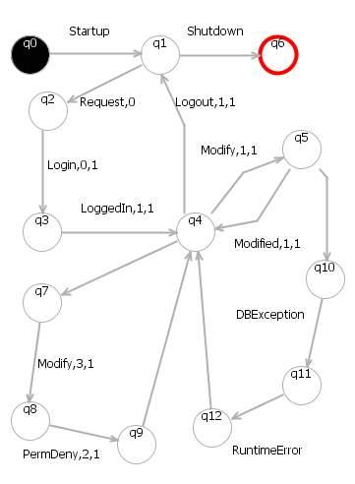
Model Inference
We use KBehavior [Mariani07] to infer Finite State Automata
  Reads the sequences of events in the log file
  Infers a model that generalizes the observed sequences
Startup
Request,0
LogIn,1,1
LoggedIn,1,1
Modify,1,1
Modified,1,1
Logout,1
Shutdown
Startup
Request,0
LogIn,0,1
LoggedIn,1,1
Modify,1,1
Modified,1,1
Modify,1,1
Modified,1,1
Logout,1
Shutdown
Startup
Request,0
LogIn,0,1
LoggedIn,1,1
Modify,1,1
Modified,1,1
Modify,1,1
Modified,1,1
Logout,1
Request,0
LogIn,0,1
LoggedIn,1,1
Modify,1,1
Modified,1,1
Logout,1
Shutdown

Slide 35
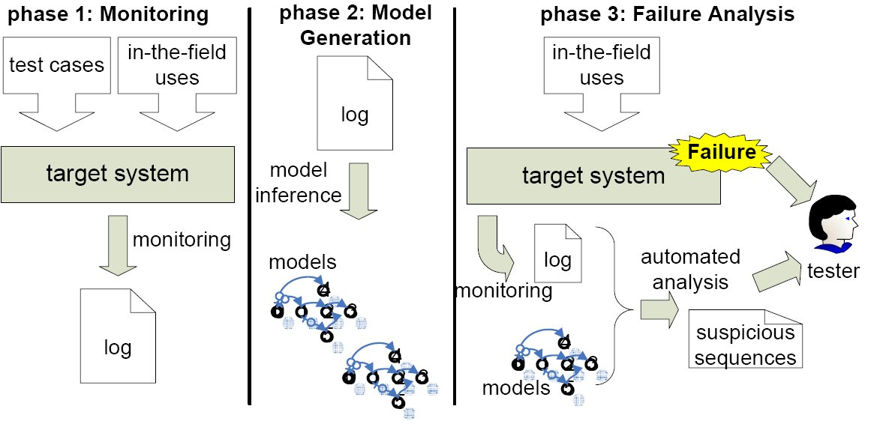
Phase 3: Failure Analysis
When a failure occurs, the log messages corresponding to the faulty execution are compared with the inferred models
  log messages are elaborated with the same strategies used to produce the models
  anomalous events are identified by extending the models with the log that represents the failed execution

Slide 36
Failure Analysis Example
Startup
Reqest 10.0.1.3
LogIn fabrizio (10.0.1.3)
LoggedIn fabrizio 10.0.1.3
Modify fabrizio (10.0.1.3)
Modified,fabrizio (10.0.1.5)
LogOut fabrizio (10.0.1.5)
Request 10.0.1.5
LogIn guest (10.0.1.5)
LoggedIn guest (10.0.1.5)
Modify fabrizio (10.0.1.5)
PermDeny guest (10.0.1.5)
Logout guest (10.0.1.5)
Request 10.0.1.7
LogIn leonardo (10.0.1.7)
LoggeIn leonardo (10.0.1.7)
Modify leonardo (10.0.1.7)
DBException
RuntimeError
Logout leonardo (10.0.1.7)
Shutdown
1
Startup
Request,0
LogIn,1,1
LoggedIn,1,1
Modify,1,1
Modified,1,1
Logout,1
Request,0
LogIn,0,1
LoggedIn,1,1
Modify,3,1
PermDeny,2,1
Logout,1,1
Request,0
LogIn,0,1
LoggedIn,1,1
Modify,1,1
DBException
RuntimeError
Logout,1,1
Shutdown
2
1
21
3
8
14
4
2
5
6
3
20
17
7
9
13
5
15
7
8
9
16
6
10
4
10
11
12
13
18
14
11
15
16
17
19
18
12
19
20
21

Slide 37
Validation
 | Case study | Failure type | Log format | Log size
A1 | CASS-Air traffic control simulator | Wrong system behavior | Syslog | 1Mb
G1 | GlassFish (version 2-GA) | Petstore not deployed | Uniform log | 1Mb
G2 | GlassFish (version 2-GA) | Petstore not deployed | Uniform log | 84Mb
G3 | GlassFish (version 3-b01) | Server hangs | Uniform log | 47Mb
T1 | Tomcat (version 6.0.4) | Web application not started | Java simple log | 17Mb
Validate effectiveness of the technique
  We analyzed 5 faults in 3 open source and commercial applications
  At testing time, we collected logs for the successful executions
  We inferred models and we investigated failure causes
  Different granularity levels have been used to empirically investigate our technique

Slide 38
Results
 | Component level analysis |  |  |  | Action level analysis |  |  |  | Application level analysis
Case study | Reported Events | FP | TP | Precision | Reported Events | FP | TP | Precision | Reported Events | FP | TP | Precision
A1 | 1.88% | 9 | 3 | 0.25 | - | - | - | - | 1.73% | 5 | 7 | 0,64
G1 | 28.57% | 3 | 5 | 0,63 | 28.25% | 0 | 5 | 1.00 | 3.57% | 1 | 0 | 0.00
G2 | 0.03% | 17 | 10 | 0.37 | 0.05% | 37 | 8 | 0.18 | 0.05% | 34 | 7 | 0.17
G3 | 0.04% | 44 | 13 | 0.16 | 0.07% | 79 | 10 | 0.11 | 0.03% | 39 | 7 | 0.15
T1 | 1.07% | 6 | 12 | 0,67 | 1.25% | 16 | 5 | 0.24 | 2.79% | 4 | 8 | 0,67
Reduction of the analysis effort:
  Only from 0.03% to 28.57% of events to inspect
All analyses levels have been effective in the 5 case studies
However, each analysis technique is more effective with a specific type of fault:
  Component level analysis is effective when unexpected events are generated by a single component
  Action level analysis is effective when unexpected events are observed during the execution of a single user action
  Application level analysis is effective when unexpected events are generated by multiple components/user-actions

Slide 39
Data Flow and Scalability
Case study | Granularity | TP | TP using DF data | num FSA | avg states | avg trans | avg symbols
A1 | application | 7 | 7 (100%) | 1 | 338 | 373 | 117
G1 | action | 5 | 0 (0%) | 2 | 84 | 130 | 74
G2 | component | 10 | 2 (20%) | 67 | 23 | 56 | 19
G3 | component | 13 | 2 (15%) | 41 | 8 | 27 | 9
T1 | component | 11 | 7 (64%) | 37 | 32 | 76 | 47
Legend:
FP false positives
TP true positives
TP using DFdata TP detected by using data flow information
num FSA number of FSA
avg states, trans, symbols average number
of states, transitions, symbols
A relevant percentage of the unexpected events have been identified by using data-flow information
Experiments demonstrates technique’s scalability
  we effectively identified unexpected events by using FSA with more than 300 states and transitions

Slide 40
Conclusions
Automated log analysis technique
  Detects anomalous sequences of events
  Identifies unexpected data flows
  Processes unknown log formats
  Multi-model analysis: same problems analyzed from different perspectives
Empirical work shows
  Effectiveness of the technique
  Scalability
  Relevance of data flow information
Future work
  Extending empirical work with comparative studies

Slide 41
Q&A

Slide 42
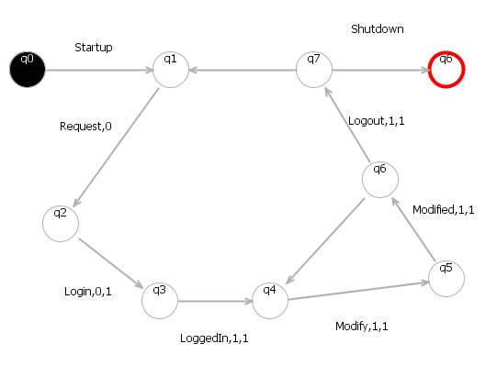
Model Inference
Configuration parameter
K=min number
of events
to match
Startup
Request,0
LogIn,1,1
LoggedIn,1,1
Modify,1,1
Modified,1,1
Logout,1
Shutdown

Slide 43
Model Inference
Configuration parameter
K=min number
of events
to match
Startup
Request,0
LogIn,1,1
LoggedIn,1,1
Modify,1,1
Modified,1,1
Logout,1
Shutdown

Slide 44
Model Inference
Configuration parameter
K=min number
of events
to match
Startup
Request,0
LogIn,1,1
LoggedIn,1,1
Modify,1,1
Modified,1,1
Logout,1
Shutdown

Slide 45
Model Inference
Configuration parameter
K=min number
of events
to match
Startup
Request,0
LogIn,1,1
LoggedIn,1,1
Modify,1,1
Modified,1,1
Logout,1
Shutdown

Slide 46
Model Inference: extend the model
New Valid Trace
Startup
Request,0
LogIn,1,1
LoggedIn,1,1
Logout,1
Request,0
LogIn,0,1
LoggedIn,1,1
Modify,1,1
Modified,1,1
Modify,1,1
Modified,1,1
Logout,1
Shutdown

Slide 47
Model Inference
Startup
Request,0
LogIn,1,1
LoggedIn,1,1
Modify,1,1
Modified,1,1
Modify,1,1
Modified,1,1
Logout,1
Shutdown

Slide 48
Model Inference
Startup
Request,0
LogIn,1,1
LoggedIn,1,1
Modify,1,1
Modified,1,1
Modify,1,1
Modified,1,1
Logout,1
Shutdown

Slide 49
Model Inference
Startup
Request,0
LogIn,1,1
LoggedIn,1,1
Modify,1,1
Modified,1,1
Modify,1,1
Modified,1,1
Logout,1
Shutdown

Slide 50
Model Inference
Startup
Request,0
LogIn,1,1
LoggedIn,1,1
Modify,1,1
Modified,1,1
Modify,1,1
Modified,1,1
Logout,1
Shutdown

Slide 51
Model Inference
Startup
Request,0
LogIn,1,1
LoggedIn,1,1
Modify,1,1
Modified,1,1
Modify,1,1
Modified,1,1
Logout,1
Request,0
LogIn,1,1
LoggedIn,1,1
Modify,1,1
Modified,1,1
Logout,1
Shutdown

Slide 52
Model Inference
Startup
Request,0
LogIn,1,1
LoggedIn,1,1
Modify,1,1
Modified,1,1
Modify,1,1
Modified,1,1
Logout,1
Request,0
LogIn,1,1
LoggedIn,1,1
Modify,1,1
Modified,1,1
Logout,1
Shutdown

Slide 53
Model Inference
Startup
Request,0
LogIn,1,1
LoggedIn,1,1
Modify,1,1
Modified,1,1
Modify,1,1
Modified,1,1
Logout,1
Request,0
LogIn,1,1
LoggedIn,1,1
Modify,1,1
Modified,1,1
Logout,1
Shutdown

Slide 54
Model Inference
Startup
Request,0
LogIn,1,1
LoggedIn,1,1
Modify,1,1
Modified,1,1
Modify,1,1
Modified,1,1
Logout,1
Request,0
LogIn,1,1
LoggedIn,1,1
Modify,1,1
Modified,1,1
Logout,1
Shutdown

Slide 55
Model Inference
Startup
Request,0
LogIn,1,1
LoggedIn,1,1
Modify,1,1
Modified,1,1
Modify,1,1
Modified,1,1
Logout,1
Request,0
LogIn,1,1
LoggedIn,1,1
Modify,1,1
Modified,1,1
Logout,1
Shutdown

Slide 56
Minimization: NFA->DFA

Slide 57
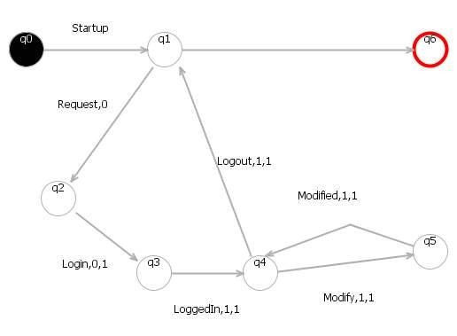
Minimization: DFA

Slide 58
References
[Chen04] M. Chen, A. Zheng, J. Lloyd, M. Jordan, and E. Brewer.Failure diagnosis using decision trees. In Proceedings of the International Conference on Autonomic Computing, 2004.
[Forrest98] S. A. Hofmeyr, S. Forrest, and A. Somayaji. Intrusion detection using sequences of system calls. Journal of Computer Security, 6(3):151–180, 1998.
[Mariani07] L. Mariani and M. Pezzè. Dynamic detection of COTS components incompatibility. IEEE Software, 24(5):76–85, 2007.
[Stearley04] J. Stearley. Towards informatic analysis of syslogs. In Proceedings of the 2004 IEEE International Conference on Cluster Computing, 2004.
[Vaarandi03] R. Vaarandi. A data clustering algorithm for mining patterns from event logs. In Proceedings of the 3rd IEEE Workshop on IP Operations and Management, 2003.

Slide 59
Splitting
Partitioning logs according to three granularity levels:
  Component level
    Required input: events include the name of the component that generated them
    Output: a log file for each component
  Action level
    Required input: events include the name of the user action that is under execution
    Output: a log file for each user action
  Application level
    No required inputs
    Output: a unique log file for the whole application (the log file is unchanged)

Slide 60
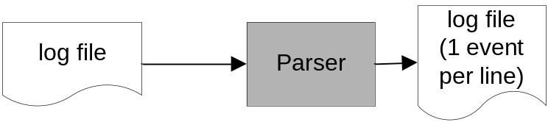
Parsing
Obtain a log file with one event per single line
Apr 23, 2008 11:49:50 PM org.apache.catalina.core.ContainerBase addChildInternal
FINE: Add child StandardHost[localhost] StandardEngine[Catalina]
Apr 23, 2008 11:49:50 PM org.apache.catalina.core.AprLifecycleListener initializeAPR
FINE: The Apache Tomcat Native library which allows optimal performance in production environments was not found on the java.library.path: /opt/jdk1.6.0_04/jre/lib/i386/server:/opt/jdk1.6.0_04/jre/lib/i386:/opt/jdk1.6.0_04/jre/../lib/i386:/usr/java/packages/lib/i386:/lib:/usr/lib
java.lang.reflect.InvocationTargetException
at sun.reflect.NativeMethodAccessorImpl.invoke0(Native Method)‏
at sun.reflect.NativeMethodAccessorImpl.invoke(NativeMethodAccessorImpl.java:39)‏
at sun.reflect.DelegatingMethodAccessorImpl.invoke(DelegatingMethodAccessorImpl.java:25)‏
at java.lang.reflect.Method.invoke(Method.java:597)‏
Apr 23, 2008 11:49:50 PM org.apache.catalina.core.ContainerBase addChildInternal FINE: Add child StandardHost[localhost] StandardEngine[Catalina]
Apr 23, 2008 11:49:50 PM org.apache.catalina.core.AprLifecycleListener initializeAPR FINE: The Apache Tomcat Native library which allows optimal performance in production environments was not found on the java.library.path: /opt/jdk1.6.0_04/jre/lib/i386/server:/opt/jdk1.6.0_04/jre/lib/i386:/opt/jdk1.6.0_04/
jre/../lib/i386:/usr/java/packages/lib/i386:/lib:/usr/lib java.lang.reflect.InvocationTargetException at sun.reflect.NativeMethodAccessorImpl.invoke0(Native Method)‏ at sun.reflect.NativeMethodAccessorImpl.invoke(NativeMethodAccessorImpl.java:39)‏ at un.reflect.DelegatingMethodAccessorImpl.invoke(Delegating
MethodAccessorImpl.java:25)‏ at java.lang.reflect.Method.invoke(Method.java:597)‏

Slide 61
Data Analysis
Data transformation strategies capture different aspects
  Global Ordering, optimal in case few distinct values appear in logs
  Relative to Initialization, optimal if values are reused few times
  Relative to Access, best if values are reused multiple times
We automatically identify the best rewriting strategy for each data-flow cluster
  Apply all the strategies
  Select the one that produces the less number of symbols to rewrite 50% of log event, i.e., we select the technique that captures most regularity in a data-flow cluster
  If more than X abstract symbols are identified, attribute values are discarded, i.e., we discard attribute values when the best rewriting technique does not capture enough regularity

Slide 62
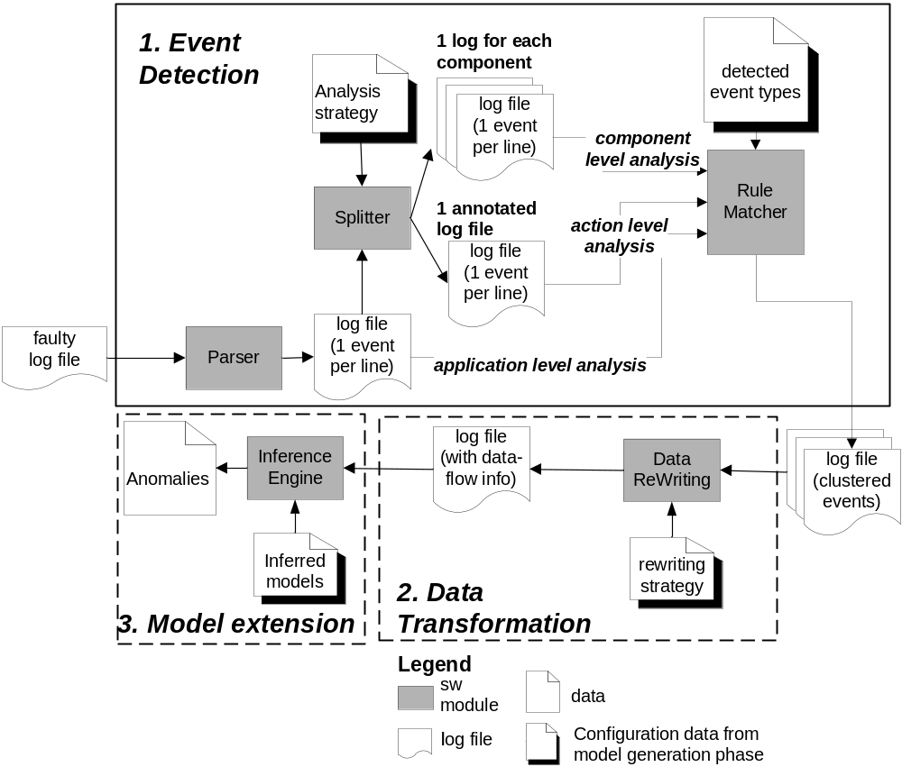
Failure Analysis
When a failure occurs, the log file is compared with the inferred models
Derive a parsed log
  Repeat preprocessing
  steps applied in
  model generation phase
  Use same detection/transformation criteria
Identify anomalies by extending the given models

Slide 63
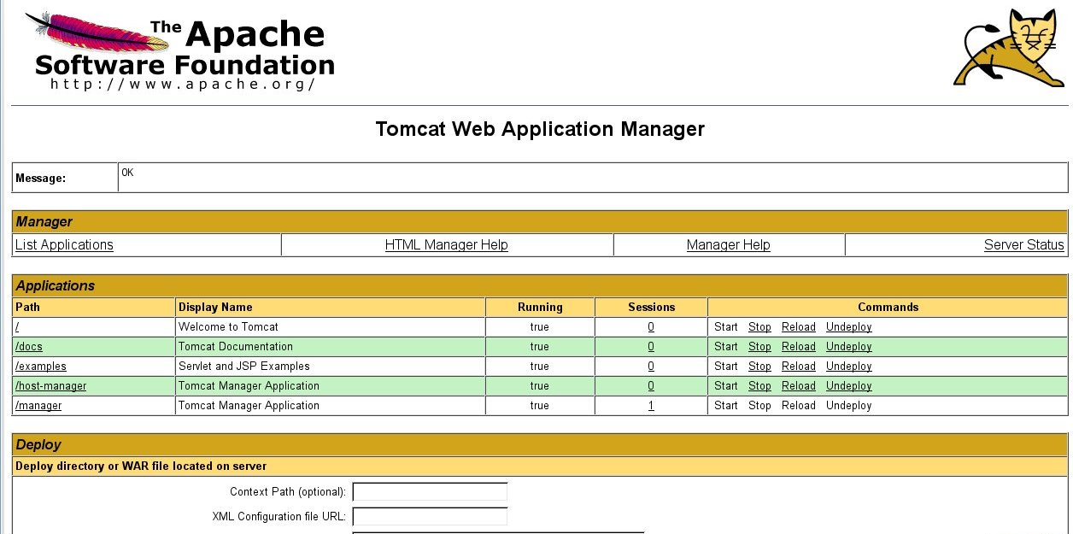
Tomcat: up and running
Laboratory of Test and Analysis

Slide 64
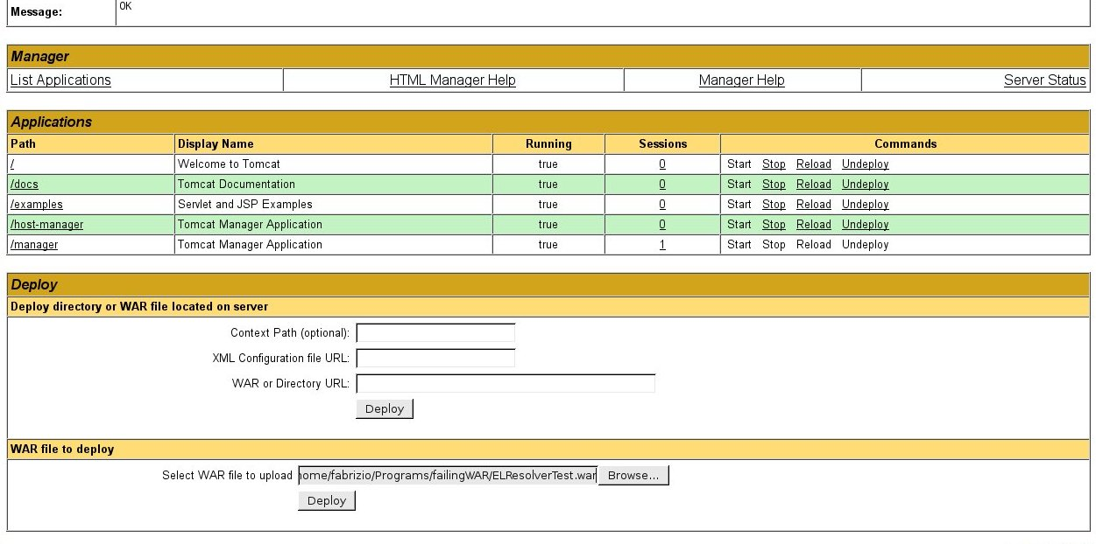

Slide 65
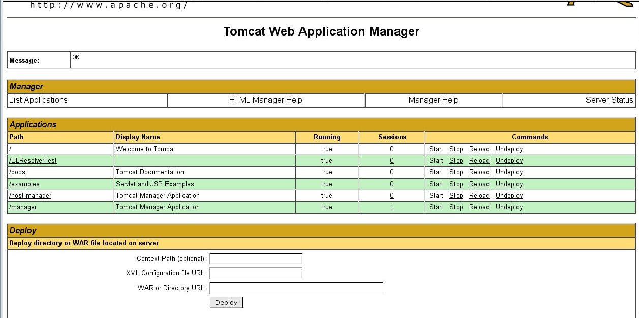

Slide 66
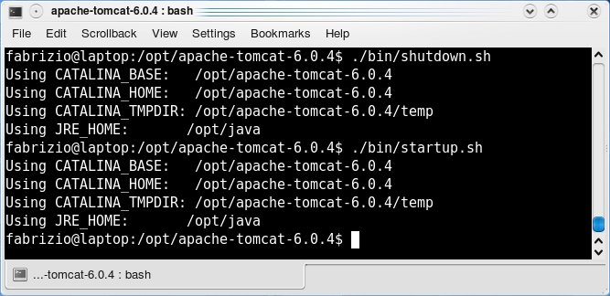

Slide 67
Manual inspaction

