Slide 1
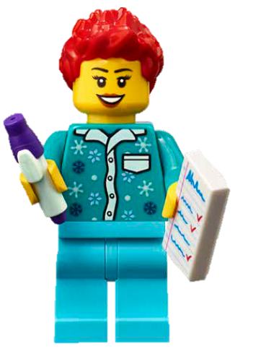

Session 4
Theater Technology

Slide 2
Guiding Questions
Can you build and code the LEGO model using motor blocks?
How do you change the program so the LEGO model moves in a different way?
Outcomes
The team will build the LEGO® model from the lesson and explore motor coding blocks.
The team will identify creative ways stages are used in a theater.
What kind of technology is used in a theater?
Can you add something to your model so it looks like a stage?
Can you modify the program to make it rotate every 10 seconds?
What will your team feature on the stage?
Notes:
Each session has Guiding Questions that can be shared to frame the session.
Session Tips
Walk the team through how to access their appropriate lesson in the app.
If your team is new to coding, you could have them complete the getting started tutorials.
The team will only use their LEGO Education SPIKE™ Essential set for this session. They won’t use anything from the Explore set or Explore model.
​The team will determine how to change motor direction and motor speed.
Teams should use pieces from the SPIKE™ Essential set to build their stage.
Teams can use the minifigures found in the SPIKE Essential set.

Slide 3



Introduction – Let’s Innovate
Examples of Innovation
Ask the students to provide examples of Innovation and record them here
Example of Innovation
Example of Innovation
We used creativity and persistence to solve problems.
Extension
Notes:
Introduction - Let’s Innovate (5-10 minutes)
Read the definition for innovation to the team. (see TMG page 5)
Talk about what innovation is. Have the team provide examples of this Core Value.
Extension: Have everyone draw a picture of an example of innovation on the Core Values page in their Engineering Notebook.

Slide 4
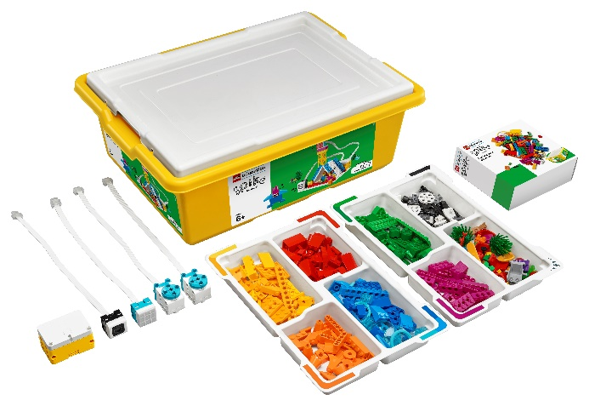

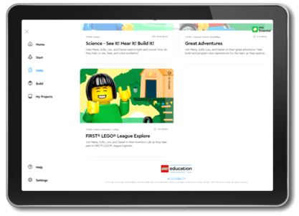
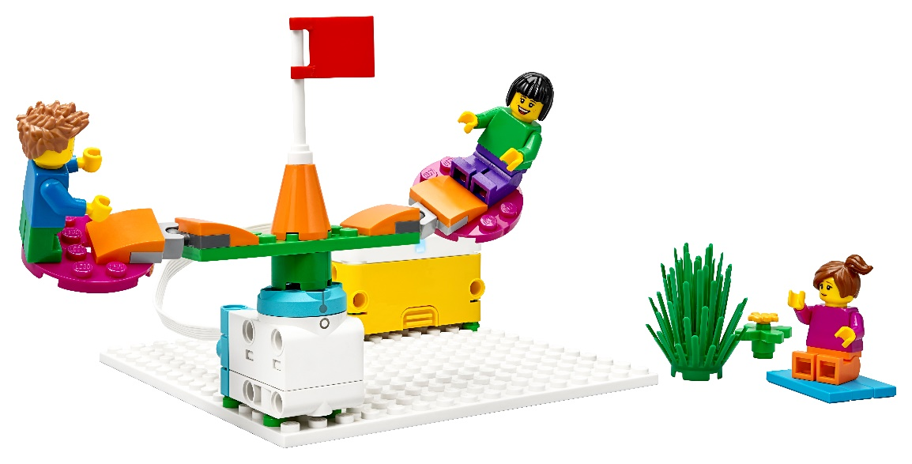
Activity 1 – Do Code
You need…
Open the SPIKE™ Essential app. Complete your lesson.
Make the model go in a different direction or rotate at a different speed.
Notes:
Activity 1 Tasks – Do Code 1 (15-20 minutes)
Open the SPIKE™ Essential app. Complete your lesson.
Make the model go in a different direction or rotate at a different speed.
Write down your ideas below for how to change the program.
Modify the program based on your ideas.
Run your new program. See what happens.
Session Tips
Walk the team through how to access their appropriate lesson in the app.
If your team is new to coding, you could have them complete the getting started tutorials.
The team will only use their LEGO Education SPIKE™ Essential set for this session. They won’t use anything from the Explore set or Explore model.

Slide 5

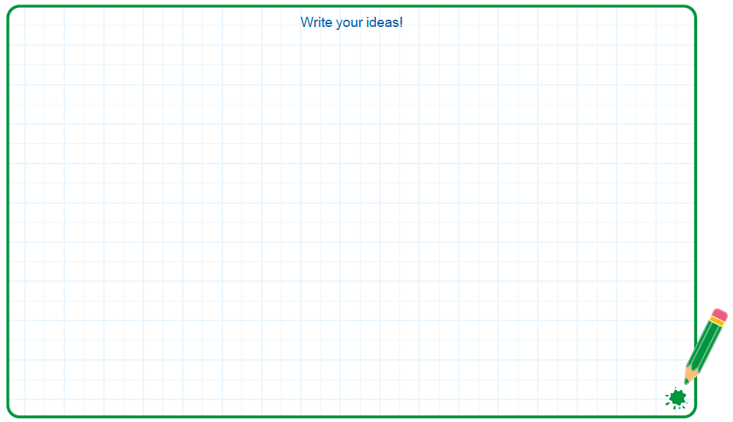

Activity 1
You need…
Write down your ideas below for how to change the program.
Notes:
Activity 1 Tasks – Do Code 1 (15-20 minutes)
Open the SPIKE™ Essential app. Complete your lesson.
Make the model go in a different direction or rotate at a different speed.
Write down your ideas below for how to change the program.
Modify the program based on your ideas.
Run your new program. See what happens.
Session Tips
Walk the team through how to access their appropriate lesson in the app.
If your team is new to coding, you could have them complete the getting started tutorials.
The team will only use their LEGO Education SPIKE™ Essential set for this session. They won’t use anything from the Explore set or Explore model.

Slide 6
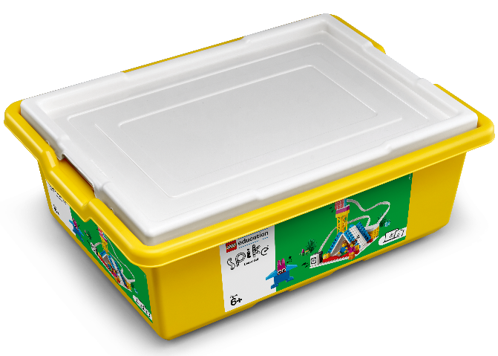
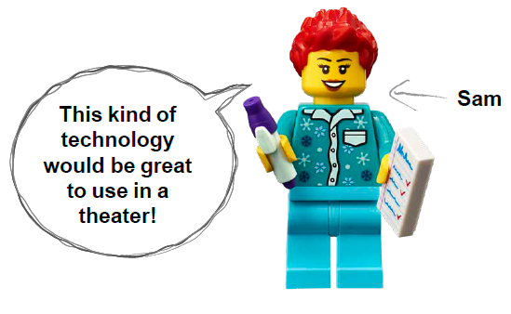
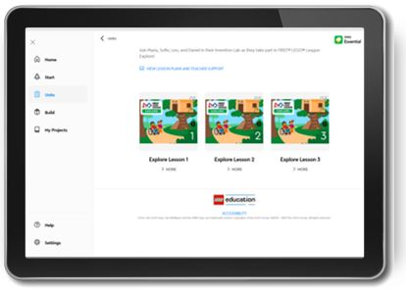
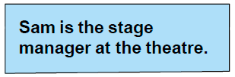
Activity 1
You need…
Modify the program based on your ideas.
Run your new program. See what happens.
Notes:
Activity 1 Tasks – Do Code 1 (15-20 minutes)
Open the SPIKE™ Essential app. Complete your lesson.
Make the model go in a different direction or rotate at a different speed.
Write down your ideas below for how to change the program.
Modify the program based on your ideas.
Run your new program. See what happens.
Session Tips
Walk the team through how to access their appropriate lesson in the app.
If your team is new to coding, you could have them complete the getting started tutorials.
The team will only use their LEGO Education SPIKE™ Essential set for this session. They won’t use anything from the Explore set or Explore model.

Slide 7
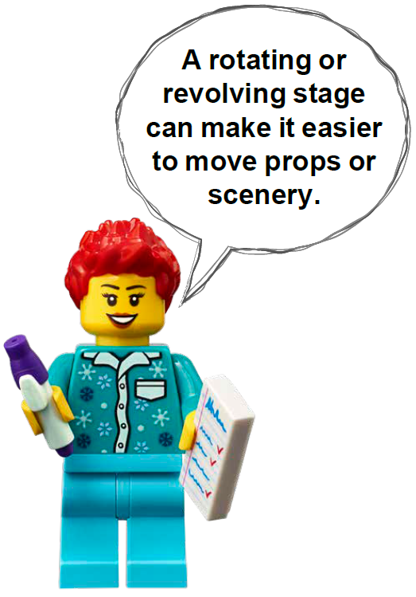

Activity 2 – Build a Theater Stage
You need…
Modify the SPIKE model from the previous task so that it represents a rotating stage.
Notes:
Activity 2 Tasks – Build a Theater Stage (15-20 minutes)
Modify the SPIKE model from the previous task so that it represents a rotating stage.
Open the SPIKE™ Essential app.
Change the program to make the stage rotate every 10 seconds. Try it out!
Challenge
Build two different scenes on your rotating stage. The scenes can be about what you love to do!
Place your stage on the mat. You could use the theater icons as building locations!
Share the scenes you built and explain how you coded the model.
Session Tips
​The team will determine how to change motor direction and motor speed.
Teams should use pieces from the SPIKE™ Essential set to build their stage.
Teams can use the minifigures found in the SPIKE Essential set.

Slide 8


Activity 2
Open the SPIKE™ Essential app.
Change the program to make the stage rotate every 10 seconds. Try it out!
Notes:
Activity 2 Tasks – Build a Theater Stage (15-20 minutes)
Modify the SPIKE model from the previous task so that it represents a rotating stage.
Open the SPIKE™ Essential app.
Change the program to make the stage rotate every 10 seconds. Try it out!
Challenge
Build two different scenes on your rotating stage. The scenes can be about what you love to do!
Place your stage on the mat. You could use the theater icons as building locations!
Share the scenes you built and explain how you coded the model.
Session Tips
​The team will determine how to change motor direction and motor speed.
Teams should use pieces from the SPIKE™ Essential set to build their stage.
Teams can use the minifigures found in the SPIKE Essential set.

Slide 9
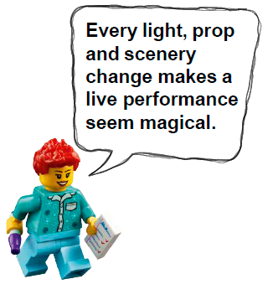

Activity 2
Challenge
Build two different scenes on your rotating stage. The scenes can be about what you love to do!
Place your stage on the mat. You could use the theater icons as building locations!
Share the scenes you built and explain how you coded the model.
Notes:
Activity 2 Tasks – Build a Theater Stage (15-20 minutes)
Modify the SPIKE model from the previous task so that it represents a rotating stage.
Open the SPIKE™ Essential app.
Change the program to make the stage rotate every 10 seconds. Try it out!
Challenge
Build two different scenes on your rotating stage. The scenes can be about what you love to do!
Place your stage on the mat. You could use the theater icons as building locations!
Share the scenes you built and explain how you coded the model.
Session Tips
​The team will determine how to change motor direction and motor speed.
Teams should use pieces from the SPIKE™ Essential set to build their stage.
Teams can use the minifigures found in the SPIKE Essential set.

Slide 10

Share
Share what you did in the session.
Show the motor coding skills they learned.
Explain how technology is used to make an impact for an audience.
Show different examples of theater icons on the mat.
What have you discovered? Share with your team!
Notes:
Share (10 minutes)
Have the team:
• Share what they did in the session.
• Show the motor coding skills they learned.
• Explain how technology is used to make an impact for an audience.
• Show different examples of theater icons on the mat.

Slide 11

Optional Video:
You may wish to embed a relevant, age-appropriate video for your students here. See the Notes for an example.
Notes:
Choose a relevant, age-appropriate video for your students.
Here is one example: https://youtu.be/fxdks_e_Dtw
This is Theatre Design Tech: Auburn University

Slide 12
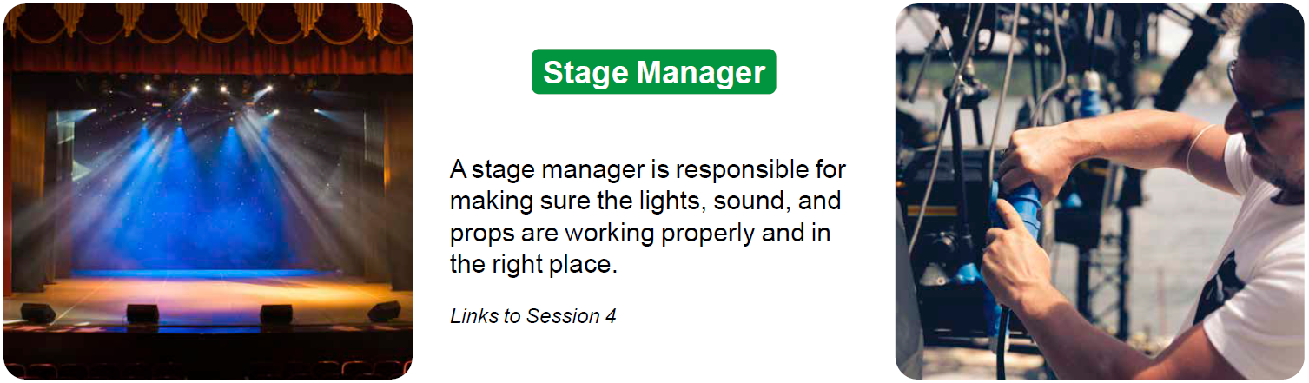
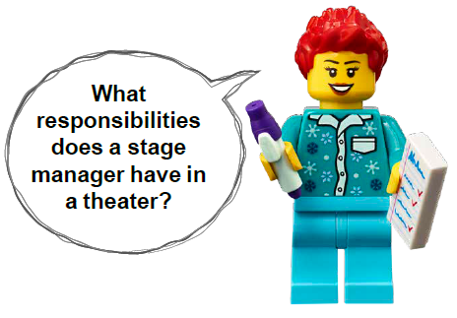
Career Connections
Stage Manager
Role:
A stage manager is responsible for making sure the lights, sound, and props are working properly and in the right place.
Notes:
Ask the children to reflect on what a stage manager does.
Explain the job. What are some of this job’s daily tasks?
What is this job’s yearly salary?
What education or training is required?
What companies could people in this job work for?

Slide 13

Clean Up
Notes:
Clean Up Pointers
• Everything built in this session should be taken apart and returned to the LEGO® Education SPIKE Essential set.
• Return minifigures to the Explore set.
• Fold the mat and store it in a place where it won’t get damaged.
You may wish to play a video or song during clean up time Link on
GoNoodle: https://family.gonoodle.com/activities/clean-up
Link on YouTube Kids: https://www.youtubekids.com/watch?v=ZJFk87ZsHn0
Link on Youtube: https://youtu.be/ZJFk87ZsHn0

Slide 14

LEGO, the LEGO logo and the SPIKE logo are trademarks of the/sont des marques de commerce du/son marcas registradas de LEGO Group. ©2023 The LEGO Group. All rights reserved/Tous droits réservés/Todos los derechos reservados. FIRST®, the FIRST® logo, and FIRST® in SHOWSM are registered trademarks of For Inspiration and Recognition of Science and Technology (FIRST). LEGO® is a registered trademark of the LEGO Group. FIRST® LEGO® League and MASTERPIECESM are jointly held trademarks of FIRST and the LEGO Group. ©2023 FIRST and the LEGO Group. All rights reserved.

