Slide 1
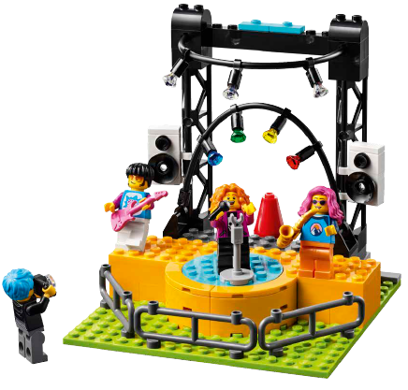

Session 7
Setting the Stage

Slide 2
Guiding Questions
How can you motorize the basic stage?
What will you add to your stage to make it unique to your team?
Outcomes
The team will combine the basic stage model with the motor and hub.
The team will apply all their coding and building knowledge to create their own stage.
Where will your model go on the mat?
Who will be coming to watch the show or interact with the exhibits?
Can you use the ramps in your design?
Can you code the stage to flash lights, play sounds, and move?
Notes:
Each session has Guiding Questions that can be shared to frame the session.
Session Tips
The motorization pieces are found in Bag 3.
The team should motorize the basic stage and write a program that will make it turn.
The team could also incorporate other moving pieces into their model.
Help the team identify an audience and think about what their needs will be when attending the show.
The team could be challenged to modify their model based on a different spot on the mat.
Identify places in your school or community that are designed to be accessible to all people.

Slide 3


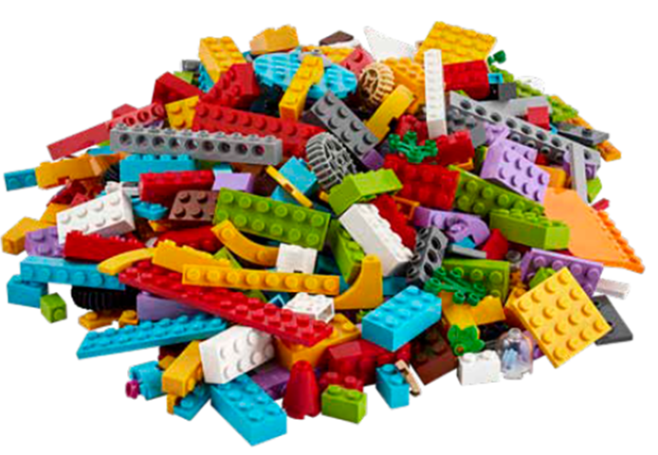
Introduction – Discovery Build
Examples of Discovery
Ask the students to provide examples of Discovery and record them here
Example of Discovery
Example of Discovery
We explored new skills and ideas.
Notes:
Introduction - Discovery Build (10 minutes)
Have the team provide examples of how they have used discovery throughout the sessions.
Have the team create a build from the prototyping pieces representing this Core Value or examples of the team using discovery.

Slide 4
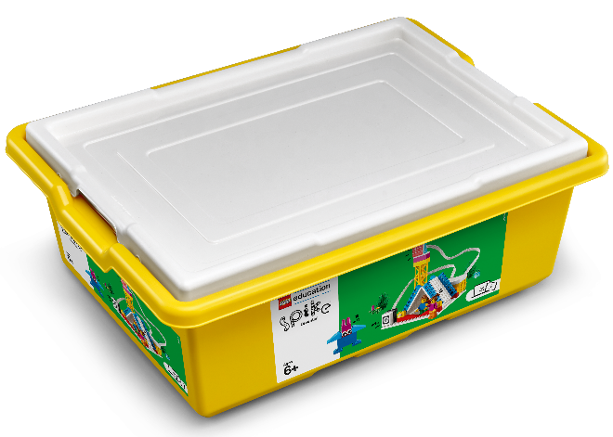
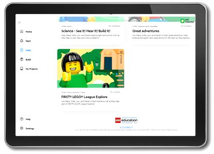

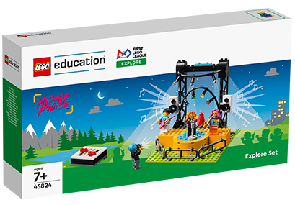
Activity 1 – Design Your Show
Build the motor and hub base following instructions in Book 2.
Connect the motor and hub to the basic stage model from Session 2.
You need…
Notes:
Activity 1 Tasks (15-20 minutes)
Build the motor and hub base following instructions in Book 2.
Connect the motor and hub to the basic stage model from Session 2.
Open the SPIKE™ Essential app. Try the program provided in Book 2 to motorize your model.
Write a new program to rotate the center of the stage where the performer stands.
Challenge
Pick a hobby or interest you and your team want to share on the stage. Draw your ideas for how you could do this below!
Session Tips
The motorization pieces are found in Bag 3.
The team should motorize the basic stage and write a program that will make it turn.
The team could also incorporate other moving pieces into their model.

Slide 5
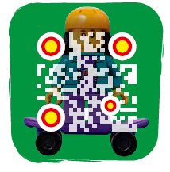
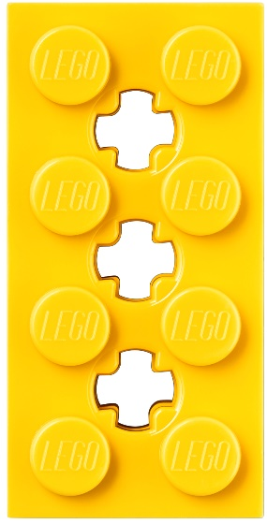
Activity 1
Open the SPIKE™ Essential app. Try the program provided in Book 2 to motorize your model.
Write a new program to rotate the center of the stage where the performer stands.
Watch video of the motorized music concert model!
Notes:
Activity 1 Tasks (15-20 minutes)
Build the motor and hub base following instructions in Book 2.
Connect the motor and hub to the basic stage model from Session 2.
Open the SPIKE™ Essential app. Try the program provided in Book 2 to motorize your model.
Write a new program to rotate the center of the stage where the performer stands.
Challenge
Pick a hobby or interest you and your team want to share on the stage. Draw your ideas for how you could do this below!
Session Tips
The motorization pieces are found in Bag 3.
The team should motorize the basic stage and write a program that will make it turn.
The team could also incorporate other moving pieces into their model.

Slide 6
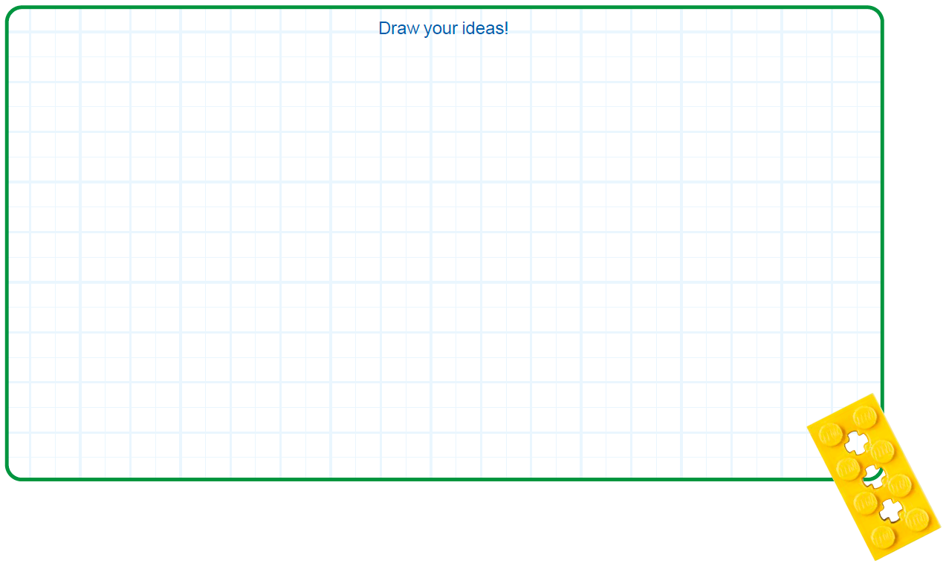

Activity 1
Challenge
Pick a hobby or interest you and your team want to share on the stage.
Draw your ideas for how you could do this!
Notes:
Activity 1 Tasks (15-20 minutes)
Build the motor and hub base following instructions in Book 2.
Connect the motor and hub to the basic stage model from Session 2.
Open the SPIKE™ Essential app. Try the program provided in Book 2 to motorize your model.
Write a new program to rotate the center of the stage where the performer stands.
Challenge
Pick a hobby or interest you and your team want to share on the stage. Draw your ideas for how you could do this below!
Session Tips
The motorization pieces are found in Bag 3.
The team should motorize the basic stage and write a program that will make it turn.
The team could also incorporate other moving pieces into their model.

Slide 7
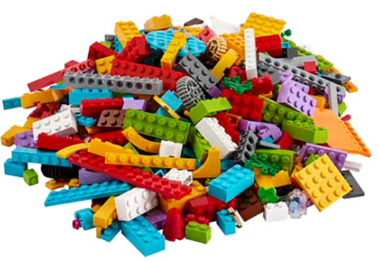

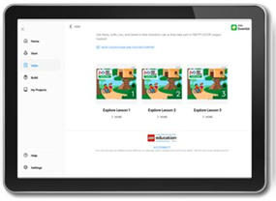

Activity 2 – Build Your Show
You need…
Decide where on the mat you will build your model.
Use the prototyping pieces to add to your stage and make it exciting for an audience!
Notes:
Activity 2 Tasks (15-20 minutes)
Decide where on the mat you will build your model.
Use the prototyping pieces to add to your stage and make it exciting for an audience!
Challenge
Change the model and the program to show off a different hobby or interest.
Share your build and explain the different kinds of technology you used.
Session Tips
Help the team identify an audience and think about what their needs will be when attending the show.
The team could be challenged to modify their model based on a different spot on the mat.
Identify places in your school or community that are designed to be accessible to all people.

Slide 8

Activity 2
Challenge
Change the model and the program to show off a different hobby or interest.
Notes:
Activity 2 Tasks (15-20 minutes)
Decide where on the mat you will build your model.
Use the prototyping pieces to add to your stage and make it exciting for an audience!
Challenge
Change the model and the program to show off a different hobby or interest.
Share your build and explain the different kinds of technology you used.
Session Tips
Help the team identify an audience and think about what their needs will be when attending the show.
The team could be challenged to modify their model based on a different spot on the mat.
Identify places in your school or community that are designed to be accessible to all people.

Slide 9



Activity 2
Share your build and explain the different kinds of technology you used.
Notes:
Activity 2 Tasks (15-20 minutes)
Decide where on the mat you will build your model.
Use the prototyping pieces to add to your stage and make it exciting for an audience!
Challenge
Change the model and the program to show off a different hobby or interest.
Share your build and explain the different kinds of technology you used.
Session Tips
Help the team identify an audience and think about what their needs will be when attending the show.
The team could be challenged to modify their model based on a different spot on the mat.
Identify places in your school or community that are designed to be accessible to all people.

Slide 10

Share
Share what you did in the session.
Show how they have applied coding skills learned in previous sessions to make their model move.
Demonstrate how their stage engages an audience.
What have you discovered? Share with your team!
Notes:
Share (10 minutes)
Have the team:
• Share what they did in the session.
• Show how they have applied coding skills learned in previous sessions to make their model move.
• Demonstrate how their stage engages an audience.

Slide 11

Optional Video:
You may wish to embed a relevant, age-appropriate video for your students here. See the Notes for an example.
Notes:
Choose a relevant, age-appropriate video for your students.
Here is one example https://www.pbs.org/video/ken-burns-country-music-behind-scenes-short-film/

Slide 12

Clean Up
Notes:
Clean Up Pointers
• Make sure unused pieces from the LEGO® Education SPIKE™ Essential set are returned.
• The motor and hub can remain attached to the stage model.
You may wish to play a video or song during clean up time Link on
GoNoodle: https://family.gonoodle.com/activities/clean-up
Link on YouTube Kids: https://www.youtubekids.com/watch?v=ZJFk87ZsHn0
Link on Youtube: https://youtu.be/ZJFk87ZsHn0

Slide 13

LEGO, the LEGO logo and the SPIKE logo are trademarks of the/sont des marques de commerce du/son marcas registradas de LEGO Group. ©2023 The LEGO Group. All rights reserved/Tous droits réservés/Todos los derechos reservados. FIRST®, the FIRST® logo, and FIRST® in SHOWSM are registered trademarks of For Inspiration and Recognition of Science and Technology (FIRST). LEGO® is a registered trademark of the LEGO Group. FIRST® LEGO® League and MASTERPIECESM are jointly held trademarks of FIRST and the LEGO Group. ©2023 FIRST and the LEGO Group. All rights reserved.

