Slide 1
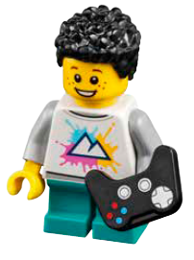

Session 1
Hobbies and Interests

Slide 2
Guiding Questions
What did you learn from the Explore story?
How do you teach people about your interests?
Outcomes
The team will use discovery to explore the MASTERPIECESM theme and explain how people share what they love to do.
The team will build a place to share a hobby or interest.
How do you use creativity in your
hobbies?
How do you share
what you love to do?
Where do you go when
you want to learn
about something new?
Does the Explore
story give you any ideas for Issy?
Notes:
Each session has Guiding Questions that can be shared to frame the session.
Session Tips
Check out the Multimedia Resources for more resources you can use with your team.
You will find various sessions reference different energy jobs. These jobs are listed on the Career Connections pages in the Engineering Notebook.
Writing and drawing space is provided throughout the notebook for each child to capture their thoughts and ideas.
Children can set goals and share their progress in their Engineering Notebook. Pages 6-7 can be used throughout the season.
Give the team the LEGO® prototyping pieces (bags labeled 4) to create their designs. Do NOT open any other bags.
At the end of each session, children should share what they have accomplished.
Extension
• Research new innovations and emerging technologies in the art and entertainment fields.
• Do a show and tell activity with the team.

Slide 3


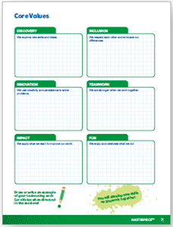
Introduction – Let’s Discover
Examples of Discovery
Ask the students to provide examples of Discovery and record them here
Example of Discovery
Example of Discovery
We explored new skills and ideas.
Extension
Notes:
Introduction - Let’s Discover (5-10 minutes)
• Read the definition for discovery to the team. (see TMG page 5)
• Talk about what discovery is. Have the team provide examples of this Core Value.
• Extension: Have everyone draw a picture of an example of discovery on the Core Values page in their Engineering Notebook.

Slide 4

MASTERPIECESM
Visit the
FIRST® LEGO ® League
YouTube Channel
to watch the
MASTERPIECESM Season Launch Video
Notes:
If you have already watched the season launch video in the introductory slides, you may choose to skip it here.

Slide 5
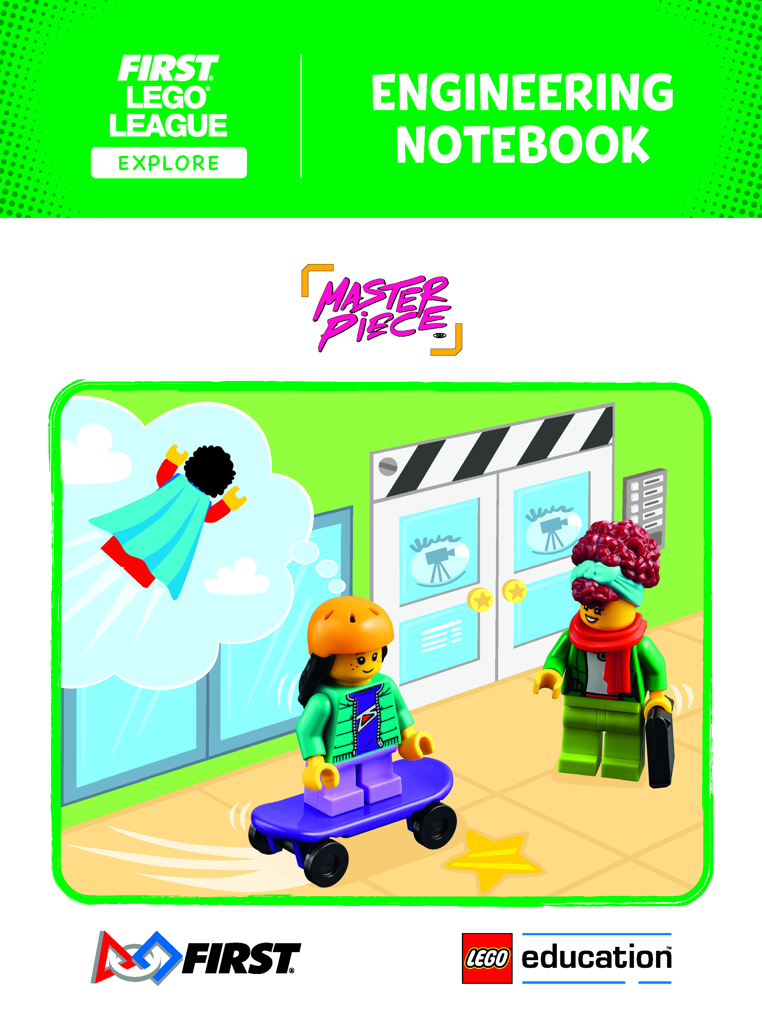
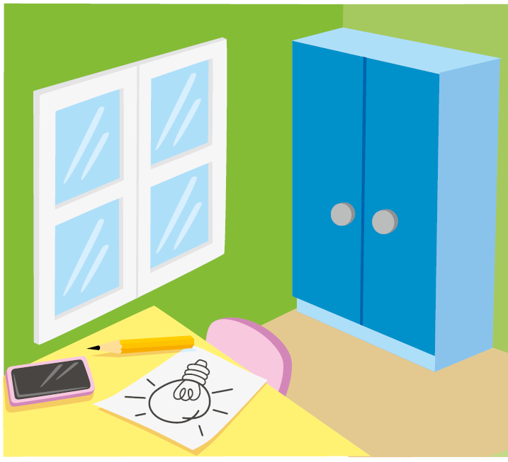
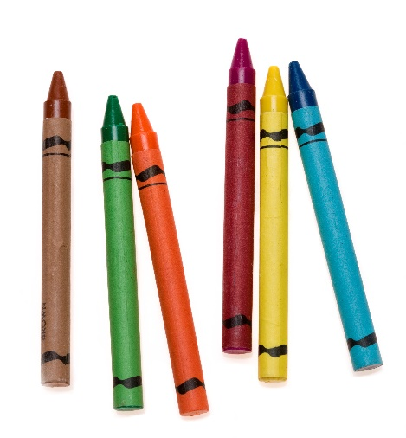
Activity 1 – Explore Season Theme
You need…
Read the Explore story and explore the MASTERPIECESM theme.
Talk about your own hobbies or interests.
Notes:
Activity 1 Tasks – Explore Season Theme (15-20 minutes)
Read the Explore story and explore the MASTERPIECESM theme.
Talk about your own hobbies or interests.
Think about how you use art or creativity in your hobbies or interests.
Draw a picture of what you love to do.
Session Tips
Check out the Multimedia Resources for more resources you can use with your team.
You will find various sessions reference different energy jobs. These jobs are listed on the Career Connections pages in the Engineering Notebook.
Writing and drawing space is provided throughout the notebook for each child to capture their thoughts and ideas.

Slide 6

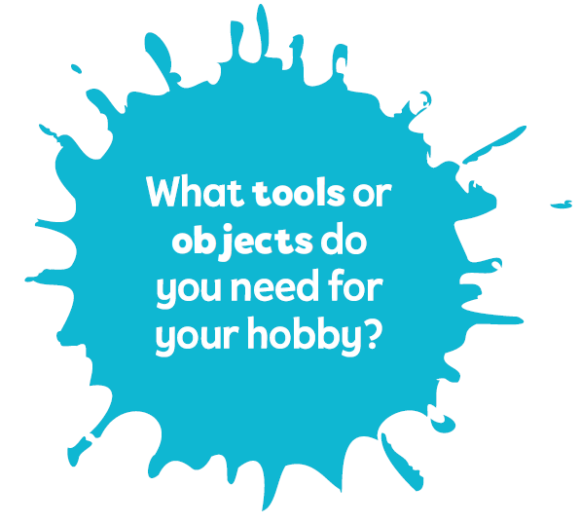
Activity 1
Think about how you use art or creativity in your hobbies or interests.
Notes:
Activity 1 Tasks – Explore Season Theme (15-20 minutes)
Read the Explore story and explore the MASTERPIECESM theme.
Talk about your own hobbies or interests.
Think about how you use art or creativity in your hobbies or interests.
Draw a picture of what you love to do.
Session Tips
Check out the Multimedia Resources for more resources you can use with your team.
You will find various sessions reference different energy jobs. These jobs are listed on the Career Connections pages in the Engineering Notebook.
Writing and drawing space is provided throughout the notebook for each child to capture their thoughts and ideas.

Slide 7
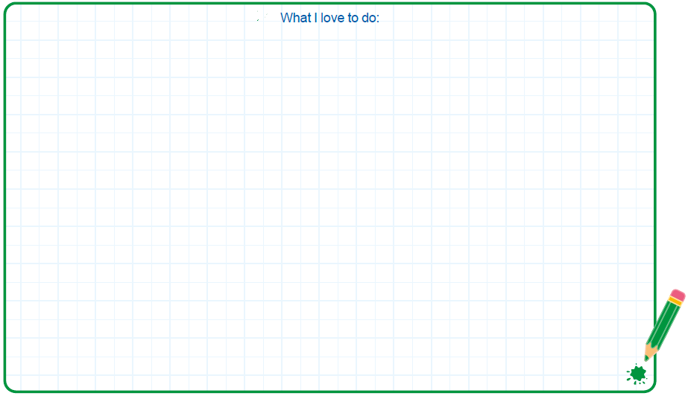


Activity 1
Draw a picture of what you love to do.
Notes:
Activity 1 Tasks – Explore Season Theme (15-20 minutes)
Read the Explore story and explore the MASTERPIECESM theme.
Talk about your own hobbies or interests.
Think about how you use art or creativity in your hobbies or interests.
Draw a picture of what you love to do.
Session Tips
Check out the Multimedia Resources for more resources you can use with your team.
You will find various sessions reference different energy jobs. These jobs are listed on the Career Connections pages in the Engineering Notebook.
Writing and drawing space is provided throughout the notebook for each child to capture their thoughts and ideas

Slide 8

Activity 2 - Build What You Love
Explore how people share what they love to do.
Talk about places in your community where people share what they love to do.
You need…
Where can I share my hobbies?
Notes:
Activity 2 Tasks – Build What You Love (15-20 minutes)
Explore how people share what they love to do.
Talk about places in your community where people share what they love to do.
Challenge
Discuss the creative ways Izzy could get her friends interested in skateboarding.
Use the prototyping pieces to build a place where Izzy could share her love of skateboarding.
Share your ideas.
Session Tips
Children can set goals and share their progress in their Engineering Notebook. Pages 6-7 can be used throughout the season.
Give the team the LEGO® prototyping pieces (bags labeled 4) to create their designs. Do NOT open any other bags.
At the end of each session, children should share what they have accomplished.

Slide 9
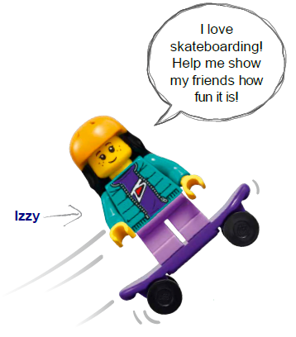
Activity 2
Challenge
Discuss the creative ways Izzy could get her friends interested in skateboarding.
Notes:
Activity 2 Tasks – Build What You Love (15-20 minutes)
Explore how people share what they love to do.
Talk about places in your community where people share what they love to do.
Challenge
Discuss the creative ways Izzy could get her friends interested in skateboarding.
Use the prototyping pieces to build a place where Izzy could share her love of skateboarding.
Share your ideas.
Session Tips
Children can set goals and share their progress in their Engineering Notebook. Pages 6-7 can be used throughout the season.
Give the team the LEGO® prototyping pieces (bags labeled 4) to create their designs. Do NOT open any other bags.
At the end of each session, children should share what they have accomplished.

Slide 10
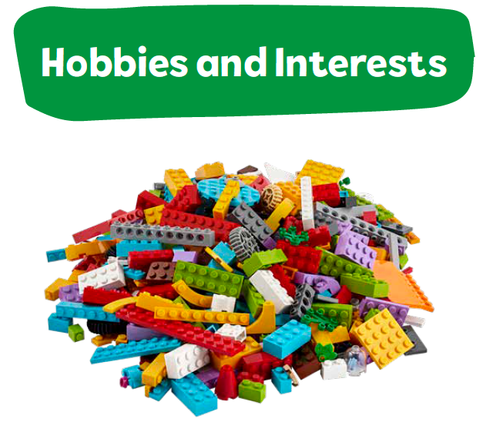
Activity 2
Use the prototyping pieces to build a place where Izzy could share her love of skateboarding.
Notes:
Activity 2 Tasks – Build What You Love (15-20 minutes)
Explore how people share what they love to do.
Talk about places in your community where people share what they love to do.
Challenge
Discuss the creative ways Izzy could get her friends interested in skateboarding.
Use the prototyping pieces to build a place where Izzy could share her love of skateboarding.
Share your ideas.
Session Tips
Children can set goals and share their progress in their Engineering Notebook. Pages 6-7 can be used throughout the season.
Give the team the LEGO® prototyping pieces (bags labeled 4) to create their designs. Do NOT open any other bags.
At the end of each session, children should share what they have accomplished.

Slide 11
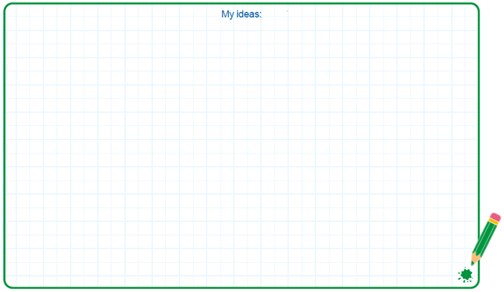
Activity 2
Share your ideas.
Notes:
Activity 2 Tasks – Build What You Love (15-20 minutes)
Explore how people share what they love to do.
Talk about places in your community where people share what they love to do.
Challenge
Discuss the creative ways Izzy could get her friends interested in skateboarding.
Use the prototyping pieces to build a place where Izzy could share her love of skateboarding.
Share your ideas.
Session Tips
Children can set goals and share their progress in their Engineering Notebook. Pages 6-7 can be used throughout the season.
Give the team the LEGO® prototyping pieces (bags labeled 4) to create their designs. Do NOT open any other bags.
At the end of each session, children should share what they have accomplished.

Slide 12

Share
What have you discovered? Share with your team!
Share what you did in the session.
Explain your hobbies and interests.
Show how you use art or creativity in your interests.
Notes:
Share (10 -15 minutes)
Have the team:
• Share what they did in the session.
• Explain your hobbies and interests.
• Show how you use art or creativity in your interests.

Slide 13
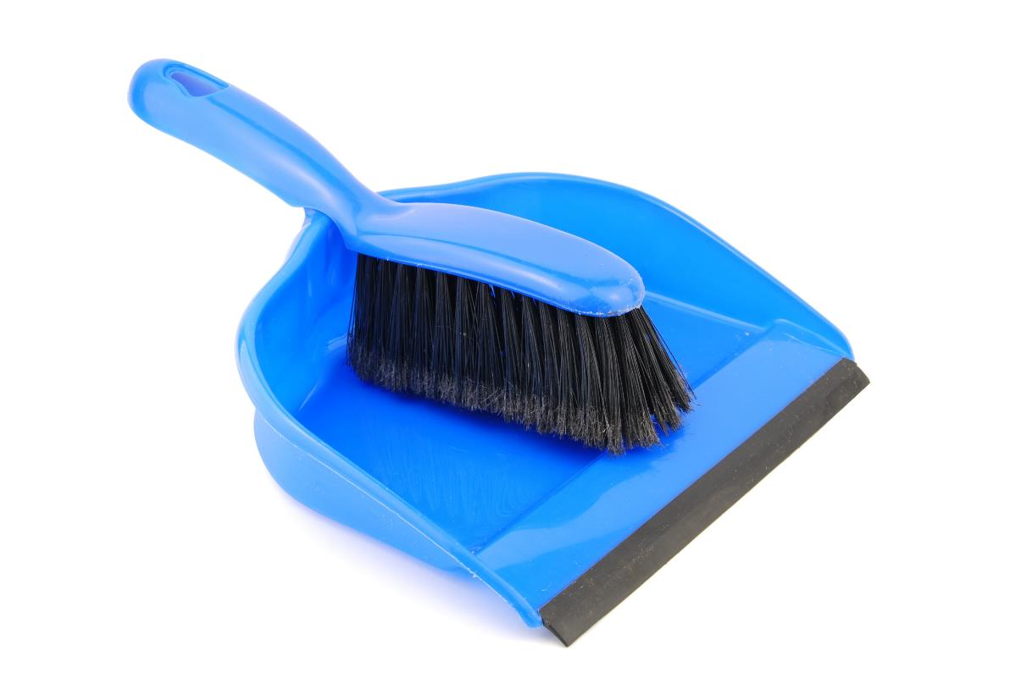
Clean Up
Notes:
Cleanup Pointers
• Anything built with the prototyping pieces should be taken apart.
• Place the prototyping pieces back in the Explore box or in a container labeled “Prototyping Pieces.”
You may wish to play a video or song during clean up time Link on
GoNoodle:. https://family.gonoodle.com/activities/clean-up
Link on YouTube Kids: https://www.youtubekids.com/watch?v=ZJFk87ZsHn0
Link on Youtube: https://youtu.be/ZJFk87ZsHn0

Slide 14

LEGO, the LEGO logo and the SPIKE logo are trademarks of the/sont des marques de commerce du/son marcas registradas de LEGO Group. ©2023 The LEGO Group. All rights reserved/Tous droits réservés/Todos los derechos reservados. FIRST®, the FIRST® logo, and FIRST® IN SHOWSM are trademarks of For Inspiration and Recognition of Science and Technology (FIRST). LEGO® is a registered trademark of the LEGO Group. FIRST® LEGO® League and MASTERPIECESM are jointly held trademarks of FIRST and the LEGO Group.
©2023 FIRST and the LEGO Group. All rights reserved.

