Slide 1

Session 5
Museum Exhibit

Slide 2
Guiding Questions
How do you change the program so the LEGO model plays a different light?
Can you code the model to make a different sound?
Outcomes
The team will build the LEGO® model from the lesson and explore the use of lights and sensors.
The team will identify how lights and sounds are used to make a museum exhibit interactive.
What kind of technology is used in
a museum?
Can you modify your model so it looks like something you would see in a museum?
Can you activate your light pattern
with a new sensor?
Can you use light and sound in the model?
Notes:
Each session has Guiding Questions that can be shared to frame the session.
Session Tips
The team will learn about and use light and sound blocks.
The team should focus on light blocks in this activity. They will experiment with sound blocks in the next activity.
There are different sensors provided in the LEGO Education SPIKE™ Essential set that the team could try to incorporate.
The team could build anything they might find in a museum (i.e., sculpture, artifact, exhibit).
The team will apply the coding concept of light, sound, and sensor blocks.
The Ideas space can be used to write down the coding steps planned or which coding blocks the team will change.

Slide 3



Introduction – Be Inclusive
Examples of Inclusion
Ask the students to provide examples of Inclusion and record them here
Example of Inclusion
Example of Inclusion
We respected each other and embraced our differences.
Extension
Notes:
Introduction - Be Inclusive (5-10 minutes)
Read the definition for inclusion to the team. (see TMG page 5)
Talk about what inclusion is. Have the team provide examples of this Core Value.
Extension: Have everyone draw a picture of an example of inclusion on the Core Values page in their Engineering Notebook.

Slide 4
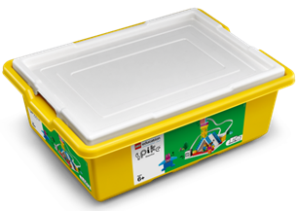
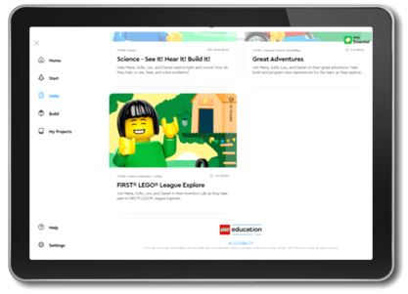

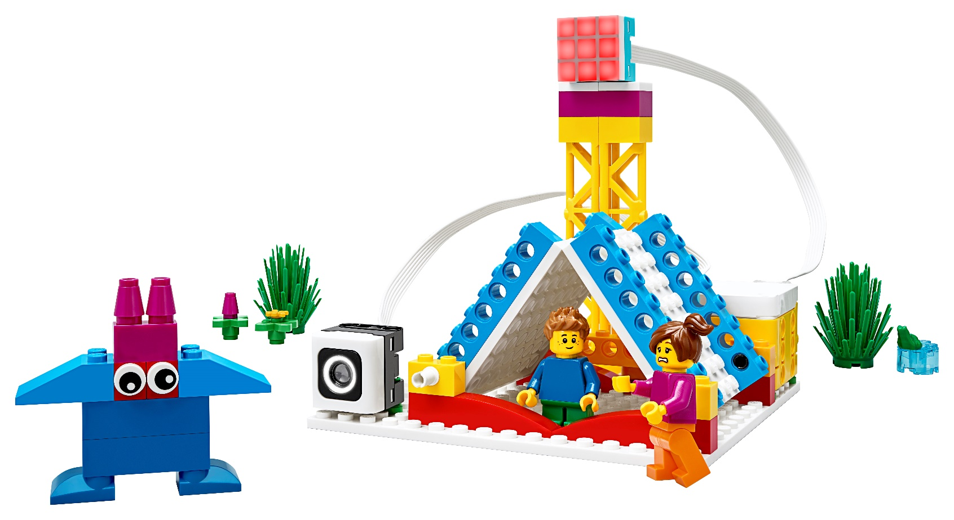

Activity 1 – Do Code
You need…
Open the SPIKETM Essential app. Complete your lesson.
Notes:
Activity 1 Tasks – Do Code 2 (15-20 minutes)
Open the SPIKE™ Essential app. Complete your lesson.
Code the model to flash a light when a team member approaches the sensor.
Modify the program based on your ideas and test it out!
Challenge
Code the model to display a different light pattern that is unique to your team.
Session Tips
The team will learn about and use light and sound blocks.
The team should focus on light blocks in this activity. They will experiment with sound blocks in the next activity.
There are different sensors provided in the LEGO Education SPIKE™ Essential set that the team could try to incorporate.

Slide 5
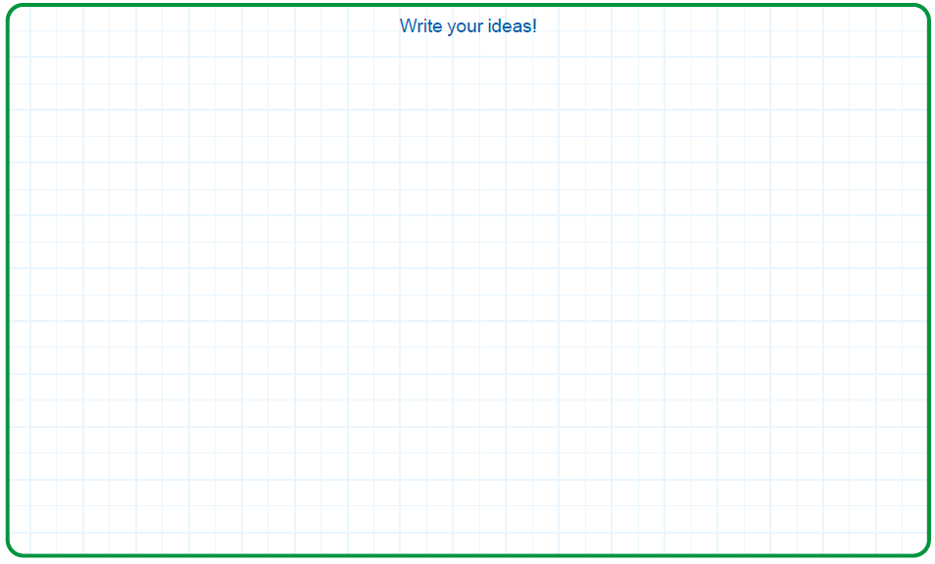
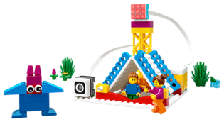


Activity 1
You need…
Code the model to flash a light when a team member approaches the sensor.
Notes:
Activity 1 Tasks – Do Code 2 (15-20 minutes)
Open the SPIKE™ Essential app. Complete your lesson.
Code the model to flash a light when a team member approaches the sensor.
Modify the program based on your ideas and test it out!
Challenge
Code the model to display a different light pattern that is unique to your team.
Session Tips
The team will learn about and use light and sound blocks.
The team should focus on light blocks in this activity. They will experiment with sound blocks in the next activity.
There are different sensors provided in the LEGO Education SPIKE™ Essential set that the team could try to incorporate.

Slide 6

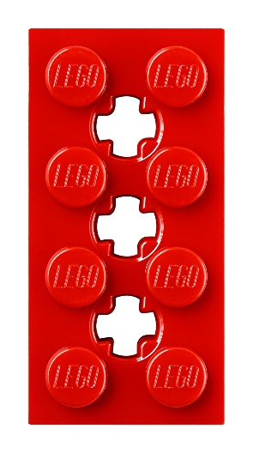
Activity 1
You need…
Modify the program based on your ideas and test it out!
Notes:
Activity 1 Tasks – Do Code 2 (15-20 minutes)
Open the SPIKE™ Essential app. Complete your lesson.
Code the model to flash a light when a team member approaches the sensor.
Modify the program based on your ideas and test it out!
Challenge
Code the model to display a different light pattern that is unique to your team.
Session Tips
The team will learn about and use light and sound blocks.
The team should focus on light blocks in this activity. They will experiment with sound blocks in the next activity.
There are different sensors provided in the LEGO Education SPIKE™ Essential set that the team could try to incorporate.

Slide 7

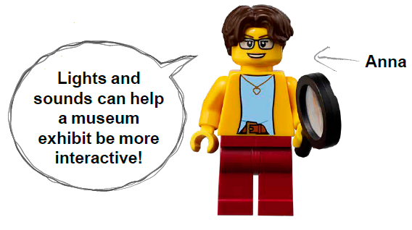
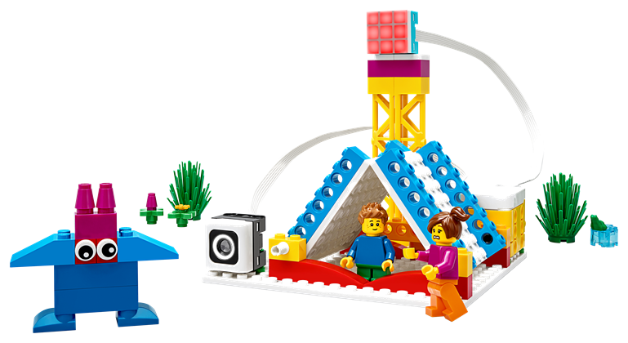
Activity 1
Challenge
Code the model to display a different light pattern that is unique to your team.
Notes:
Activity 1 Tasks – Do Code 2 (15-20 minutes)
Open the SPIKE™ Essential app. Complete your lesson.
Code the model to flash a light when a team member approaches the sensor.
Modify the program based on your ideas and test it out!
Challenge
Code the model to display a different light pattern that is unique to your team.
Session Tips
The team will learn about and use light and sound blocks.
The team should focus on light blocks in this activity. They will experiment with sound blocks in the next activity.
There are different sensors provided in the LEGO Education SPIKE™ Essential set that the team could try to incorporate.

Slide 8
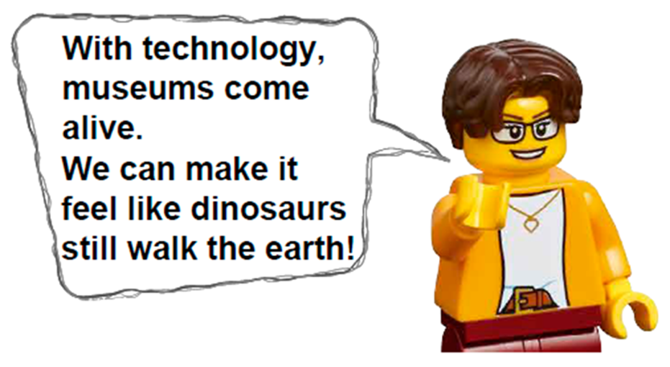
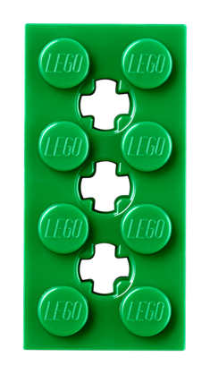
Activity 2 – Build a Museum Exhibit
You need…
Modify the SPIKE model from the previous task so that it represents a museum exhibit.
Open the SPIKE™ Essential app.
Notes:
Activity 2 Tasks – Build a Museum Exhibit (15-20 minutes)
Modify the SPIKE model from the previous task so that it represents a museum exhibit.
Open the SPIKE™ Essential app.
Change the program so that it displays a new light pattern. Try it out!
Challenge
Change the program so that the model will play a sound when someone approaches your exhibit.
Share what you built and explain how you coded the model.
Session Tips
The team could build anything they might find in a museum (i.e., sculpture, artifact, exhibit).
The team will apply the coding concept of light, sound, and sensor blocks.
The Ideas space can be used to write down the coding steps planned or which coding blocks the team will change.

Slide 9
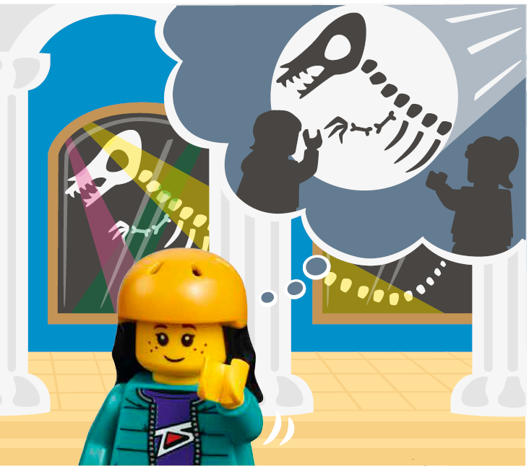
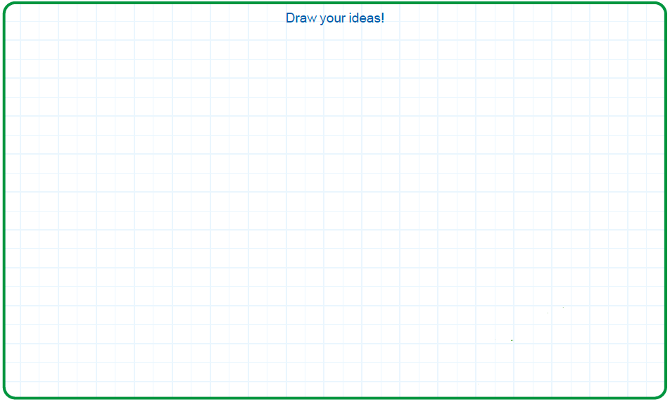


Activity 2
Change the program so that it displays a new light pattern. Try it out!
Notes:
Activity 2 Tasks – Build a Museum Exhibit (15-20 minutes)
Modify the SPIKE model from the previous task so that it represents a museum exhibit.
Open the SPIKE™ Essential app.
Change the program so that it displays a new light pattern. Try it out!
Challenge
Change the program so that the model will play a sound when someone approaches your exhibit.
Share what you built and explain how you coded the model.
Session Tips
The team could build anything they might find in a museum (i.e., sculpture, artifact, exhibit).
The team will apply the coding concept of light, sound, and sensor blocks.
The Ideas space can be used to write down the coding steps planned or which coding blocks the team will change.

Slide 10
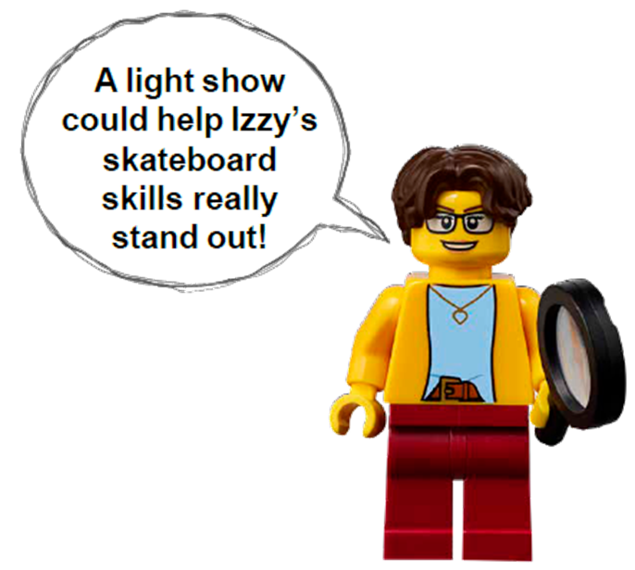
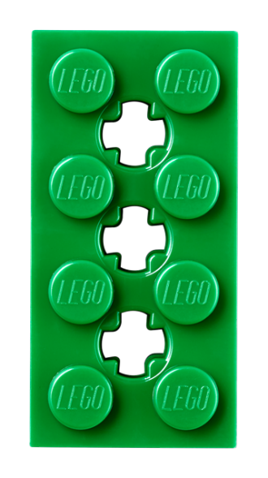
Activity 2
Challenge
Change the program so that the model will play a sound when someone approaches your exhibit.
Share what you built and explain how you coded the model.
Notes:
Activity 2 Tasks – Build a Museum Exhibit (15-20 minutes)
Modify the SPIKE model from the previous task so that it represents a museum exhibit.
Open the SPIKE™ Essential app.
Change the program so that it displays a new light pattern. Try it out!
Challenge
Change the program so that the model will play a sound when someone approaches your exhibit.
Share what you built and explain how you coded the model.
Session Tips
The team could build anything they might find in a museum (i.e., sculpture, artifact, exhibit).
The team will apply the coding concept of light, sound, and sensor blocks.
The Ideas space can be used to write down the coding steps planned or which coding blocks the team will change.

Slide 11

Share
Share what you did in the session.
Show the motor coding skills you learned.
Demonstrate how you modified the model and code so that light and sound is triggered by a sensor.
What have you discovered? Share with your team!
Notes:
Share (10 minutes)
Have the team:
• Share what they did in the session.
• Show the sensor coding skills they learned.
• Demonstrate how they modified the model and code so that light and sound is triggered by a sensor.

Slide 12

Optional Video:
You may wish to embed a relevant, age-appropriate video for your students here. See the Notes for an example.
Notes:
Choose a relevant, age-appropriate video for your students.
Here is one example: https://youtu.be/mQMlZHpo6w0
Art Museum | Virtual Field Trip | KidVision Pre-K South Florida PBS

Slide 13
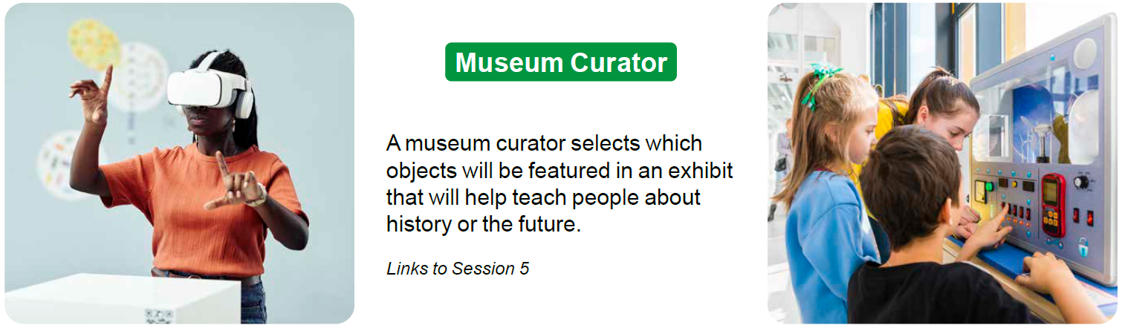
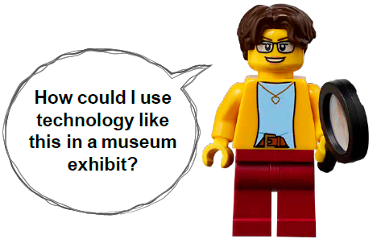
Career Connections
Museum Curator
Role:
A museum curator selects which objects will be featured in an exhibit that will help teach people about history or the future.
Notes:
Ask the children to reflect on what a museum curator does.
Explain the job. What are some of this job’s daily tasks?
What is this job’s yearly salary?
What education or training is required?
What companies could people in this job work for?

Slide 14

Clean Up
Notes:
Clean Up Pointers
• Everything built in this session should be taken apart and returned to the LEGO Education SPIKE Essential set .
• For easier material management, keep the pieces from the Explore set separate from the SPIKE Essential set.
You may wish to play a video or song during clean up time Link on
GoNoodle: https://family.gonoodle.com/activities/clean-up
Link on YouTube Kids: https://www.youtubekids.com/watch?v=ZJFk87ZsHn0
Link on Youtube: https://youtu.be/ZJFk87ZsHn0

Slide 15

LEGO, the LEGO logo and the SPIKE logo are trademarks of the/sont des marques de commerce du/son marcas registradas de LEGO Group. ©2023 The LEGO Group. All rights reserved/Tous droits réservés/Todos los derechos reservados. FIRST®, the FIRST® logo, and FIRST® in SHOWSM are registered trademarks of For Inspiration and Recognition of Science and Technology (FIRST). LEGO® is a registered trademark of the LEGO Group. FIRST® LEGO® League and MASTERPIECESM are jointly held trademarks of FIRST and the LEGO Group. ©2023 FIRST and the LEGO Group. All rights reserved.

