Slide 1
Department of Information Science
From One Source to Many Minds
A source-actor architecture for knowledge diffusion
Yuan An, PhD
Associate Professor
SOLIR Kickoff Workshop at Rutgers
Oct. 19., 2026

Slide 2
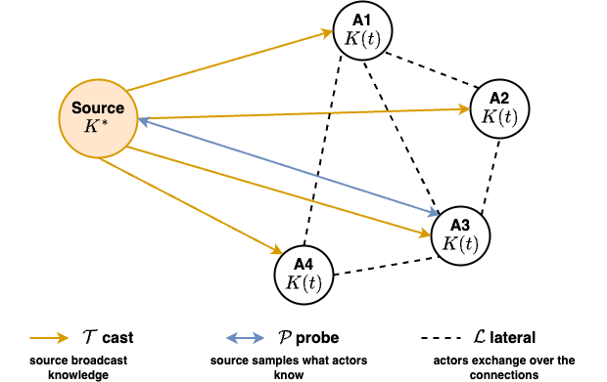
The problem: Source-Actor Knowledge Diffusion
In many situations, there is a source dictating knowledge to many actors who dynamically acquire and refine their own knowledge from the source.

Slide 3
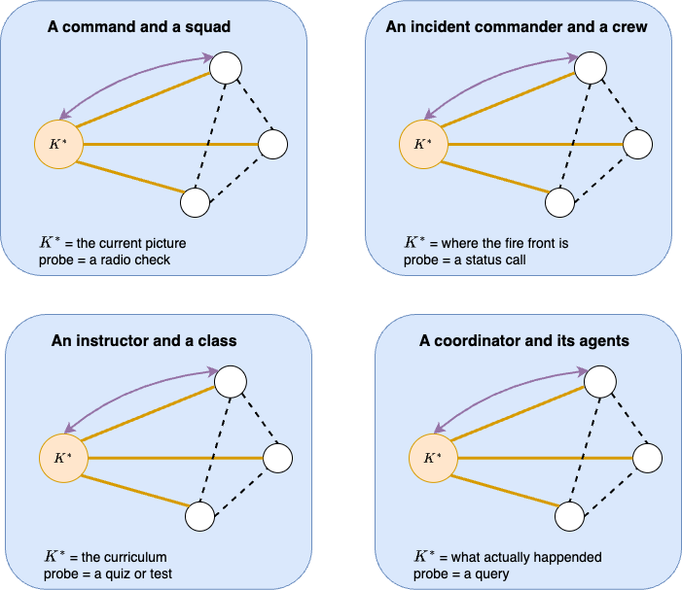
Scenarios
The same picture applies to different domains.
The source holds the truth; many actors have partial copies which update dynamically.
Actors exchange information with each other.
3

Slide 4
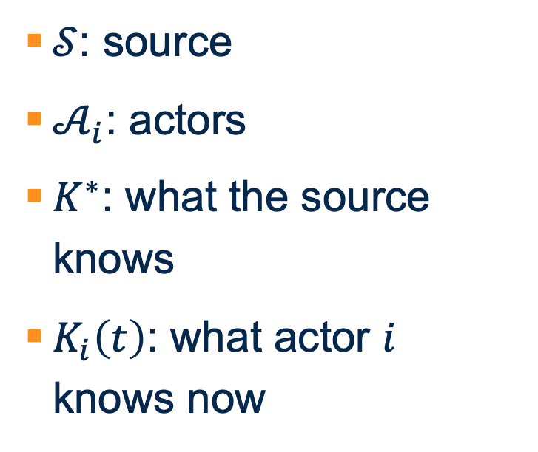
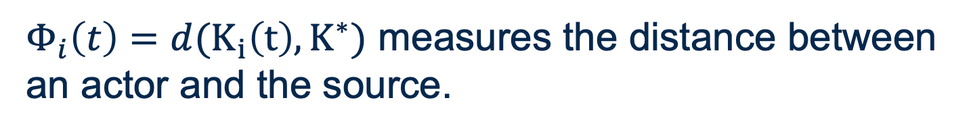
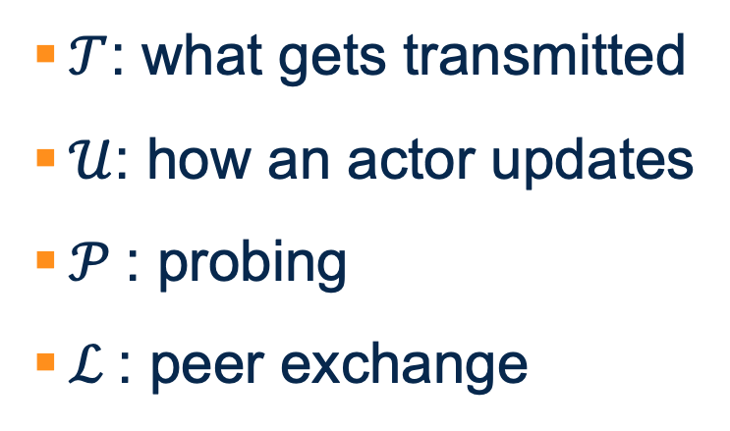
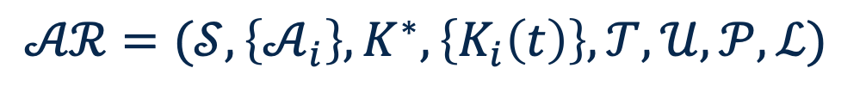
Components in the Architecture $𝓐𝓡$
$$𝒜ℛ=(𝒮, \left\{𝒜_{i}\right\}, K^{∗}, \left\{K_{i}\left(t\right)\right\}, 𝒯, 𝒰, 𝒫, ℒ)$$
$𝒮$: source
$𝒜_{i}$: actors
$K^{∗}$: what the source knows
$K_{i}\left(t\right)$: what actor $i$ knows now
$𝒯$: what gets transmitted
$𝒰$: how an actor updates
$𝒫$: probing
$ℒ$: peer exchange
$Φ_{i}\left(t\right)=d(K_{i}\left(t\right), K^{∗})$ measures the distance between
an actor and the source.

Slide 5
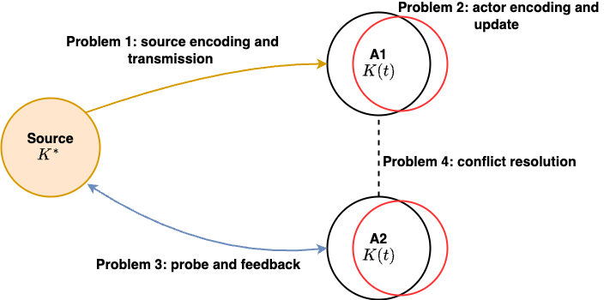
Core Problems

Slide 6
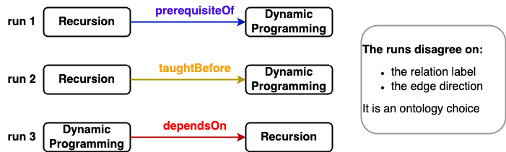
Source Encoding: Ontology and Knowledge Graph Construction
“Students should finish recursion before they start dynamic programming.”
A human can settle it in one line.
Rule: “should finish X before Y” means prerequisiteOf(X, Y). Plain ordering in a syllabus means taughtBefore.
The same rule then fixes every other sentence in the document with the same pattern.

Slide 7
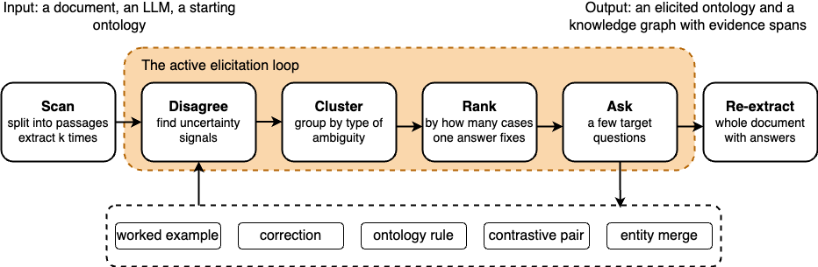
Active Elicitation: Human-in-the-loop Workflow

Slide 8
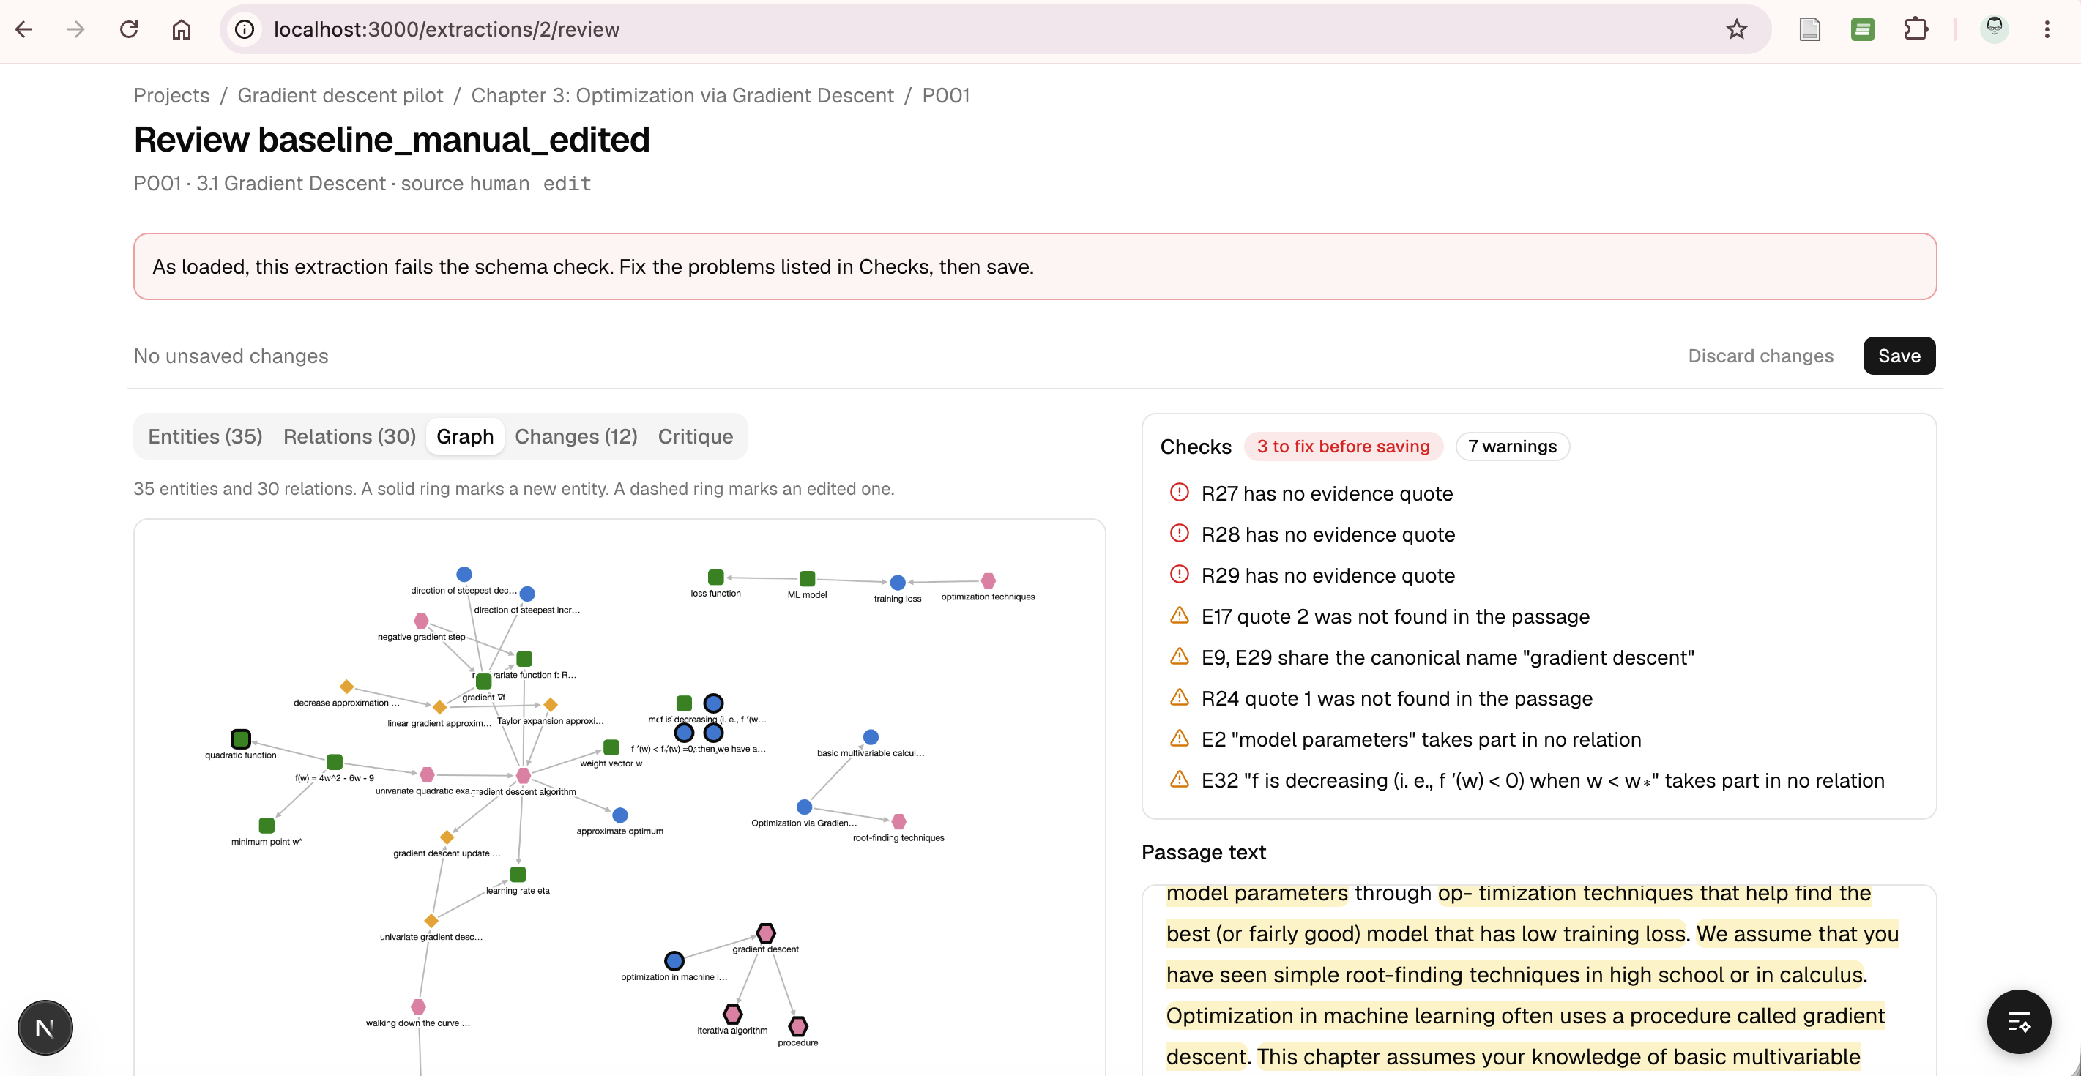
Active Ontology Elicitation and KG Construction (Demo)

Slide 9
Actor Encoding and Updating
Stochastic knowledge graph
  For example, students in classroom
  Mechanism: Encodes source knowledge by building a stochastic student knowledge graph, where mastery probabilities are assigned across knowledge triples derived from the instructor's source knowledge graph.
Parametric model weights
  For example, foundation models
  Mechanism: Internalizes source knowledge directly by updating internal model weights, such as through post-training or fine-tuning on incoming source signals.
Hybrid agent structures
  For example, AI agents
  Mechanism: Combines both encoding modalities into a unified architecture, linking a stochastic knowledge graph with an underlying foundation model.

Slide 10
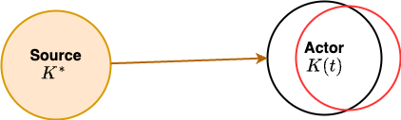
Distance between Actor and Source
Without measuring distance, knowledge diffusion is unguided.
Distance metrics provide the error signal needed to achieve precision alignment across all actor representations.
Quantifying knowledge divergence and fidelity loss.

Slide 11
Rate-Distortion Guided KG Construction
Extracting task-oriented KGs remains challenging.
Raw LLM extraction is noisy: inconsistent, redundant, or incomplete
Need a principled way to balance completeness vs. complexity
Goal: produce compact, pedagogically meaningful knowledge graphs
Yuan An, Ruhma Hashmi, Michelle Rogers, Jane Greenberg, and Brian K. Smith. Rate-Distortion Guided Knowledge Graph Construction from Lecture Notes Using Gromov-Wasserstein Optimal Transport. IEEE BigData 2025. Macau SAR, China.

Slide 12
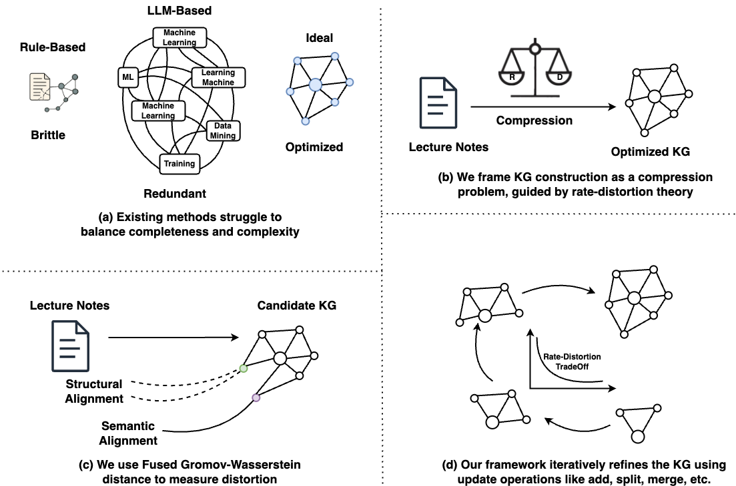
Balancing Graph Size And Fidelity
Notes:
The main challenge is finding the right balance between completeness and complexity.
If the KG is too large, it becomes redundant and unmanageable.
If it’s too small, it fails to capture important concepts from the lectures.
Most existing methods rely on heuristics, cutoff thresholds, or human curation. None provide a formal mechanism to negotiate the trade-off between representing enough information while maintaining a manageable structure.
Our solution is to treat KG construction as a compression problem, just like compressing an image or audio signal, and decide what level of detail is necessary to preserve the core information in the lecture.

Slide 13
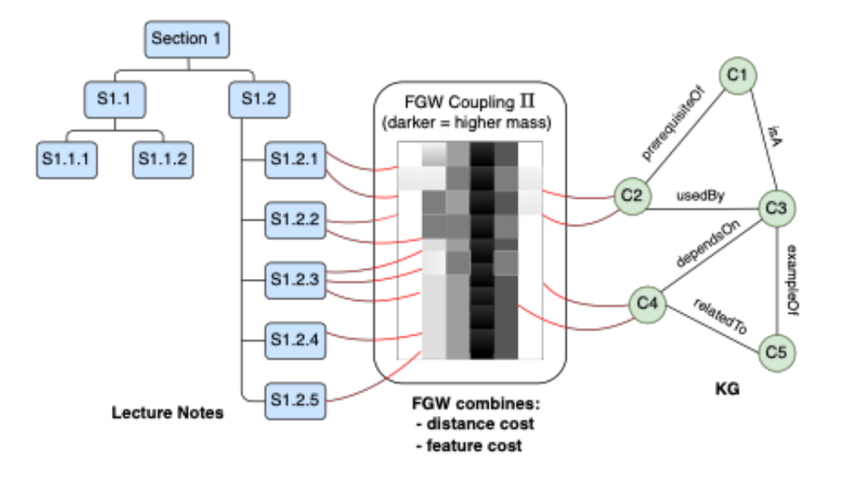
Optimal Transport for Alignment: Fused Gromov-Wasserstein (FGW) Distance
Aligns lecture content with KG nodes
Captures two aspects:
  structure mismatch
  semantic mismatch
Produces a coupling matrix showing where the KG under- or over-represents content
Guides refinement operations
Notes:
To measure distortion, we use fused Gromov-Wasserstein optimal transport, or FGW.
FGW provides a way to align two spaces, even if they live in completely different forms, like text segments vs. graph nodes. It captures two kinds of mismatch:
Structural mismatch – whether the relationships in the KG reflect how topics are organized in the lecture.
Semantic mismatch – whether the meanings of concepts align with the text.
The output is a coupling matrix that tells us which parts of the lecture are well represented and which are not. This alignment becomes the feedback signal that guides refinement.

Slide 14
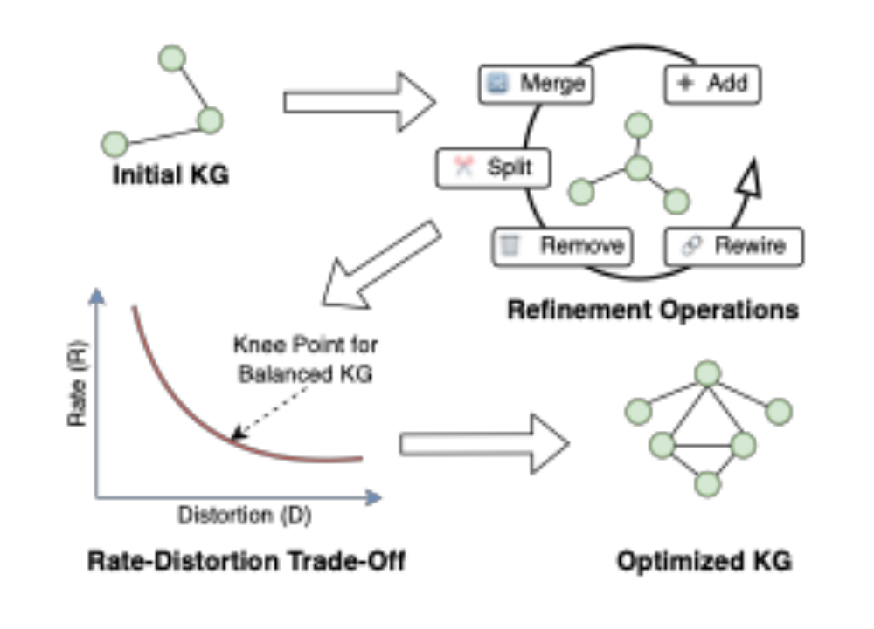
Refinement Operators: How The KG is Improved
Add missing concepts
Split overloaded nodes
Merge redundant nodes
Remove low-support concepts
Rewire prerequisite / relatedTo links
Each operation accepted only if it improves the RD objective
Notes:
The refinement process is key to our method.
We apply five types of operations:
Add nodes when the alignment shows some lecture content is under-represented.
Split nodes when a single concept is overloaded with heterogeneous content.
Merge nodes when two concepts are nearly duplicates.
Remove nodes with negligible support.
Rewire relationships when the structure does not match lecture ordering or semantic connections.
Each operation is accepted only if it improves the rate-distortion objective.
This gives us a systematic path toward an optimized KG, not based on heuristics, but based on measurable improvement in representation quality.

Slide 15
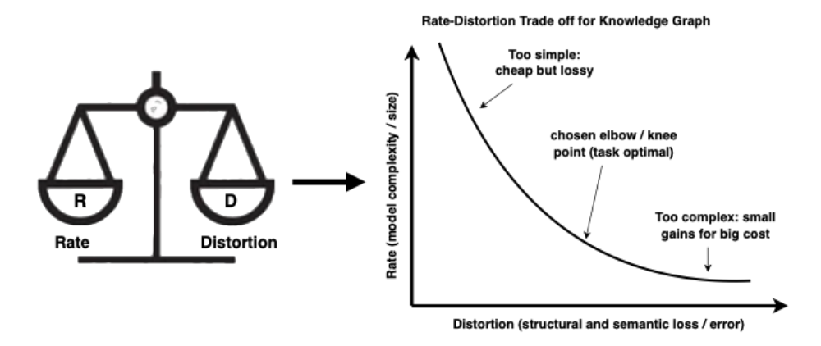
Rate-distortion Curve: Finding The “Knee Point”
RD curve tracks R vs. D across refinement steps
Knee = maximum curvature point
Represents compact yet faithful KG
Provides principled stopping criterion
Notes:
Across refinement steps, we record the rate and distortion, producing a rate–distortion curve.
This curve typically shows steep distortion reduction early on, followed by diminishing returns.
We identify the knee point, the place where further reduction in distortion would require a large increase in complexity.
This point represents the most efficient KG: compact yet still faithful.
This knee point becomes our principled stopping criterion.

Slide 16
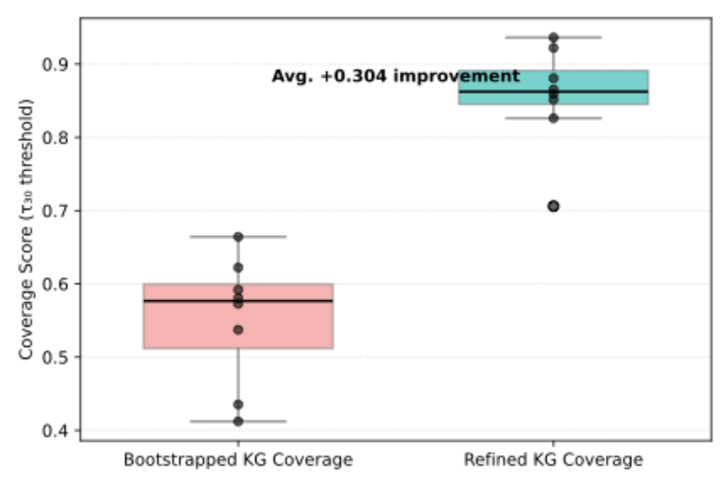
Coverage And RD Improvements
Average coverage improvement: +0.304
Significant reduction in distortion before knee point
Refinement reveals missing concepts and improves structure
Consistent across all 8 lectures
Notes:
The results show consistent and substantial improvements.
Coverage, the fraction of lecture segments aligned to at least one KG node, increased by an average of +0.304 across the eight lectures.
This means the refined KGs explained significantly more of the underlying instructional material.
The RD curves consistently showed steep early gains, validating the benefit of refinement, and the identified knee points achieved around 50% distortion reduction with only 30% of total possible complexity increases.

Slide 17
From Mastery Profile to Simulated Response
Synthetic student data helps:
  train knowledge tracing models before a course runs
  stress test a tutoring system across mastery levels
  pilot new test items before real students see them.
An LLM can solve almost every question in a curriculum:
  accuracy 96.8-100% from three LLMs on every profile, even for a struggling student with low mastery of most algebra concepts
How can it act like a student at a lower mastery level?
An, Y., Wang, E., Wang, B., and Hashmi, R., “From Mastery Profile to Simulated Response: Stochastic Student Knowledge Graphs (SSKG) for Faithful LLM Student Simulation”, arXiv e-prints, Art. no. arXiv:2608.21668, 2026. doi:10.48550/arXiv.2608.21668.

Slide 18
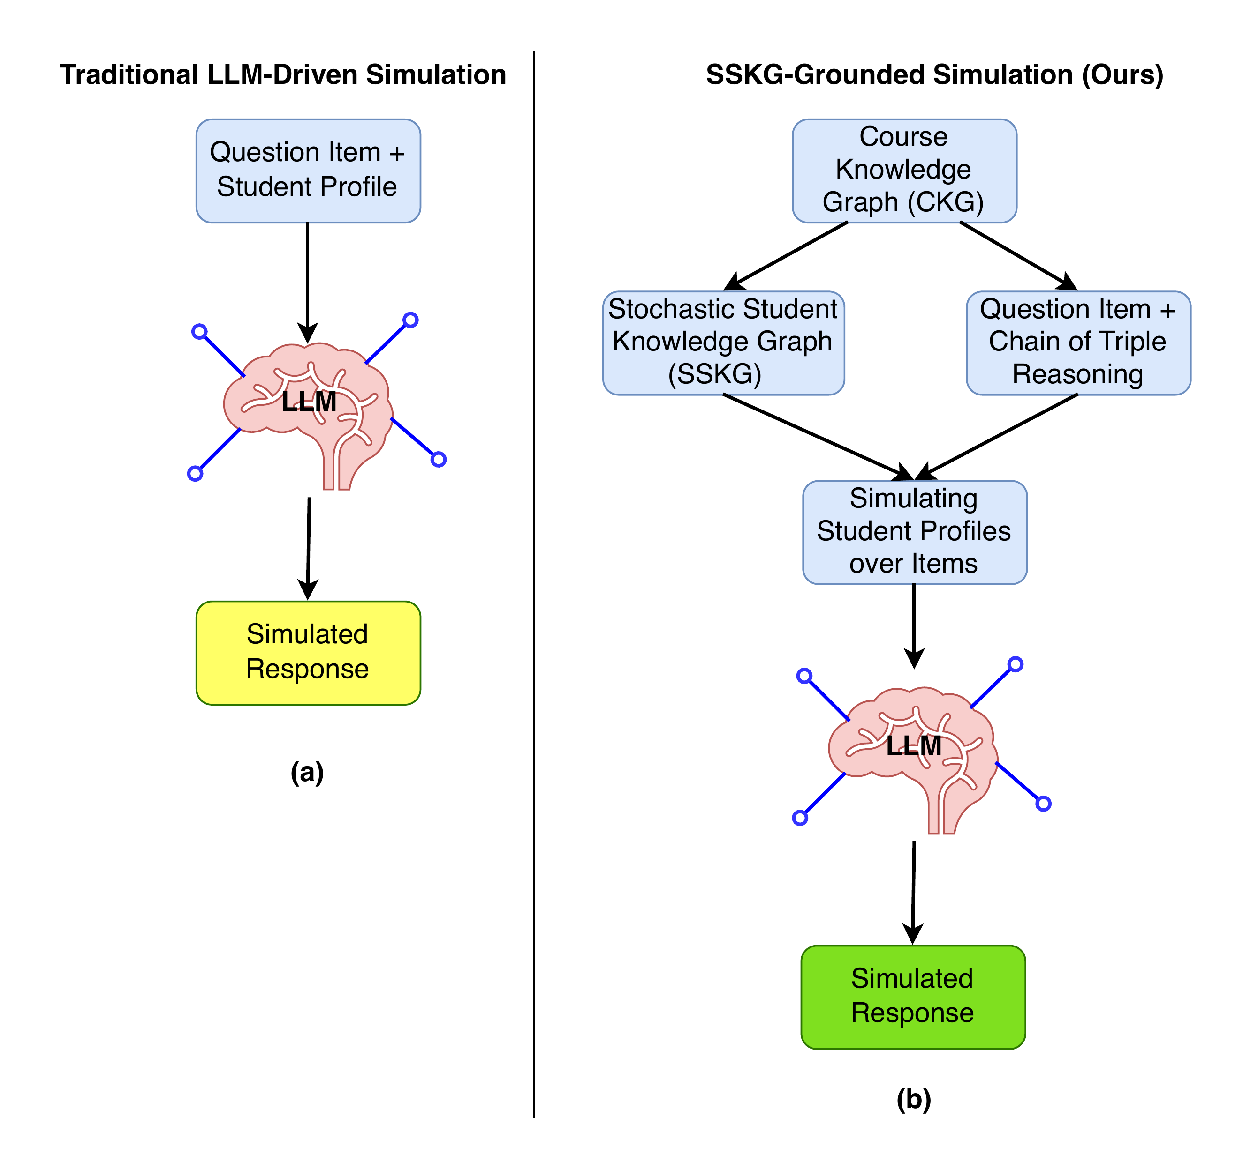
Decide with a Knowledge Graph
Build a Curriculum Knowledge Graph (CKG) of fine grained triples.
A student profile is an Stochastic Student Knowledge Graph (SSKG). It gives each triple a mastery probability.
Each question maps to the chain of triples needed to solve it.
Sampling over the chain decides the outcome.
The LLM then writes a first person rationale that matches the outcome.
Notes:
Walk the figure left to right. Left is the traditional pipeline.
Right is ours.
The CKG is built once from course material.
A student profile is an SSKG that gives each triple a mastery probability.
Each question maps to a chain of triples. We sample to decide correct or wrong. Only then does the LLM write the rationale.

Slide 19
Properties of a Faithful Simulator
Property | Meaning | Metric
Prop1 Monotonicity | A student with higher mastery on every triple should do at least as well. | M1, M2
Prop2 Skill specificity | Errors should fall on items that draw on the student's weak region. | M3
Prop3 Diagnosability | A wrong answer should trace to a specific low mastery triple in its chain. | M4
Notes:
These properties drive the metrics later. Prop1 maps to M1 and M2. Prop2 maps to M3. Prop3 maps to M4.

Slide 20
SSKG and student profiles
Profile | Archetype | Mastery per triple
P1 | Near expert | U(0.85, 0.99) all triples
P2 | Average, inconsistent | U(0.50, 0.70) all triples
P3 | Struggling | U(0.10, 0.30) all triples
P4 | Prerequisite gap | U(0.10, 0.25) early, U(0.60, 0.80) later
P5 | Strong basics, weak advanced | U(0.80, 0.95) early, U(0.15, 0.35) later
Notes:
An SSKG gives every CKG triple a mastery probability. For the 864 triples that is an 864 dimensional vector. Five profiles. P1 to P3 are uniform. P4 and P5 are diagnostic: they put the gap in different regions. Early means chapters 1 and 2, which is 214 triples. The items split 140 early only, 143 mixed, 96 later only.

Slide 21
Two-Stage Procedure
Stage 1 Decide
For each step in the chain, draw knows ~ Bernoulli(p).
If the student knows it, draw slips ~ Bernoulli(0.05).
A step succeeds if it is known and not slipped.
The item is correct only if every active step succeeds.
On failure, pick the wrong choice from the distractor map.
Stage 2 LLM Narrate
Input. The outcome, the trace of which steps failed, and the student's SSKG for this chain.
Task. Write a first person rationale that matches the outcome.
The LLM cannot change the answer.
Notes:
Stage 1 has no LLM call. It is deterministic given a recorded seed. Each chain step has two Bernoulli draws: does the student know it, and if so, do they slip. Slip rate is 0.05. This idea comes from Bayesian knowledge tracing. The item is correct only if every active step succeeds, which is the DINA rule from cognitive diagnosis. Definitional triples are demoted, in the spirit of G-DINA. DINA: Deterministic Input, Noisy “And” gate model.

Slide 22
Evaluation setup. Seven baselines and a scatter control
ID | Method | Controls ability
B1 | Vanilla LLM, no student description | nothing
B2 | Persona prompt | the prompt
B3 | Level prompt, 1 to 5 (Benedetto et al.) | the prompt
B4a | Skill list prompt, student voice (Lu and Wang) | the prompt
B4b | Skill list prompt, teacher predicts student | the prompt
B5 | Persona plus chain of thought | the prompt
B6 | Persona plus two worked examples | the prompt
B7 | Scatter control, same error count as ours | nothing
Ours | SSKG simulation | per triple mastery
379 SAT Algebra questions, five profiles.
377 items in the comparison (two held out for B6).
Main LLM. Gemini 3.1 Flash-lite.
B1 and B2 also run on Claude Haiku 4.5 and GPT-5.4-mini.

Slide 23
Result 1. Baselines stay near the ceiling
Method | P1 | P2 | P3 | P4 | P5
B1 | 1.000 | 1.000 | 1.000 | 1.000 | 1.000
B2 | 1.000 | 0.997 | 0.968 | 1.000 | 1.000
B3 | 0.987 | 0.984 | 0.897 | n/a | n/a
B4a | 1.000 | 0.997 | 0.968 | 0.997 | 0.992
B4b | 1.000 | 0.894 | 0.865 | 0.912 | 0.976
B5 | 1.000 | 1.000 | 1.000 | 1.000 | 1.000
B6 | 1.000 | 0.997 | 0.966 | 0.995 | 1.000
B7 (scatter) | 0.859 | 0.578 | 0.446 | 0.475 | 0.602
Ours | 0.852 | 0.578 | 0.441 | 0.485 | 0.599
Seven baselines score 86.5 to 100%.
Ours spans 44.1 to 85.2%, a 41 point range.
P1 to P2 to P3 falls 85.2, 57.8, 44.1.
B7 matches our accuracy by design, so M1 cannot separate the two.

Slide 24
Results 2 and 3. Order and placement of errors
M2 Mastery ordering
M3 Gap localization
Method | M2
B1, B5 | 0.000
B2, B4a, B6 | about 0.90
B4b | 0.950
B7 (scatter) | 0.979
Ours | 0.982
Method | P4 gap | P5 gap
B2 | +0.000 | +0.000
B4a | -0.003 | +0.010
B4b | +0.010 | +0.030
B7 (scatter) | +0.062 | +0.001
Ours | +0.217 | +0.079
M2 cannot separate us from the scatter control.
M3 does. B7 has the same error count, but places errors at random.

Slide 25
SOLIR Links
Component | SOLIR link
Ontology and KG Construction and Transmission | Graph entropy
Actor Encoding and Updating | Continual post training
Quantifying knowledge divergence | Rate-distortion theory
Lateral merging across nodes | Distributed consensus

