Slide 1
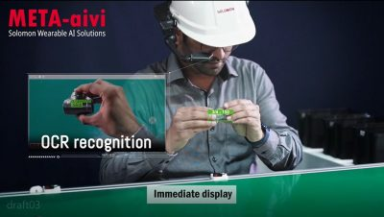

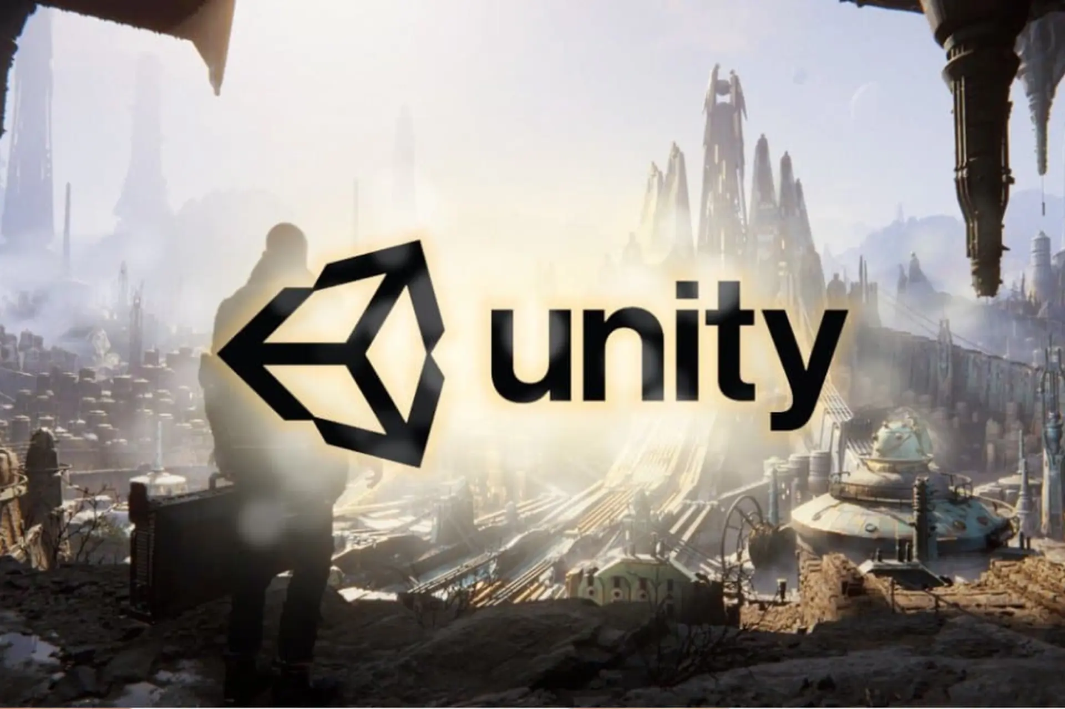
Introduction to Vuforia AR with Unity & Meta AIVI

Slide 2

What is Vuforia?
Vuforia is an Augmented Reality SDK
Enables image and object recognition
Supports Android, iOS, and UWP platforms

Slide 3
Vuforia Key Features
Image Targets
Model Targets
Object Recognition
Ground Plane
VuMarks
Cloud Recognition

Slide 4
Vuforia Image Targets
Recognizes and tracks 2D images
Used to place 3D objects over real-world images
Requires uploading target to Vuforia Target Manager
How to Create Image Targets ?
Video

Slide 5
Vuforia Model Targets
Tracks 3D objects using CAD models or scans
Ideal for industrial use (cars, machinery, etc.)
Supports Guide Views for alignment
How to Create Model Targets ?
Video

Slide 6
Setting Up Vuforia in Unity
Install Unity with Vuforia support
Enable Vuforia in XR settings
Import Vuforia Engine package
Create ARCamera and Target assets
Video

Slide 7
Using Image Targets in Unity
Upload image to Vuforia Target Manager
Download database and import into Unity
Add Image Target Game Object
Attach content (3D models, animations)
Tutorial Video

Slide 8
Using Model Targets in Unity
Use Vuforia Model Target Generator
Import .fbx or .obj model
Generate and import target
Use Model Target prefab in Unity scene
PF525 Demo
Tutorial Video

Slide 9

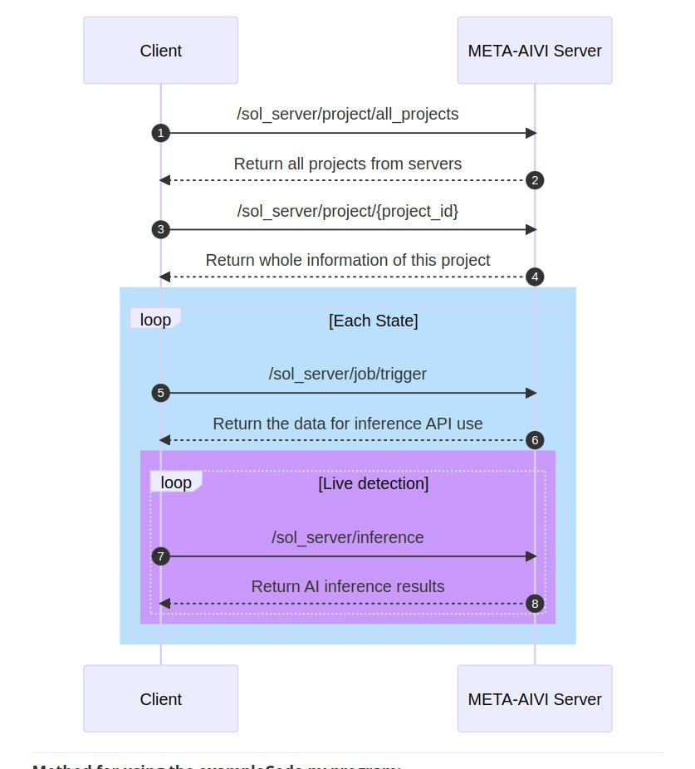
META-AIVI API intergration
There are a total of four major steps.
GetProjectList ➤ Retrieve all project IDs and their corresponding names from the server.
GetSingleProject ➤ Based on the project_id of the domain name, retrieve information about each level inside.
Register Jobs ➤ Enter the user-defined username, as well as the project-ID, model_id, and state_id corresponding to GetSingleProject. Then, the server will return a job-id. Note that a job must be registered each time a new state (level) is entered.
Inference ➤ Enter the state-Id, model_id, tool name obtained from GetSingleProject, and the job-id obtained through the RegisterJobs API. Afterward, you can use the Inference API to obtain detection results. In the returned result, please refer to the "rule" key inside the "data" section. It will record whether the state can be passed. The server will calculate, and if an object is detected continuously for five times, it will judge as True and allow to proceed to the next level (i.e., return True). If there is any interruption in between, it will return False.

Slide 10
Practice Topic
Target Object: Air Compressor
AR Engine: Vuforia
Platform: Unity 3D
AI Engine: Meta AIVI
Requirements & Setup
1. Vuforia
Obtain a Vuforia license key.
Prepare a 3D model of the air compressor.
Use Vuforia Model Target Generator or Polycam for scanning.
2. Meta AIVI
Set up a project on the Meta AIVI server.
Train or configure the AI model for the air compressor.
3. Unity (with Vuforia Integration)
Import and configure the 3D model as a Model Target.
Set up the ARCamera and place virtual content over the 3D model.
Access the camera feed in Unity.
Send the image/frame to Meta AIVI for inference.
Receive and display AI results (e.g., diagnostics, labels, instructions).

Slide 11
Practice Topic
Target Object: Air Compressor
AR Engine: Vuforia
Platform: Unity 3D
AI Engine: Meta AIVI
Sample code review
(30 mins)

Slide 12
Tips & Best Practices
Use high-quality targets (clear contrast, detail)
Optimize model geometry for Model Targets
Test on device frequently
Avoid reflective surfaces in models

Slide 13
Resources
developer.vuforia.com
Unity Documentation
Vuforia Forums
Tutorials (YouTube, blogs)

Slide 14
Questions?
Thank you

