Slide 1
CODERETRIEVER
SAMSUNG PRISM GENAI HACKATHON 2026 · THEME 1
Version-aware semantic code search that runs on a laptop CPU, with an optional GPU mode and a desktop app for any folder or GitHub repository.
Team: [Team name] · Members: [Names]

Slide 2
Find code by what it does, across every version
THE PROBLEM
P0
P1
Bonus
Retrieval accuracy
Retrieval across versions
Evolutionary retrieval
Given a programming problem in natural language, rank the correct solution first among 8,765 candidates. Scored by NDCG@10 and MRR on CoIR AppsRetrieval via MTEB, CPU first.
Search any release of a codebase, and rebuild the index quickly when a new version arrives.
Answer questions across all versions at once: where a function lives now, and when and how it changed.

Slide 3
Strong accuracy on CPU, near-instant re-indexing
RESULTS AT A GLANCE
84.03
80.70
99.5%
10.7×
NDCG@10 on AppsRetrieval test, CPU fp32 (submission run)
MRR@10 on the same run
Recall@100: the right solution is almost always in the top 100
Faster average re-index for a new version (psf/requests)
CPU and GPU give the same score to within 0.02 NDCG@10, so the CPU-first submission loses nothing. Searches over an indexed repository answer in about 80–130 ms.

Slide 4
Base EmbeddingGemma won every comparison
MODEL SELECTION
Benchmarked two strong small embedding models; our setup reproduced the published MTEB scores (84.39 and 75.34).
Fine-tuned EmbeddingGemma on the APPS train split with mined hard negatives (1,079 tuples, 161 min on the laptop GPU).
The fine-tune lost on the held-out dev set (76.28 vs 79.41) and on test, so the base model was kept.
Test data was never used for training or for choosing the model.

Slide 5
Plain problem text beat engineered query views
QUERY PREPROCESSING
The pre/post pipeline splits each problem into views (story, core task, input/output spec) and blends their embeddings.
Adding the narrower views lowered the score, so the submission embeds the full statement only.
An optional post-step runs candidate solutions against the examples in the problem and promotes the ones that pass.

Slide 6
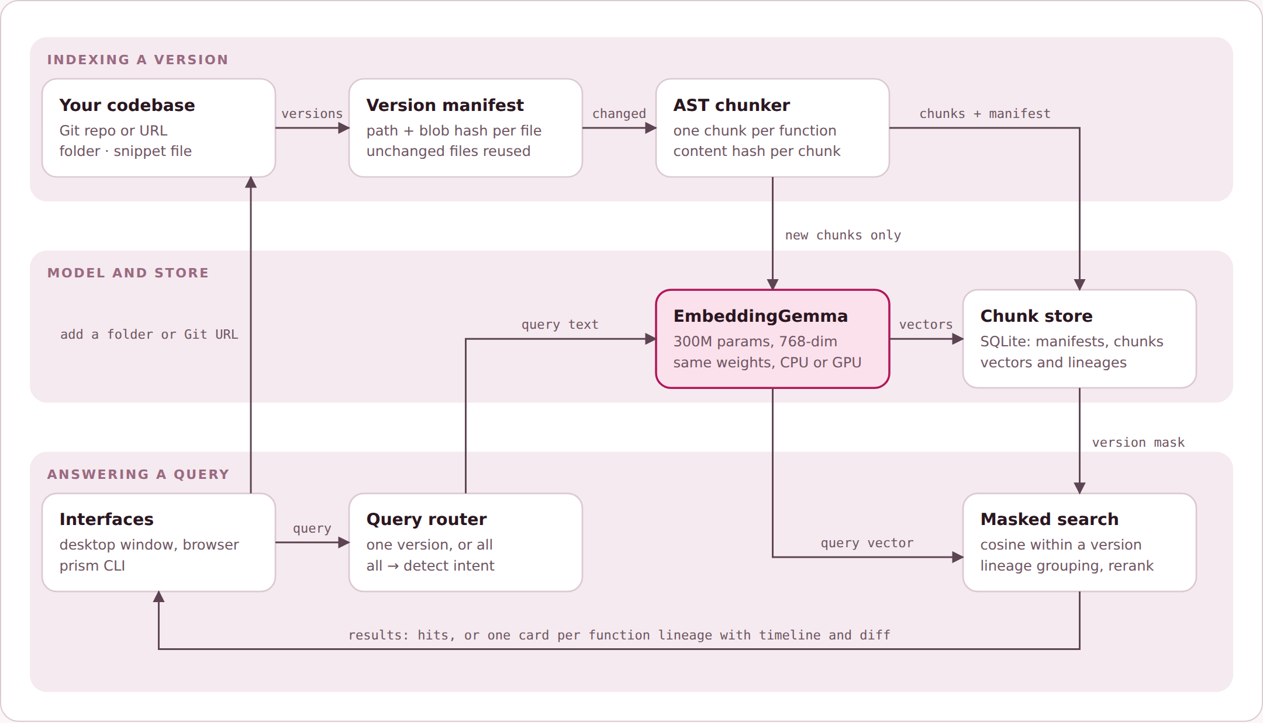
Two paths, one model and one store
ARCHITECTURE
Indexing: Git or folder → per-file blob hash → AST chunks (one per function) → embeddings for new chunks only.
Store: SQLite holds manifests, chunks, vectors and function lineages; NumPy does exact cosine search.
Query: a router picks one version or detects intent across all versions, then searches inside that version's mask.
Same weights on CPU and GPU, so switching device never invalidates an index.

Slide 7
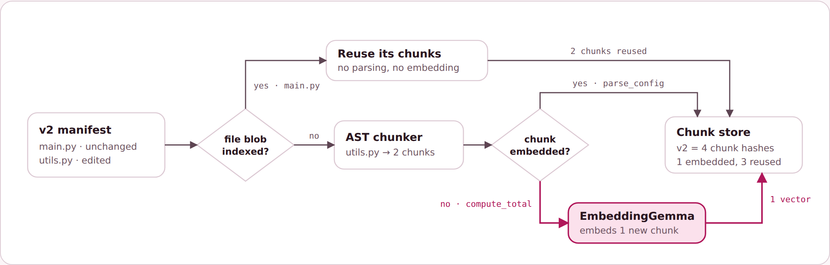
A new version only embeds the code that changed
P1 · RETRIEVAL ACROSS VERSIONS
Version | Chunks | Newly embedded | Reused | Time
v2.30.0 | 533 | 533 | 0% | 6.43 s
v2.31.0 | 534 | 4 | 99.3% | 0.13 s
v2.32.0 | 558 | 88 | 84.2% | 1.46 s
v2.32.3 | 559 | 7 | 98.7% | 0.22 s
Each file is identified by its Git blob hash; unchanged files are skipped without parsing.
Each function is identified by a content hash; unchanged functions reuse their stored vector.
A version is a manifest of chunk hashes. Searching it masks the vector matrix to exactly that manifest.
psf/requests, four releases, RTX 4060
Unit-test example: v2 edits one function, so only 1 of 4 chunks reaches the model.

Slide 8
Search the whole history of a function
BONUS · EVOLUTIONARY RETRIEVAL
01
Lineages
Functions are linked across versions by path and name, followed through file renames, and matched by hash or embedding similarity when code moves.
02
Intent routing
"parse_config in v1.2" searches that version; "when was the retry limit changed" finds the version where it changed; anything else ranks the latest code.
03
Timeline and diff
Each result shows the versions the function appears in, marks where it changed, and shows the diff for that change.

Slide 9
Point it at a folder or a GitHub URL
DESKTOP APPLICATION
Add
Index
A local folder (with a folder picker) or a Git HTTPS link; repositories are cloned and their tags and branches listed as versions.
Tick the versions to index; the app shows chunks embedded versus reused for each one.
Search
CPU / GPU
Plain-language queries over one version or all versions, with timelines and diffs.
One toggle switches device at runtime; indexes stay valid because the weights are the same.
Python backend with a local HTTP API, pywebview (WebView2) window, black-and-white UI with overlay sidebars and macOS-style window controls. Also runs in a browser, from the CLI, or in Docker.

Slide 10
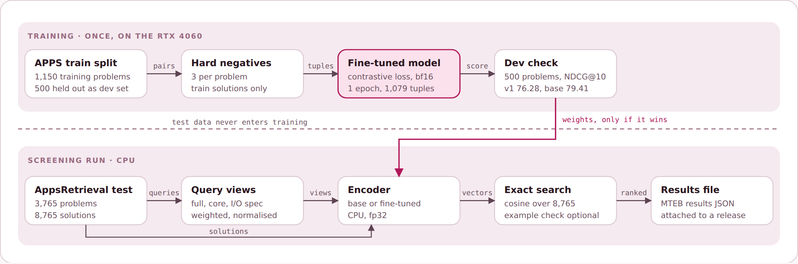
From training data to the MTEB results file
SCREENING SUBMISSION
PrePostPipelineEncoder (an MTEB AbsEncoder) wraps the chosen model and query preprocessing. The official run on CPU wrote results/appsretrieval_results.json: 84.03 NDCG@10 in 98 minutes.

Slide 11
Measure first: the base model beat our fine-tune
WHAT WE LEARNED AND WHAT IS NEXT
Learned
Next
Fine-tuning on about 1k examples lowered both dev and test scores; the held-out dev set caught this before submission.
Some mined hard negatives were near-duplicate problems, which likely acted as false negatives.
Recall@100 is 99.5%, so the remaining headroom is in ranking, not retrieval.
Content hashing makes version indexing almost free after the first version.
A reranker that fits beside the embedder in 8 GB, to lift top-1 accuracy.
Gentler adaptation: LoRA, lower learning rate, de-duplicated negatives.
Down-weight test files in repository search.
One-click Windows installer with bundled fonts.

Slide 12
CODE, RESULTS, DEMO
THANK YOU
github.com/SOMASEKAR17/CodeRetriever
Tag: PRISM_GENAI_HACKATHON_Y2026 · Demo video linked in the README

