Slide 1
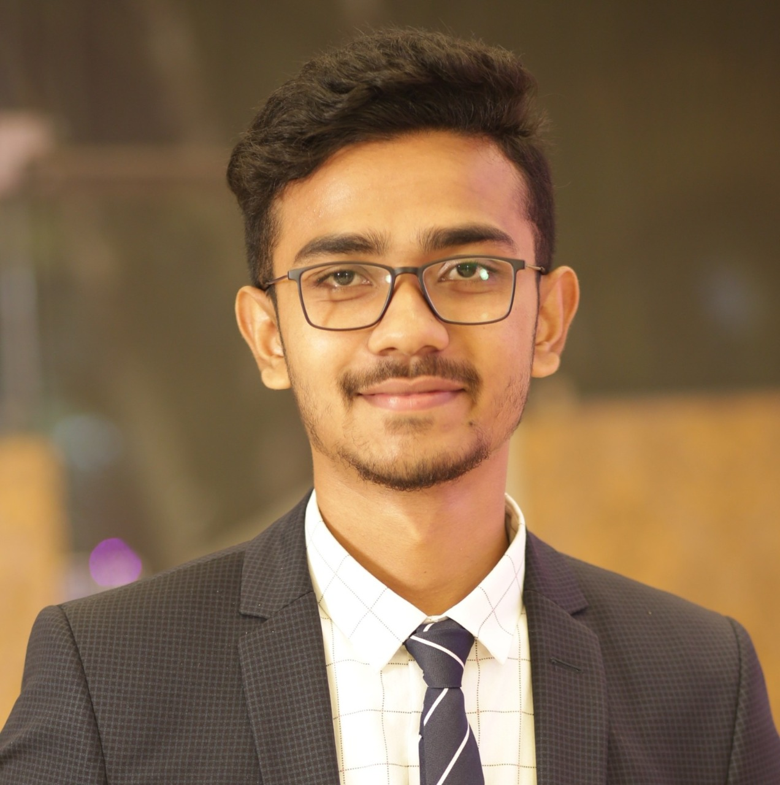

Somshubhra Roy
Bachelor of Technlogy, Computer Science and Engineering : 2018-2022
Analyst/Software Engineer
Skills
C# | Basics, OOPS, Exception Handling ,Arrays ,Collection and Generics, Delegates and Events, File Io and Serialization.
.NET Framework | Architecture which includes CTS,CLS,FCL,BCL and CLR.
Ado.net | Basics Architecture
Database | SQL
Tools | GIT
UI Technology | HTML5 ,CSS & Angular
Add On Skills | Communication Skills, Team Management, UI Designing(Sketching).
Mumbai
somshubhra.roy@capgemini.com
+91 7980387718
A4
Full Stack Developer
Understanding of RDMS concepts using SQL Server.
Practical understanding of C# and SQL concepts using Visual Studio and SQL Server
Hands on experience in developing applications using .NET Framework, ADO.NET Core
Understanding of HTML5 , CSS and Angular Cli
Completed case study on Hotel Management System which is to simplify the day to day processes of the hotel. The system will be able to handle many services to take care of all customers in a quick manner. As a solution to the large amount of file handling happening at the hotel, this software will be used to overcome those drawbacks. Safety, easiness of using and most importantly the efficiency of information retrieval are some benefits the development team going to present with this system.
Technologies used:
ANGULAR
ASP.NET CORE
Microsoft SQL Server
Video Link : Click
GitHub Link

