Slide 1

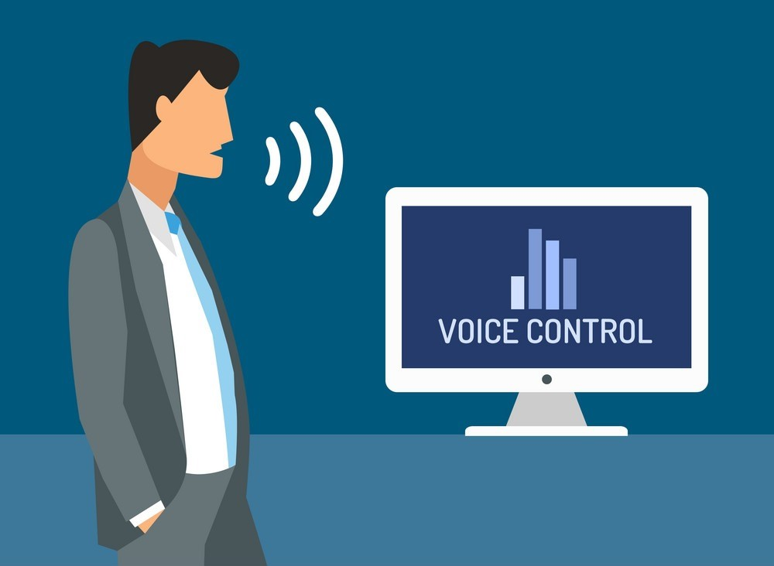
IDEA TITLE
FINK LINK
FINK LINK – It is a automation to control the laptop to
give the commands using AI.
The problem is mainly used for disabilities persons.
Our fink link main objectives is all human beings easily used the computer through voice command.

Slide 2
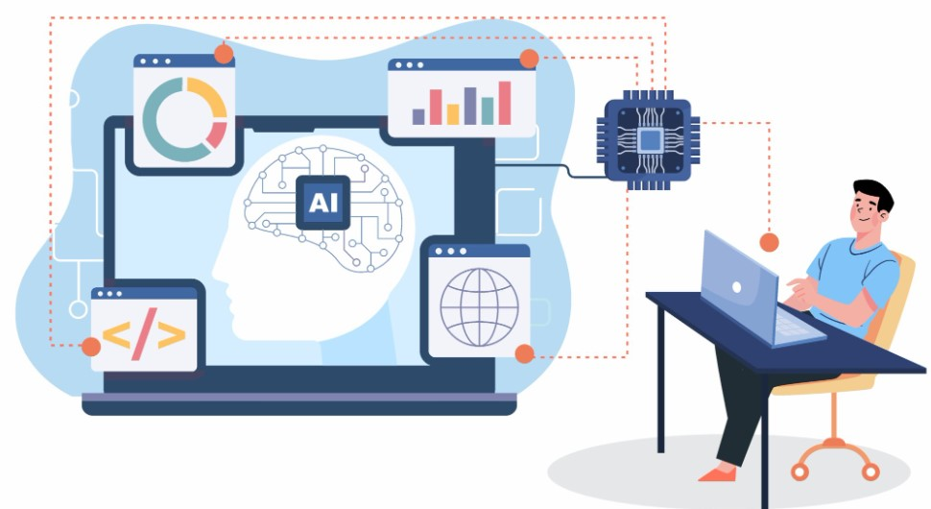
TECHNICAL APPROACH
Technologies used :
1. Python , AI , ML technologies be used the projects .
we imported the python libraries like speech recognition.
2. To give commands the our lap automation it is to do
something works implements .
3.Speech to text recognition – it convert our speech to
text convertion.
4. The use of voice recognition to enhance the user experience.

Slide 3

FEASIBILITY AND VIABILITY
The technology that enables machines to understand and respond to human voice commands .
Collecting and analyzing the software requirements to understand the designed functionality and performance .
30% of the total revenue generated by e-commerce websites will through voice searches .

Slide 4
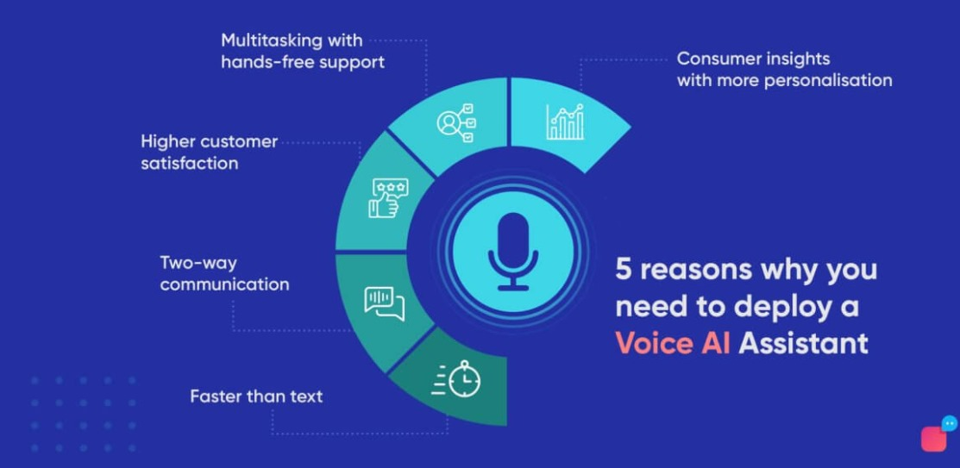
BENEFITS AND IMPACTS
COVENIENCE : Voice control can make it easier to do
things like call him , play music .
EASY ACCESS : Voice recognition and AI technology can
make more accessible .
EFFICIENCY IN VOICE OVER : AI can quickly process and
which can reduce the time .
Voice automation enables to work at peak performance with the
Elimination of distractions and unnecessary steps .

Slide 5
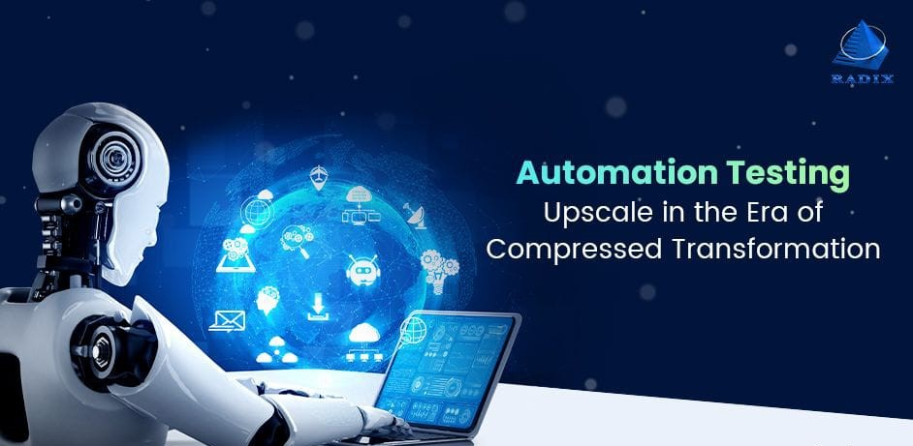
RESEARCH AND REFERENCE
Fink link is our mainly focus on disabilities persons to use easily through our voice command.
It works on AI and connect with IOT to control the whole system .
To give the commands in AI it will works our voice command.
for example : open whatsapp , call her , text good morning , chatbot.

