Slide 1



Mahendra Institute of Technology Department of CSE
INTRA INSTITUTIONAL IDEA COMPETITION
Title: EDU-PAY
25.11.2024
PRESENTED BY:
Sirisha
Somnath

Slide 2

WE ARE NOT INVOLVING THE COLLEGE MANAGEMENT

Slide 3

IDEA STATEMENT
Edu pay is the best way to pay your fee in online process.
This web helps the students to pay fee in a short period of time.

Slide 4
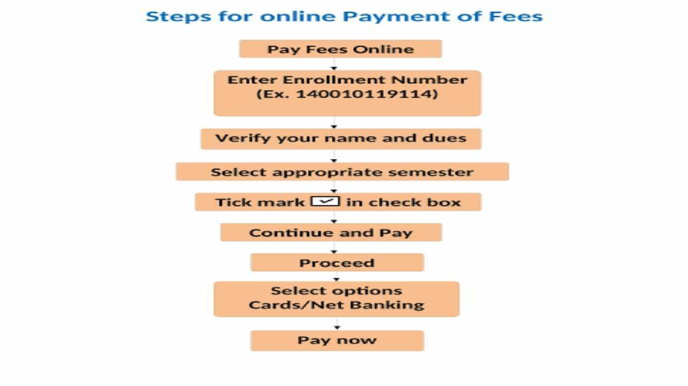
GOOGLE SHEETS
CHALLAN DETAILS
ADVISOR
ACCOUNTANT

Slide 5

ADVANTAGES FOR USING OUR EDU PAY
One click and your fees are paid. Fast, secure and simple fee payment.
Effortless fee payment, anytime and anywhere.
Very use full for students who are facing to pay fee in college queue.

Slide 6
TECHNOLOGIES USED:
In our Edu pay we are used frontend development .
* Html and CSS
*JavaScript
*Google Sheet
This web is an easy platform for students to pay they fees easily. This helps to students to know the technology in an advance way.

Slide 7
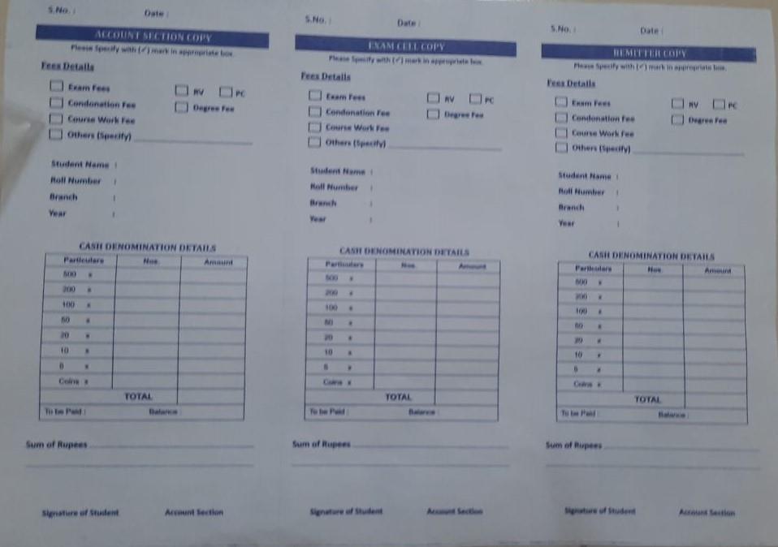
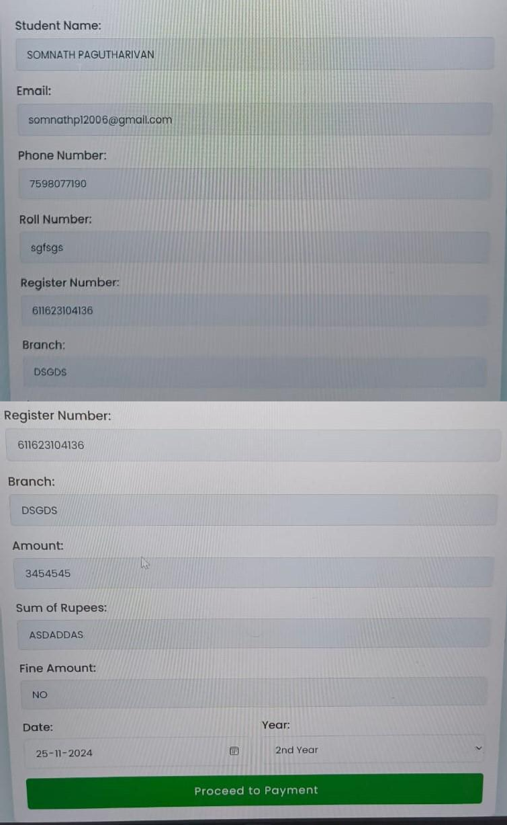
IN ADVANCE TECHNOLOGY WAY
WAY

Slide 8
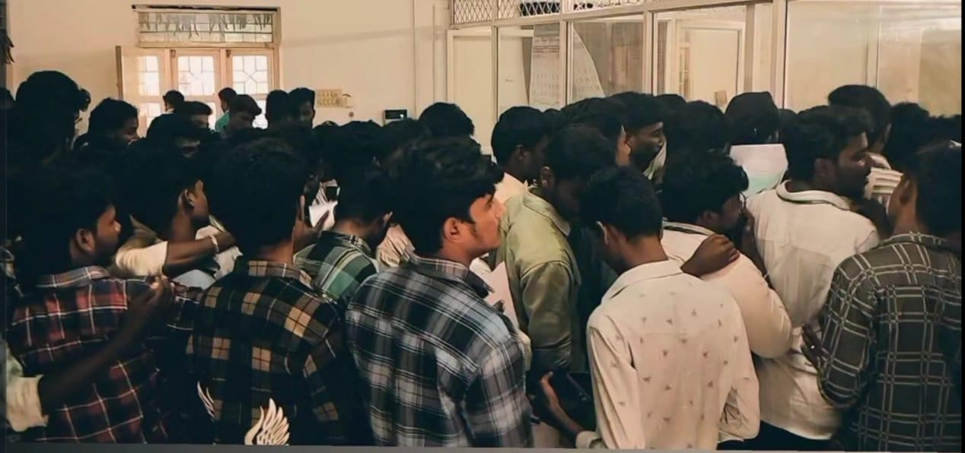
THE PROBLEM PRESENT WE ALL ARE FACING NOW

Slide 9
STUDENTS PROBLEMS :
In our college students are facing a lots of problems to pay they fee in a critical times.
It takes lots of time to pay fee while standing in line and students are missing some class through this problem. And they are

Slide 10
HOW TO USE EDU PAY
With the help of the mobile you can easily operate this Edu pay .
Just enter your name , roll number , department and year you can get your total fee details include the fine amount.
By using Net banking, you can process your payment, and you will get the receipt fast.

Slide 11


THANK YOU
https://somu3103.github.io/edupay/

