Slide 1

Introduction to SaneQL
COMPILER DESIGN PROJECT
Presented By:
Mayank Mishra (211210038)
Sonali Kashyap (211210065)

Slide 2
Table of Content
A Critique of Modern SQL And A Proposal Towards A Simple and Expressive Query Language
Section 1: Critique of Modern SQL
Section 2: Syntax-Related Challenges
Section 3: Lack of Extensibility and Abstraction
Section 4: SaneQL: A New Query Language
Section 5: How It works
Section 6: Parser Process
Section 7: Implementation Details

Slide 3
CRITIQUE OF MODERN SQL
1.1. Irregular Pseudo-English Syntax
Complex Grammar: The irregularity of modern SQL makes it hard to learn, write, and implement, leading to impenetrable error messages.
Challenges for Learners: SQL's irregular syntax poses difficulties for learners, especially when faced with real-world queries.

Slide 4
CRITIQUE OF MODERN SQL
1.2.Lack of Extensibility and Abstraction
Absence of Abstraction: SQL lacks mechanisms for abstraction, hindering its power and flexibility.
Functional Limitations: The inability to define new operators and pass expressions limits the language's capabilities.

Slide 5
CRITIQUE OF MODERN SQL
1.3: Semantic Ordering Constraints
Implicit Ordering Rules: Semantical ordering constraints not visible in the syntactic structure.
Lack of Portability: SQL's lack of portability across different systems.

Slide 6
Syntax-Related Challenges
2.1: Unhelpful Error Messages
Impenetrable Messages: SQL's irregular grammar leads to unhelpful error messages, making debugging and implementation challenging.
Compile Time Errors: A significant number of queries result in compile time errors, indicating the syntax-related challenges faced by learners.

Slide 7
Syntax-Related Challenges
2.2: Lack of Syntactical Orthogonality
Inconsistent Syntax: The syntax of SQL lacks orthogonality, leading to difficulties in writing and understanding complex queries.
Implicit Ordering Rules: SQL relies on implicit ordering rules that are not visible in its syntactic structure, complicating query composition.

Slide 8
SaneQL: A New Query Language
3.1: Simple and Regular Syntax
Improved Learnability: SaneQL features a straightforward and consistent syntax, improving its learnability and ease of implementation.
Extensibility: SaneQL allows the definition of new operators that integrate seamlessly with the existing built-in ones, enhancing its capabilities.

Slide 9
SaneQL: A New Query Language
3.2: Embracing Core Principles
Multiset Semantics: SaneQL fully embraces the core principles behind SQL, especially multiset semantics, ensuring the enduring success of relational database technology.
Modularity: SaneQL enables the reuse of logic across queries, providing a more flexible and accessible language interface.

Slide 10
HOW IT WORKS
Input Receives an Saneql query string.
Lexical Analysis : Breaks down the query into individual tokens(keyword, identifier, operator etc.)
Syntactic Analysis : Checks if the token sequence adheres to Saneql grammar rules.
Semantic Analysis : Verifies if the tokens and their relationships makes sense within the context of Saneql.
Output: Produces a structured representation of the query , often as a parse tree or abstract syntax tree. This output can be used for further processing or query execution.

Slide 11
SANEQL PARSE PHASE
SANEQL Parser overview
Language: ANTLR ( Another tool for language Recognition)
Grammar: Saneql Parser
Lexer : Saneql Lexer
Purpose:
1. Parse Saneql queries
2. Validate syntax and semantics
3. Generate a parse tree for further processing

Slide 12
PARSER PROCESS
1.Lexical Analysis (Lexer)
Tokenization: Breaks the input query into tokens.
Ignoring whitespaces and comments: Removes unnecessary characters.
Recognizing keywords, identifiers, literals, and symbols: Identifies the basic components of the AQL query.
2. Syntax Analysis (Parser)
Constructing a parse tree: Builds a hierarchical representation of the query.
Validating the query's syntax: Checks if the query adheres to the defined grammar rules
Checking for semantic errors: Verifies the meaningfulness of the query.
3. Semantic Analysis (Parser)
Validating the correctness of the query: Ensures the query is logically correct.
Checking for undeclared variables: Identifies variables that are not declared
Ensuring correct usage of functions and operators: Verifies the proper use of AQL functions and operators.

Slide 13
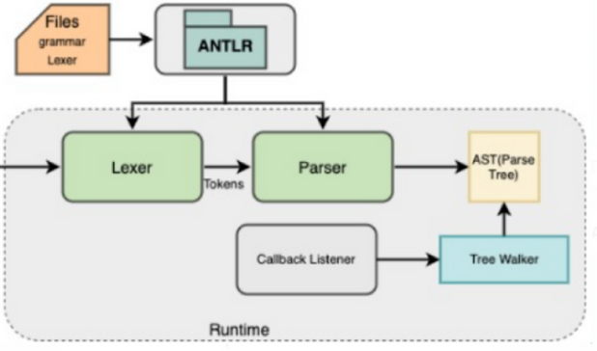
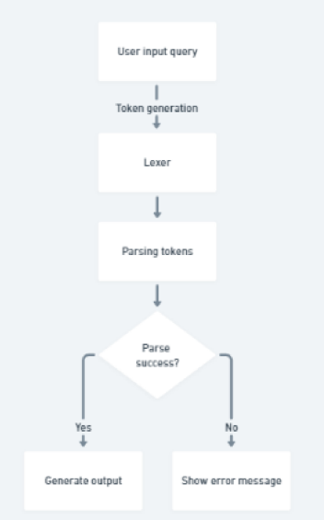
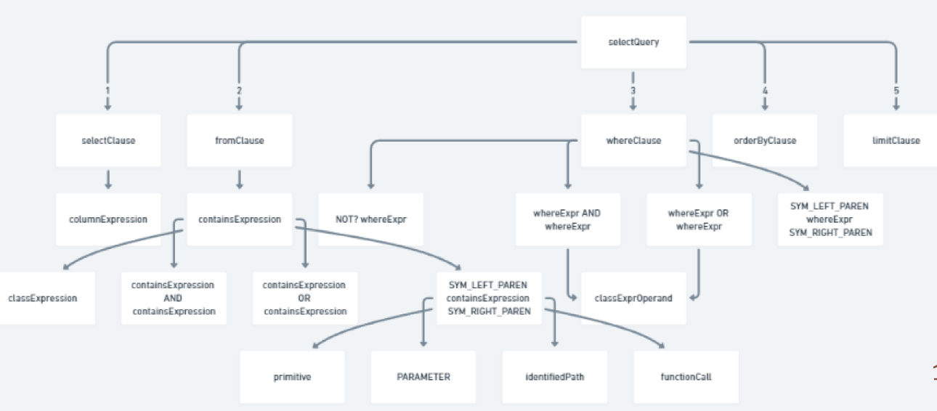
PARSER PROCESS

Slide 14
Conclusion
4.1: Implementation of SaneQL
Mapping to Relational Algebra: SaneQL's straightforward mapping to relational algebra makes it a promising alternative query language.
Interactive Query Construction: SaneQL's step-by-step semantics can lead to powerful and intuitive interactive query construction interfaces.

Slide 15
Conclusion
4.2: Future Research
Physical Query Plans: Future work includes the potential use of SaneQL to represent physical query plans, enhancing its practical applications.
Integration into Host Languages: Exploring the integration of SaneQL into host languages to expand its usability and adoption.

Slide 16
Thank You

