Slide 1
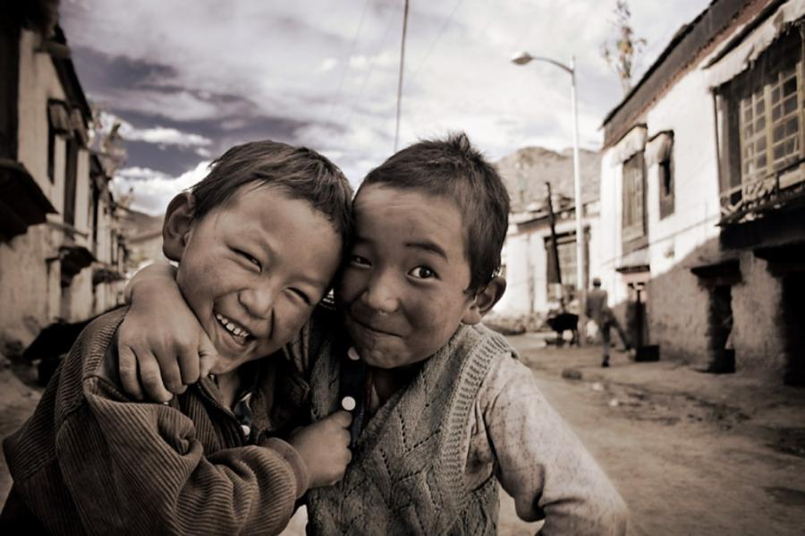
Medi Serve
Objective :
The objective of our team is to provide generic medicines after reducing its cost to those who are unable to afford these high price medicines as our tag-line says “RIGHT TO LIVE HEALTHY INDIA”. So we decided to add these generic stores to our web page to provide medicines at the cheapest cost to the people below poverty line.

Slide 2
Title
We are team UNITEDCREATION and our title of web page is Medi-Serve means to serve our medical services to the people below poverty line because it is the right of every Indian to be healthy and safe.

Slide 3
Solution of the Problem
As we know that poor peoples are dying due to an inevitableble reason that, is they can’t afford costly medicines as the diseases are also spreading among all over world very fastly. And there are government stores for the medicines but everyone can’t reach there. So the solution is that we will design such a website to connect these generic medicines stores, so that everyone can easily get these medical services and for providing cheapest medicines , we have a donation section where peoples can donate money and on website, we will allow ads of different companies, and earnings by them will help us to provide these generic medicines at more cheapest cost.

Slide 4
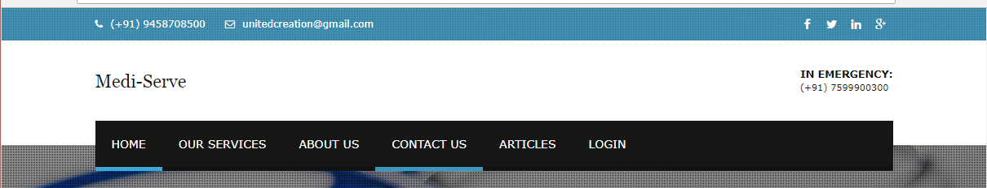
Navigation bar
The navigation bar contains all the information of page
Home
Our services
About us
Contact us
Articles
Login

Slide 5
Content
Content section of our page contains -
Buy medicines – to purchase medicines
Customer-corner- for emergency services, healthy tips, donation
Medical services and resources
Who we are – to reach us
Disease outbreaks- current diseases and their precaution and cure
Contact us
Join us

Slide 6
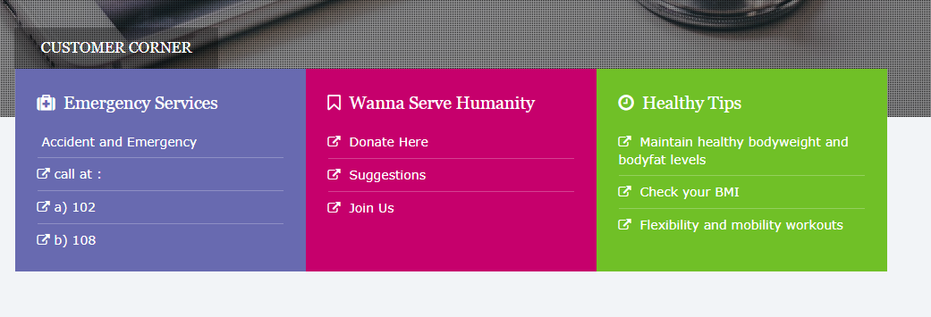

screenshots

Slide 7

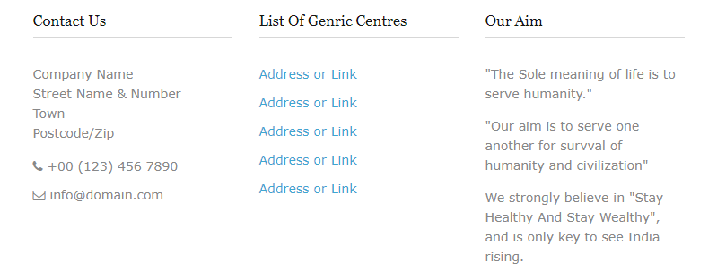

Slide 8
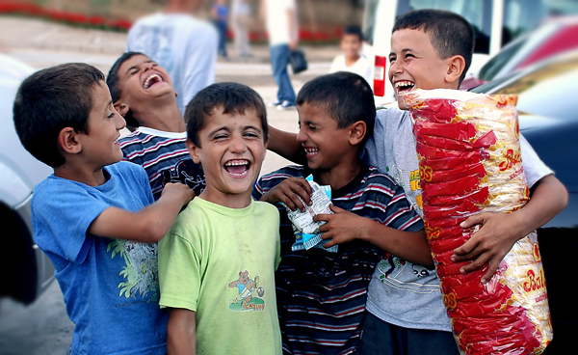
footer
Lastly we have footer with copyrights and yah!! We have created it with love... To be the reason behind millions of smiles...

Slide 9
Our Goal
And lastly UNITEDCREATION (“Anjali , Hemant , Sonali , Suraj”) want to say that we will work on this project till we will not accomplish all our objectives......

