Slide 1

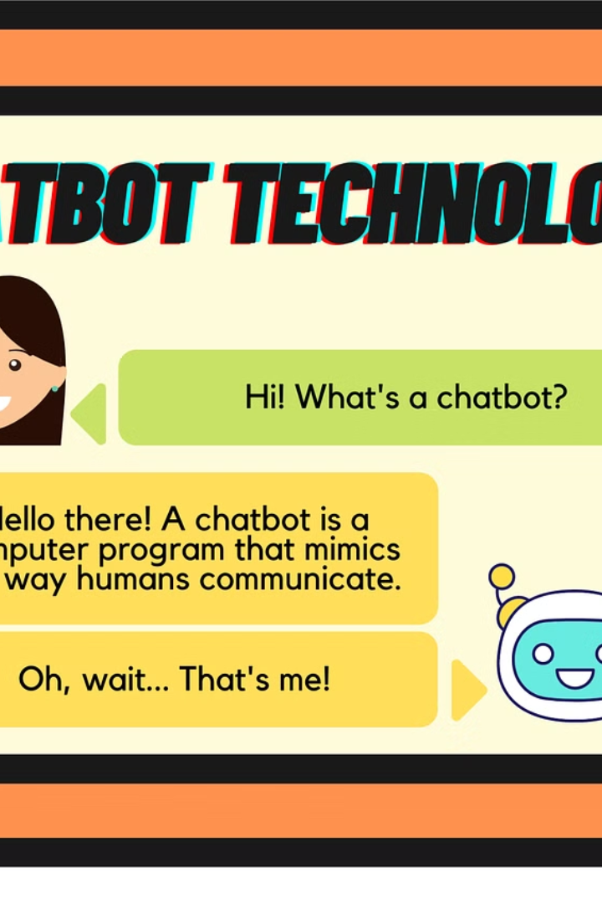
Introduction to Chatbots
Chatbots are AI-powered virtual assistants designed to facilitate communication between humans and computer systems. They are used extensively in various industries, including the stock market, to provide prompt and efficient customer service.
DS
by Devesh Soni

Slide 2
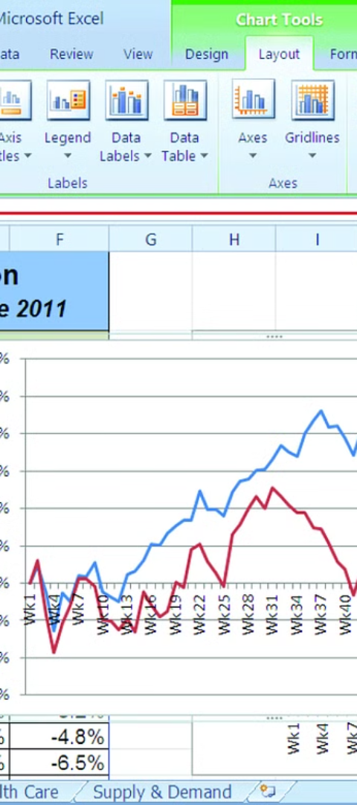
Overview of Stock Market Assistance
1
Real-Time Data Analysis
Chatbots can analyze stock market trends and provide real-time data to users for informed decision-making.
2
Portfolio Management
They assist in managing investment portfolios and offer personalized financial advice to users.
3
Automated Notifications
Chatbots can send automated alerts about price changes, news, and market movements.

Slide 3

Benefits of Using Chatbots for Stock Market Assistance
1
24/7 Availability
2
Efficient Customer Service
Chatbots provide round-the-clock support, ensuring users can access assistance at any time.
They enable quick resolution of queries and help users make informed investment decisions.
3
Personalized Recommendations
They offer tailored investment advice based on individual financial goals and risk preferences.

Slide 4

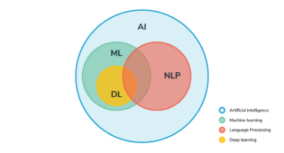
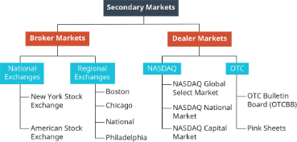
Features of an Excellent Chatbot for Stock Market Assistance
Advanced Analytics
Natural Language Processing
Integration with Trading Platforms
Ability to analyze complex data sets and generate comprehensive insights for users.
Understanding and responding to user queries in natural language for seamless interactions.
Seamless integration with stock trading platforms for portfolio management and trade execution.

Slide 5



Case Studies of Successful Chatbots in the Stock Market Industry
Wealthfront
Ally Invest
Sofi
Implemented chatbot assists users in making intelligent investment decisions and portfolio management.
Chatbot provides personalized investment advice based on user preferences and market trends.
Intelligent chatbot enables users to track market changes and manage their investment portfolios efficiently.

Slide 6

Challenges and Limitations of Chatbots for Stock Market Assistance
1
Complex User Queries
2
Data Security Concerns
3
User Trust and Reliability
Handling intricate financial questions that require human expertise and insight.
Ensuring the protection of sensitive financial information and maintaining privacy.
Building user trust in the accuracy and reliability of chatbot-generated insights and advice.

Slide 7
Best Practices for Designing and Implementing a Chatbot for Stock Market Assistance
User-Centric Design
Continuous Learning
Focus on creating a seamless and intuitive user experience for efficient interactions.
Implement machine learning algorithms to improve chatbot responses and insights over time.
Transparent Communication
Data Privacy Standards
Ensure clear communication about the chatbot's capabilities and limitations to users.
Adhere to strict data privacy regulations and maintain transparency in data usage.

Slide 8
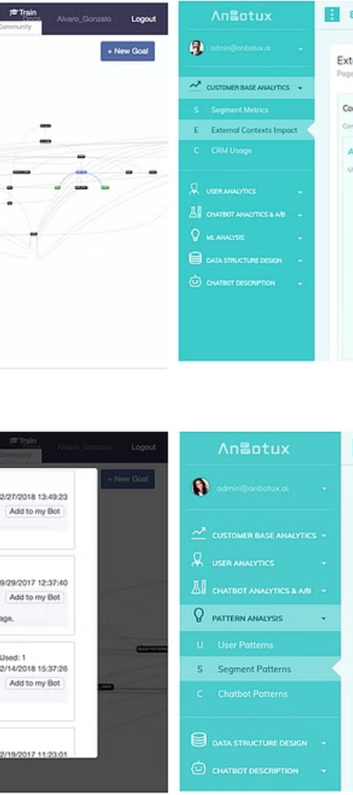
Conclusion and Key Takeaways
1
Empowering Financial Decisions
2
Ongoing Evolution
Continuous advancements in AI technology will further enhance the capabilities and reliability of chatbots.
Chatbots play a pivotal role in empowering users to make informed and efficient financial decisions.
3
User Experience Enhancement
Focus on enhancing the user experience and personalization for seamless interactions and support.

Slide 9

Thank You!

