Slide 1
Student Performance
Prediction System
Machine Learning Capstone Project
Soham Mukherjee
Domain – Machine Learning
Internship Capstone - SkillOrbit

Slide 2
Agenda
1
Project Overview & Objectives
2
Dataset & Preprocessing
3
Exploratory Data Analysis
4
Prediction Models & Results
5
Performance Dashboard
6
Recommendation System
7
Conclusion & Future Scope
Student Performance Prediction System
2

Slide 3
Project Overview
A machine learning system that analyzes student academic data to predict exam performance and generate targeted improvement recommendations - built around the workflow used in real EdTech and academic analytics platforms.
Objectives
Analyze student academic data
Predict performance levels (Low/Average/High)
Identify key factors affecting performance
Generate personalized insights
Visualize analytics through a dashboard
Student Performance Prediction System
3

Slide 4
The Dataset
StudentPerformanceFactors.csv
6,607 student records | 20 columns | Target: Exam_Score
Study Habits
Hours_Studied, Attendance, Tutoring_Sessions
Home Environment
Parental_Involvement, Family_Income, Parental_Education_Level, Distance_from_Home
Personal Factors
Sleep_Hours, Motivation_Level, Physical_Activity, Learning_Disabilities
Other
Access_to_Resources, Internet_Access, Teacher_Quality, School_Type, Peer_Influence, Gender, Extracurricular_Activities
Student Performance Prediction System
4

Slide 5
Data Preprocessing
Missing Values
Duplicates
3 categorical columns had gaps (67-90 rows). Filled with mode instead of dropping rows.
Checked and confirmed - none found in the dataset.
Encoding
Scaling
Ordinal columns (Low/Medium/High) mapped to 0/1/2 to preserve order; binary Yes/No columns mapped to 1/0.
Numeric features standardized with StandardScaler for the Linear Regression model.
Student Performance Prediction System
5

Slide 6
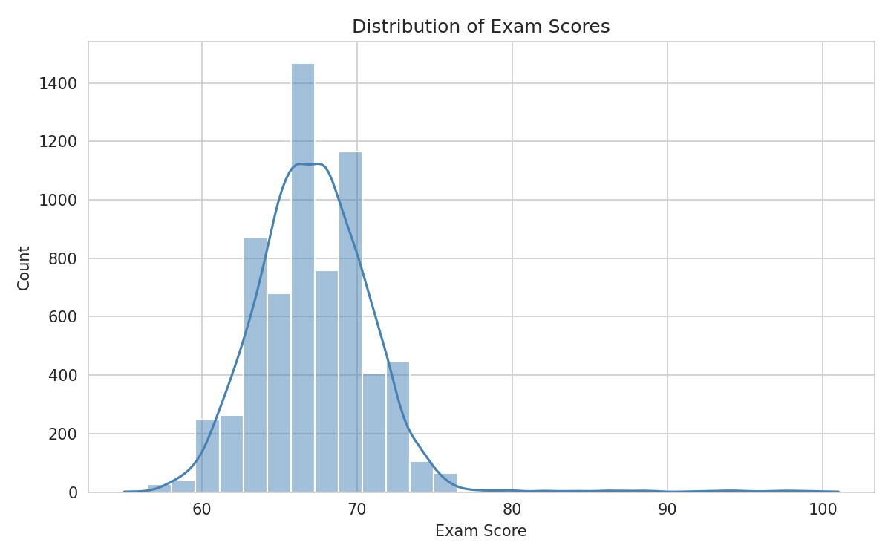
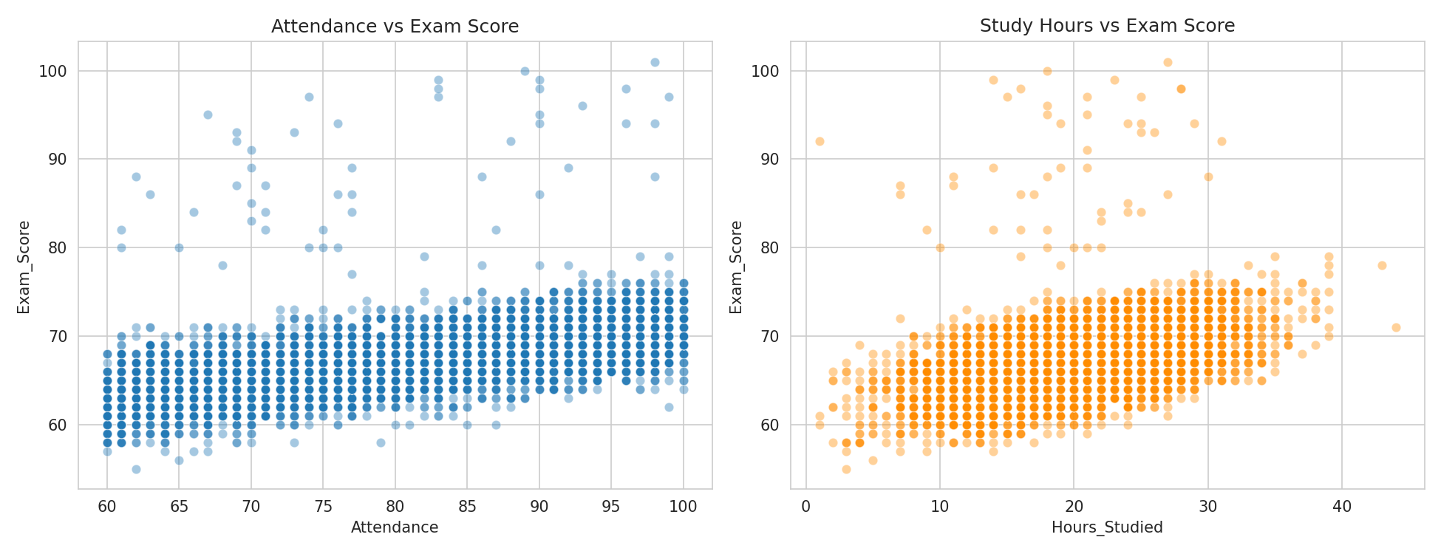
Exploratory Data Analysis
Score distribution & the two strongest predictors
Attendance and study hours both show a clear positive relationship with exam score.
Student Performance Prediction System
6

Slide 7
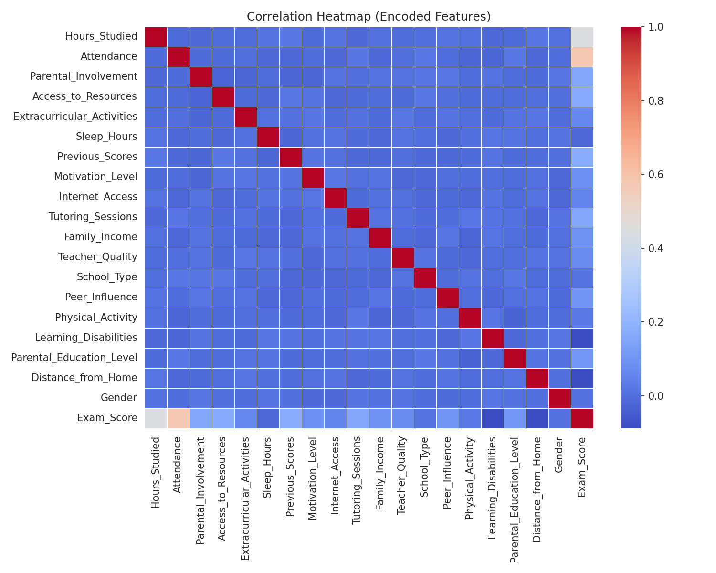
Correlation Heatmap
Student Performance Prediction System
7

Slide 8
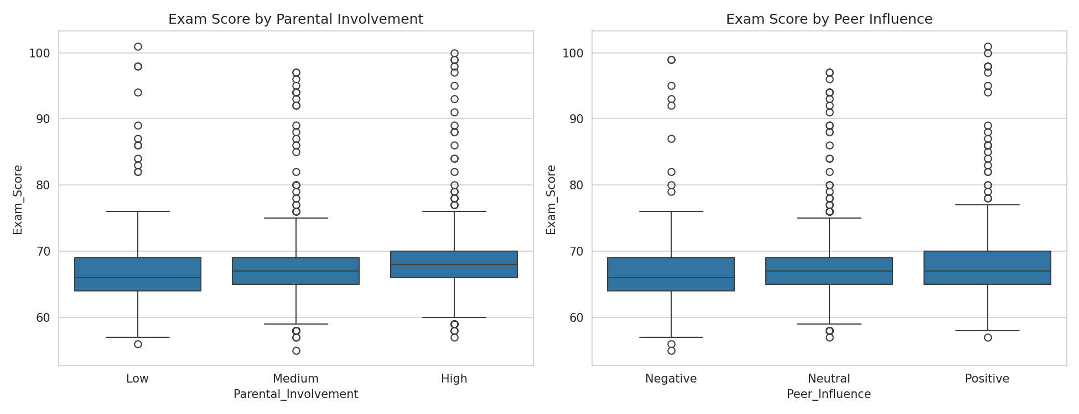
Score by Parental Involvement & Peer Influence
Higher parental involvement and more positive peer influence nudge scores up, though the spread within each group stays large.
Student Performance Prediction System
8

Slide 9
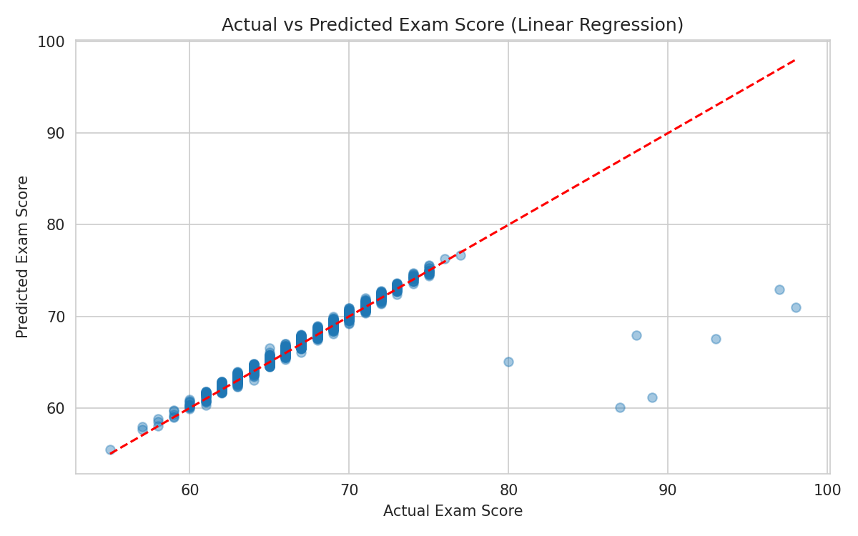
Predicting Exam Score (Regression)
Model | MAE | RMSE | R2 Score
Linear Regression | 0.444 | 1.799 | 0.771
Random Forest | 1.228 | 2.243 | 0.644
Decision Tree | 1.645 | 2.676 | 0.493
Linear Regression wins - the relationship between the top features and Exam_Score is close to linear, so the tree models' extra flexibility didn't help and led to mild overfitting.
Student Performance Prediction System
9

Slide 10
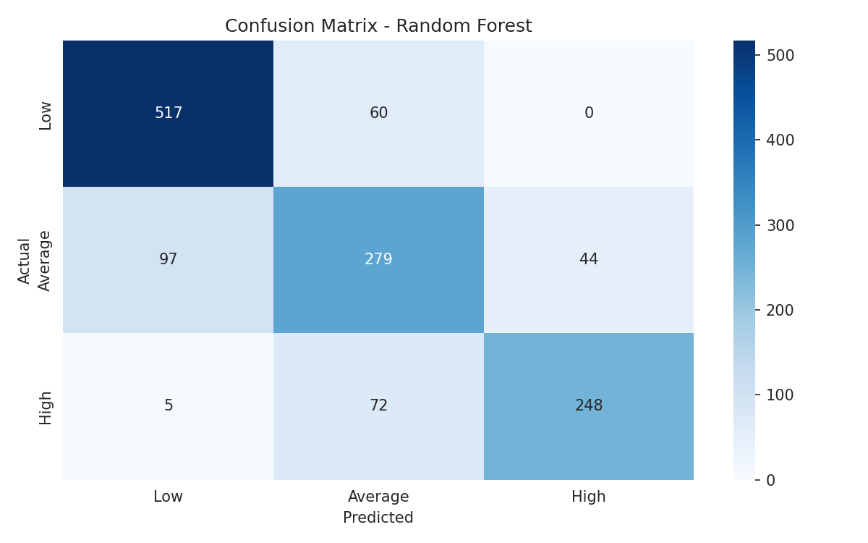
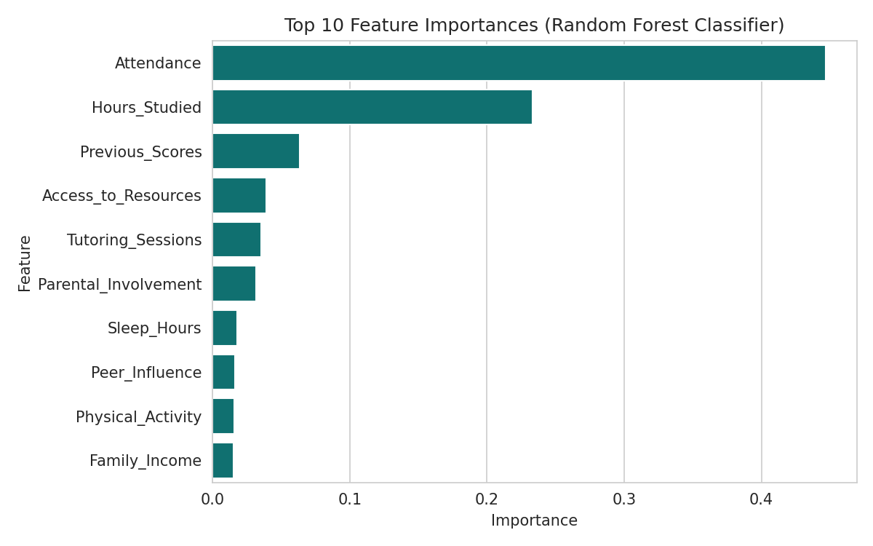
Predicting Performance Level (Classification)
Model | Accuracy
Random Forest | 78.97%
Decision Tree | 71.94%
Random Forest generalizes better than a single Decision Tree. Most errors happen between adjacent classes (Low <-> Average), not Low <-> High.
Student Performance Prediction System
10

Slide 11
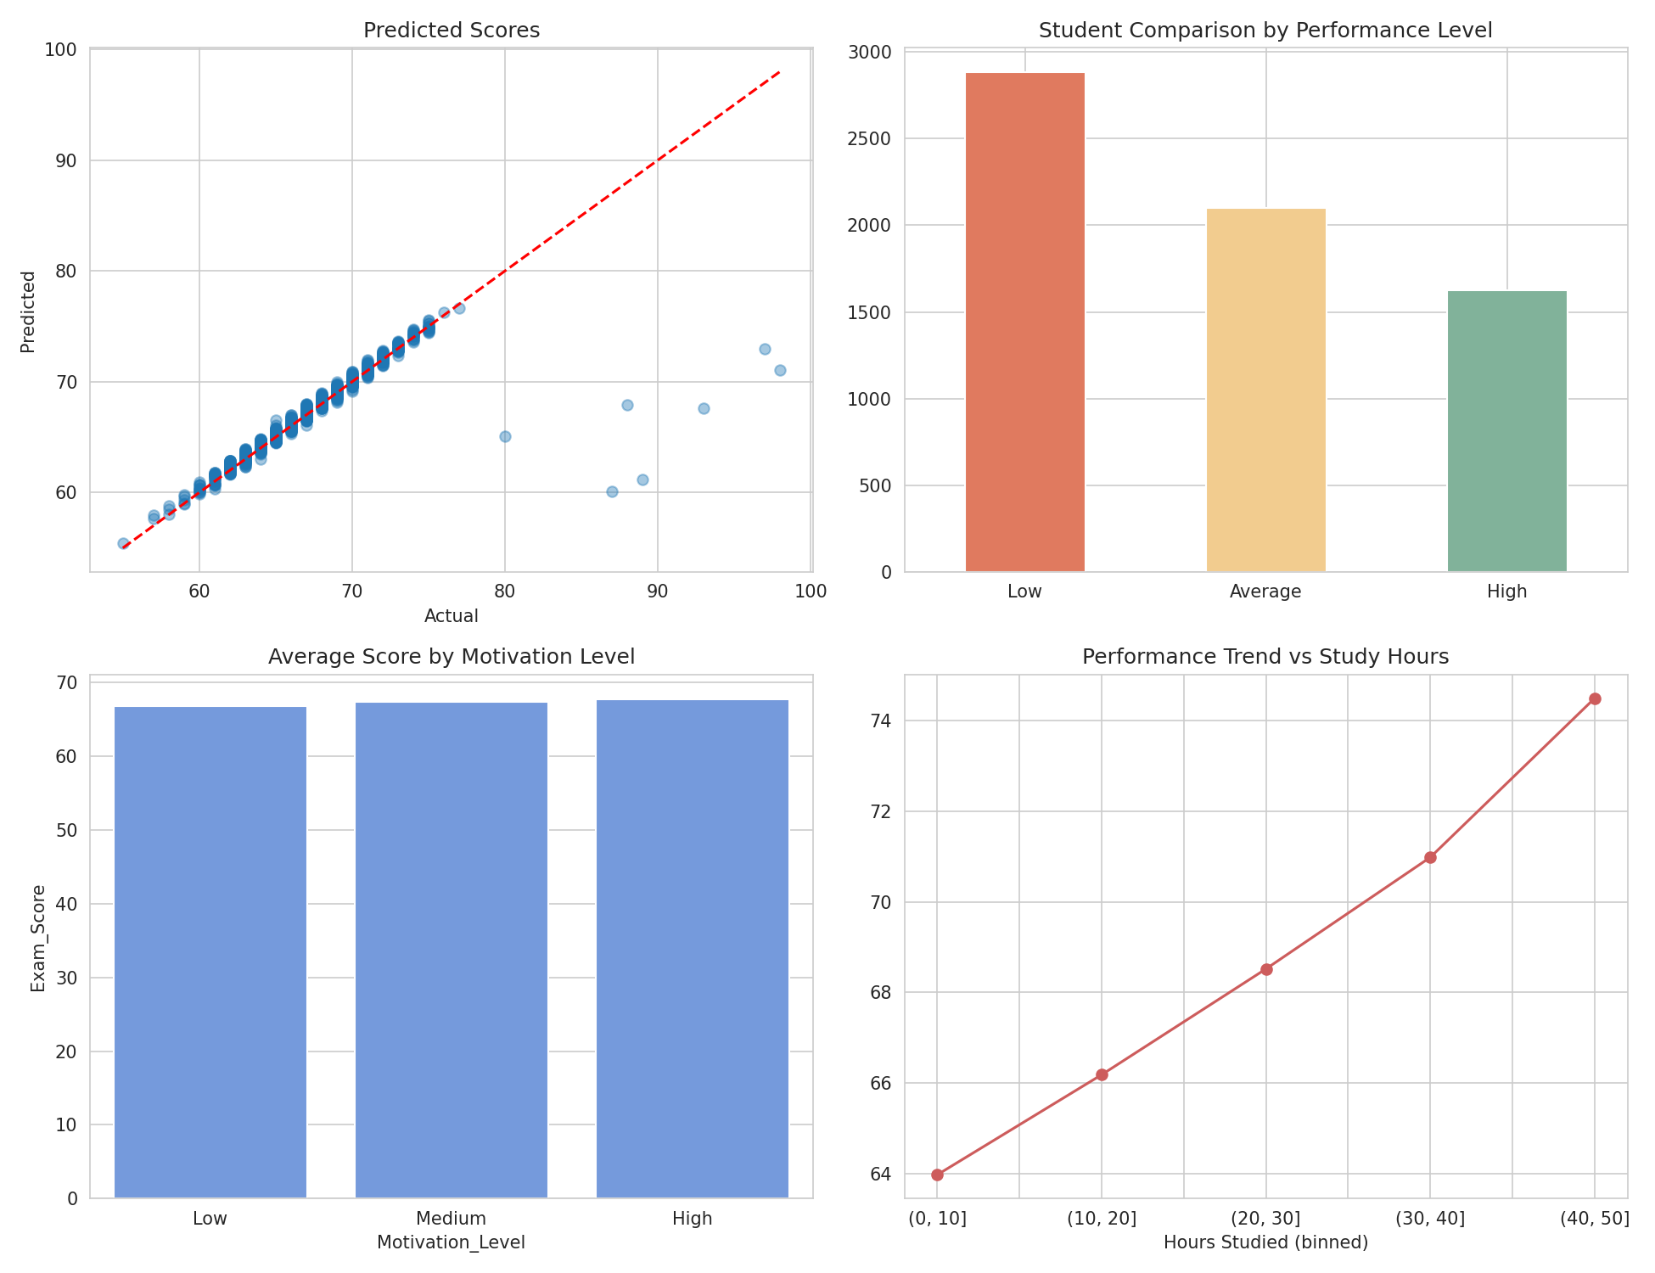
Performance Dashboard
Interactive Streamlit app (dashboard.py) - pick a student, see predicted score, performance level, class comparison, and trend position.
Student Performance Prediction System
11

Slide 12
Recommendation System
Rule-based engine comparing each student to class medians
Increase weekly study hours
Why rule-based?
Improve class attendance
No ML model here on purpose - the thresholds are directly interpretable, which matters more than raw predictive power when a student or teacher has to act on the output.
Focus on weak foundational topics
Attend more tutoring / practice sessions
Build a more consistent sleep routine
Student Performance Prediction System
12

Slide 13
Tech Stack & Workflow
Workflow
Language
Python
1. Dataset Collection
2. Data Cleaning
Libraries
Pandas, NumPy, Scikit-learn, Matplotlib, Seaborn
3. EDA
Dashboard
Streamlit
4. Model Development
5. Prediction
Deployment
Streamlit Cloud
6. Dashboard
7. Recommendations
Student Performance Prediction System
13

Slide 14
Conclusion & Future Scope
Key Findings
Future Scope
Attendance, study hours & previous scores are the strongest predictors
Hyperparameter tuning (GridSearchCV)
Linear Regression best for exact score prediction (R2 = 0.77)
Gradient boosting models (XGBoost)
Random Forest best for performance-level classification (79% accuracy)
Subject-wise marks for finer recommendations
Student Performance Prediction System
14

Slide 15
Thank You

