Slide 1
Empty List
-1
0
front
back
Iterator
previous
next
-1
previousIdx
lastRetrieved
nextIndex
0

Slide 2
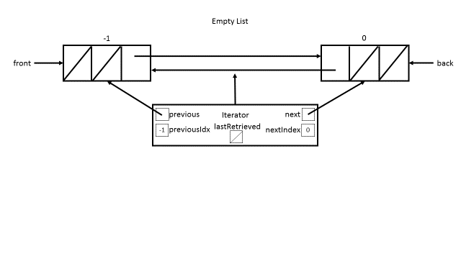

Slide 3
List of Size 1
-1
0
1
data
front
back
Iterator
previous
next
-1
previousIdx
lastRetrieved
nextIndex
0

