Slide 1
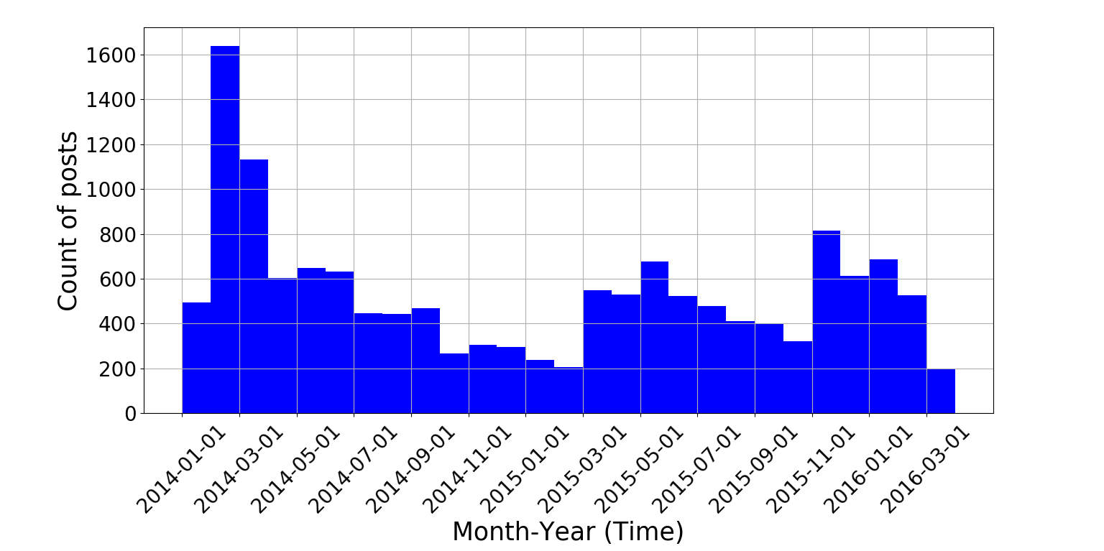
Topic modeling – Forum Posts

