Slide 1
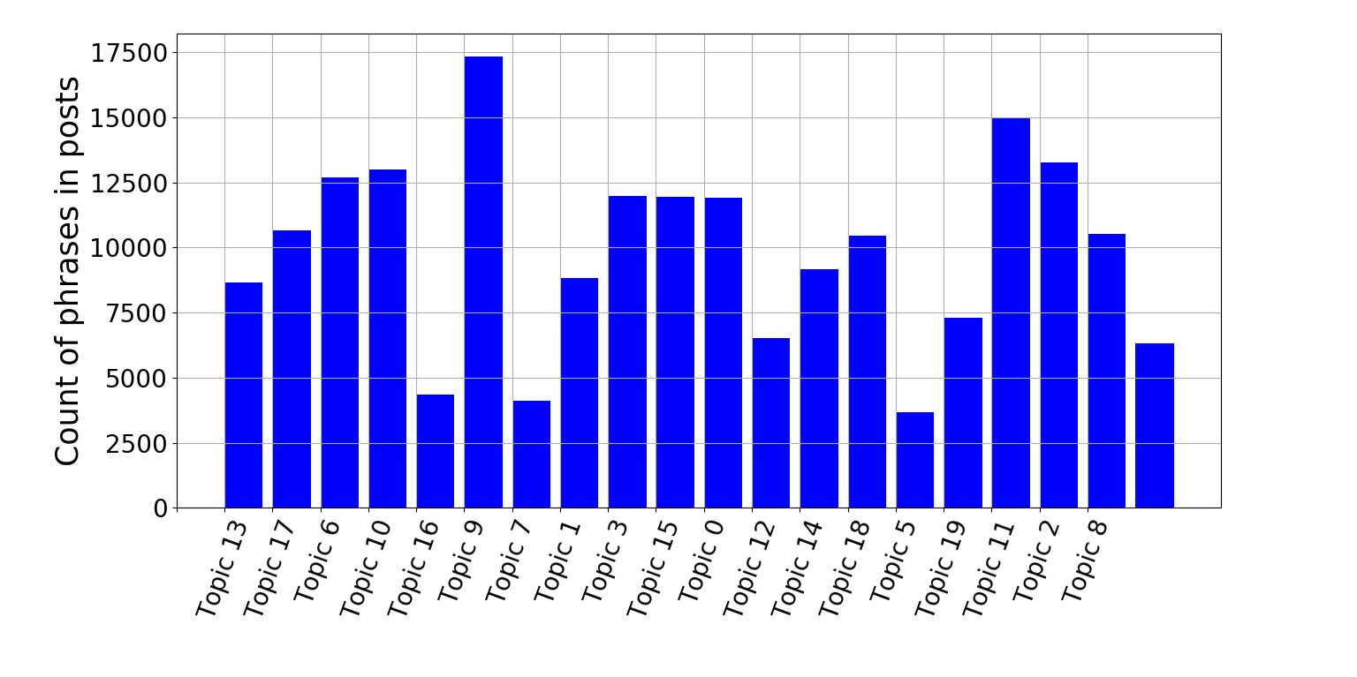
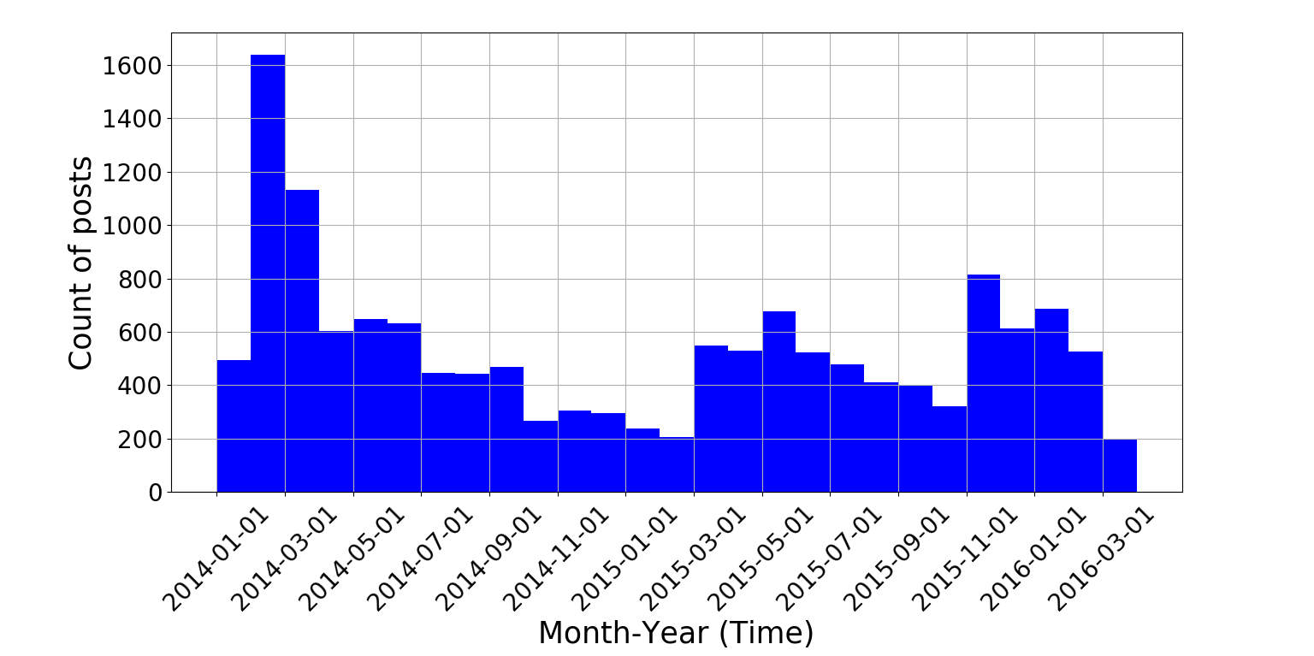
Topic modeling – Forum Posts
A
C
B

Slide 2
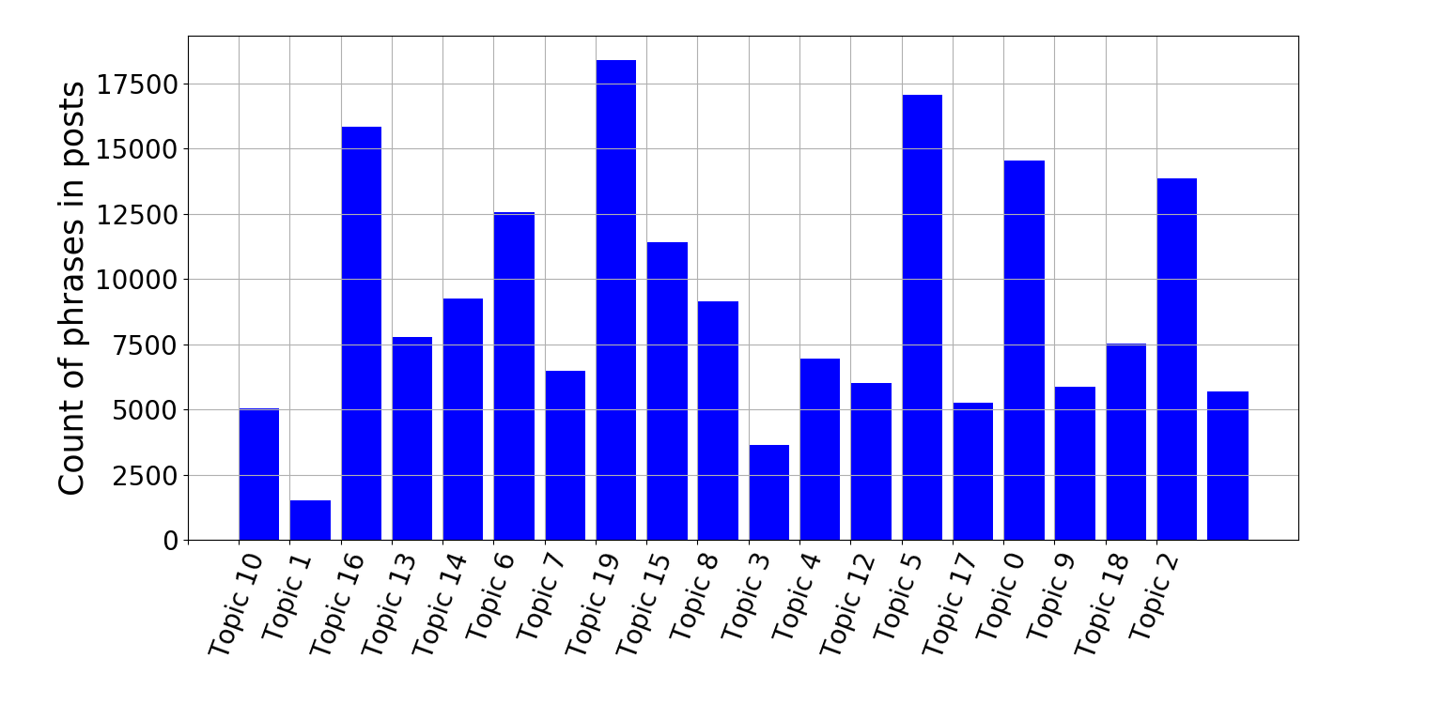
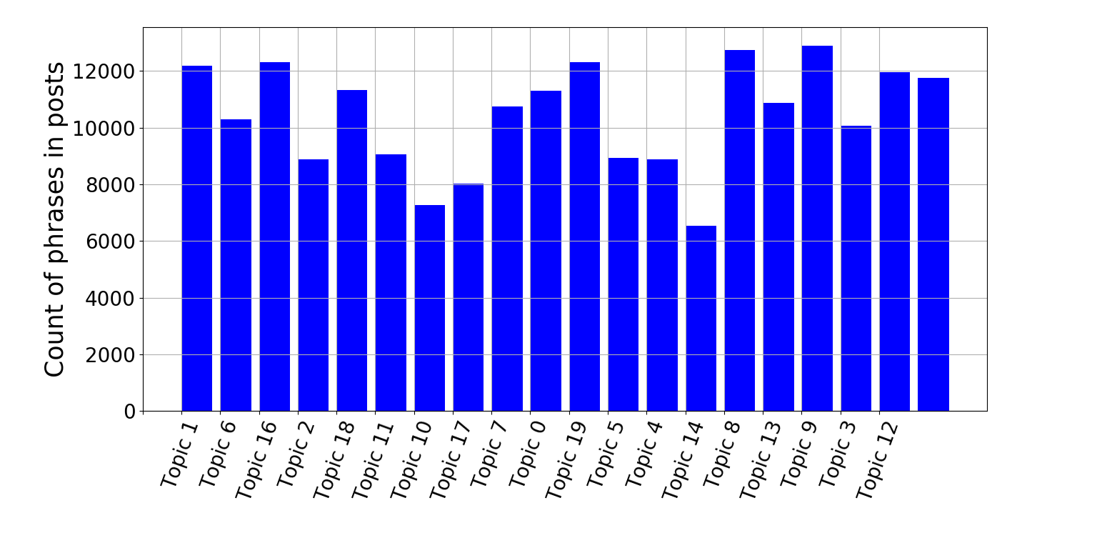
A
B
C
Num Topics: 20
Num phrases/Words in each topic: 20
Some pruning done based on frequency in entire forum although can be improved

Slide 3










Slide 4
To – dos / Some thoughts
There is provision to improve this dynamic topic modeling technique using existing research models on time based topic transition.
Role of users ignored here – can jointly model user role and topic role
“CQARank: Jointly Model Topics and Expertise in Community Question Answering ” – this paper does some relevant stuff.
Or, can look at Forum-LDA models - need to think about this !!!

