Slide 1
Implemented a basic CNN model over the text data.
Some sampling strategies adopted
Used pretrained word vectors for initialization which were kept fixed

Slide 2
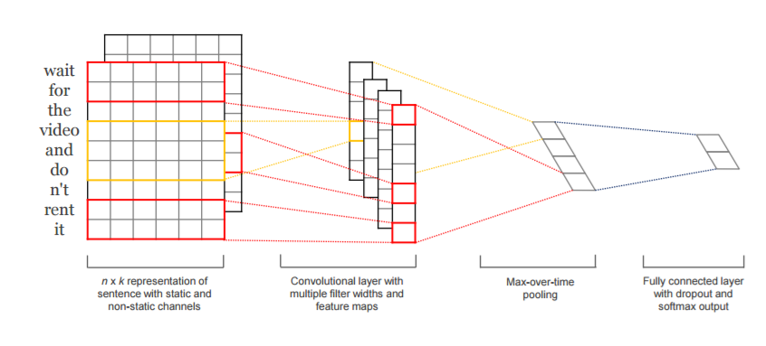
Basic CNN architecture

Slide 3
Sampling strategies
Features were common across all labels – for starting
Instances were sentences enumerated over the documents.
Fixed a held-out test set from the original data for testing the model (20% of training data)
Subsampled the negative instances to balance the training data
Subsampling was random.
Did note use SMOTE since do not want to infuse synthetic data with an aim of getting the best sentences out of the CNN to form filtered documents.
Introduced unlabeled examples – highest confidence by TSVM – 500 samples approx. for each label.
80:20 train:validation run 5 times.

Slide 5
Next experiments
Use CNN with non-static word vectors input that would be learned during the training.
Use two-view embeddings as input– static + non-static without introducing unlabeled samples.
Compare RNN / SVM for label correlation with the features obtained from the FC layer of CNN – final multi-label classification.

