Slide 1
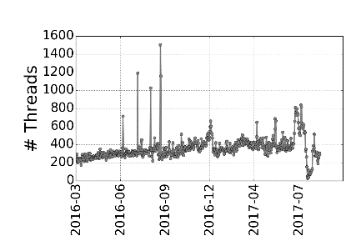
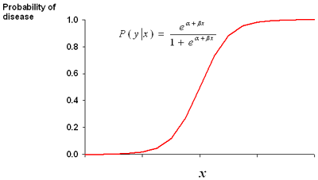
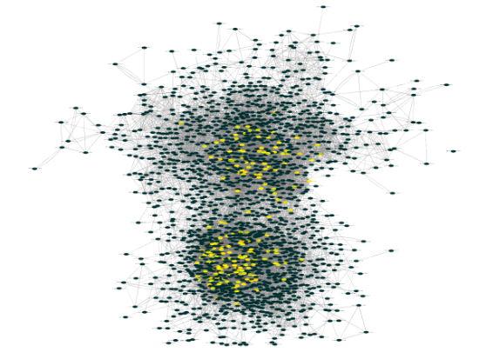
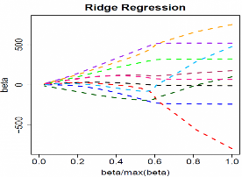


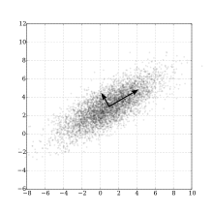
Time series data
Learning models
Attack prediction
Top CPEs
Historical reply Network
Supervised Model
Time series – Network interaction statistics
Test input Time Series
CVE
mentions
Logistic regression
+
Regularization
In-degree
Daily attack prediction
Input – Daily forum posts/user information
Attack labels
(GT)
Expert
Users
PCA subspace
anomaly detector
Time series – Forum statistics
Unsupervised Model

