Slide 1
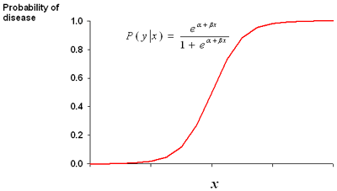
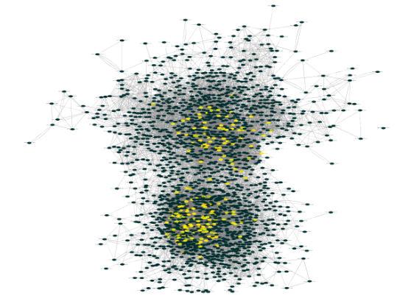
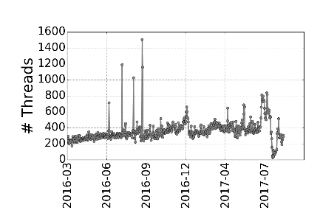
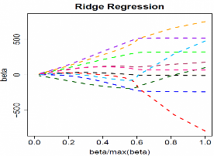
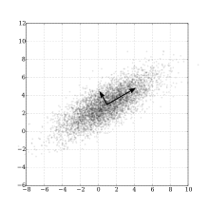
Creating time series
Learning models
Attack prediction
Top CPEs
Supervised Model
Historical reply Network
Attack classification – predictive analysis
Time series – Network interaction statistics
CVE
mentions
Logistic regression
+
Sparsity
In-degree
Input – Daily forum posts/user information
Attack labels
Test input Time Series
Expert
Users
Time series – Forum Statistics
PCA subspace
anomaly detector
Attack detection – explanatory analysis
Unsupervised Model

