Slide 1
PROJECT TITLE
CAPSTONE PROJECT
Presented By: Soumalya Ganguly
Student Name : Soumalya Ganguly
College Name & Department : MCKV Institute of Engineering(CSE)

Slide 2
OUTLINE
Problem Statement
Technology used
Wow factor
End users
Result
Conclusion
Git-hub Link
Future scope

Slide 3
Problem Statement
In today's digital world, data security and privacy are major concerns. Traditional encryption methods protect data during transmission, but steganography offers an additional layer of security by hiding secret information inside images. This project focuses on implementing image-based steganography, allowing users to embed secret messages inside images using encryption and password protection.

Slide 4
Technology used
Programming Language: Python
GUI Library: Tkinter (for user-friendly interface)
Image Processing: OpenCV (cv2)
Encryption: SHA-256 hashing for password security
File Handling: PIL and OpenCV for image modifications
Data Encoding: Pixel manipulation technique

Slide 5
Wow factors
✅ Dual Security: The message is both hidden inside an image and protected with a password.
✅ No File Size Increase: The encrypted image looks the same and does not reveal any obvious changes.
✅ User-Friendly Interface: Simple GUI using Tkinter for encryption and decryption.
✅ Supports Multiple Formats: Can hide messages in PNG and JPG images (but outputs encrypted images as PNG to avoid corruption).
✅ No Need for Additional Software: Runs as a standalone Python program.

Slide 6
End users
This project is useful for:
Journalists & Whistleblowers – Securely share confidential messages.
Government & Military – Hide sensitive communications in images.
Businesses – Protect trade secrets and confidential data.
General Users – Send hidden messages without detection.

Slide 7
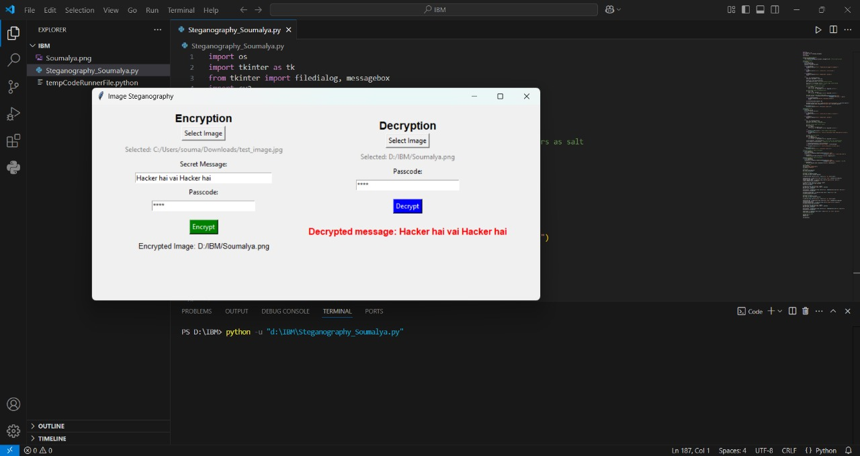
Results

Slide 8
Conclusion
This project demonstrates the practical application of steganography in enhancing data security. By combining image encoding and encryption, we provide a robust and easy-to-use solution for securely hiding messages in images. This technique ensures that sensitive information remains undetectable to unauthorized users, adding an extra layer of security compared to traditional cryptographic methods.

Slide 9
GitHub Link
https://github.com/SOUMALYA-07CODER/Secure-Data-Hiding-in-Images-Using-Steganography.git

Slide 10
Future scope(optional)
✅ Support for GIF and BMP formats for wider compatibility.
✅ Increase capacity to store larger secret messages efficiently.
✅ Use more advanced encryption like AES-256 before embedding data.
✅ Develop a mobile app for Android/iOS for on-the-go encryption and decryption.
✅ Implement AI-based steganalysis protection to make detection even harder.

Slide 11
THANK YOU

