Slide 1


FX Macro Correlation Dashboard
Python + AI project for FX analysis
Using macroeconomic indicators to generate trading signals
https://raboexplorationfxmacro.streamlit.app/
Soumen Roy
Delfryn Williams
Navkaran Basra
Amrender Singh
Notes:
Introduce project as a prototype for macro-driven trading strategies.

Slide 2
Business Problem
FX markets react to macroeconomic data
Traders need systematic tools to analyse relationships
Notes:
Explain why macro matters in FX (inflation, rates, employment).

Slide 3
Objective
Analyse
- Analyse FX vs macro relationships
Identify
- Identify leading indicators
Generate
- Generate trading signals
Notes:
Frame as a data-driven decision support tool.

Slide 4
Data Sources
FX: Yahoo Finance
Macro: FRED (CPI, FEDRATE, UNRATE)
Notes:
Mention reliability and frequency differences.

Slide 5
Architecture
Python (pandas, numpy)
Data APIs
Streamlit dashboard
Plotly visualisation
Notes:
Explain modular design: data → analysis → visualisation.

Slide 6
Project Demo
https://raboexplorationfxmacro.streamlit.app/

Slide 7
Lag Analysis
Identify leading macro indicators
Best lag used for signals
Notes:
Very important for predictive modelling.

Slide 8
Trading Signals
Rule-based:
BUY / SELL / HOLD
Based on correlation + macro trend
Notes:
Explain simple but interpretable model.

Slide 9
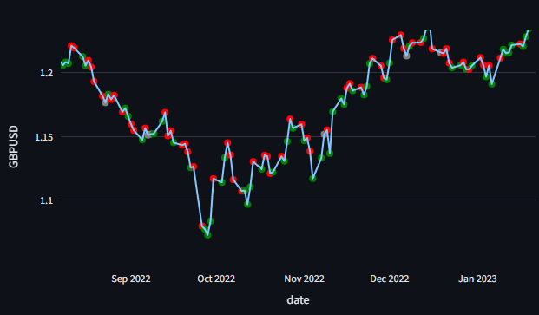
Example Signals
Showing buy/sell markers on FX chart
Notes:
Demonstrate practical output.

Slide 10
Business Impact
Informs trader decision-making
Identifies macro drivers
Framework for systematic strategies
“Is there any relationship between this macro variable and this FX pair?”
“Does USDJPY move 2–3 days after Fed rate changes?”
Rolling correlation, Heatmap, Overlay chart
Notes:
Position as decision-support, not black-box trading.

Slide 11

Limitations
No backtesting
No risk modelling
Correlation ≠ causation
Notes:
Shows awareness and maturity.

Slide 12

Future Enhancements
- Backtesting & PnL
- Sharpe ratio
- ML models
- Regime detection
Notes:
Highlight scalability.

Slide 13

Conclusion
Strong prototype for macro-driven FX analysis
Foundation for quant trading strategies
Notes:
End confidently with impact.

