Slide 1
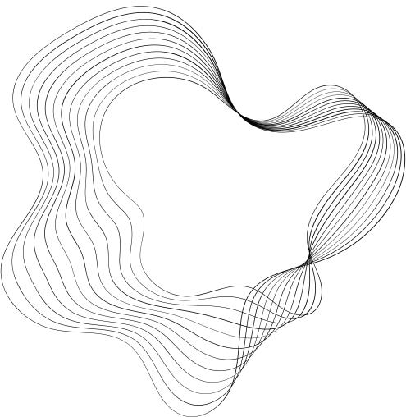

ASAPP
HACKATHON
TEAM MEMBERS
HARRI SASTHAA G 21Z307
SOUNDARA BHARATH 21I359

Slide 2
QA BOT FOR RESEARCH PAPERS

Slide 3
Abstract
The notebook outlines a workflow for analyzing research papers stored as PDF documents. It begins with setting up the environment by installing necessary Python packages and authenticating services, including the Hugging Face Hub for accessing language models and Astra DB for database connections. The workflow involves mounting Google Drive to access PDFs, followed by loading and processing the documents using tools such as PyPDFLoader to extract text. The text is then split into manageable chunks for further analysis. The objective is to streamline document processing and enable efficient querying or analysis of the text content, leveraging machine learning models for tasks like text embedding and semantic search.

Slide 4
SCOPE OF WORK
The project's scope involves developing a QA chatbot that can answer questions based on the content of a research paper in PDF format. It focuses on extracting relevant information from the document and using natural language processing techniques to generate contextual responses. The user interface, built with Streamlit, provides a seamless and interactive experience for querying the research paper. Additionally, the system is designed to be extensible, allowing for integration with different models and potential support for multiple documents.

Slide 5
TECHNOLOGY STACK
Preprocessing: Text Splitting,Chunks.
Embedding Models: Sentence Transformers(all-MiniLM-L6-v2).
Vector Database: astra_vector_store.
LLM for Response Generation: Llama(Meta-Llama-3.1-70B-Instruct-Turbo)
Web Interface: Gradio.

Slide 6
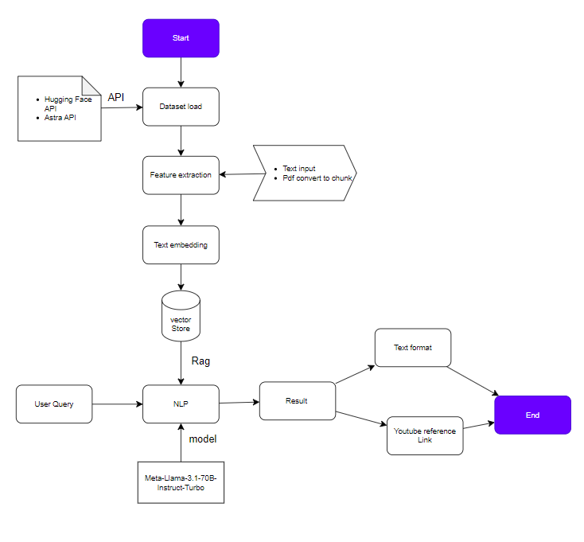
FLOW DIAGRAM

Slide 7
CODE WORKING FLOW
Data Loading and Preprocessing
PDF Loading: The script defines paths to PDF documents stored in Google Drive and attempts to load each document using PyPDFLoader
Text Splitting: After successfully loading the documents, the text content is preprocessed. The RecursiveCharacterTextSplitter is used to break down the content into smaller chunks
Text Embedding Generation :
Embeddings are numerical representations of text that capture its semantic meaning. These embeddings allow the system to perform efficient and accurate searches by comparing the vectors of a query with the vectors of the stored chunks

Slide 8
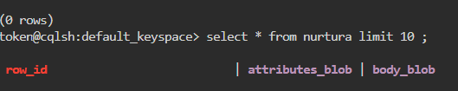
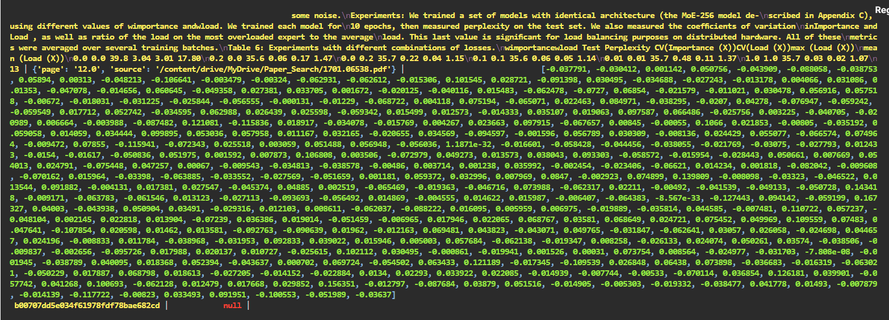
Storing Embeddings in Vector Database :
This database setup facilitates fast and efficient retrieval of information when a user query is received. The vector store allows for quick similarity searches to identify which text chunks are most relevant to a given query. Example Astra vector db

Slide 9
RESPONSE GENERATION USING LARGE LANGUAGE MODEL
The LLM takes the retrieved chunks, understands the context, and produces a natural language response that answers the user’s query. This is the core of the generation step in a RAG (Retrieval-Augmented Generation) setup.
WEB INTERFACE FOR USER INTERACTION
Gradio allows users to interact with the model easily, inputting queries and receiving responses without needing to understand the backend processes. It streamlines the workflow, making the entire system more accessible and practical for end users.

Slide 10
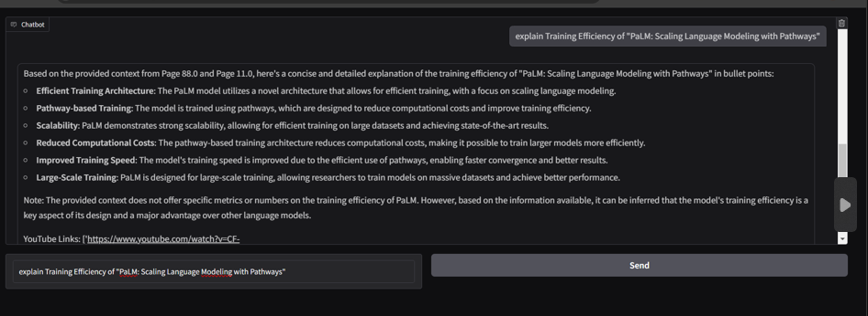
RESULTS

Slide 11
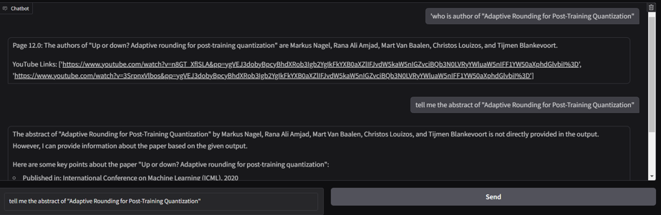
Results

Slide 12
Future improvements for the project
I. Improving Data Preprocessing: Implement more sophisticated text preprocessing methods such as removing noise (e.g., watermarks, headers, footers), handling special characters, and extracting structured data from tables and figures in PDFs. This would improve the quality of the embeddings and the overall accuracy of the system.
II. Efficient Vector Storage and Retrieval: Move to a more scalable vector database or optimize the current setup to handle larger datasets more efficiently. This would include sharding, distributed indexing, and caching mechanisms to improve retrieval speeds for larger collections of documents.
III. Expanding the Web Interface: Add features to the Gradio interface that allow for more complex queries, such as multi-step questions, filters, or specifying document sources. This will make the interface more flexible and user-friendly.
IV. Multi-Modal Support: Expand the interface to support images, charts, or diagrams, where users can input non-textual data and the system can process and respond to these inputs. This would make the system more versatile.

Slide 13
References
https://huggingface.co/settings/tokens/
https://astra.datastax.com/org
https://api.together.xyz/settings/api-keys
https://medium.com/@gitmaxd/understanding-state-in-langgraph-a-comprehensive-guide-191462220997

Slide 14
THANK YOU

