Slide 1
MPONLINE LIMITED
KNOME Enterprise Platform
Next-Generation Knowledge Management, Media Streaming & Collaborative Workspace
Comprehensive Architectural Walkthrough, Core Functional Modules & Governance Deep Dive
ASP.NET Core 10 Web API
React 19 / Vite / TypeScript
Microsoft SQL Server 2022
SignalR Real-Time Hub
EmployeeHub Dual-Issuer SSO

Slide 2
EXECUTIVE OVERVIEW
Bridging Institutional Knowledge & Modern Collaboration
Why Knome was architected for MPOnline Limited
CHALLENGES IN ENTERPRISE KNOWLEDGE
• Information Silos: Critical technical solutions and project SOPs remained trapped in isolated departmental hard drives and email threads.
• Onboarding Delays: New recruits faced steep learning curves navigating fragmented documentation without centralized media.
• No Unified Media Portal: Lack of an enterprise-grade platform for hosting MPOnline tech talks, architectural videos, and audio podcasts.
• Passive Knowledge Sharing: No incentive or gamification system to encourage senior engineers to document edge cases and mentor peers.
• Security & Compliance Gaps: Unregulated document downloads and external file sharing posed governance and IP leakage risks.
THE KNOME TRANSFORMATION
✔ Unified 4-in-1 Ecosystem: Combines social networking, rich technical publishing, video/audio media, and gamified karma into a single portal.
✔ Seamless EmployeeHub SSO: Zero-friction login with enterprise-wide Single Sign-On and dual-issuer JWT token trust.
✔ Curated Media Studio: Dedicated video streaming, YouTube playlist auto-sync, and episode-based podcast channels.
✔ Gamified Karma Engine: Autonomous SQL point ledger rewarding articles (+10), videos (+8), posts (+2), and peer recognition (+1 to +3).
✔ Enterprise-Grade Protection: In-app sandboxed PDF viewing with zero raw download links and immutable SQL audit logs.
KNOME Enterprise Platform — MPOnline Limited | Confidential & Proprietary
Slide 2 of 16

Slide 3
CORE PRODUCT VISION
The 4-in-1 Hybrid Enterprise Ecosystem
Synthesizing the best paradigms of premier consumer platforms into a private corporate intranet
LinkedIn Model
Social Networking & Feed
Medium Model
Long-Form Knowledge Base
YouTube Model
Media Studio & Podcasts
StackOverflow Model
Karma Engine & Gamification
• Employee professional profiles & roles
• Follow colleagues & departmental peers
• Rich interactive activity timeline feed
• Connection requests & status alerts
• Multi-format post sharing & mentions
• Rich WYSIWYG documentation editor
• Full revision history & author tracking
• Tag-based discovery & category filters
• Sandboxed in-app PDF document reader
• Departmental SOPs & technical blueprints
• Self-hosted high-definition video streaming
• Automated YouTube playlist sync
• Audio podcast channels with player
• Episode transcripts & speaker tags
• Timestamped comments & user bookmarks
• Autonomous SQL Server point ledger
• Tier progression (Bronze to Platinum)
• Live real-time company leaderboard
• Automated badges & achievement awards
• Peer recognition & upvote incentives
KNOME Enterprise Platform — MPOnline Limited | Confidential & Proprietary
Slide 3 of 16

Slide 4
SYSTEM ARCHITECTURE
6-Layer Full-Stack Enterprise Blueprint
High performance, zero-leakage, and modular ASP.NET Core 10 & React 19 architecture
Layer 1: Presentation Tier — React 19, Vite HMR, TypeScript / JSX, Tailwind UI Design Tokens, Responsive Desktop/Tablet Layouts
Layer 2: API Gateway & Security — YARP Reverse Proxy, Dual-Issuer JWT HS256 Authentication Middleware, RBAC Claim Evaluators
Layer 3: Application Controllers — 14 RESTful Controllers, FluentValidation Pipeline, ApiResponse<T> Standardized Envelopes, Swagger OpenAPI
Layer 4: Business Logic & Services — 12 Modular Services (Article, Video, Podcast, Community, Karma, Notification, Analytics, Audit)
Layer 5: Real-Time Communication — SignalR WebSocket Hub (/hubs/notifications), LIFO Instant Push Delivery, Role & Community Live Signals
Layer 6: Persistence & Storage — Microsoft SQL Server 2022, EF Core 10 Live Scaffolding, Local Protected File Storage Service
KNOME Enterprise Platform — MPOnline Limited | Confidential & Proprietary
Slide 4 of 16

Slide 5
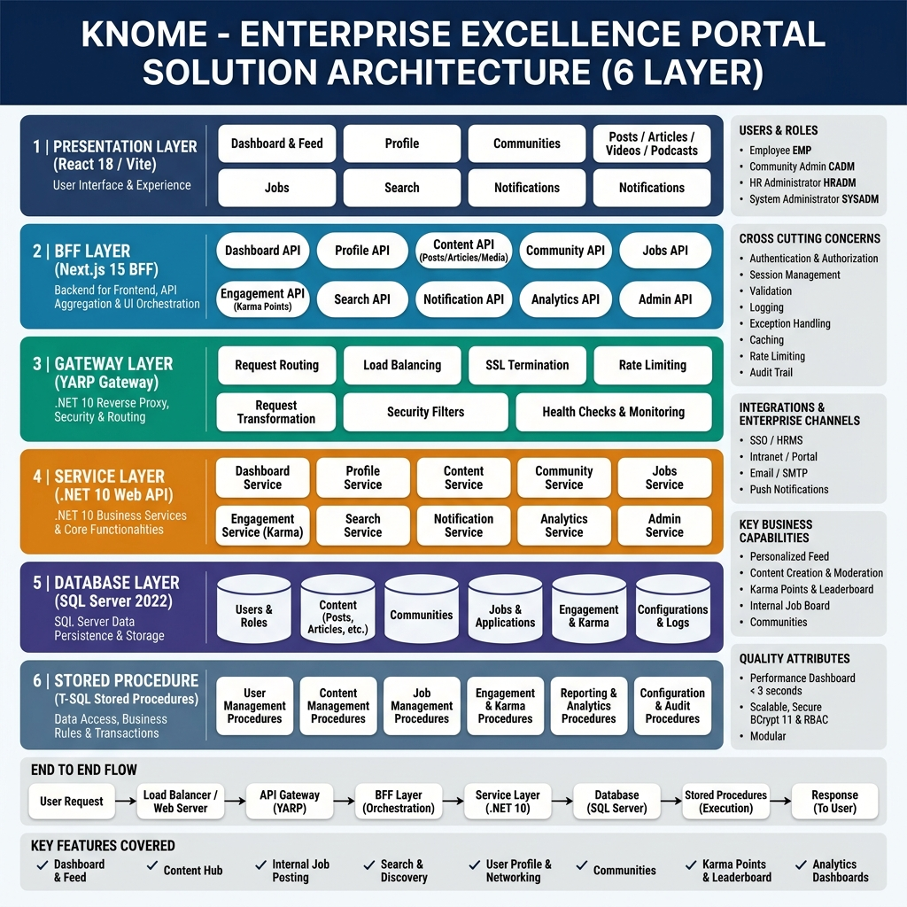
SYSTEM ARCHITECTURE
Visual Architecture & Component Integration Diagram
Complete end-to-end integration between EmployeeHub, Knome Web, and Backend Services
KNOME Enterprise Platform — MPOnline Limited | Confidential & Proprietary
Slide 5 of 16

Slide 6
IDENTITY & SECURITY
EmployeeHub Single Sign-On (SSO) & Dual-Issuer Trust
Cryptographically verified cross-portal zero-click login with HMAC-SHA256 signature verification
1. AUTHENTICATION & TOKEN ISSUANCE
• Employee accesses EmployeeHub Identity Portal (`:5001`).
• Enters Employee ID and corporate credentials.
• EmployeeHub validates against corporate Identity DB.
• Issues HMAC-SHA256 signed JWT token containing claims: `sub`, `employeeId`, `fullName`, `role`.
• Redirects user to Knome: `http://localhost:5173/?sso_token=<JWT>&employeeId=MPO103`
2. FRONTEND URL INTERCEPTION
• Knome React `UserContext.jsx` intercepts `sso_token` and `employeeId` from window query params.
• Stores securely in browser `localStorage` under `knome_jwt` and `knome_employeeId` keys.
• Cleans the browser address bar instantly using `window.history.replaceState` to prevent token leakage.
• Initializes authenticated user session state and triggers SignalR real-time notification subscription.
3. BACKEND DUAL-ISSUER TRUST
• ASP.NET Core API Dual-Issuer JWT Bearer middleware validates token signatures in-memory.
• ValidIssuers: `["Knome.API", "EmployeeHub.Identity"]`
• ValidAudiences: `["Knome.Client", "EmployeeHub.Client"]`
• Zero external HTTP round-trips needed for token verification — instant sub-millisecond execution!
• Automatic fallback to Knome native auth if standalone login is used.
KNOME Enterprise Platform — MPOnline Limited | Confidential & Proprietary
Slide 6 of 16

Slide 7
KNOWLEDGE MANAGEMENT (MEDIUM MODEL)
Rich Articles, Documentation & SOP Governance
Empowering engineering teams to create, preserve, and search institutional knowledge
Rich WYSIWYG & Markdown Authoring
Multi-format publishing supporting embedded code syntax highlighting, formatted data tables, dynamic callouts, and multi-image attachments.
Immutable Revision History & Versioning
Every article edit creates a trackable historical snapshot with author attribution, diff view capability, and rollback safety.
Cross-Departmental Discovery & Tagging
Taxonomy-driven categorization by Department (Finance, IT, Operations, Civil), custom technology tags, and full-text keyword indexing.
In-App Sandboxed PDF SOP Viewer
Technical manuals, standard operating procedures, and architecture PDFs open inside a sandboxed reader with print, save, and download ribbons suppressed.
KNOME Enterprise Platform — MPOnline Limited | Confidential & Proprietary
Slide 7 of 16

Slide 8
MEDIA STUDIO (YOUTUBE MODEL)
Enterprise Video Streaming & Technical Podcasts
Centralized audio/video repository for MPOnline tech talks, architectural deep dives, and tutorials
VIDEO STREAMING & YOUTUBE SYNC
▶ High-Definition Video Streaming: Direct in-app playback with responsive HTML5 video player and adaptive buffering.
▶ YouTube Playlist Synchronization: Ingests public and unlisted YouTube playlists with automatic title, duration, and thumbnail extraction.
▶ Interactive Timestamp Comments: Employees can click timestamped comments (e.g. 03:45) to jump directly to specific segments.
▶ Watch History & Bookmarks: Personal watch history, 'Watch Later' queues, and curated departmental playlists.
▶ Engagement Metrics: Live like/dislike counts, view counts, and karma awards for top video creators.
ENTERPRISE AUDIO PODCAST CHANNELS
🎙 Persistent Background Audio Player: Listen to technical leadership podcasts while continuing to browse feeds or read articles.
🎙 Episode & Channel Architecture: Structured audio channels with seasonal grouping, speaker attribution, and duration tags.
🎙 Audio Scrubbing & Speed Controls: Variable playback speeds (0.75x, 1.0x, 1.25x, 1.5x, 2.0x) and 10s skip controls.
🎙 Searchable Episode Transcripts: In-app audio transcripts allowing keyword search across recorded technical talks.
🎙 Mobile & Desktop Responsive: Optimized media player layout supporting desktop multitasking and mobile audio listening.
KNOME Enterprise Platform — MPOnline Limited | Confidential & Proprietary
Slide 8 of 16

Slide 9
COMMUNITIES & COLLABORATION
Community Creation & Admin Approval Lifecycle
Structured community governance balancing employee initiative with corporate administrative oversight
Step 1: Submission
Step 2: Review Queue
Step 3: Admin Review
Step 4: Activation
Employee submits community request specifying Name, Description, Category, Custom Rules, and Banner image.
System marks community as 'Pending Approval' and dispatches real-time SignalR push notifications to HR & SysAdmins.
Admins review submissions on the dedicated '/communities?tab=Approvals' dashboard with one-click Approve / Reject.
On approval, community is published live, creator is automatically promoted to 'Community Admin', and broadcast alerts fire.
Key Governance Benefit: Ensures high-quality departmental spaces (e.g. Java Champions, DevSecOps, MPOnline Sports) while eliminating spam and orphaned groups.
KNOME Enterprise Platform — MPOnline Limited | Confidential & Proprietary
Slide 9 of 16

Slide 10
GAMIFICATION (STACKOVERFLOW MODEL)
Autonomous Karma Engine & Contribution Tiers
Incentivizing institutional knowledge sharing through automated SQL point awards and recognition
AUTONOMOUS POINT SCORING MATRIX
+10 Points — Publishing an In-Depth Knowledge Article / SOP
+8 Points — Uploading a Technical Video or Podcast Episode
+2 Points — Creating a Thought-Leadership Timeline Feed Post
+3 Points — Receiving a Content Share or Save
+2 Points — Receiving Helpful Comments on Published Content
+1 Point — Receiving Content Reactions (Like, Insightful, Claps)
RECOGNITION TIERS & LEADERBOARDS
★ BRONZE (Newbie) (0 – 250 Points): Initial onboarding status for new joiners engaging with basic timeline posts.
★ SILVER (Contributor) (251 – 1,000 Points): Active contributors publishing technical articles and engaging in discussions.
★ GOLD (Expert) (1,001 – 5,000 Points): Recognized subject matter experts creating video series and SOPs.
★ PLATINUM (Legend) (5,000+ Points): Top enterprise technical mentors and departmental thought leaders.
KNOME Enterprise Platform — MPOnline Limited | Confidential & Proprietary
Slide 10 of 16

Slide 11
REAL-TIME & COLLABORATION
SignalR WebSocket Engine & Document Protection
Sub-second event streaming, peer-to-peer sharing, and anti-leakage document viewers
SIGNALR REAL-TIME NOTIFICATION HUB
⚡ Instant Push Delivery: Comments, mentions, community invites, and badge promotions delivered instantly via `/hubs/notifications`.
⚡ Strict Chronological LIFO Priority: Latest incoming notifications are pinned at Index 0 (top of tray) with 'Just now' live timestamps.
⚡ Real-Time Role Unlock: When an Admin assigns a new role, the user's pending authorization modal clears live without page refresh.
⚡ Zero Polling Overhead: Persistent WebSocket connection eliminates redundant HTTP polling requests.
STANDARDIZED SHARING & DATA PROTECTION
🔒 Unified 2-Option Share Modal: 1) 'Share to Community' (direct to group feed), 2) 'Share with Users' (targeted peer notification).
🔒 Zero Raw Download Links: Eliminated direct file links (`target='_blank'`) to prevent unauthorized local file saving.
🔒 Sandboxed PDF Streamer: Print toolbars and PDF download ribbons suppressed via `#toolbar=0` in-app embed.
🔒 Right-Click & Copy Protection: Context menus and text selection scraping disabled on sensitive preview modals.
KNOME Enterprise Platform — MPOnline Limited | Confidential & Proprietary
Slide 11 of 16

Slide 12
GOVERNANCE & SECURITY
4-Tier Role-Based Access Control (RBAC)
Fine-grained permissions and security boundaries ensuring administrative integrity
Employee (EMP)
Self-Service & Collaboration
Community Admin (CADM)
Departmental Space Moderation
HR Administrator (HRADM)
Workforce & Content Governance
System Administrator (SYSADM)
Platform & Infrastructure Control
• Create & edit personal articles & videos
• Post timeline updates & engage with peers
• Request community creation
• Accumulate karma points & badges
• View protected technical documentation
• Manage assigned community spaces
• Review & approve join requests
• Pin key announcements & SOPs
• Moderate discussions & remove spam
• Configure group rules & banner branding
• Review & approve community creation queues
• Assign & approve employee system roles
• Broadcast company-wide announcements
• Access live HR analytics & workforce reports
• Export audit data to Excel / CSV
• Full governance over all platform modules
• Manage user accounts & active/suspended states
• Access immutable SQL security audit logs
• Configure system-wide settings & gateways
• Manage database scaffolding & API routes
KNOME Enterprise Platform — MPOnline Limited | Confidential & Proprietary
Slide 12 of 16

Slide 13
EXECUTIVE ANALYTICS
HR Analytics & Workforce Intelligence Dashboard
100% Live SQL Server aggregated metrics for administrative decision-making
RPT-01: User Engagement: Total registered workforce, active 30-day users, account suspension status, and company-wide karma distribution across departments.
RPT-02: Community Health: Active community spaces, membership growth rates, pending approval queue depth, and group post frequencies.
RPT-03: Content Performance: Aggregated counts across published articles, video streams, audio podcasts, timeline feed posts, and total peer reactions.
RPT-04: Trending Contributors: Dynamic leaderboard identifying top departmental knowledge champions and mentors from live karma transaction logs.
RPT-05: Security & Audit Logs: Comprehensive tracking of login events, role assignment changes, flagged content moderation logs, and resolution statuses.
KNOME Enterprise Platform — MPOnline Limited | Confidential & Proprietary
Slide 13 of 16

Slide 14
DATA ARCHITECTURE
Microsoft SQL Server 2022 Schema & Data Models
Strict relational integrity, live EF Core 10 scaffolding, and optimized query performance
Identity & Users | dbo.Users, dbo.Roles, dbo.UserRoles, dbo.Departments, dbo.UserConnections
Stores enterprise user profiles, hashed passwords, departmental assignments, and social follow networks.
Knowledge & Media | dbo.Articles, dbo.ArticleRevisions, dbo.Videos, dbo.Podcasts, dbo.PodcastEpisodes
Houses long-form markdown articles, revision audits, video streaming records, and audio series.
Communities & Posts | dbo.Communities, dbo.CommunityMembers, dbo.Posts, dbo.Comments, dbo.Reactions
Governs departmental collaboration spaces, membership approvals, timeline posts, and thread replies.
Gamification & Audits | dbo.KarmaTransactions, dbo.Badges, dbo.AuditLogs, dbo.ContentReports, dbo.Notifications
Maintains immutable ledger of point transactions, user badges, SignalR notifications, and security audits.
KNOME Enterprise Platform — MPOnline Limited | Confidential & Proprietary
Slide 14 of 16

Slide 15
STRATEGIC IMPACT
Business Value & ROI for MPOnline Limited
Measurable organizational efficiency, security compliance, and cultural acceleration
40%+ Accelerated Onboarding
New engineers and administrative staff ramp up rapidly by accessing curated video tutorials, technical SOPs, and departmental FAQs in a single searchable portal.
Zero Institutional Knowledge Loss
Critical architectural blueprints and edge-case solutions are permanently captured in the corporate database rather than disappearing when key staff depart.
Heightened Security & Compliance
On-premise SQL Server deployment, sandboxed in-app document viewing with download restrictions, and immutable audit logs ensure complete corporate compliance.
Vibrant Engineering Culture
Gamified karma engine and live leaderboards create a culture of continuous learning, peer recognition, and technical excellence.
KNOME Enterprise Platform — MPOnline Limited | Confidential & Proprietary
Slide 15 of 16

Slide 16
KNOME ENTERPRISE PLATFORM
Ready for Executive Demonstration & Staging Deployment
EmployeeHub SSO Portal
http://localhost:5001
Identity Provider, Centralized Login, Cross-Portal Redirects
Knome Web Portal
http://localhost:5173
React 19 Frontend, Rich Knowledge Base, Media Studio, Communities
Knome ASP.NET Core API
http://localhost:5095/swagger
14 REST Controllers, SignalR Hub, Live SQL Database & Swagger Docs
Thank you! Prepared for MPOnline Limited by the Knome Engineering Team.

