Slide 1


Slide 2
Web development
Home Page
Products
About
Contact
Services
Login
Updates

Slide 3
Home Page
Total 4 Sections
Slider with buttons; Image changes in 2secs
Categories – PCB , Hardware, software, training, Design, Casting,
With little description and learn more button.
Our work Ethics explained with graphics
Working team with linkedin profile
Footer with basic things

Slide 4
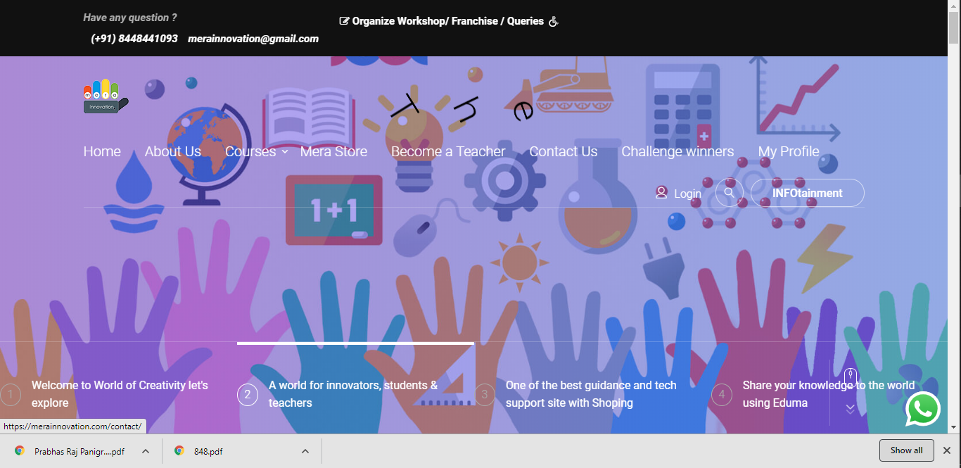
Slider with buttons; Image changes in 2secs

Slide 5
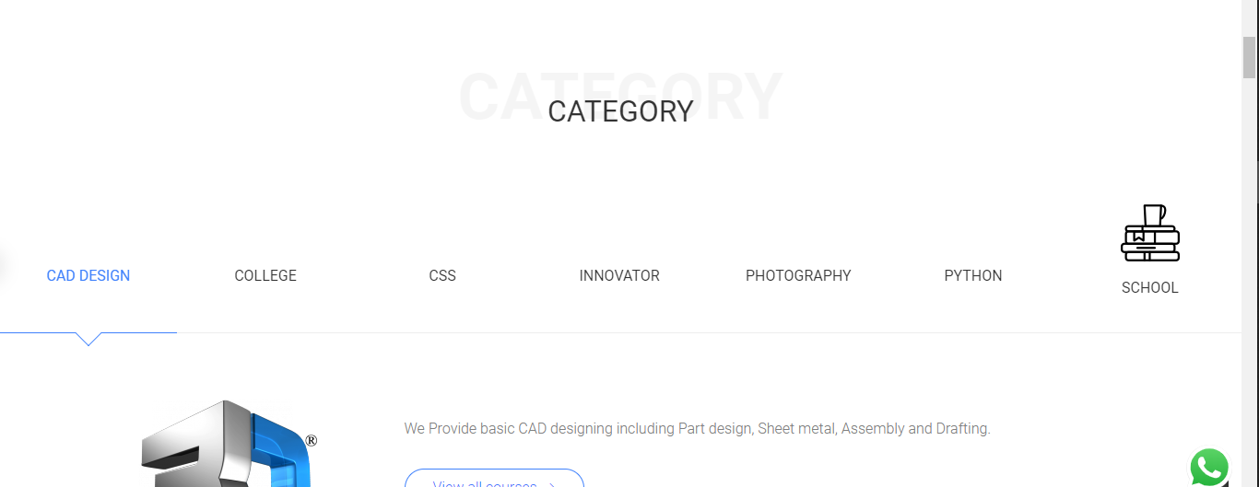
Categories

Slide 6
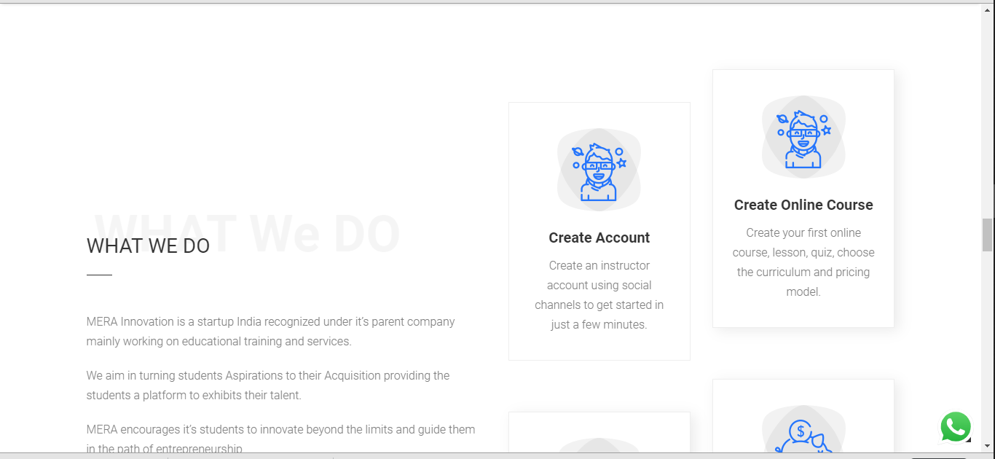
Our work Ethics explained with graphics

Slide 7
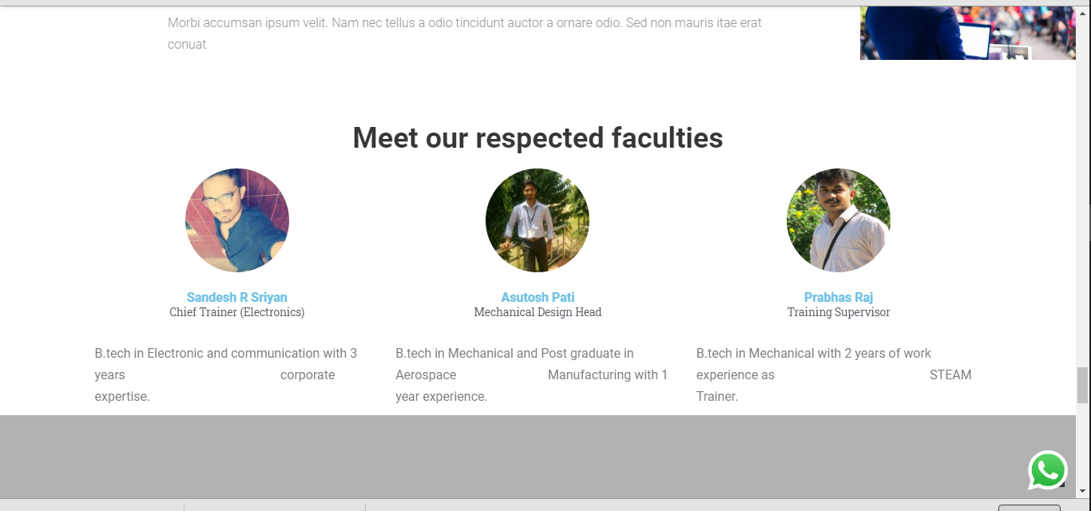
Working team with Linkedin profile

Slide 8
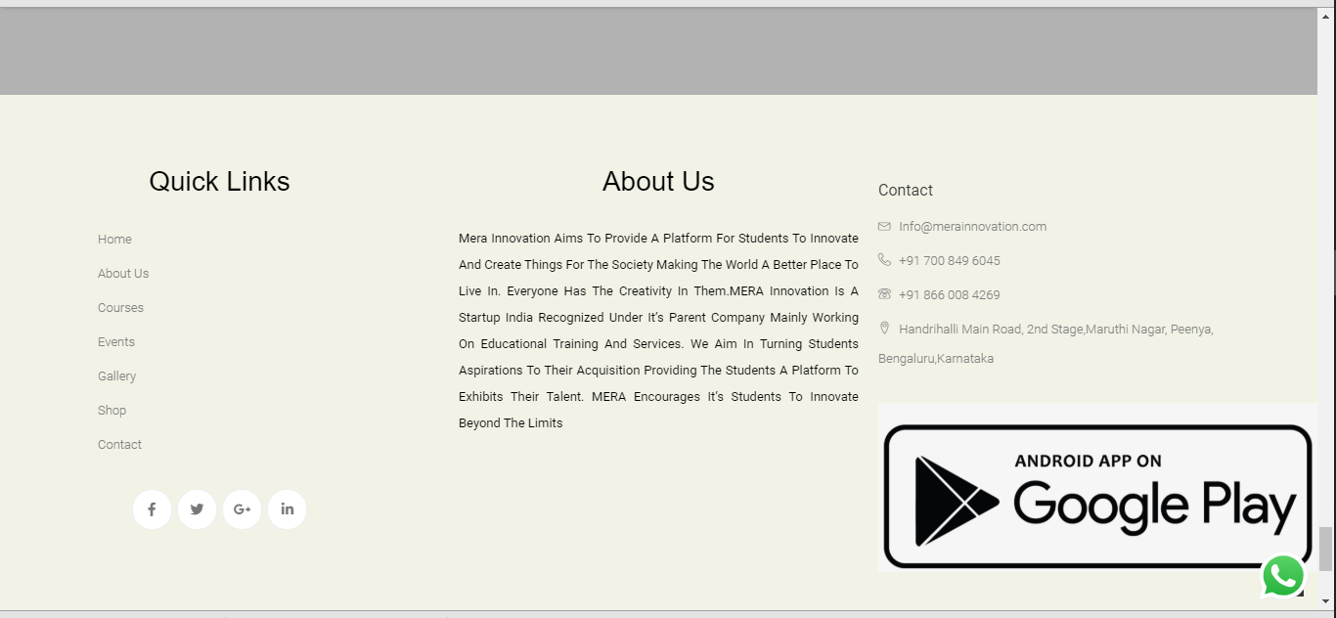
Footer with basic things

Slide 9
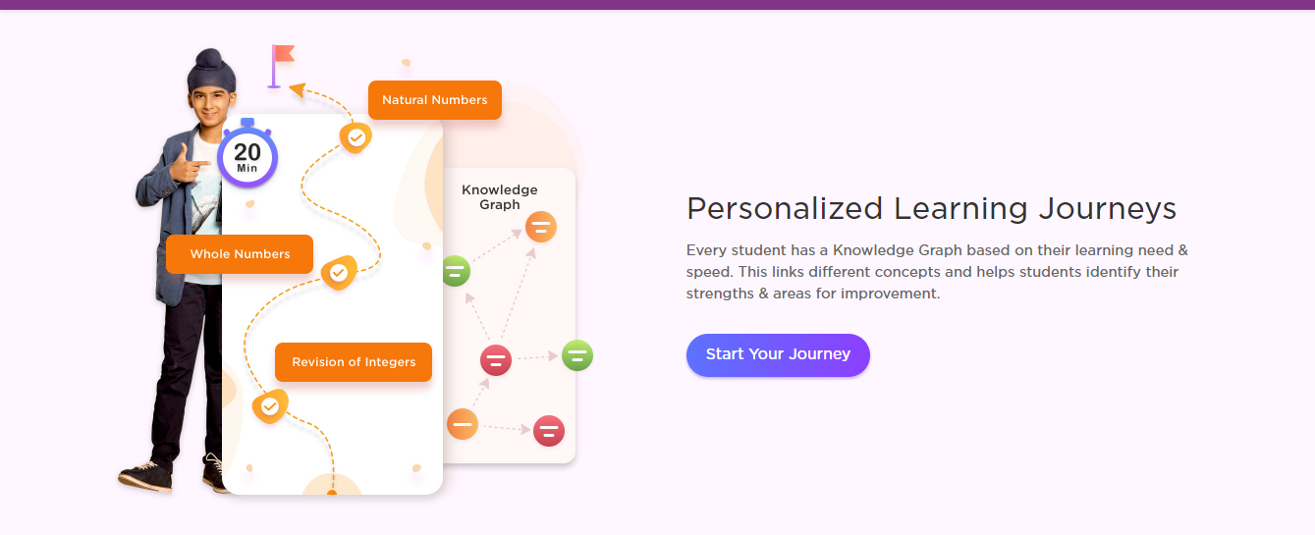
Products Section (Different PD)

Slide 10
About section
Company info
Key founding team – expertise
Investor
Featured news
Our contribution to society

Slide 11
Contact
Contact form with regardings
WhatsApp contact button
Contact person names, contact number, Zone specs….
Map directions for different offices

Slide 12
Services (Similar to Products section)
Generally Software based like for Tables inventory management etc.
PCB manufacturing
3D prototyping and testing
Glass Engraving
Static web development

Slide 13
Login
Single login can enrol different products and services with dedicated dashboards.
2 login section, for admin and other for customers

Slide 14
Updates
Event
News
Career
Content
Community

Slide 15
Future assumptions
Payment integration
Invoice auto preparation
Easy to use for admins with out tech knowledge
Employee work allocation portal, comp off portal, leave apply portal (can only access after permitted by supervisers)

