Slide 1
PROJECT ON BANK
Presented by: SOUVIK CHAUDHURI

Slide 2
Problem Statement
XYZ bank wants to find out who are the customers who are most likely to respond to their marketing campaign for a Term Policy

Slide 3
Solution Proposed
Build a classification model that will categorise customers by their likelihood of purchasing the particular term policy based on historical data
Customer demographics
Age, job, marital, education
Account Information
Balance, Defaults, Existing Loans
Campaign Info
Previous campaign methods and outcomes

Slide 4
Expected Client Benefits
Client will be able to target their customers better, and thus save money and improve customer satisfaction by calling the right customer for the right product
KPI - Conversion Rate
No of customers who were contacted and purchased my products
No of customers contacted
KPI = 0.06%
KPI = 0.15% Increase of $$$ 50 % 400k→ 200k usd

Slide 5
Data Quality Report
No of rows = 45211
Primary Key = no primary key
No of columns = 17
No of Categorical columns = 10
No of numeric columns = 7
No of date columns = no date column
Outcome = y
Outcome %- = 11.69% have subscribed and 82.31% have not subscribed

Slide 6
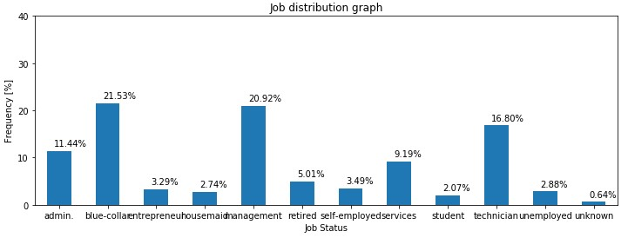
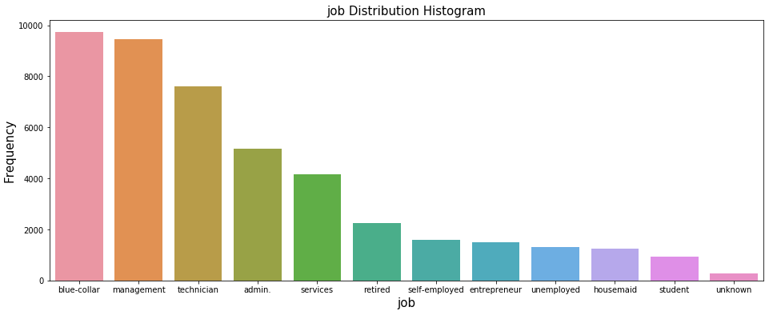
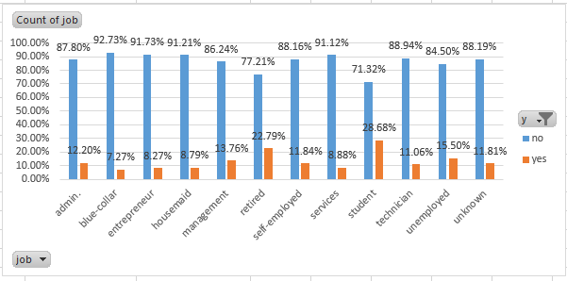
Variable : Job
v
.
Admin | 5171
blue-collar | 9732
entrepreneur | 1487
housemaid | 1240
management | 9458
retired | 2264
self-employed | 1579
services | 4154
student | 938
technician | 7597
unemployed | 1303
unknown | 288

Slide 7
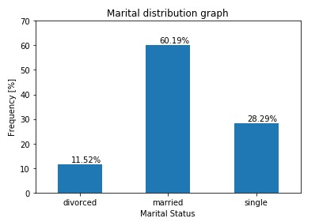
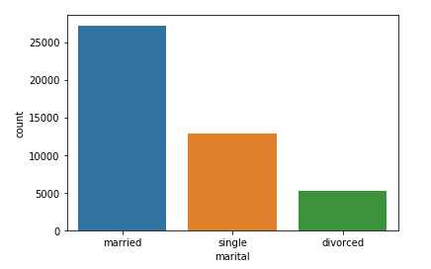
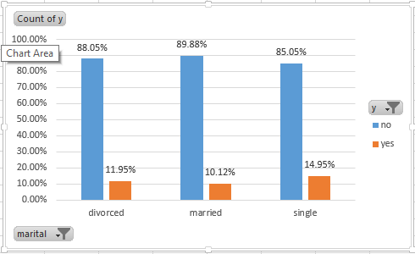
Variable: marital
This column indicates the marital status of a person
Unique value = 3
There are 60.19% married customers.
The conversion rate is highest for the single customers which is 14.95%
Married | 27214
Single | 12790
Divorced | 5207

Slide 8
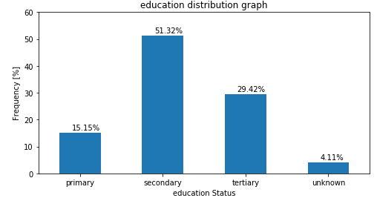
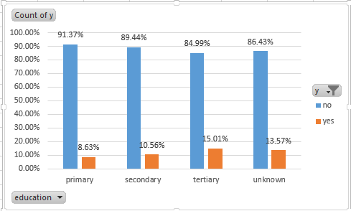
Variable: Education
Indicates the education level of the employees.
Null value = 0
51.32% people have secondary education
15.01% Among the customers who have tertiary education have bought the policy.
tertiary | 6851
secondary | 23202
primary | 13301
unknown | 1857

Slide 9
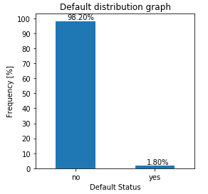
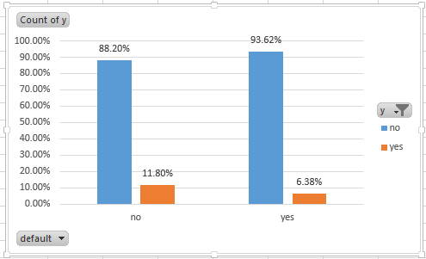
Variable: default
Indicates whether a person has credit in default or not.
Data_type = Categorical
Almost 98.20% people don’t have any credit in default.
11.80% people have bought the policy among the people who don’t have any credit in default.
yes | 815
no | 44396

Slide 10
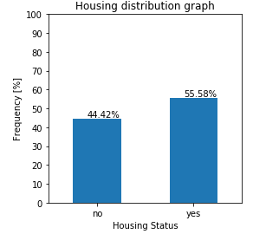
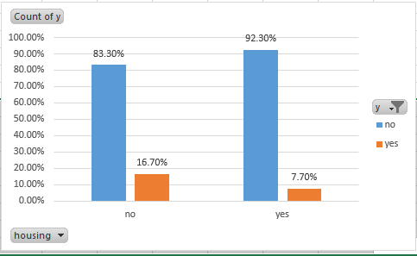
Variable: housing
Indicates whether a person has home loan or not.
55.58% customers have home loan.
The highest conversion rate is 16.70% and it is for the customers who don’t have any home loan.
yes | 25130
no | 20081

Slide 11
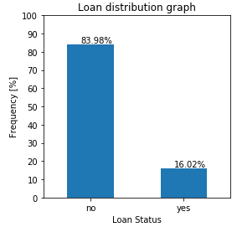
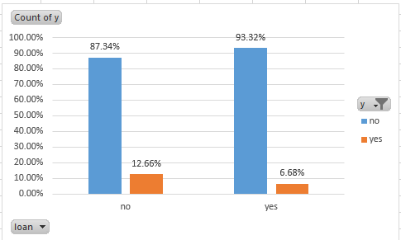
Variable: loan
Indicates whether a person has personal loan or not.
83.98% customers don’t have any personal loan.
Among the customers who don’t have any personal loan 12.66% customers and 6.68% from the rest of the customers have bought the policy.
yes | 7244
no | 37967

Slide 12
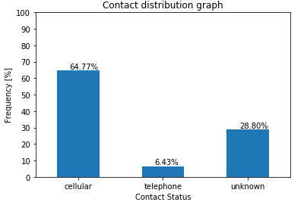
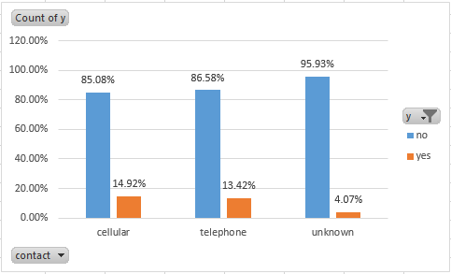
Variable: contact
In which way the customer was contacted before.
64.77% customers were contacted through Cellular.
14.92% of customers who were contacted via cellular have bought the policy which is the highest conversion rate.
Telephone | 2906
Cellular | 29285
Unknown | 13020

Slide 13
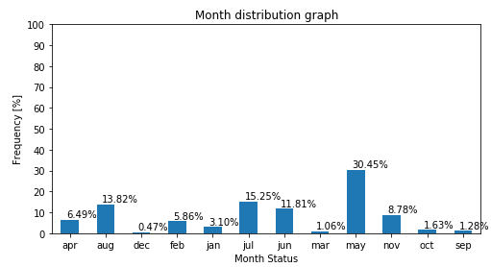
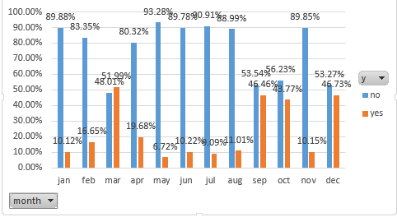
Variable: Month
Last contact month of year i.e. in which month of the current year the person was contacted for the last time.
Most number of customers were contacted in the month of May.
May but it has the lowest conversion rate(6.72%) and the highest conversion rate is in month of March (48.01%) followed by Dec(46.46%), Sep (46.73%), Oct(43.77%) etc.
Unique value | 12
Top value | May
frequency | 13766

Slide 14
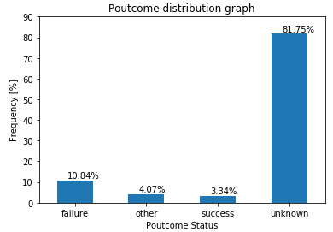
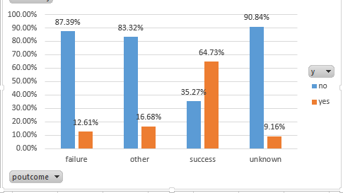
Variable: poutcome
Outcome of the previous campaign.
In their previous campaign 81.75% result was unknown.
In the previous campaign 64.73% among success phone calls and 12.61% of the failure phone calls brought the term policy.
success | 1511
failure | 4901
other | 1840
unknown | 36959

Slide 15
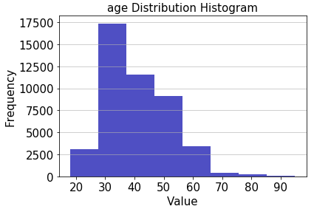
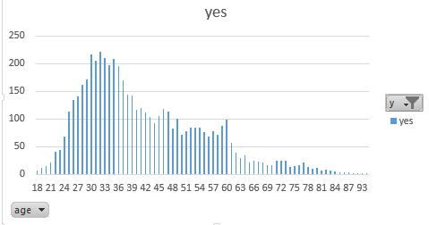
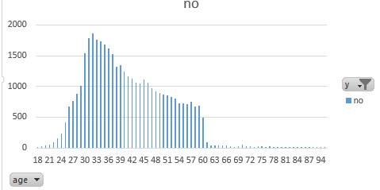
Variable: age
Indicates the age of the customers.
min | 18
max | 95
mean | 40.93
std | 10.62

Slide 16
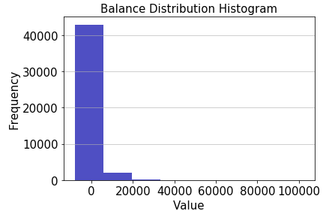
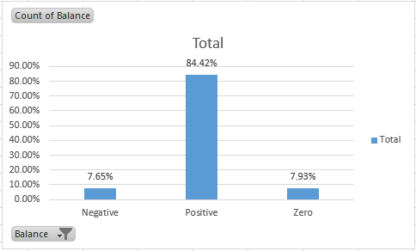
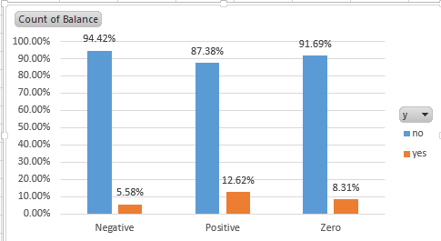
Variable: balance
Indicates the current available balance in customer’s account.
84.42% customers have positive(>0) balance in their accounts.
5.58% of people having negative balance in their accounts also have bought the term condition.
Min | -8019
max | 102127
average | 1362.27
std | 3044.77

Slide 17
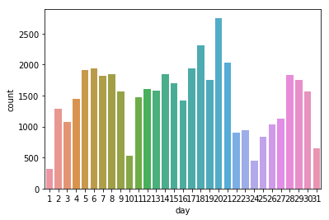
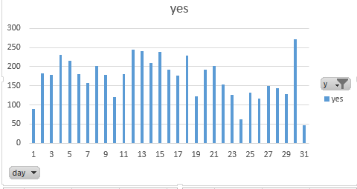
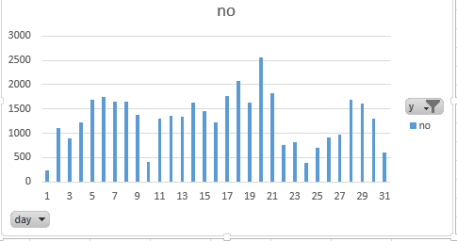
Variable: day
last contact day of the month i.e in which day of the month the person was being contacted by the bank.
Maximum customers were contacted on the day of 20 among which 93% didn’t bought the term policy.
Those who were contacted on the day of 30 among them 17.31% customers have bought the term policy.
mean | 15.81
std | 8.32
min | 1
max | 31

Slide 18
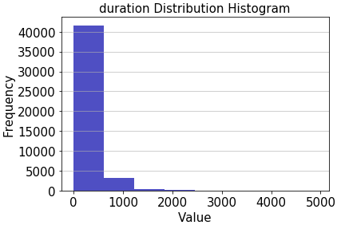
Variable: duration
last contact duration with the person, in seconds.
mean | 258.16
std | 257.53
min | 0
max | 4918

Slide 19
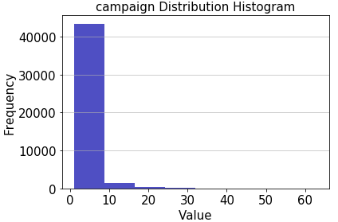
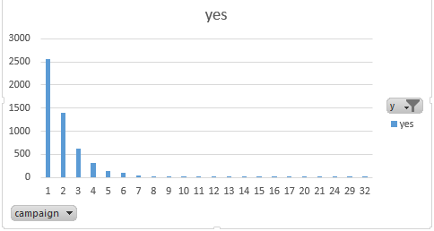
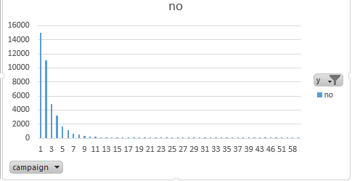
Variable: campaign
number of contacts performed during this campaign and for a particular customer.
The customers who were contacted more than 32 times they have not bought the term policy.
The persons who were contacted only once among them 14.60% customers have bought the term policy.
mean | 2.76
std | 3.10
min | 1
max | 63

Slide 20
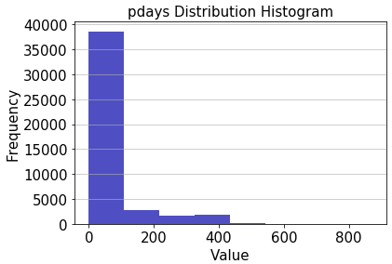
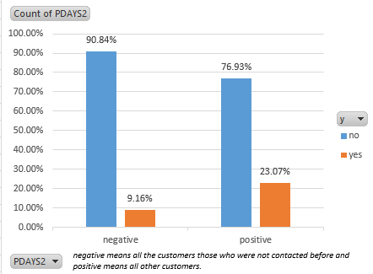
Variable: pdays
number of days that passed by after the customer was contacted for the last time after the previous campaign.
** here -1 means the customer was not previously contacted.
Those customers who were not contacted at least once among them 9.16% customers have bought the term policy.
min | -1
max | 871
mean | 40.2
std | 100.13

Slide 21
Variable: previous
number of contacts performed before this campaign and for this customer.
min | 0
max | 275
mean | 0.58
std | 2.30

Slide 22
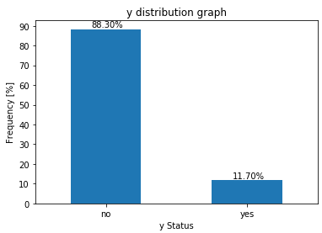
Variable: y [Output variable]
Indicates whether the customer has subscribed a term deposit or bought a term policy or not.
According to the record 88.30% has not bought the previous term condition.

Slide 23
What we have done with the Data Set
Have drop the ‘month’ column.
Converted all the categorical data to numerical.
Modified the ‘job’ column.
Applied normalization and standardization to the ‘balance’ and ‘duration’ column.
Used train-test split.
Ran various models on the data set.
Among various models with the best model (based on test score) calculated prediction and probability of the customers (who will buy the term policy).

Slide 24
Modification of ‘job’ column
We have converted all the job profiles into 4 groups.
I. A : entrepreneur, self-employed, house maid, services, unemployed
II. B : retired and student
III. C : blue-collar, management and technician
IV. D : admin and services
We have made the division based on the correlation of the job profiles with each other.
Among all these groups we have kept only the group B and deleted all other groups.

Slide 25
Train-test split
We have splitted the data as train set (70%) and test test (30%).

Slide 26
Models
We have used 6 models on the data set.
LogisticRegression
Decision Tree
Random Forest
K - Nearest Neighbor
Gaussian Naive Bayes
Support Vector Machine
Among all these models the test score of Random Forest model is the most. So we have used ‘Random Forest’ model for the prediction test and probability test.

Slide 27
Prediction test & Probability test
Based on all the above information the model have predicted the customers who may buy the term policy and calculated a probability for each customer.
Where the probability is greater or equal to 0.5 the model has converted the prediction as 1 which means the customers may buy the term policy.

