Slide 1
Music Recommendation System
Building a content based music recommendation system:
Content-based filtering uses item features to recommend other items similar to what the user likes, based on their previous actions or explicit feedback.
Why use content based filtering:
The model doesn't need any data about other users, since the recommendations are specific to this user. This makes it easier to scale to a large number of users.
Recommendations are highly relevant to the user
Tech stack used :
Python
HTML
CSS
JavaScript

Slide 2
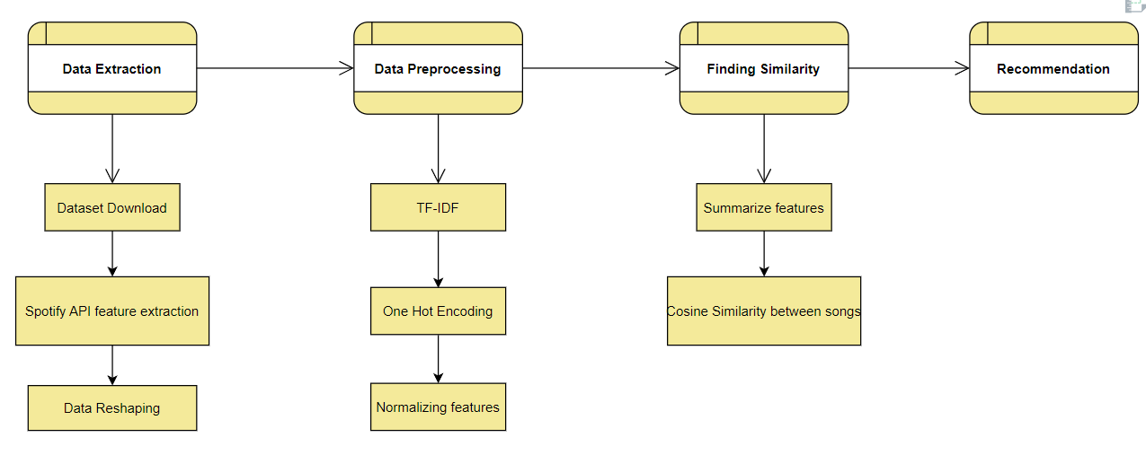
Recommendation System Pipeline

Slide 3
How to generate recommendations for a song
Connecting to Spotify API.
Data preparation
Feature Engineering
Generate recommendations.
Details:
Algorithm Type: Content based Recommendation system.
Limitations:
Dataset used is quite small(around 6000 songs) which affects the recommendation.
Many genres missing in the dataset or have only a few songs. This affected the recommendation for songs of certain genres.

Slide 4

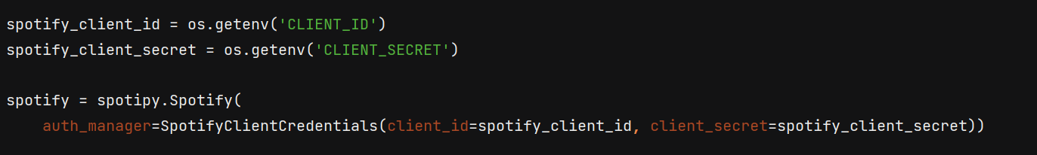
Connecting to Spotify API
Installing Spotipy
Firstly we will install Spotipy using pip. Spotipy is a Python client for the Spotify Web API that makes it easy for developers to fetch data and query Spotify’s catalog for songs.
Type of authorization : Client Credentials flow.
CLIENT_ID and CLIENT_SECRET is stored as environment variables in the .env file.

Slide 5
Data Preparation
The dataset used for this project was taken from Kaggle.
This dataset contains various track features as well as track id, track name, track artists.
The genre column of this dataset is actually given in form of string although it looks like list of strings.
I'm going to put together a regex statement to extract the genres and input into a list.
Now I will retrieve the user track information/data with the help of song name and song artist.

Slide 6
# fetching the information regarding the track that user entered def fetch_track(song_name, song_artist): result = spotify.search(q='track: {} artist: {}'.format(song_name, song_artist), limit=1) # not able to find song (return None) if result['tracks']['items'] == []: return None song_id = result['tracks']['items'][0]['id'] # retrieving the user tracks features from spotify api track_info = spotify.audio_features(tracks=song_id) track_info = track_info[0] track_data = defaultdict() for key, value in track_info.items(): track_data[key] = value artist_id = result['tracks']['items'][0]['album']['artists'][0]['id'] artist_info = spotify.artist(artist_id=artist_id) artist_genres = artist_info['genres'] track_data['genres'] = [artist_genres] track_data['artists'] = artist_info['name'] track_data['name'] = result['tracks']['items'][0]['name'] track_data['release_year'] = result['tracks']['items'][0]['album']['release_date'] track_data['popularity'] = result['tracks']['items'][0]['popularity'] track_data['duration_min'] = track_info['duration_ms'] / (1000 * 60) track_data['release_year'] = int(track_data['release_year'][:4]) return pd.DataFrame(track_data)

Slide 7
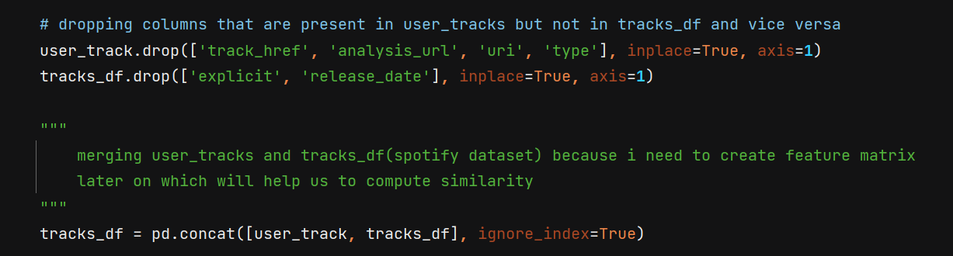
After this I need to combine together the genres that have spaces between them into one single word using underscores. This is needed because we will be creating a TF-IDF matrix of genre column later on and I don’t want to treat a single genre as a set of different words.
Example: hip hop → hip_hop
Note: Spotify dataset(tracks_df) already had genres in this format so there wasn’t any needed to perform the re.sub() and replace spaces with underscore.
Now I will remove all those columns that are present in user_track but not in tracks_df and vice versa as I need to merge these two dataframes together. This is required because I need to create the feature set of the user track also through which we will compute similarity later on.

Slide 8
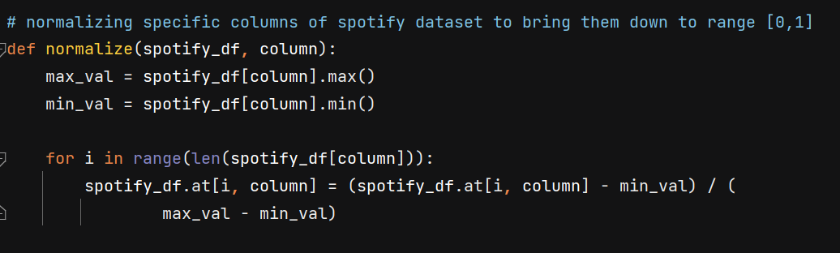
Feature Engineering
Normalizing columns
Create TF-IDF features for genre column
One hot encoding the year column

Slide 9
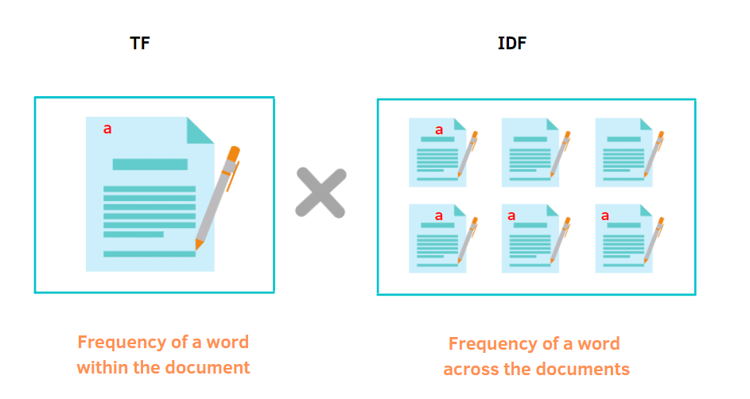
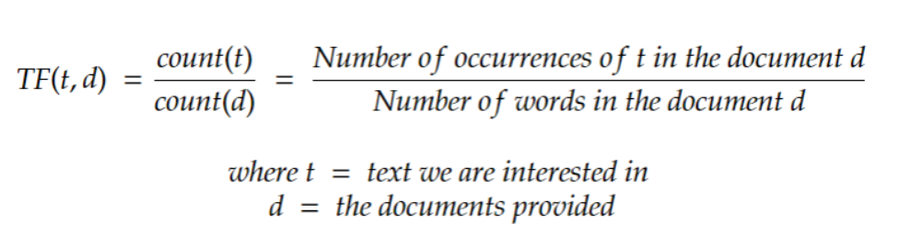
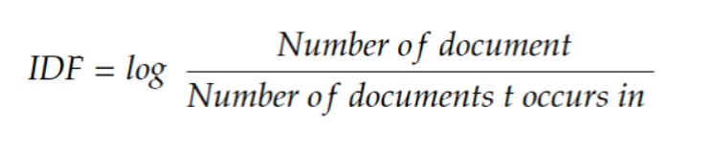
The genres in Spotify dataset are not balanced distributed with some genres more prevalent while others are more obscure. In addition, one artist or track could be associated with multiple genres. Hence, we need to weigh the importance of each genre to combat overweighing specific genres while underestimating others.
Therefore, TF-IDF measures are introduced and applied to the genre data. TF-IDF, also known as Term Frequency-Inverse Document Frequency, is a tool to quantify words in a set of documents. The goal of TF-IDF is to show the importance of a word in the documents and the corpus.
The general formula for calculating TF-IDF is:

Slide 10
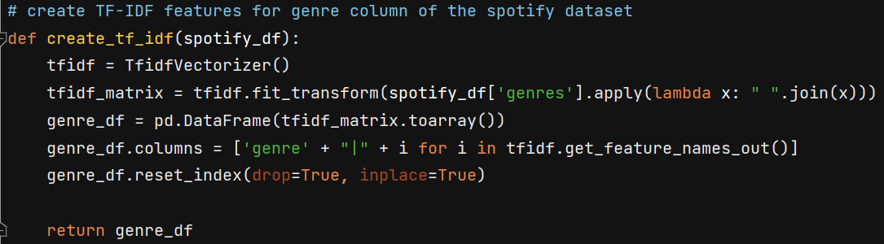
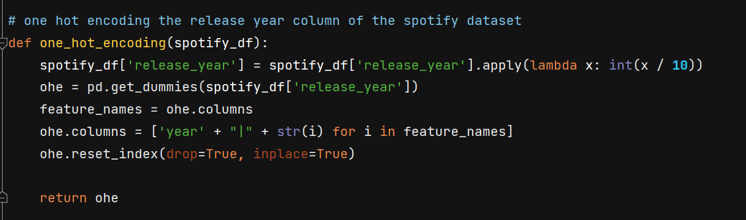
Now we need to One Hot Encode the release year column of the dataset. But before doing that I will perform binning on the release year and divide them into bins of 10 years, because any song that is released in this duration is a good recommendation.
Finally after doing all the above mentioned feature engineering we are now ready to group together the final set of useful features which will help us in generating the recommendations.

Slide 11
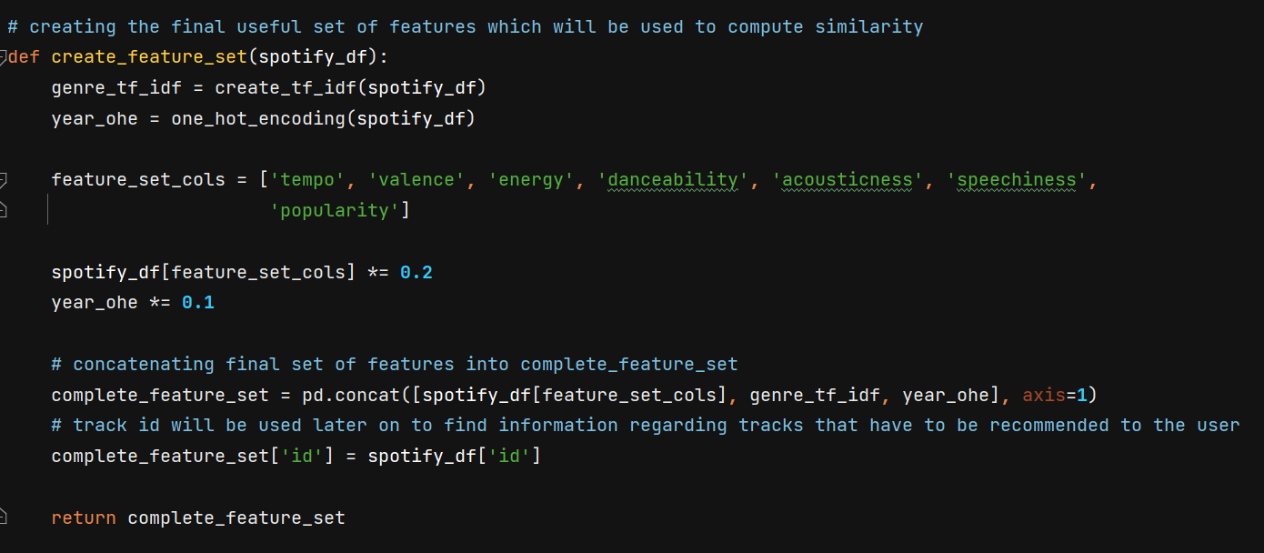
One thing to note here is that I have assigned different weights to different feature set by multiplying them with some constant this has been done by testing the model on various inputs in order to generate better recommendations.

Slide 12
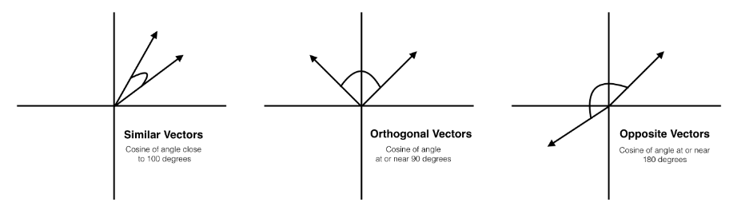
Generate Recommendations
Firstly I need to separate final useful set of user_track feature set from tracks_df( spotify dataset ) as I had merged them together before, this is needed because I need to compute similarity between user_track feature set and tracks_df. This also prevents user track from becoming a possible candidate for final recommendation.
Now to find out the similarity score between user song and tracks present in our dataset. The similarity metric chosen is Cosine similarity.
Cosine similarity is a mathematical value that measures the similarities between vectors. Imagining our songs vectors as only two-dimensional, the visual representation would look similar to the figure below.

Slide 13
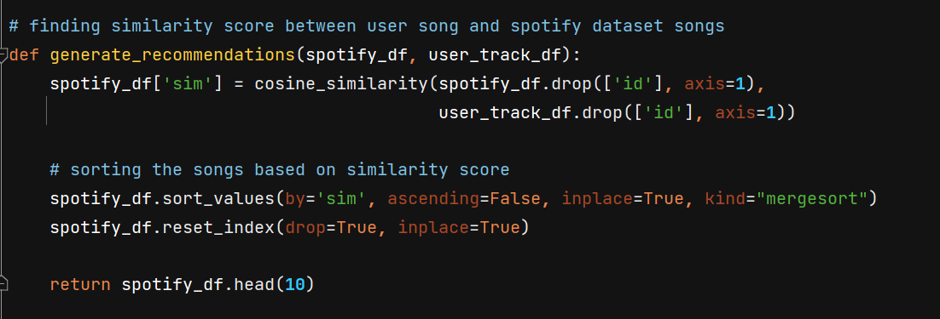
Once the two vectors are pointing generally in the same direction, then they are similar. This implies that a higher value of cos(theta) where theta is the angle between the two vectors, tells us that the songs are similar.
The generate recommendation function computes similarity between the user track and spotify dataframe and then sorts the spotify dataframe on the basis on decreasing similarity score. The type of sorting used is Merge Sort because of its nlogn time complexity.
Finally it returns the top 10 songs from the spotify dataframe after sorting.

Slide 14
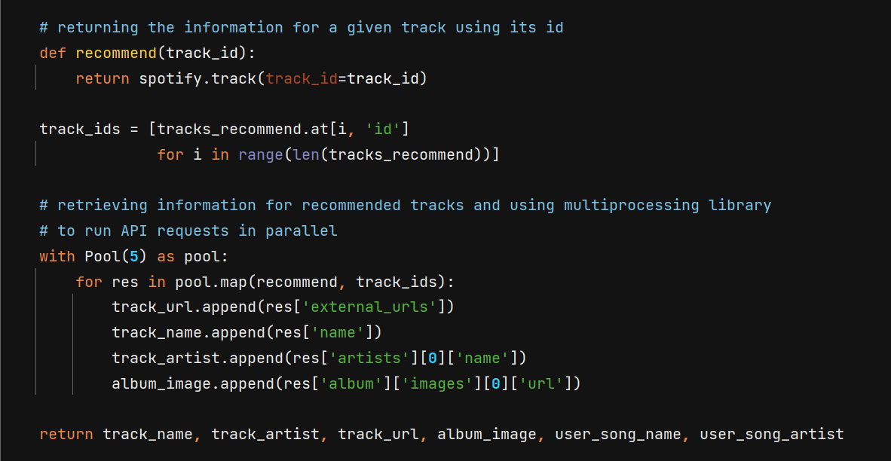
Now we have the top 10 songs that we want to recommend to the user. The name, artist, album image and spotify link of the tracks will be retrieved through spotify API and will be shown to the user on the website. Here I’ve used the multiprocessing module to run the API requests in parallel, this helped to reduce the runtime of the application.

Slide 15
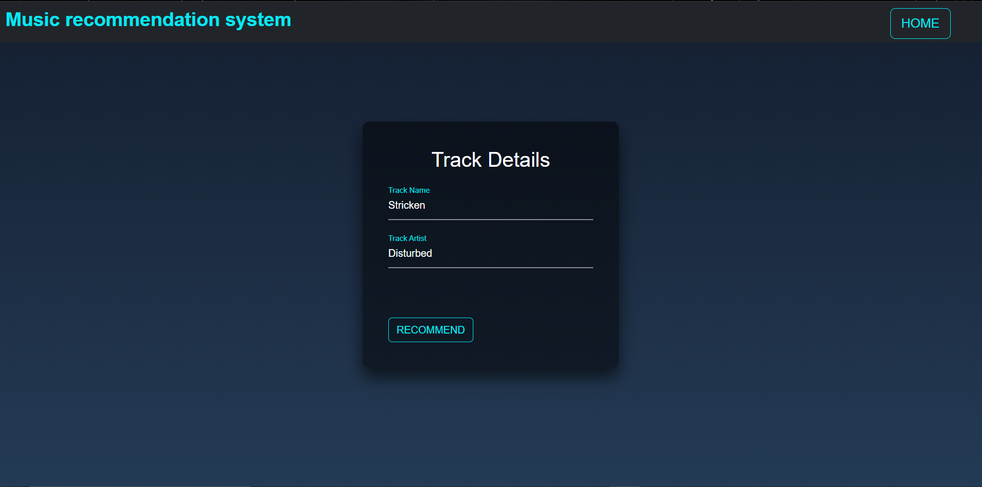
Web Application
Website: https://music-recommendation-alucard.herokuapp.com/

Slide 16
