Slide 1

ATTENDANCE MANAGEMENT SYSTEM
BLOOD DONOR MANAGEMENT SYSTEM
Kagitha Sowjanya
220101021 Semester-V
Supervised by: Dr. KABITA THAORIJAM
T. Sameer Reddy Semester-V
Supervised by: Dr. Kishorjit Nongmeikapam

Slide 2
October 22, 2024
Content Overview
1
2
3
4
5
Introduction and Motivation
Proposed System
System Design
Implementation
Results & Conclusion

Slide 3
October 22, 2024
Introduction and Motivation
Problem:
Solution: A Computerized system to streamline blood donor and blood bank operations.
Motivation:
Inefficient blood donation tracking.
Difficulty in finding suitable donors.
Manual blood stock management prone to errors.
Lack of a centralized system for blood banks and donors.
Improved donor records management.
Efficient search for compatible donors.
Accurate blood stock maintenance.
Enhanced blood availability for patients in need.
Faster and more reliable service to customers.

Slide 4
October 22, 2024
Proposed System
Key Features:
Target Users:
Donor Management: Add, delete, edit, and search for donors based on various criteria (blood group, address, last donation date).
Blood Bank Management:Add blood stock, serve blood to customers, and track inventory.
Data Persistence: Save and load donor and blood bank from files to ensure data integrity.
User-Friendly Interface: Simple and intuitive menus from files to ensure data integrity.
Blood bank administrators
Medical Staff
Potential blood donors

Slide 5
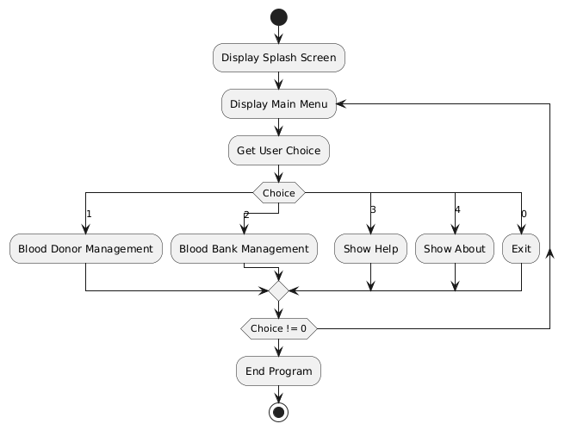
October 22, 2024
System Design
Flow Chart

Slide 6
October 22, 2024
Implementation
Programming Language: c
Key Functions:
Code Structure:
addDonor(), deleteDonorByPhoneNumber(), editDonorByPhoneNumber(), ViewFilteredDonors(), searchDonor(), viewAllDonors(), saveDonorsToFile(), loadDonorsFromFile()
addBloodstock(), serveBlood(), viewBloodstock(), displayCustomerList(), saveData(), readcustometList()
Modular design with separate functions for each operations.
Use of header files (stdio.h, stdlib.h, string.h, unistd.h, time.h) for standard input/output, memory allocation, string manipulation, and time-related functions.

Slide 7
October 22, 2024
Results and Conclusion
Achievements:
Future Enhancements:
Successfully implemented a function blood bank management system.
Demonstrated the use of data structures and file handling in C for real-world applications.
Implement a graphical user interface(GUI) for improved user experience.
Add features for blood compatibility checking.
Develop a web-based application for wider accessibility.

Slide 8

THANK YOU

