Slide 1

Miniproject(19AI701) – Review 1
Data Visualization with PowerBI
Submitted by:
SOWMIYA N (212221230106)
2020-2024 Batch
TEAM NO:TEAMDS06
Under the guidance of:
ARCHANA S H
Assistant Professor , Department of AIDS
DEPARTMENT OF ARTIFICIAL INTELLIGENCE AND DATA SCIENCE
SAVEETHA ENGINEERING COLLEGE
(Autonomous Institution – UGC, Govt. of India)
(Affiliated to Anna University, Approved by AICTE - Accredited by NBA & NAAC – ‘A’ Grade - ISO 9001:2015 Certified)
Saveetha Nagar, Thandalam, Chennai-602 105, TamilNadu, INDIA.

Slide 2
Agenda
Introduction
Statement of the Problem
Purpose of the project
Proposed Methodology
Expected results and its Implications
References

Slide 3
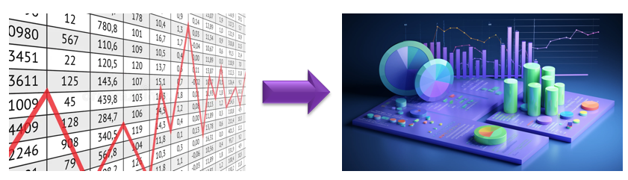
Introduction
DATA STORYTELLING WITH POWERBI
Data storytelling: It leverages data as the basis for a compelling narrative to engage and persuade an audience.
Data visualization: It uses graphical elements to represent data for improved understanding.
Power BI: A Microsoft tool for data visualization and interactive reporting.

Slide 4
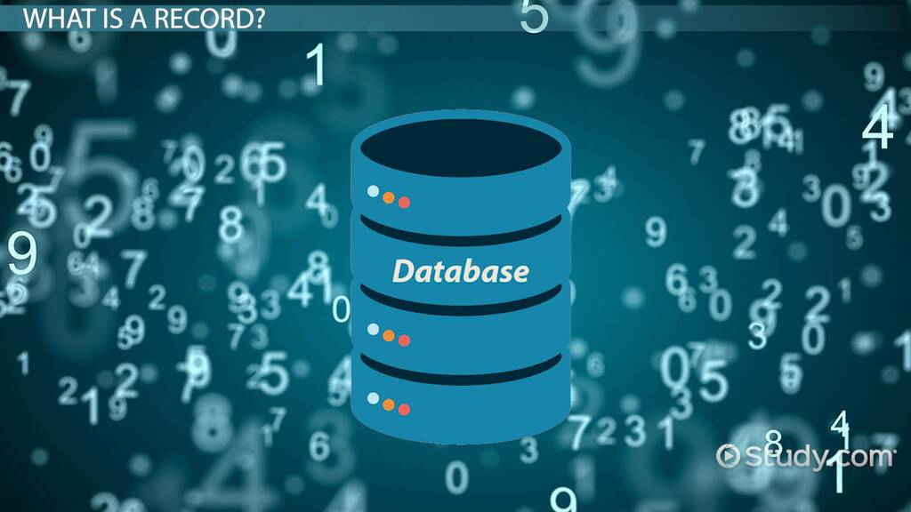
Statement of the Problem
Addressing challenges that businesses face in making sense of large volumes of numerical data.
Suboptimal decision-making
Making Communication with the end user difficult.

Slide 5

Purpose of the project
Creating an interactive BI dashboard that help analyze raw data, identify patterns and trends, and enhance the firm's performance in the market.
Why PowerBI ?
Interactive Report Generation.
Updation of data.
Accessible among the organization.
Provides Mobile Interface.
Ease of Understanding

Slide 6
Proposed Methodology
DATA STORYTELLING WITH POWERBI
Data Collection
Data Cleaning
Exploratory Data Analysis
Dumping into SQL Database
Data Visualization with PowerBI
Interactive Dashboard Development
Testing and refinement

Slide 7
Expected Results and Implications
The expected results of this project are as follows:
• A method for generating interactive reports that can help business users make more informed decisions.
• A set of interactive reports that can be used by business users to visualize numerical data and identify trends.

Slide 8

Conclusion
Large volume of data can be easily visualized.
Improved decision making
Can easily communicate with the end user.

Slide 9
References
Papers
https://www.researchgate.net/publication/321804138_Data_Visualization_for_Business_Intelligence
https://www.researchgate.net/publication/352735133_Data_Visualization_A_Study_of_Tools_and_Challenges
https://www.ijsce.org/wp-content/uploads/papers/v7i3/C3011077317.pdf
Books
Cole Nussbaumer Knaflic “Storytelling with Data” : A Data Visualization Guide for Business Professionals
Andy Kirk “ Data Visualisation” : A Handbook for Data Driven Design 2019
Suren Machiraju, Suraj Gaurav “Power BI Data Analysis and Visualization” 2018
Brian Larson · “Data Analysis with Microsoft Power BI” 2020
Brett Powell “Mastering Microsoft Power BI” : Expert Techniques for Effective Data Analytics and Business Intelligence 2018

