Slide 1
Angular reactive forms
FormControl:
It matches to a HTML form control such as an input or a selector.
it tracks the value and validity status of an angular form control.
This basic example shows a FormControl for the name property which should not be empty.
FormGroup:
it tracks the value and validity state of a FormBuilder instance group.
It aggregates the values of each child FormControl into one object, with each form control name as the key.
It calculates its status by reducing the statuses of its children.
For example, if one of the controls in a group is invalid, the entire group becomes invalid.

Slide 2
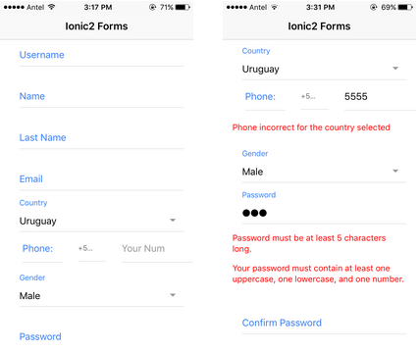
FormBuilder :
is a helper class that creates FormGroup, FormControl and FormArray instances for us.
It basically reduces the repetition and clutter by handling details of form control creation for you.

Slide 3
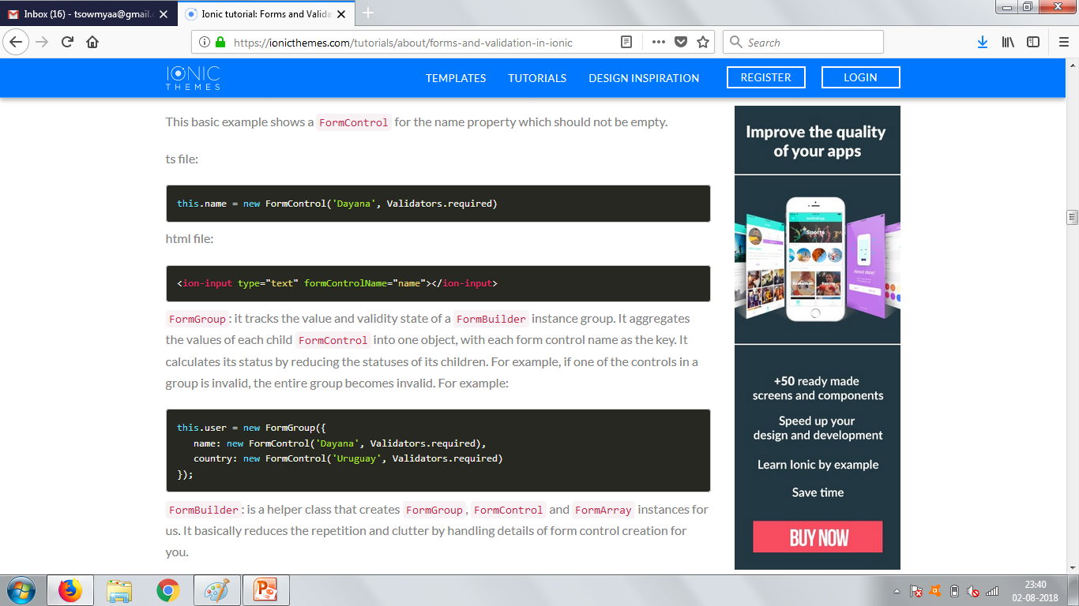

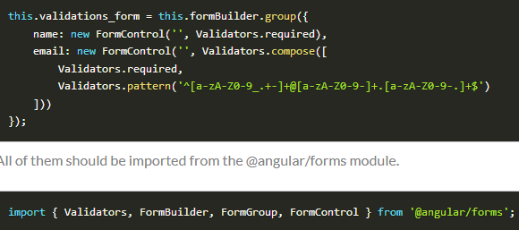

Slide 4
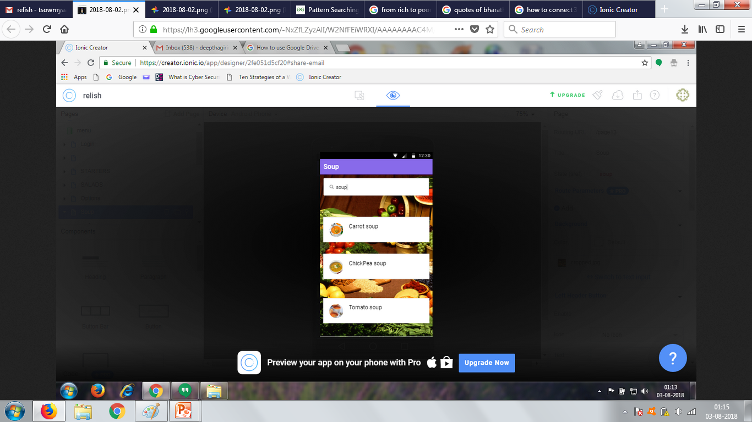
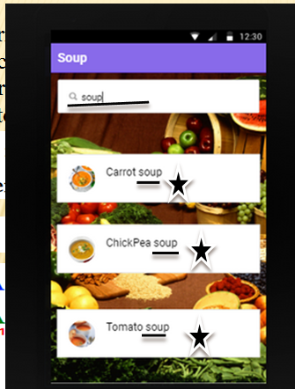
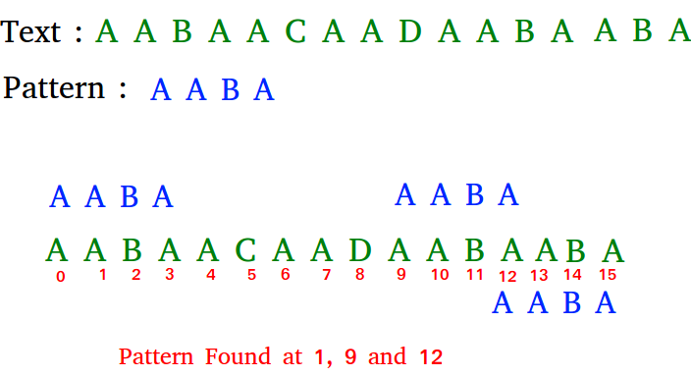
BOYER MOORE ALGORITHM :
Pattern searching is an important problem in computer science. When we do search for a string in notepad/word file or browser or database, pattern searching algorithms are used to show the search results.

Slide 5


FUTURE SCOPES AND IMPROVEMENTS:
Upgraded versions of software
Customized search
Videos to Animated GIFs
Hunger Forum

Slide 6
Upgraded versions of the app:
This includes launch of infinite new and unique , authentic dishes for the customers who pay and upgrade RELISH from time to time .
The default app incorporates all varieties of dishes but the number of recipes will be increased for upgraded versions only.
Customized search :
This feature to be extended into the app , allows the user to search for a dish based on their ingredients they have .
So cooking with what you have is the basis for this strategy.

Slide 7




Videos to Animated GIF’s:
This idea is to prevent the user from getting annoyed from watching lengthy videos and to make their cooking short and sweet using Animated GIF’s .
HUNGER FORUM !
If you can't feed a hundred people, then feed just one.

Slide 8


