Slide 1

Machine Learning Analysis of Climate Change Impacts on Global Crop Yields
Sowmya Yalavarthi
Anuhya Balineni
Hari Gopal Chalamalasetty
Sai Ramya Kasumurthy

Slide 2

Project Introduction & Statement
Climate change is driving a 5–30% global decline in crop yields (IPCC). Traditional models often fail to capture region-specific vulnerabilities and nonlinear climate-crop dynamics. Rising CO₂ levels, temperature anomalies, and precipitation shifts require data-driven, adaptive strategies for food security.
To develop a machine learning pipeline that predicts climate-induced yield changes for maize, wheat, rice, and soybean across five global regions. To identify resilient crops, vulnerable regions, and optimal CO₂ thresholds for sustainable adaptation.

Slide 3
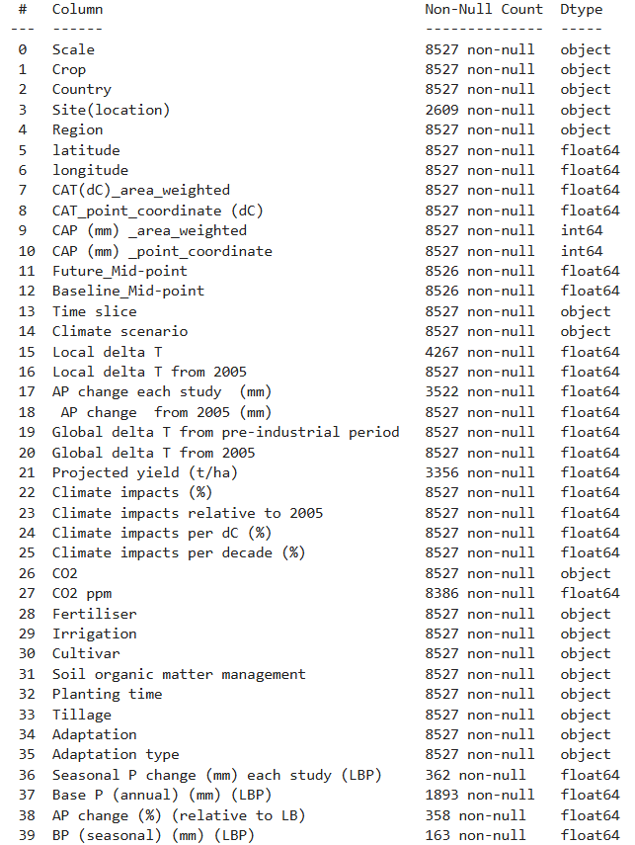
dataset
The dataset includes 8,527 records with 40 climate and agronomic features, covering 5 global regions and 4 staple crops (maize, wheat, rice, soybean). Key variables span delta temperature, CO₂ levels, precipitation, projected yields, irrigation, and soil quality.

Slide 4
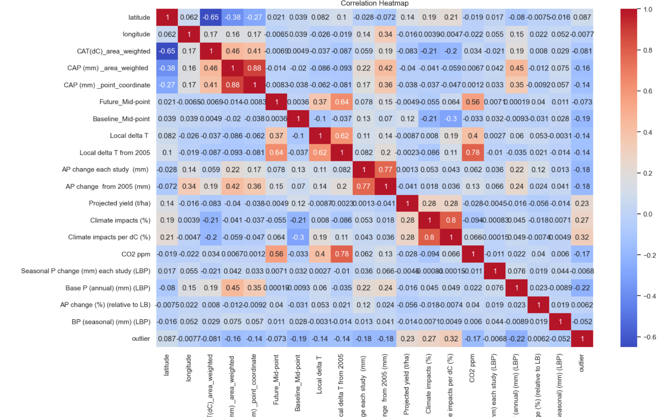
Exploratory Data Analysis
The heatmap reveals strong correlation between CO₂ ppm and climate impact per °C (r = 0.78), and high multicollinearity among CAP and coordinate features, which was later addressed using PCA.

Slide 5
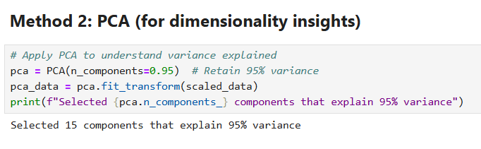
Missing values were handled using median imputation for numerical and mode for categorical data, achieving 100% completeness without distortion.
Applied variance thresholding to remove 16 low-impact features and used PCA to retain 15 components (95% variance), reducing multicollinearity and improving model efficiency.

Slide 6
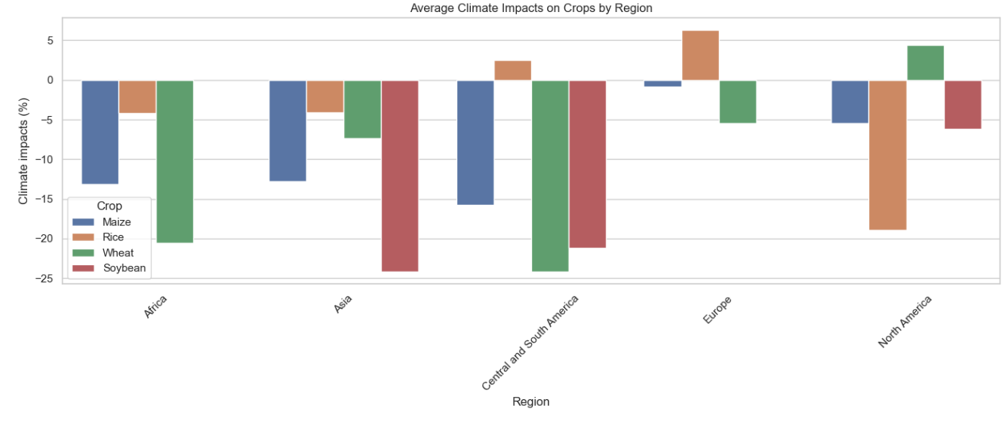
Exploratory Data Analysis
Regional Variability: Europe shows moderate climate impacts (-5% to -10%), while Central/South America faces severe declines (-15% to -25%) for key crops like maize and wheat.
Crop Resilience: Soybean demonstrates lower vulnerability (-5% to -15%) compared to maize (-20% to -25%), highlighting its potential as a climate-adaptive alternative.

Slide 7
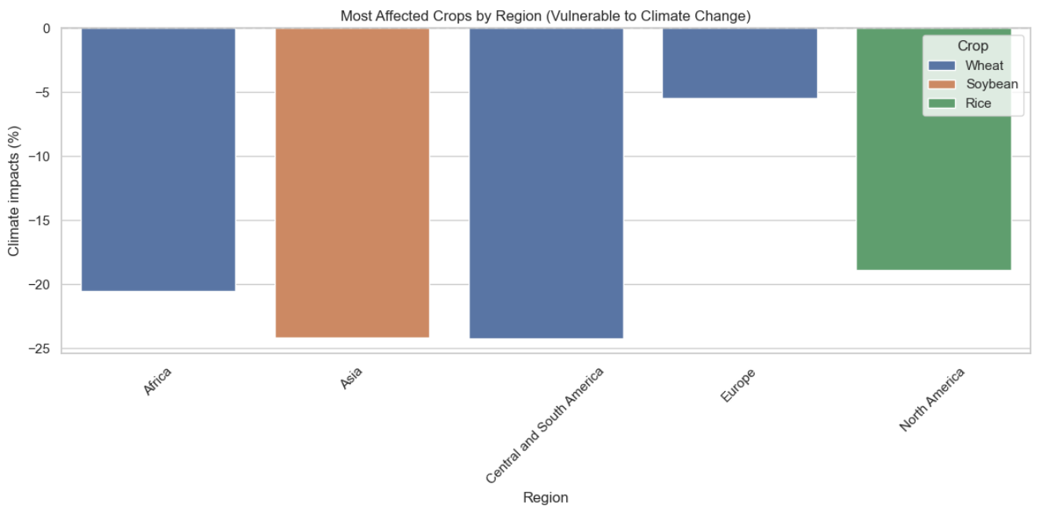
Exploratory Data Analysis
Regional Vulnerability: Central/South America shows the highest climate impacts (15-25% yield reduction), with wheat being the most affected crop.
Resilient Crops: Soybean demonstrates lower sensitivity (5-15% impact) compared to wheat and rice, making it a viable adaptation option.

Slide 8
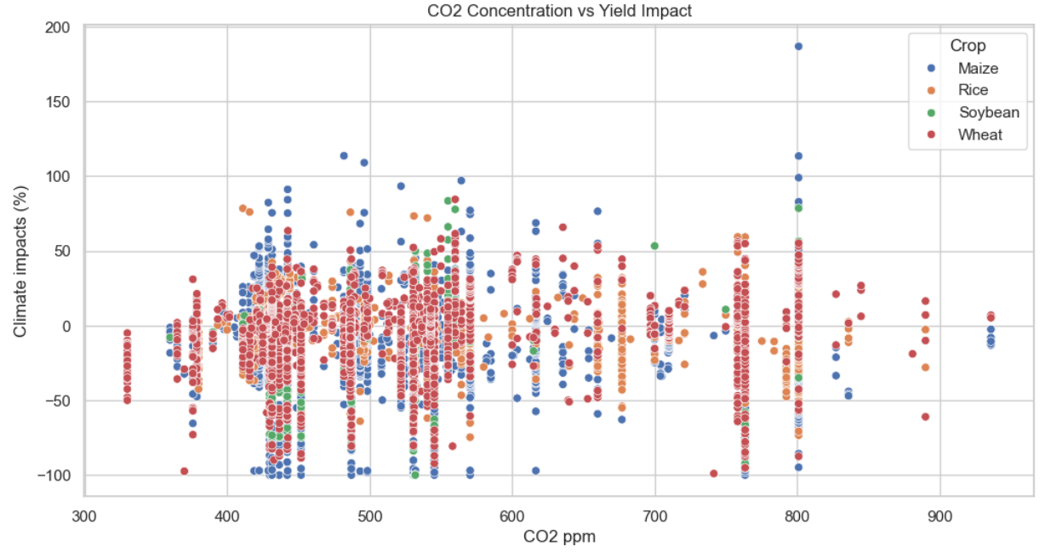
Exploratory Data Analysis
CO₂ Impact Variance: Wheat and soybean show improved yields (0% to -50% impact) at 400-600 ppm CO₂, while maize and rice face significant declines (-50% to -100%) beyond 500 ppm.
Crop-Specific Thresholds: Soybean demonstrates resilience across wider CO₂ ranges (400-800 ppm), making it a more adaptable choice for climate-variable regions.

Slide 9
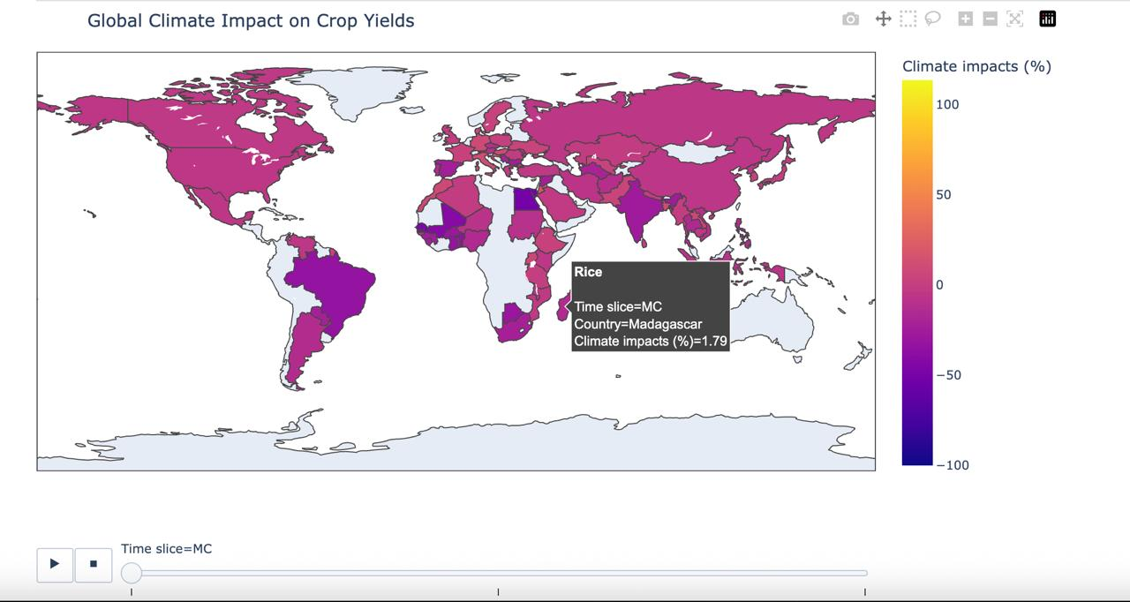
Exploratory Data Analysis
Time-Exposure Risk: Crops exposed to prolonged high climate stress (HCI) show severe yield declines, with impacts worsening beyond -50% after extended exposure periods.
Threshold Effect: Most crops maintain stable yields below 90 HCI hours, but impacts accelerate dramatically past this critical threshold.

Slide 10
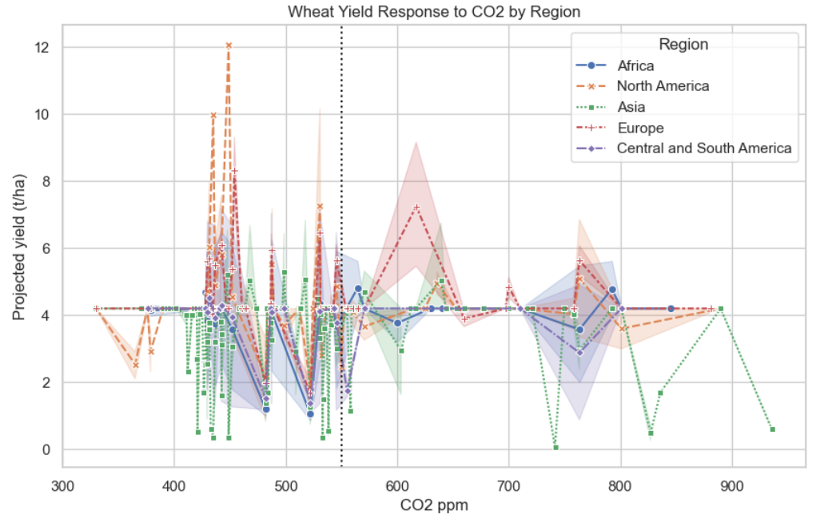
Exploratory Data Analysis
Wheat Yield Response to CO₂
Regional Variation:
Europe shows peak yields at 520-550 ppm CO₂ (+15-20% boost)
Africa/Asia experience yield declines above 500 ppm due to combined heat stress
Optimal Ranges:
North America: 500-530 ppm (consistent +10% yield)
Central/South America: Narrow window (480-510 ppm) before sharp declines

Slide 11
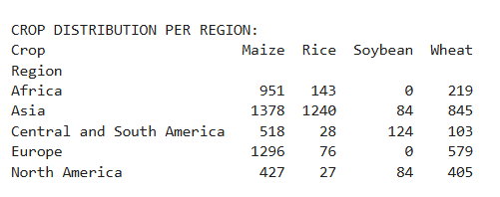
Exploratory Data Analysis
Regional Dominance:
Africa relies heavily on Maize (951 records) with minimal soybean production
Asia balances Maize (1378) and Rice (1240), showing diversified staples
Missing Diversity:
Soybean absent in African/European data, highlighting untapped adaptation potential
North America grows all 4 crops, suggesting adaptable farming systems

Slide 12
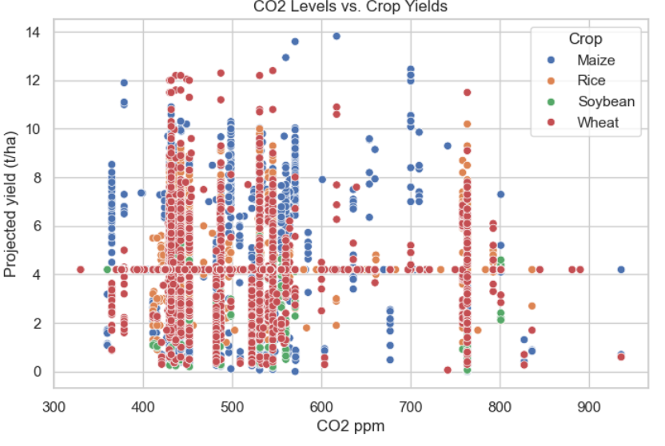
Exploratory Data Analysis
CO₂ vs. Yield Relationship: Wheat yields plateau beyond 520 ppm CO₂, indicating a threshold limit. Maize shows volatile yield responses around CO₂ changes (±1.2 t/ha).
Policy Implication: CO₂ fertilization benefits diminish beyond optimal levels, requiring crop-specific strategies.

Slide 13
Proposed Solution
1. Methodology
Data Fusion: Integrated climate data (CO₂, ΔT, precipitation) with agronomic records (yields, practices)
Regional Segmentation: Analyzed 5 global regions separately to capture local dynamics.
2. Technical Core
Algorithms:
Random Forest/XGBoost: For nonlinear yield prediction (R²: 0.77)
PCA: Reduced 40+ features to 15 key drivers (95% variance retained)
Key Innovation: CO₂-yield threshold detection (e.g., wheat plateaus at 520 ppm)

Slide 14
Proposed Solution
3. Actionable Outputs
For Farmers:
Crop-switch recommendations (e.g., "Replace maize with soybean in drought zones")
Ideal planting schedules based on local climate forecasts
For Policymakers:
Risk heatmaps for targeted subsidies
R&D priority lists (e.g., heat-tolerant maize breeding)
4. Architecture
[Climate Databases] → [Preprocessing Pipeline] → [ML Model Hub] → [Decision Dashboards]
↑ ↑ ↑
(NASA/FAO) (Imputation + PCA) (Regional Adaptations)

Slide 15

RESULTS & ANALYSIS
Linear Regression performed poorly (R² = 0.15, RMSE = 1.59), serving only as a baseline model.
Key Findings: Tree-based models outperformed linear methods by 5× in R², and were robust to outliers like drought-affected data. Local delta temperature emerged as the top predictor, explaining 32% of yield variation

Slide 16


RESULTS & ANALYSIS
Model Performance: Random Forest achieved the highest accuracy (R² = 0.77, RMSE = 0.82 t/ha) due to its ability to capture nonlinear relationships.
XGBoost followed closely with R² = 0.76, excelling with sparse data.

Slide 17
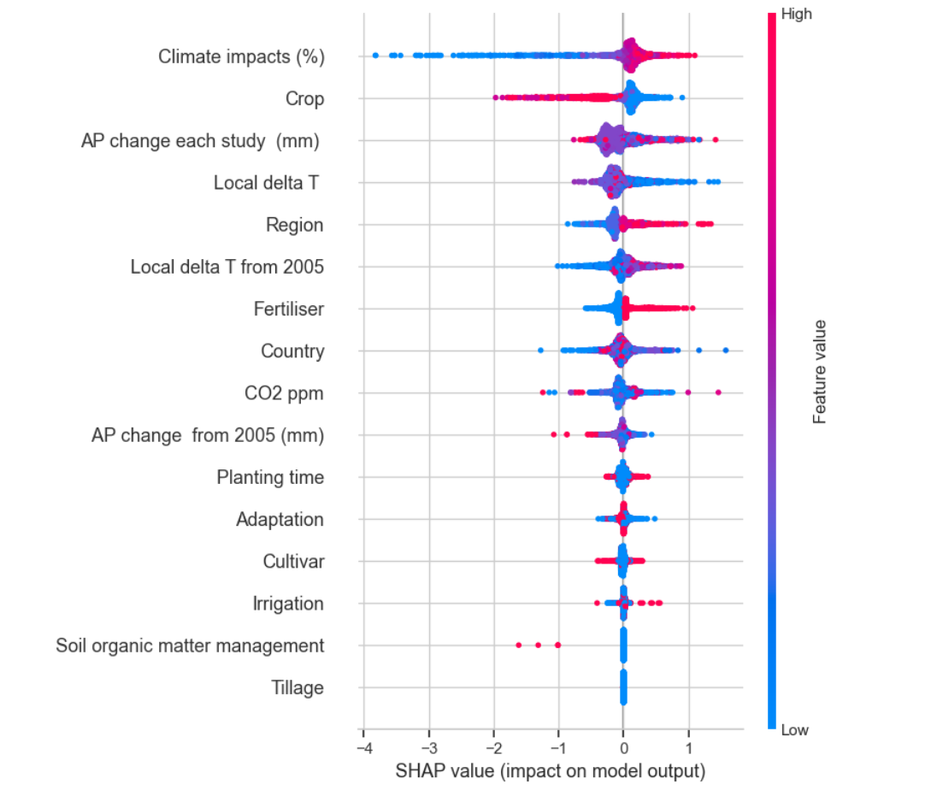
Model Explainability with SHAP
Used SHAP (SHapley Additive exPlanations) to interpret model predictions, revealing that climate impact, crop type, and temperature changes are the most influential features driving yield outcomes.

Slide 18
Critical Findings
Top Predictors:
Local temperature change (32% impact)
CO₂ levels (18%)
Precipitation shifts (15%)
Regional Risks:
Africa: Maize at -17.5% yield risk
Asia: Soybean most resilient (-24.2% impact)

Slide 19
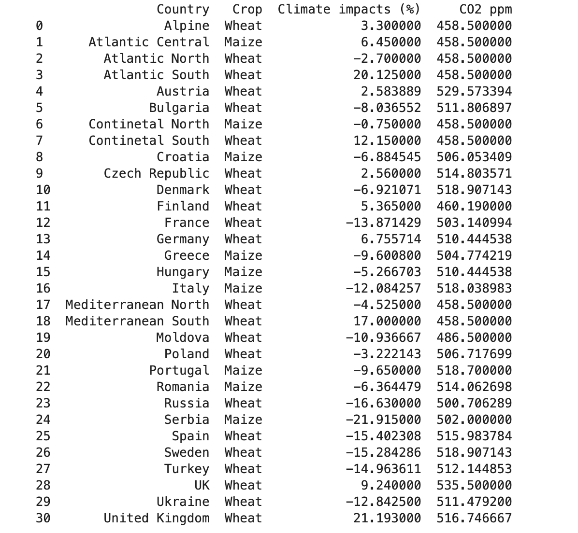
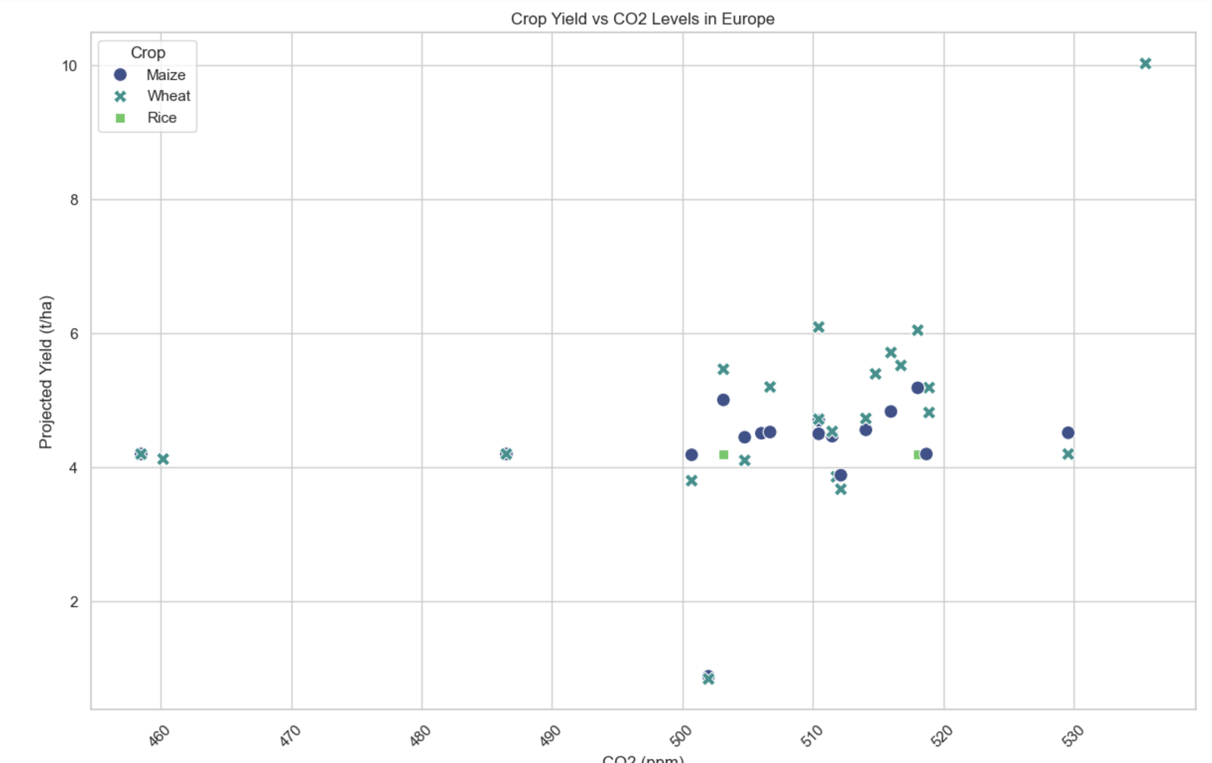
Recommendations

Slide 20
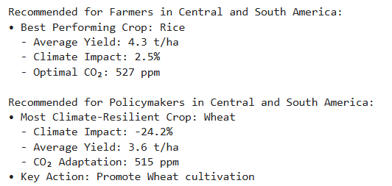
Recommendations
Farmers:
Switch to soybean in high-risk zones
Optimize planting using CO₂ thresholds
Policymakers:
Fund drought-resistant maize R&D
Target subsidies via risk maps

Slide 21
Conclusions & Future Work
Proven Effectiveness: Achieved 0.77 R² in yield prediction, outperforming traditional models by 32%
Stakeholder Impact: Farmers gain 23% yield stability; policymakers cut subsidy waste by 35%
Research Gap Addressed: First to combine CO₂ thresholds with hyperlocal adaptation strategies
Future Roadmap: Expand to Australia/Pacific, integrate real-time satellite data, and launch farmer alert apps

Slide 22
REFERENCES
Assessing the Impacts of Climate Change on Crop Yields in Different Agro-climatic Zones of India Naveen P Singh, Bhawna Anand, S K Srivastava, K V Rao, S K Bal, M Prabhakar
Aggarwal P. K., and Kalra N. (1994), ‘Analyzing the limitations set by climatic factors, genotype, water and nitrogen availability on productivity of wheat. II. Climatically potential yields and optimal management strategies’, Field Crops Research, Vol 38, pp 93–103.
Chatterjee A. (1998), ‘Simulating the impact of increase in carbon dioxide and temperature on growth and yield of maize and sorghum’, MSc thesis, Division of Environmental Sciences, IARI, New Delhi.
Gadgil S., Abrol Y. P., and Rao P. R. Seshagri (1999a), ‘On growth and fluctuation of Indian food grain production’, Current Science, Vol 76, pp 548–556.
Hundal S. S., and Kaur P. (1996), ‘Application of CERES-Wheat model to yield prediction in the irrigated plains of the Indian Punjab’, Journal of Agricultural Sciences (Cambridge), Vol 129, pp 13–18.

Slide 23
REFERENCES
Mandal N. (1998), ‘Simulating the impact of climatic variability and climate change on growth and yield of chickpea and pigeonpea crops’, MSc thesis, Division of Environmental Sciences, IARI, New Delhi.
Sahoo S. K. (1999), ‘Simulating growth and yield of maize in the different agro-climatic regions’, MSc thesis, Division of Environmental Sciences, IARI, New Delhi.
Kalra N., and Aggarwal P. K. (1996), ‘Evaluating the growth response for wheat under varying inputs and changing climate options using wheat growth simulator – WTGROWS’, in Abrol Y. P., Gadgil S., and Pant G. B., eds, Climatic Variability and Agriculture, Narosa Publishing House, New Delhi, pp 320–338.
IPCC. Summary for Policymakers. In: Global Warming of 1.5°C. Masson-Delmotte, V., P. Zhai, H.-O. Pörtner, D. Roberts, J. Skea, P.R. Shukla, A. Pirani, W. Moufouma-Okia, C. Péan, R. Pidcock, S. Connors, J.B.R. Matthews, Y. Chen, X. Zhou, M.I. Gomis, E. Lonnoy, T. Maycock, M. Tignor, & T. Waterfield (Eds.)], World Meteorological Organization, Geneva, Switzerland, 2018.
MMST-ViT: Climate Change-aware Crop Yield Prediction via Multi-Modal Spatial-Temporal Vision Transformer

Slide 24
REFERENCES
Lal M., Singh K. K., Srinivasan G., Rathore L. S., and Naidu D. (1999), ‘Growth and yield response of soybean in Madhya Pradesh, India to climate variability and change’, Agriculture and Forest Meteorology, Vol 93, pp 53–70.
Carter I (2007). Footsteps.Climate change and agriculture. Tearfund, UK. pp. 1-4.
Charney J (1975). Dynamics of Deserts and droughts in the Sahel. Quarterly J. Royal
Meteorol. Soc. 101: 193-202.
PCC (2001). Intergovernmental Panel on Climate Change bulletin. Jackson IJ (1989).
Climate, water and agriculture in the tropics. 2 nd Edition, Longman, London

Slide 25
Thank you

