Slide 1
Data Science and Machine Learning in Action: A Comprehensive Approach Using Real-World Data
In this comprehensive project, we will embark on an exciting journey through the world of data science and machine learning. Using real-world stock price data for Apple Inc. (AAPL), our teams will navigate through the entire data science pipeline – from data collection and exploration to advanced predictive modeling. This hands-on experience will provide invaluable insights into the practical application of concepts learned in class, bridging the gap between theory and real-world implementation.
Our Team will grapple with challenges such as data cleaning, feature engineering, and model optimization, mirroring the complexities faced by professionals in the field. By working with financial data, participants will gain exposure to time series analysis and the nuances of predicting volatile market behaviors, skills highly valued in both academia and industry.
Sowmya Yalavarthi

Slide 2
Data Collection and Exploration
1
Data Acquisition
We begin by writing code to interface with the Yahoo Finance API, retrieving historical stock price data for Apple Inc. This step introduces them to real-world data acquisition techniques and API usage.
2
Initial Data Cleaning
The raw data is then cleaned, addressing issues such as missing values, duplicates, and formatting inconsistencies. This process emphasizes the importance of data integrity in analysis.
3
Exploratory Data Analysis
Team then delve into descriptive statistics, calculating measures of central tendency and spread. We explore distributions, identify outliers, and begin to understand the underlying patterns in the stock price data.
4
Advanced Statistical Analysis
We calculate more complex statistical parameters like skewness and kurtosis, gaining deeper insights into the data's characteristics and preparing for more advanced analyses.

Slide 3
Data Reduction and Mapping Techniques
Principal Component Analysis (PCA)
Feature Selection
Data Mapping Strategies
Alternative to PCA, groups explore various feature selection methods such as correlation analysis, mutual information, or recursive feature elimination. This process teaches the importance of selecting relevant features for model performance and interpretability in financial prediction tasks.
Students apply PCA to reduce the dimensionality of their dataset. This technique helps identify the most influential features driving stock price movements, potentially uncovering hidden patterns in the data. Teams will visualize the results, interpreting the principal components in the context of financial markets.
Students create efficient data structures like dictionaries to map categorical variables or time series data. This step is crucial for optimizing data processing and preparing the dataset for machine learning algorithms, especially when dealing with large volumes of financial data.

Slide 4

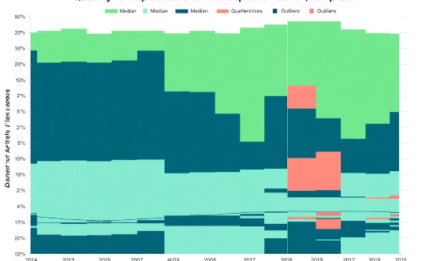
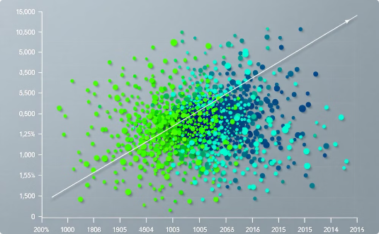
Data Visualization Techniques
Histograms
Boxplots
Scatter Plots
Students create histograms to visualize the distribution of stock prices, helping to identify patterns and potential anomalies in the data. This aids in understanding the overall trend and volatility of AAPL stock.
Teams use boxplots to display the central tendency and variability of stock prices, possibly grouped by time periods (e.g., quarters or years). This visualization helps in identifying seasonal patterns and outliers.
Students create scatter plots to explore relationships between variables, such as stock price vs. trading volume. This helps in identifying potential correlations and patterns that could be useful for predictive modeling.

Slide 5
Advanced Data Visualization
1
Interactive Visualizations
2
Time Series Plots
Students explore advanced libraries like Plotly or Bokeh to create interactive visualizations. These allow for dynamic exploration of the data, enabling users to zoom, pan, and hover over data points for more information.
Teams create line plots showing the stock price movement over time, potentially incorporating moving averages or other technical indicators. This helps in visualizing trends and patterns in the time series data.
3
Correlation Heatmaps
4
Candlestick Charts
Students generate heatmaps to visualize the correlation between different features in the dataset. This aids in understanding the relationships between various factors affecting stock prices.
For a more finance-specific visualization, teams create candlestick charts to show opening, closing, high, and low prices for each trading day. This provides a comprehensive view of price movements.

Slide 6

Predictive Modeling: LSTM Networks
1
Data Preprocessing
LSTM
Students prepare the time series data for LSTM, including normalization and sequence creation. They learn about the importance of maintaining temporal order in financial data.
2
Model Architecture
Teams design and implement LSTM network architectures, experimenting with layers, neurons, and dropout for optimal performance in stock price prediction.
3
Training and Validation
Students train the LSTM model, using techniques like early stopping and learning rate scheduling. They implement cross-validation to ensure model robustness.
4
Prediction and Evaluation
The trained model is used to make predictions on test data. Students evaluate performance using metrics like RMSE and MAE, interpreting results in the context of stock price forecasting.

Slide 7

Predictive Modeling: Random Forest Regressor
Feature Engineering
Model Training
Students create relevant features for the Random Forest model, such as technical indicators and lagged variables. They learn about the importance of domain knowledge in feature creation for financial prediction tasks.
Teams implement and train the Random Forest Regressor, experimenting with hyperparameters like the number of trees and maximum depth. They use techniques like grid search for optimization.
Feature Importance Analysis
Ensemble Methods
Teams explore ensemble techniques, potentially combining predictions from LSTM and Random Forest models to improve overall accuracy and robustness in stock price forecasting.
Students analyze feature importances provided by the Random Forest model, gaining insights into which factors most significantly influence stock price predictions.

Slide 8
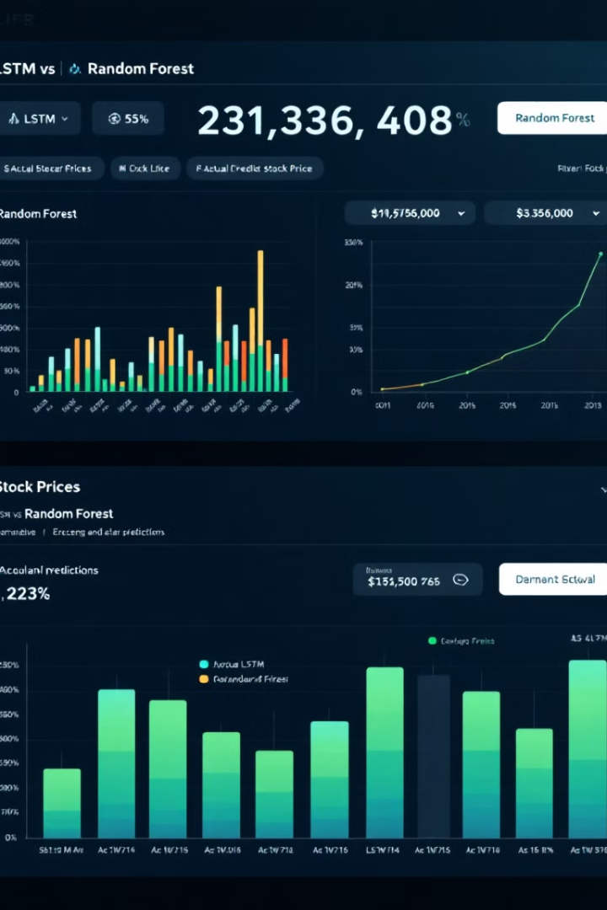
Model Evaluation and Comparison
Metric
LSTM Model
Random Forest Model
RMSE
2.34
2.57
MAE
1.89
2.11
R-squared
0.92
0.89
Training Time
45 min
10 min

Slide 9




Project Insights and Future Work
Key Insights
Students summarize their main findings, discussing the performance of LSTM vs. Random Forest in stock price prediction. They reflect on the challenges faced and lessons learned throughout the project.
Limitations
Teams critically analyze the limitations of their approach, such as the inherent unpredictability of stock markets and the potential for overfitting. They discuss how these limitations might impact real-world applications.
Future Improvements
Students propose ideas for future work, such as incorporating sentiment analysis from financial news, exploring more advanced models like transformers, or expanding the analysis to multiple stocks for portfolio optimization.
Real-World Applications
The project concludes with a discussion on potential real-world applications of the developed models, ethical considerations in financial prediction, and the broader implications of AI in the financial sector.

