Slide 1
Spelunk-a-bot
Group members:
Sri Parasara Aravind Sri Ram (G01301679)
Vaibhav Vijay Oza (G01337138)
Pratyusha Arvapalli (G01328372)
Venkata Sai Devi Priyanka Pilla (G01351608)
Koushik Sura Bhaskar (G01327456)

Slide 2
Scope and tools:
Problem statement: Is there an efficient way to survey a mine to gather precautionary data without risking human life?
Goals: Build a small tool that consolidates a series of gas sensors and an alarm that alerts when it detects the below gases 1. Alcohol 2. Methane 3. Butane

Slide 3
Scope and tools:
Operating system: Debian with preempt RT kernel.
Sensors: 1. MQ-5 (Methane detection) 2. MQ-6 (Butane) 3. MQ-3 (alcohol) 4. Humidity sensor 5. Alarm 6. LEDs
Controller board: Beaglebone Black.

Slide 4
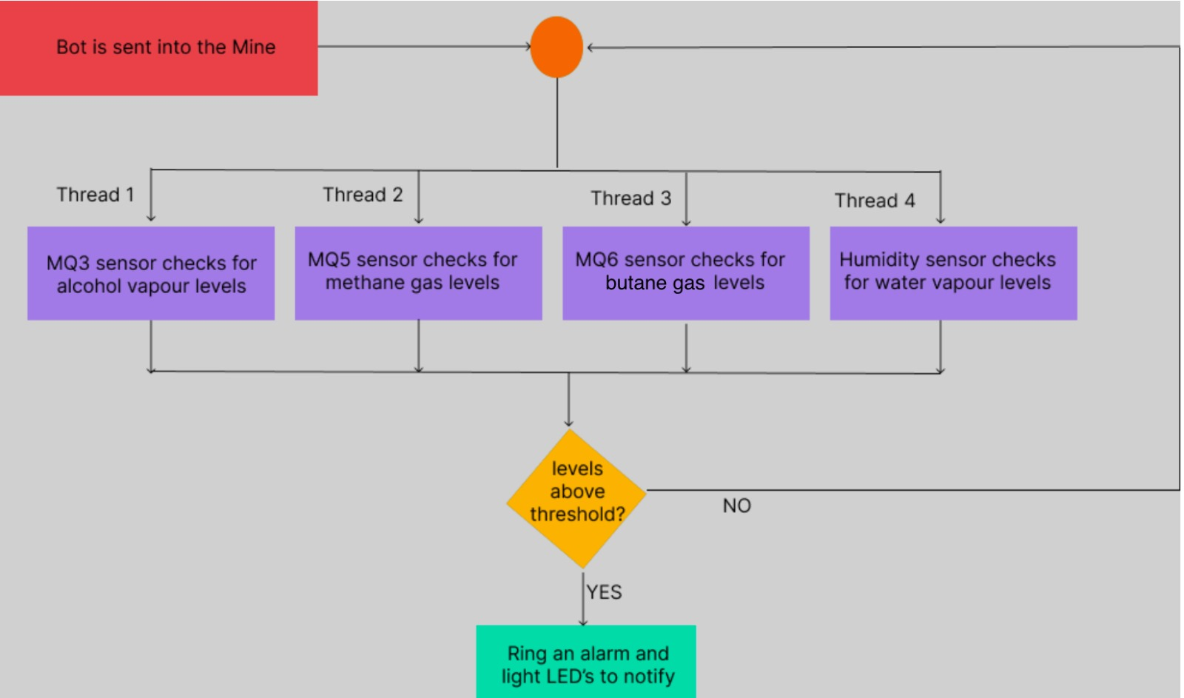
Software Process Flow

Slide 5
Software Specification
Languages used: C
Libraries used: stdio.h, unistd.h, signal.h, stdlib.h, stdint.h, pthread.h

Slide 6
Hardware Specification
Sensors: 1. MQ – 3: - Supports both Analog and Digital IO. - Used to detect the presence of Alcohol. 2. MQ – 6: - Supports both Analog and Digital IO. - Used to detect the presence of LPG, Butane. 3. MQ – 5: - Supports both Analog and Digital IO. - Used to detect natural gas and coal gas.

Slide 7
Hardware specification
Sensors 4. Humidity Sensor DHT-11: - Supports both Analog and Digital IO. - Used to detect the temperature and the humidity. 5. Alarm: - Supports Digital IO.

Slide 8
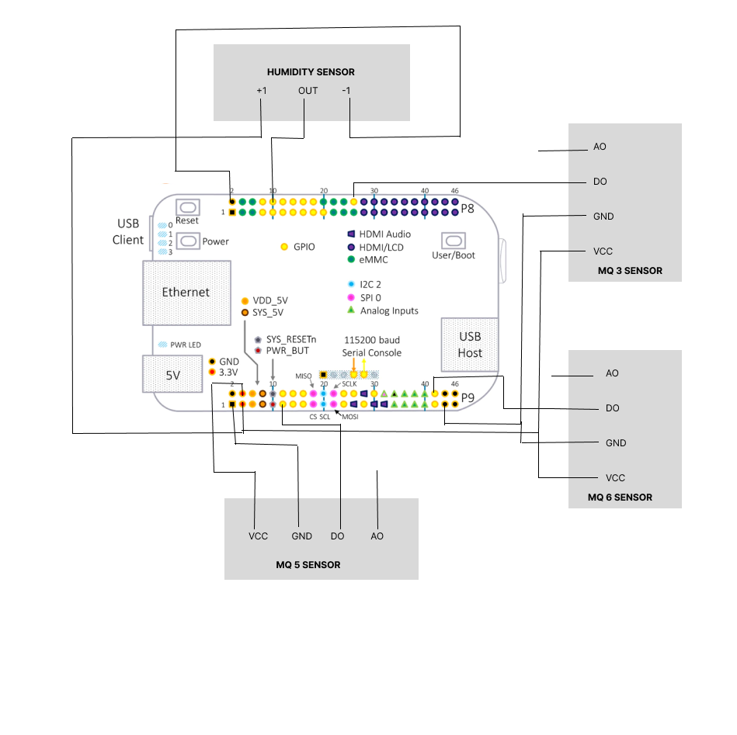
Hardware Circuit Diagram

Slide 9
Schedule
 | Task
Aug. 31 | Submit all the individual ideas in the group (internal) | Done
Sept. 1 | Hop on a zoom discuss through all the proposed ideas and use the evaluation criteria to select at least 4 projects to submit | Done
Sept. 2/3 | Prepare the final draft (sales pitch) for all the selected ideas | Done
Sept. 4 | Last minute touch up and Submit the proposal | Done
Sept. 5-11 | Get a concrete idea of the selected final project and start working on the Use-case, Component & Activity diagram | Done
Sept. 12 -18 | Start working on a Hardware & Software requirement specification document and start ordering all the components (At this point all of us must and should have a clear picture of the entire final product and the expectations) | Done

Slide 10
Schedule
 | Task
Sept. 19-25 | Start ordering all the required components and discuss on the number of stories | Done
Sept. 26 – Oct. 2 | Finalize, Create and assign these stories | Done
Oct. 3-9 | Consolidate all the documents, Design models and submit them for design approval. Plan a small demo too. | Done
Oct. 10 -16 | Start picking up stories and start the initial work. | Done
Oct. 17 – 23 | Reflect on the received critique – make any required design or implementation changes. | Done
Oct. 24 – Nov. 24 | Work | Done

Slide 11
Schedule
 | Task
Nov. 25 – Nov. 29 | Prototype Testing | Done
Nov.29 – Dec. 6 | Final Updates and Presentation | Done
Every proposed objective was achieved.

Slide 12
General Testing Approach
Step 1 : Sensor specific Code for each sensor
Step 2 : Run and Test each sensor individually
Step 3 : Integrate Code for all sensors
Step 4 : Run and Test for all sensors together
Step 5 : Test Limits

Slide 13
Testing DHT11
Initially we made sure DHT11 detects temperature of the environment correctly
We detected Room Temperature initially and then Temperature in an open environment at night(To make sure it detects lower temperatures)
Second phase was to test DHT11 to detect a higher temperature so we put a flame from a lighter next to the sensor and printed the temperature and humidity.

Slide 14
Testing MQ Sensors
We detected :
Alcohol using MQ3 sensor by putting the sensor on top of a high-alcohol content Hand sanitizer.
Butane using MQ6 sensor by a cigarette lighter without starting a light.
Methane using MQ5 sensor by a LPG stove without lighting it.

Slide 15
Challenges Faced
Sensors may burn while prototype is tested. Have back up sensors available.
If testing near flame, Keep Sensor away so that it does not catch fire.
Analog input reading is difficult and maybe heavily affected by sensitivity of sensors used

Slide 16
Real World vs Prototype
Our testing approach is limited to household stuff. To test the potential efficiency of this bot, a testing scenario needs to take place in an actual mine.
Gas detection works well but DHT11 needs to be replaced by a more sensitive sensor to get real-time temperature data as soon as there is a fire or sudden increase in temperature.

Slide 17
Future Scope
Add more Gas sensors
Create an unmanned ATV to place this platform
Increase sensitivity on all sensors
Create a secure platform to place the sensors
Test in actual mine

Slide 18
References
“Adafruit_Python_DHT/Source/Beaglebone_Black at Master · Adafruit/Adafruit_Python_DHT.” GitHub, https://github.com/adafruit/Adafruit_Python_DHT Accessed 4 Dec. 2022.

