Slide 1

Gen AI Masterclass
SANTHOSH SUNDARAM S
AI - Product Manager
Quantiphi Analytics

Slide 2


About Instructor
Santhosh S, Working as AI Product Manager in Quantiphi Analytics.
6 years of experience in Data Science, Machine learning, Deep learning frameworks specialised in Generative AI (Gen AI), Automatic Speech recognition (ASR) & Natural Language Processing (NLP).
4+ years of experience as Student mentor & Instructor in Udacity for multiple ND programs.
Certified & Hand-on Experience in Cloud infra such as GCP, AWS & Azure.
As AI Product Manager, have built 6+ AI products.

Slide 3
Topics for Today
What is Generative AI
Different Types of Gen AI
What is Prompt Engineering
What are the Different Types of Prompt Engineering
Generative AI for Professionals

Slide 4
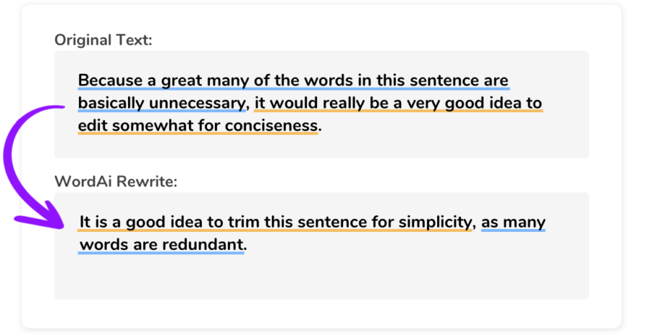

What is Generative AI
“Generative AI refers to a class of artificial intelligence that is designed to generate new content that is similar to existing data.”
Types of Generative AI:
Text Generation:
Language Models: Models like GPT (Generative Pre-trained Transformer) are used for generating human-like text based on given prompts or contexts. These models can be used for applications such as chatbots, translation, and content creation.
Image Generation:
GANs (Generative Adversarial Networks): GANs are a class of generative models that are used for generating realistic images, art, and design.

Slide 5

Types of Generative AI
Video Generation:
GANs: GANs can also be used for generating video content, including realistic synthetic video or video styles from specific artistic movements.
Audio Generation:
WaveNet: This model can generate high-quality audio and has applications in speech synthesis, music creation, and audio effects.
Code Generation:
Transformer Models: Models like Codex can generate code based on a natural language description of a coding task. This can be used for software development and automation.

Slide 6
Native Machine Learning / Deep Learning (Before Gen AI)
Very Good
Customer
Sentiment Classifier
Model 1
Good
Customer Support
Call Recording
Transcription
Bad
Yes
Call back Requested
Model 2
No

Slide 7
Generative AI
What is Customer Sentiment?
Customer Support
Call Recording
Transcription
Gen AI
What is Agent Score?
Is the Ticket Closed?
.
.
.

Slide 8
PROMPT ENGINEERING

Slide 9
What is a Prompt?
Input to the model; Mechanism of interacting with an LLM
Superset of Instruction; Multiple component
Answer the question only based on the context provided below. Keep the answer short and concise. Respond “Unsure about answer” if not sure about the answer.
Leskode.com implemented a sophisticated Code generationplatform using Google Cloud Platform, unifying customer behavioral data, purchase history, and feedback information to deliver a holistic view of customer engagement.
Who developed the centralized data analytics platform using Google Cloud Platform?
Answer: leskode.com
Instruction
Context
Input
Output Indicator

Slide 10
What is Prompt Engineering?
Art of designing prompts to elicit the best response from the model
Multiple techniques and combinations, with partial automation
Prompting
k-shot Prompting
Chain-of-Thought (CoT)Prompting
Program Aided Prompting

Slide 11
Prompting Techniques
Prompting
Describe the task to the model in the form of instructions
Please label the sentiment towards the movie of the given movie review. The sentiment label should be "POSITIVE" or "NEGATIVE".
Text: The movie failed to capture the essence of the book, and the performances felt lackluster.
Sentiment: NEGATIVE

Slide 12
Prompting Techniques
Few-shot Prompting
Describe the task to the model in the form of demonstrations
Text: I really enjoyed the play.
Sentiment: positive
Text: The concert was a bit disappointing; the band didn't live up to my expectations.
Sentiment: NEGATIVE
Text: I'll bet the video game is a lot more fun than the film.
Sentiment: positive
Few-shot examples

Slide 13
Prompting Techniques
Chain of Thought (Few shot)
Example 1:
Question: Sarah can complete a puzzle in 45 minutes. James takes three times as long as Sarah to finish the same puzzle. How many hours does it take James to complete the puzzle?
Answer:
James takes 3 times longer, so it takes James 45 * 3 = 135 minutes to complete the puzzle.
135 minutes divided by 60 = 2.25 hours.
So the answer is 2.25.
Question: Alex can swim a certain distance in 20 minutes. Rebecca takes twice as long as Alex does to swim the same distance. How many minutes does it take Rebecca to swim the distance?
Answer:
Rebecca takes 2 times longer, so it takes Rebecca 20 * 2 = 40 minutes to swim the distance.
Few-shot reasoning example

Slide 14
Prompting Techniques
PAL (Program Aided Language)
Model uses runtime (e.g. Python Interpreter) to generate solution.
Question: In my kitchen, I have three tomatoes, two carrots, a bell pepper, a bunch of spinach, and four cucumbers. How many vegetables do I have?
Answer:
vegetables_to_count = {
'tomato': 3,
'carrot': 2,
'bell pepper': 1,
'spinach': 1,
'cucumber': 4
}
veg_count = sum(vegetables_to_count.values())
The answer is 11.

Slide 15
General Tips for Designing Prompts
1
Start Simple:
Breaking down complex tasks into manageable subtasks to simplify the prompt design process.
2
The Instruction:
Using clear commands (e.g., Write, Classify, Summarize) to effectively guide the model in achieving the desired task.
3
Specificity:
Providing precise and detailed instructions to obtain better results from the model.
4
Avoid Impreciseness:
Emphasizing the importance of direct and clear communication for effective prompt design. No noise.

Slide 16
Generative AI for Professionals

Slide 17
Professionals
Platform Engineers
Software Developers
Product Managers
Business Analysts

Slide 18
Platform Engineers

Slide 19
Platform Engineers - Code Assistant
Using ChatGPT as Code Assistance:
Generating Code snippets
Code Explainability
Debugging
Code Review

Slide 20
Platform Engineer - Terra Form
Example: Asking ChatGPT to generate code snippets for a creating EC2 instance on AWS using Terraform.
provider "aws" {
region = "us-west-2" # Update with your desired AWS region
}
resource "aws_instance" "example" {
count = 5 # Create five instances
ami = "ami-0c55b159cbfafe1f0" # Update with your desired AMI ID
instance_type = "t2.micro" # Update with your desired instance type
subnet_id = "subnet-0123456789abcdef0" # Update with your subnet ID
}

Slide 21
Platform Engineers - Infrastructure Management
Using ChatGPT for Infrastructure Management
Managing Infrastructure
Setting up environments
Troubleshooting.
Example:
Asking Chat GPT to suggest the best configuration for a server setup.

Slide 22
Platform Engineers - Automated Testing
Using ChatGPT for Automated Testing
Writing test cases
Generating test data
Example: Asking Chat GPT to generate test cases for a new API endpoint

Slide 23
Software Developers

Slide 24
Software Developers - Code Assistant
Using ChatGPT as Code Assistance:
Generating Code snippets
Writing functions
Implementing algorithms
Debugging
Code Review

Slide 25
Software Developer - Bubble Sort
Example: Asking Chat GPT to generate code snippets for Bubble in python.
def bubble_sort(arr):
n = len(arr)
# Traverse through all elements in the array
for i in range(n):
# Last i elements are already sorted, so we only need to traverse through the unsorted elements
for j in range(0, n-i-1):
# Swap if the element found is greater than the next element
if arr[j] > arr[j+1]:
arr[j], arr[j+1] = arr[j+1], arr[j]
# Example usage:
arr = [64, 34, 25, 12, 22, 11, 90]
bubble_sort(arr)
print("Sorted array:", arr)

Slide 26
Software Developer - Code Review and Optimization
Using ChatGPT as Code Review and Optimization:
Reviewing code,
Suggesting optimizations etc.,
Example:
Asking Chat GPT to review a piece of code and suggest ways to improve its efficiency.

Slide 27
Software Developer - Bug Fixing
ChatGPT for Bug Fixing:
Identifying and fixing bugs
Debugging issues
Writing error handling code
Example:
Asking Chat GPT to debug a crash report and suggest a fix

Slide 28
Product Managers

Slide 29
Product Managers - Market Research
Using ChatGPT for Market Research:
Conducting market research,
Analyzing trends,
Gathering customer feedback
Example:
Asking ChatGPT to analyze customer reviews and summarize key insights

Slide 30
Product Managers - Idea Generation
Chat GPT for Idea Generation:
Brainstorming product ideas,
Creating feature lists,
Prioritizing tasks
Example:
Asking Chat GPT to generate ideas for improving user engagement on a mobile app

Slide 31
Business Analyst

Slide 32
Business Analyst -Data Analysis
Using Chat GPT for Data Analysis:
Assist in data analysis,
Generating insights,
Visualizing data
Example:
Asking ChatGPT to analyze sales data and identify trends or anomalies.

Slide 33
Summary
What is Prompt Engineering:
Crafting prompts to evoke optimal responses from the model involves employing various techniques and combinations, often with a degree of automation.
Different type of prompting techniques:
Prompting
k-shot Prompting
Program Aided Prompting
Chain-of-Thought

Slide 34
Q & A

Slide 35
Thank you

