Slide 1
Agent-Based Modeling
How to model and understand very complex systems
A short primer with demonstrations

Slide 2
A brief history of ABM
John von Neumann and cellular automata (Conway’s Game of Life being the most well-known)
Thomas Schelling studied racial dynamics in the early 1970-s. Founded agent-based computational economics. 2005 Nobel for "having enhanced our understanding of conflict and cooperation through game-theory analysis."
During the 80-s and 90-s, efforts of computer scientists and economists and other scientists merged, giving rise to modern ABM
Notes:
Segregation model in Netlogo Models Library
Thomas C. Schelling “Dynamic Models of Segregation” Journal of Mathematical Sociology 1971 Vol. 1 https://www.stat.berkeley.edu/~aldous/157/Papers/Schelling_Seg_Models.pdf

Slide 3
So, what is agent-based modeling?
Agent-based modeling is a methodology of simulating and studying complex systems by defining those through properties of individual actors (agents), the environment, and interactions between participating agents as well as agent-environment interactions
ABM has applications in economics, sociology, biology, operations research, finance.
Many modeling environments are available: Swarm, Repast, MASON…
1999: NetLogo is released by Uri Wilensky. Turtles, patches, links, observer. Low threshold and no ceiling!
Easy exploration of emergent phenomena.
Notes:
Model is defined as abstracted description of a process, object, or event; usually exaggerates certain aspects at the expense of others. “All models are wrong, but some are useful” – George Box
Python library: Project Mesa - https://github.com/projectmesa/mesa

Slide 4
Few Interesting Models
Fire
Biology: Flocking
Check the resources!
Notes:
Netlogo Model library: Flocking

Slide 5
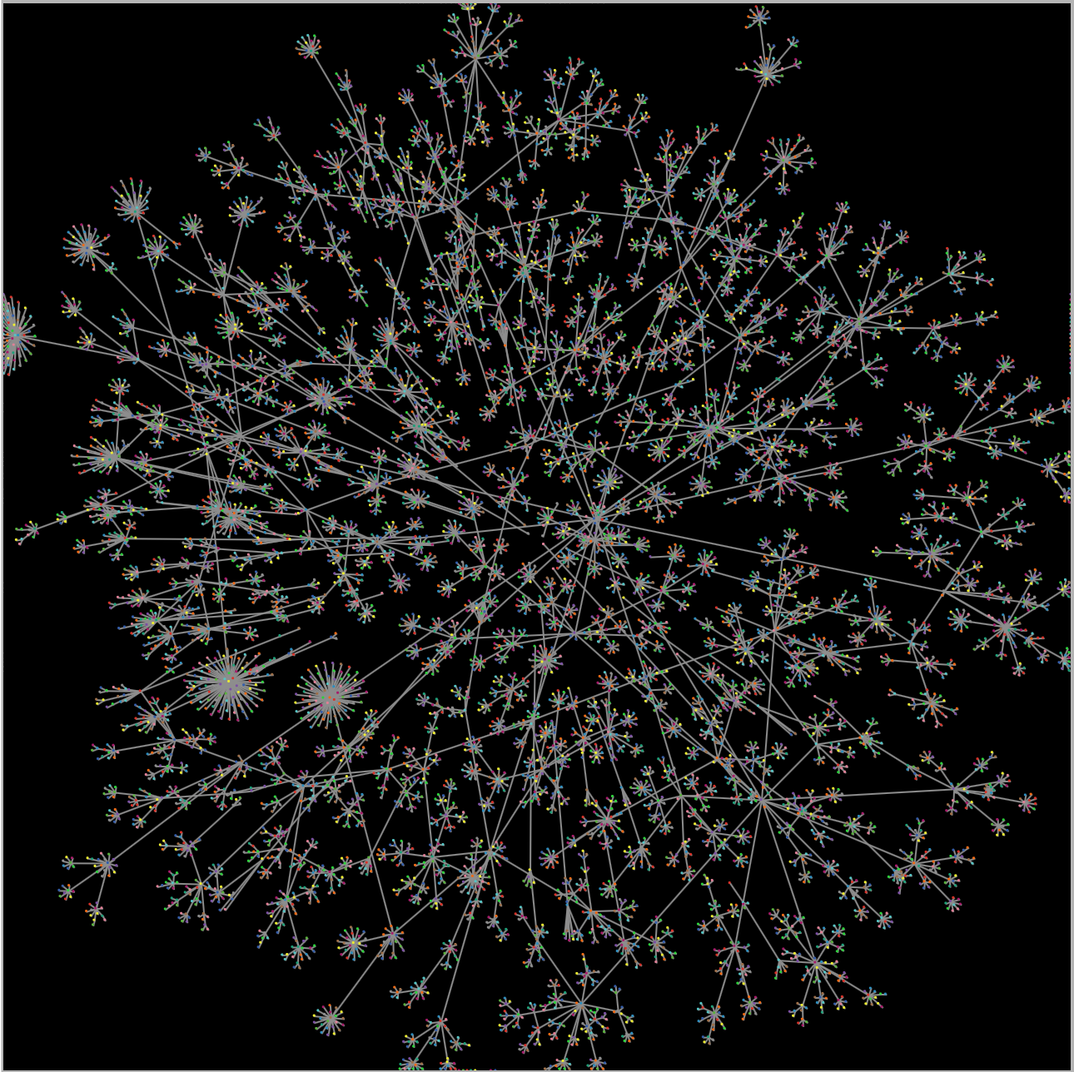
Easy to conduct thought experiments
How information is reaching different parts of an organization?
Is the CEO most informed person in the organization?
Conway’s law: “Any organization that designs a system (defined broadly) will produce a design whose structure is a copy of the organization's communication structure”
Model: communication follows organizational structure, with both signal and information quality loss (“Chinese whisper” factor).
Notes:
Melvin Conway “How Do Committees Invent?” http://www.melconway.com/Home/Conways_Law.html

Slide 6
Resources
Santa Fe Institute Complexity Explorer
Netlogo at Northwestern's Center for Connected Learning and Computer-Based Modeling
ComSES Network | OpenABM: community of researches, educators and professionals; a model library
Complexity Explorables - Interactive explorations of complex systems in biology, physics, mathematics, social sciences, ecology, epidemiology and ....

Slide 7
Thank You!
Slav Pidgorny
@slav636
https://github.com/SP3269
sp@anz.com
Models used: Segregation, Fire, Flocking – NetLogo model library;
Organizational Communications - https://github.com/SP3269/Agent-Based-Models

