Slide 1

Unleashing the Proﬁt Potential: A Deep Dive into Amazon Sales Data Analysis

Slide 2

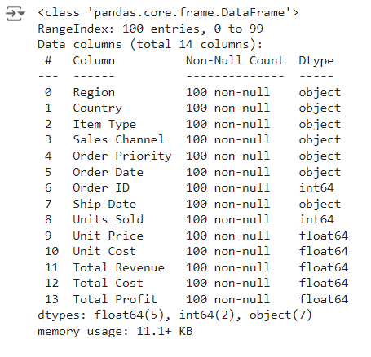
Info of the dataset

Slide 3


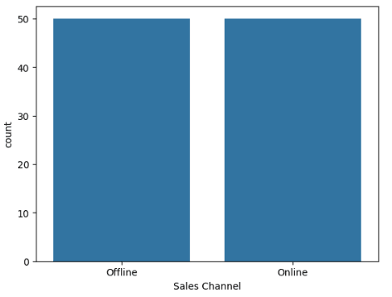
Unleashing the Potential
Welcome to the unleashing journey into Amazon sales data analysis. Let's dive deep into the numbers and discover the hidden opportunities for ma imizing proﬁts.
This represents that number or the count of users using online and o ine sales channel is well balanced

Slide 4

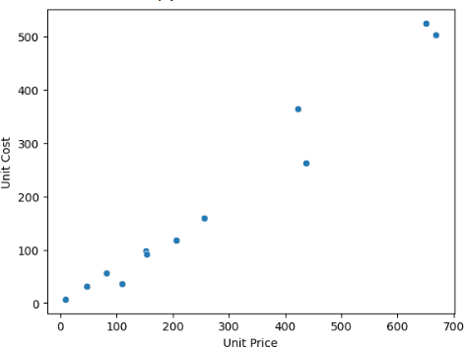
Understanding Data Trends
Unlock the power of data analysis to identify trends and patterns in Amazon sales. By understanding these insights, we can make informed decisions to drive
proﬁtability.
This is the plot between unit price amd unit costs which shows that unit cost increases with increase in unit price.

Slide 5


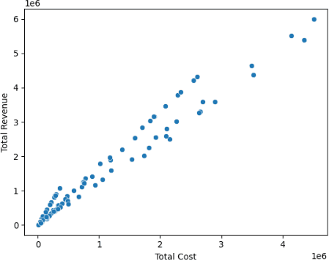
Optimizing Product Performance
Ma imize product performance by leveraging data to identify top-selling items, analyze customer preferences, and optimize pricing strategies for increased proﬁtability.
This is the graph between total cost and total revenue which shows that revenue increases with increase in total cost

Slide 6

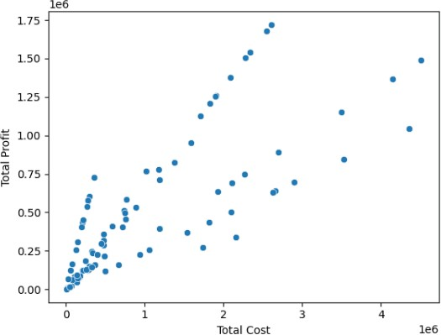
Targeting Key Demographics
Identify and target key demographics through data analysis to tailor marketing strategies and product oIerings, resulting in higher conversion rates and increased
sales.
This is the graph between total cost and total proﬁt which shows that proﬁt increases with increase in total cost

Slide 7
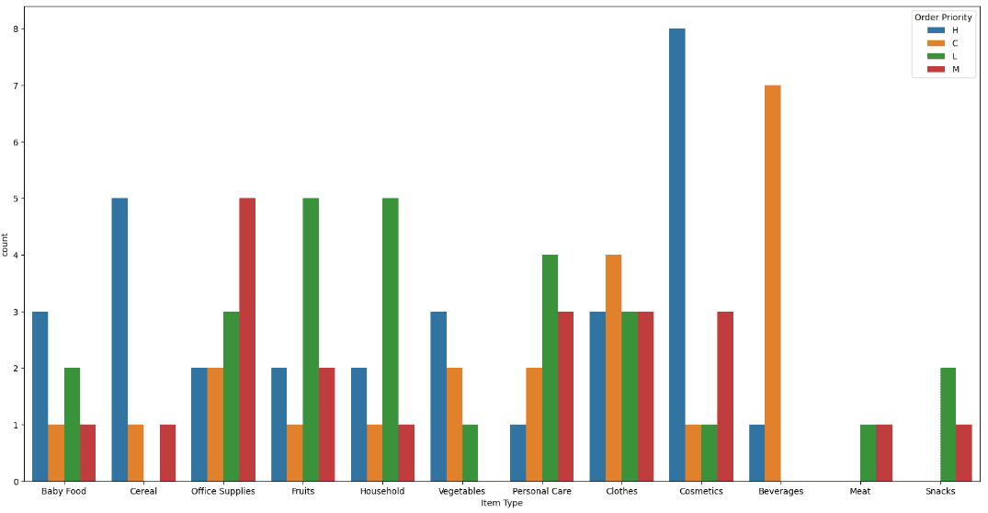

Enhancing Customer E perience
Utilize data insights to enhance the customer experience by personalizing recommendations, improving satisfaction, and fostering brand loyalty, ultimately driving repeat sales and long-term proﬁtability.
UUttiilliizzee ddaattaa iinnssiigghhttss ttoo eennhhaannccee tthhee
ccuussttoommeerr eexxppeerriieennccee bbyy ppeerrssoonnaalliizziinngg rreeccoommmmeennddaattiioonnss,, iimmpprroovviinngg ssaattiissffaaccttiioonn,, aanndd
ffoosstteerriinngg bbrraanndd llooyyaallttyy,, uullttiimmaatteellyy ddrriivviinngg rreeppeeaatt ssaalleess aanndd lloonngg--tteerrmm pprrooﬁﬁttaabbiilliittyy..
Countplot of Item type with respect to Order Priority which shows the count of people buying diIerent products and it shows the count with repect to the
order priority.

Slide 8

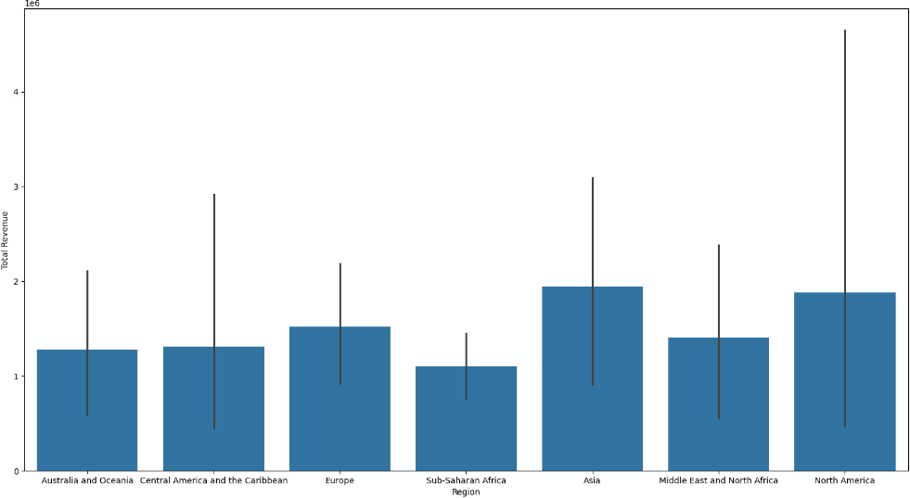
Leveraging Competitive Analysis
Gain a competitive edge by conducting competitive analysis to understand market positioning, pricing strategies, and product diIerentiation, enabling strategic decisions for increased market share and proﬁtability.
Barplot of the total revenue with respect to the regions speciﬁed in the dataset. The highest revenue is generated in the Asia, then North America, then Europe, and successive decrease in others

Slide 9

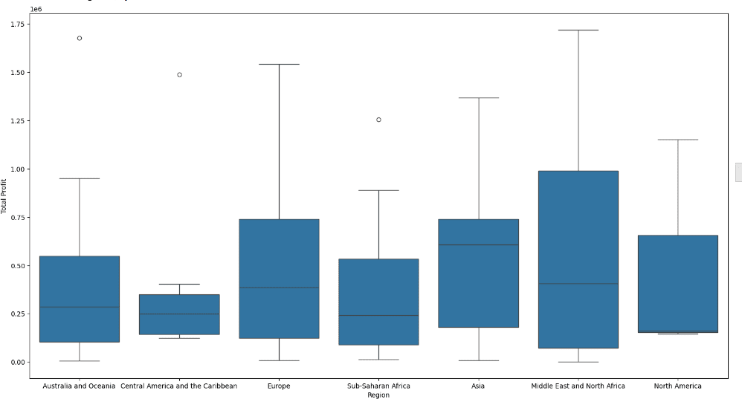

Forecasting Future Growth
Harness the power of data to forecast future growth and demand trends, enabling proactive inventory management, strategic e pansion, and capitalizing on emerging market opportunities for sustained proﬁtability.
Bo plot of Total Proﬁt with repect to the region. The highest proﬁt can be seen in the Middle eastern region and lowest proﬁt can be seen in the Central America and the Caribbean region

Slide 10

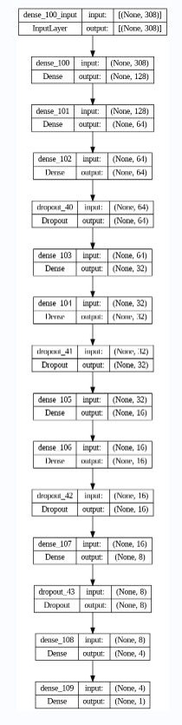
Implementing Actionable
Insights
Translate data analysis into actionable insights to drive strategic decision-making, optimize operations, and capitalize on untapped opportunities for increased sales
and proﬁtability.
This is the plot of the deep learning model used for the prediction of the total proﬁt that has one input layer, one output layer and 13 hidden layers for increasing the overall performance of the model.

Slide 11

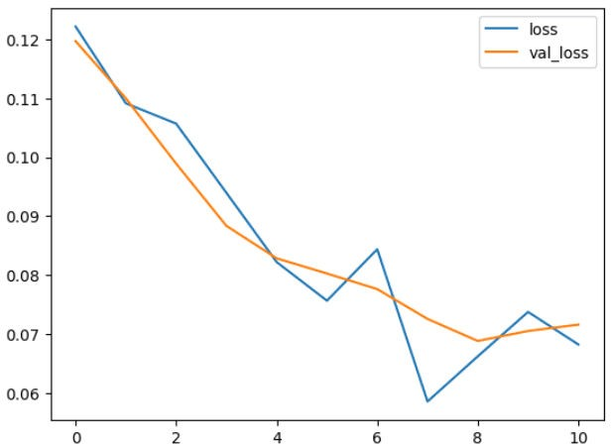


Measuring Success
Metrics
Evaluate the eIectiveness of strategies by measuring success metrics such as ROI, conversion rates, and customer satisfaction, enabling continuous improvement and
sustained proﬁtability.
This is the loss graph of the model during the training and validating on the testing data. a is represents number of epochs, y a is represents values for which the loss and validation loss is decreasing

Slide 12
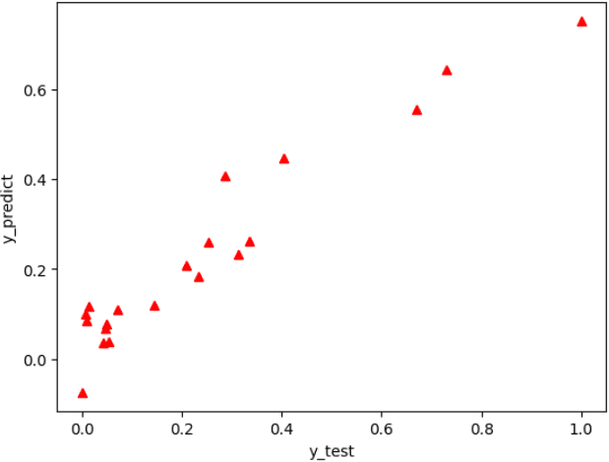
Measuring Success
Metrics
Evaluate the eIectiveness of strategies by measuring success metrics such as ROI, conversion rates, and customer satisfaction, enabling continuous improvement and
sustained proﬁtability.
Plotting the predicted values, which are predicted by the model, it is represented by the y_test on x axis and y_predicted on the y axis

Slide 13
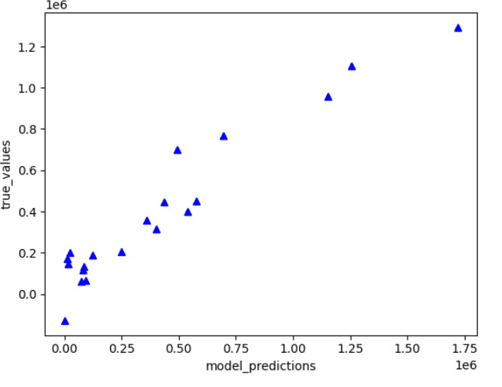

Measuring Success
Metrics
Evaluate the eIectiveness of strategies by measuring success metrics such as ROI, conversion rates, and customer satisfaction, enabling continuous improvement and
sustained proﬁtability.
Plotting the true values, which are it is represented by the true_predictions on a is and true_values on the y a is

Slide 14
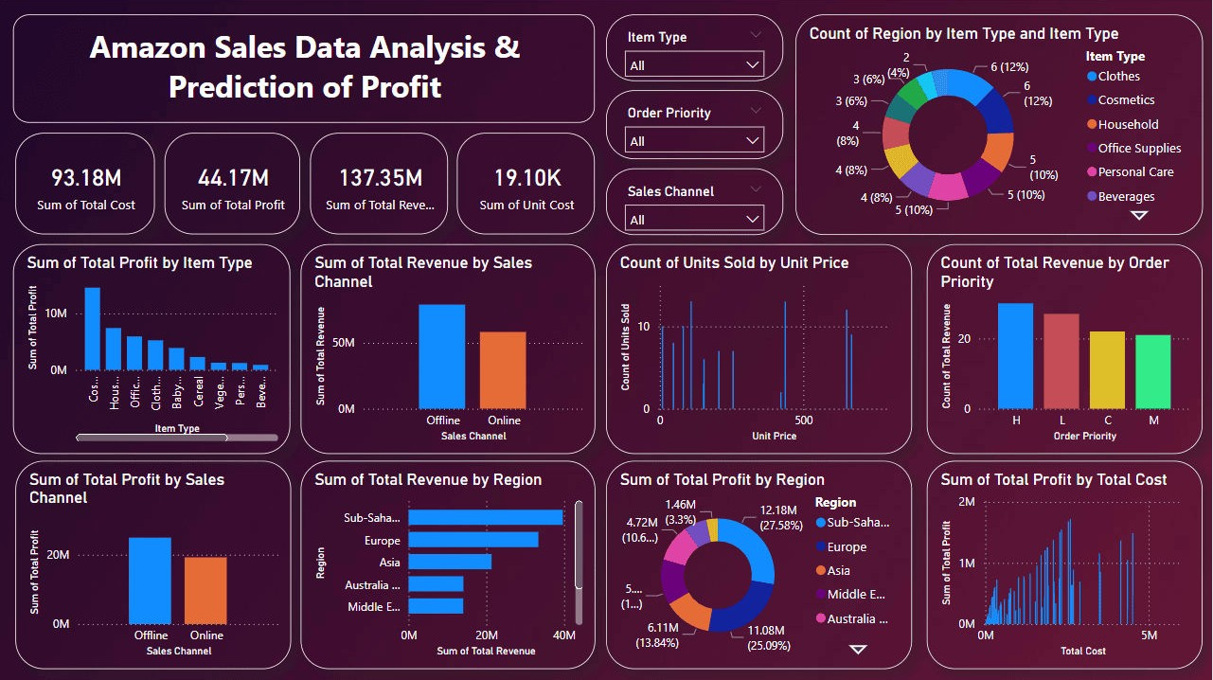
Dashboard of the project: Amazon Sales Data Analysis
Summary Statistics: The top section shows the total sums for key ﬁnancial metrics: total cost (93.18M), total proﬁt (44.17M), total revenue (137.35M), and unit cost (19.10K).
Total Proﬁt by Item Type: A bar chart displays the sum of total proﬁt for diIerent item types, with cosmetics generating the highest proﬁt and beverages the lowest.
Total Revenue by Sales Channel: A bar chart compares the total revenue from o ine and online sales channels, with o ine sales generating slightly more revenue than online sales.
Units Sold by Unit Price: A scatter plot shows the count of units sold across diIerent unit prices, highlighting the distribution of sales prices.
Total Revenue by Order Priority: A bar chart illustrates total revenue based on order priority levels (H, L, C, M), with high-priority orders generating the most revenue.
Proﬁt and Revenue by Region: A bar chart and a pie chart display the sum of total proﬁt and total revenue by region, showing signiﬁcant contributions from Europe, Asia, and other regions.
Filters and Interactive Elements: The dashboard includes ﬁlters for item type, order priority, and sales channel, allowing users to reﬁne the displayed data. A pie chart shows the count of regions by item type, providing insights into geographical distribution.

Slide 15

Conclusion: Unleashing Proﬁt Potential
In conclusion, by leveraging data analysis, we can unleash the full proﬁt potential of Amazon sales. Let's continue to explore and innovate, maximizing proﬁtability and driving sustainable growth.

Slide 16
Thanks!
Do you have any questions? suyashpandey9611@gmail.com
+91 7905174871

